Slide 1
The Fascinating Wonders of Bolivia
Exploring the Exotic and Diverse Land of Bolivia

Slide 2
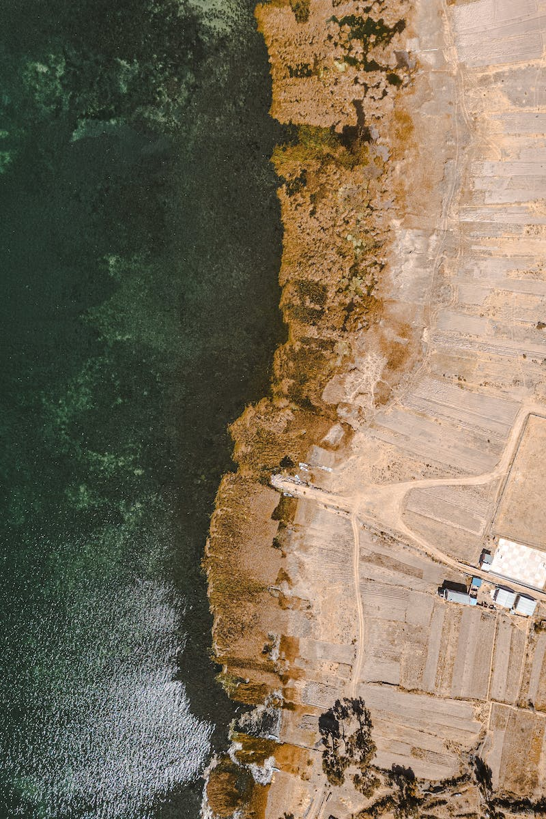
Introduction
• Welcome to the Top Ten Archive!
• Join us as we delve into the wonders of Bolivia
• Discover why over one million people visit this exotic country each year
• Prepare to be amazed by its rich culture, breathtaking landscapes, and fascinating facts
Photo by Pexels

Slide 3
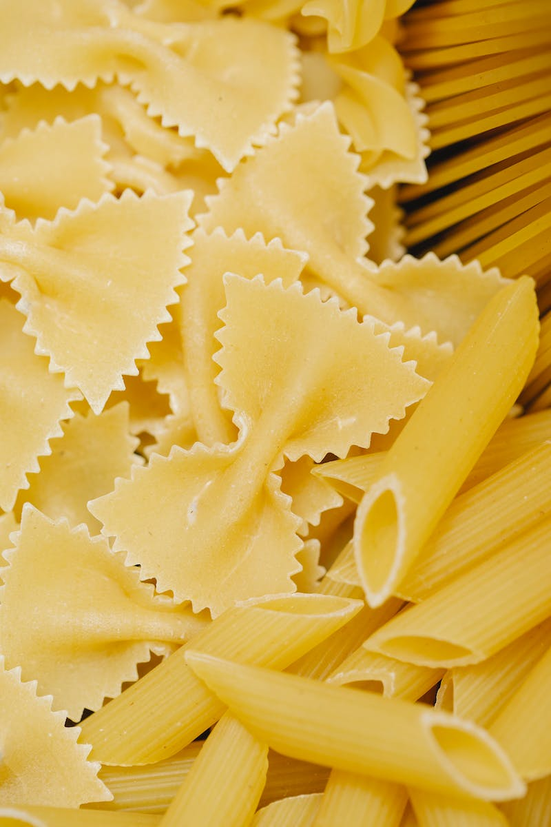
Cuisine of Bolivia
• Guinea pig, a traditional dish in Bolivia, is a major source of protein
• Other popular dishes include salteñas and Silpancho
• Bolivia also offers refreshing beverages like api and mocochinchi
• The country's culinary delights are a feast for the senses
Photo by Pexels

Slide 4
World Records
• Bolivia holds world records for various musical ensembles
• The country boasts the largest charango, a South American guitar
• Bolivia also achieved the record for the largest folk dance
• These records reflect Bolivia's passion for music and cultural heritage
Photo by Pexels

Slide 5
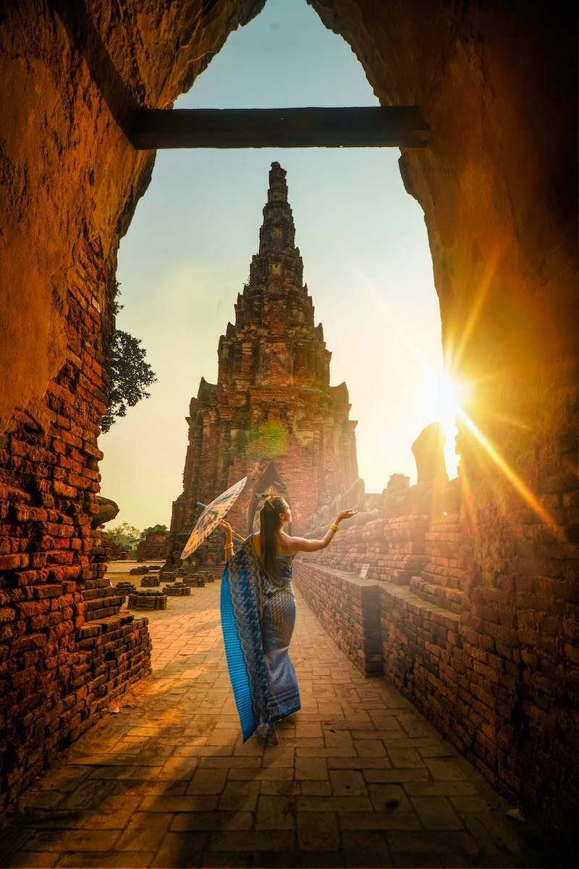
Famous Bolivians
• Bolivia is home to renowned actresses like Carla Ortiz and Ci Herrera
• Football stars Gil Alvarez and Carlos Ce have represented Bolivia
• Maria Fern fernando Alvarez is recognized for her tennis prowess
• Internet stars like Elias Fab App and Andrea Roman have gained fame from Bolivia
• Bolivia's talent and achievements extend across various fields
Photo by Pexels

Slide 6
Stunning Sites
• The Salar de Uyuni is the world's largest salt flat
• Visitors can explore this vast mirror-like wonder for days
• Lake Titicaca, South America's largest by volume, is considered sacred
• Bolivia's stunning natural sites are a testament to its beauty
Photo by Pexels

Slide 7
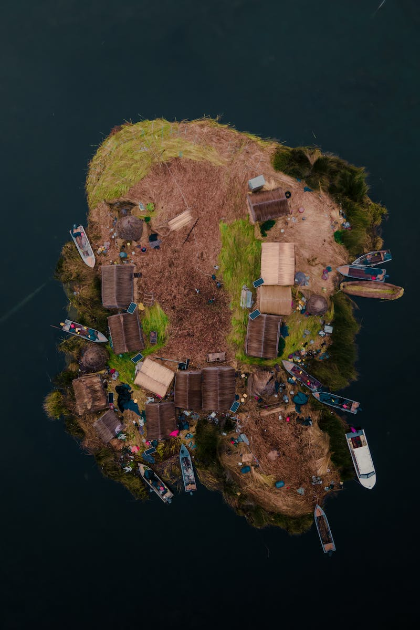
Sacred Lake Titicaca
• Lake Titicaca is believed to be the birthplace of ancient civilizations
• According to myth, the God Kon Tiki emerged from the lake
• The lake holds deep spiritual significance for the indigenous people
• The connection between humanity and nature is profound in Bolivia
Photo by Pexels

Slide 8
Sports of Bolivia
• Football (soccer) is immensely popular in Bolivia
• Club Bolivar is the most successful team in the country
• The sport is celebrated with an indoor version called futsal
• Bolivia's passion for football runs deep in its culture
Photo by Pexels

Slide 9
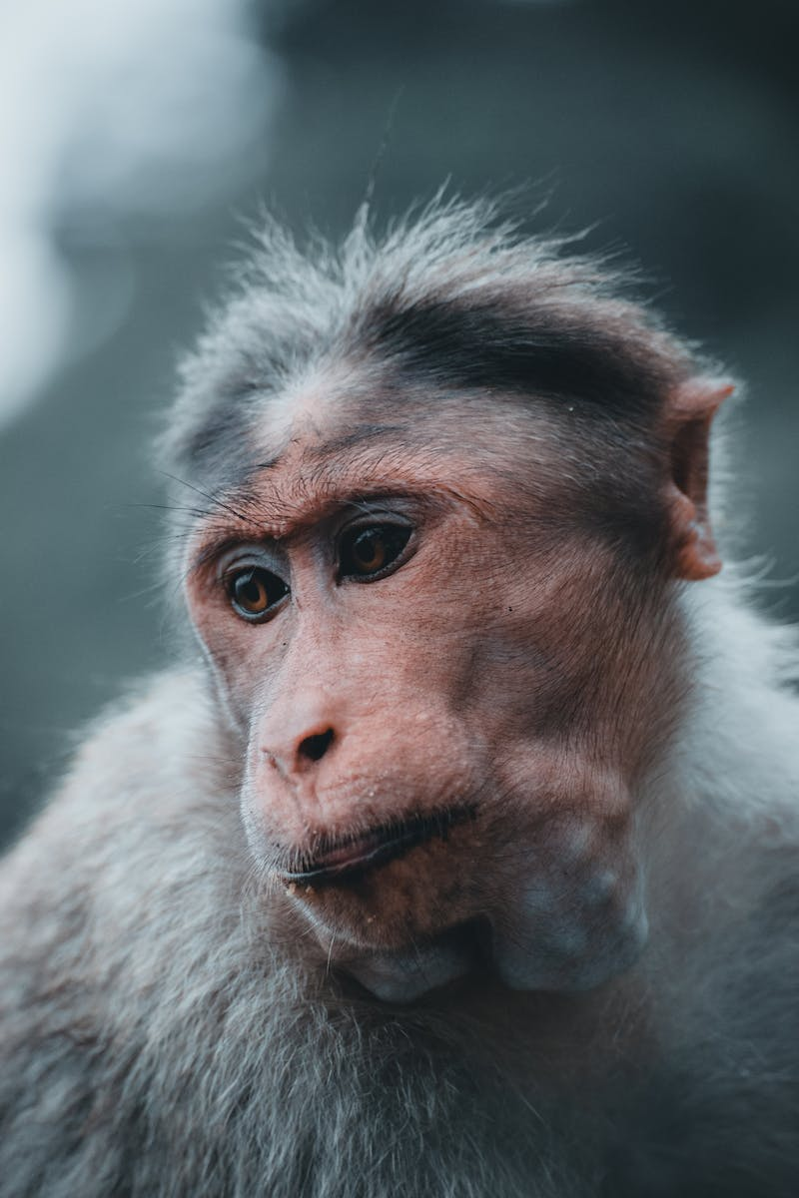
Bolivia and Nature
• Bolivia's traditions are deeply rooted in respect for nature
• The concept of Pachamama (Mother Earth) is worshipped
• The government passed a law of rights for mother earth
• Bolivia's commitment to preserving nature is commendable
Photo by Pexels

Slide 10
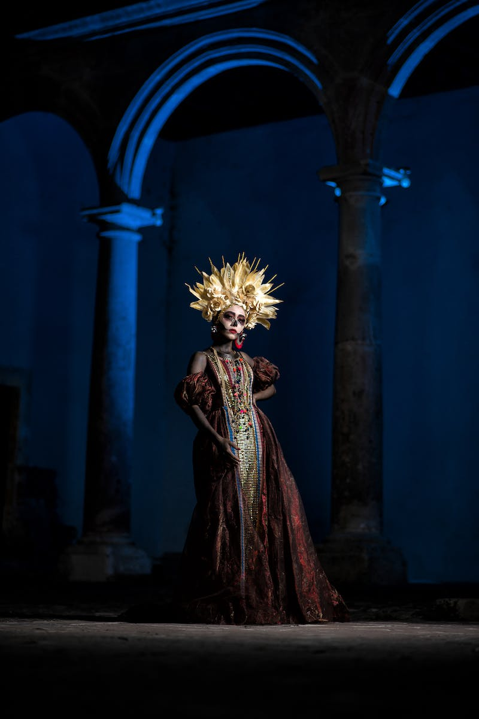
Bolivia Festivals
• Bolivia enjoys a rich calendar of festive celebrations
• The Ale festival in January honors the God of abundance
• The Tinku festival showcases intense and symbolic combat
• The vibrant festivals of Bolivia offer unique cultural experiences
Photo by Pexels

Slide 11
Bolivia's Battle for Independence
• Bolivia fought a long and bloody war for independence from Spain
• Simón Bolívar and Antonio José de Sucre played crucial roles
• Independence was declared on August 6, 1825
• Bolivia's struggle for freedom is a testament to its resilience
Photo by Pexels

Slide 12
The Naming of Bolivia
• Simón Bolívar played a pivotal role in Bolivia's independence
• Congressman Manuel Martín Cruz proposed the name 'Bolivia'
• The name reflects the country's diversity and multiple ethnicities
• Bolivia's name change in 2009 further recognized its cultural richness
Photo by Pexels

Slide 13
Conclusion
• Bolivia's wonders span from its cuisine to its stunning landscapes
• The country's rich culture and history leave a lasting impression
• Join us in celebrating the diverse and captivating world of Bolivia
• Thank you for watching and don't forget to like and comment!
Photo by Pexels

