Slide 1
Heredity and Genetics
Understanding the Rules of Inheritance and Genetic Variation

Slide 2
Introduction to Heredity and Genetics
• Hello and welcome to the presentation on heredity and genetics.
• In this presentation, we will cover the basics of heredity and genetics in plants.
• We will explore concepts such as Mendelian genetics and Punnett squares.
• We will also discuss non-Mendelian genetics and the rules of inheritance among plants.
Photo by Pexels

Slide 3
Mendelian Genetics and Punnett Squares
• Mendelian genetics is the study of patterns of inheritance based on the principles established by Gregor Mendel.
• Punnett squares are visual tools used to determine the possible combinations of alleles in offspring.
• We will explore Mendelian genetics and Punnett squares in Grade 8 and Grade 9 biology.
• This knowledge forms the foundation for understanding genetics in greater detail.
Photo by Pexels

Slide 4
Non-Mendelian Genetics - Beyond the Basics
• While Mendelian genetics provides a strong framework, not all genetic traits can be explained by these principles.
• Non-Mendelian genetics involves patterns of inheritance that do not follow simple Mendelian rules.
• We will cover non-Mendelian genetics in the first quarter of Grade 9 biology.
• This will provide a more comprehensive understanding of genetic variation and inheritance.
Photo by Pexels

Slide 5
Rules of Inheritance Among Plants
• Inheritance patterns among plants can be observed through various traits and characteristics.
• For example, the color of flowers in plants can be determined by genetic inheritance.
• We will explore examples of plant inheritance, such as the combination of purple and white flower colors.
• This will demonstrate how genetic traits are passed down from parent plants to their offspring.
Photo by Pexels

Slide 6
Units of Inheritance and Heredity
• Inheritance and heredity are governed by specific units called genes.
• Genes are segments of DNA that carry specific information and determine the traits of an organism.
• Just as atoms are the basic units of matter, genes are the basic units of inheritance in all living things.
• Understanding genes and their role in heredity is crucial for comprehending the diversity of life.
Photo by Pexels

Slide 7
Segregation and Combination of Genes
• Genes undergo segregation and combination during the process of inheritance.
• Segregation refers to the separation of genes into different gametes during reproductive processes.
• Combination, on the other hand, involves the recombination of genes from both parents to form new combinations in offspring.
• This process leads to the formation of unique genetic profiles and contributes to the inheritance of traits.
Photo by Pexels

Slide 8
Law of Segregation and Genetic Ratios
• The Law of Segregation states that alleles (alternate forms of a gene) separate from one another during gamete formation.
• This separation leads to the formation of different combinations of alleles in offspring.
• For example, when a pair of genes coding for skin color is considered, different combinations can result in dark or light skin.
• Understanding the Law of Segregation helps predict the probabilities of specific traits in offspring.
Photo by Pexels

Slide 9
Law of Independent Assortment and Linkage
• The Law of Independent Assortment states that alleles of different genes assort independently during gamete formation.
• This means that the inheritance of one gene does not influence the inheritance of another gene.
• However, genes that are located close to each other on the same chromosome may be inherited together.
• Linkage refers to the phenomenon of genes being physically linked and inherited as a unit.
Photo by Pexels

Slide 10
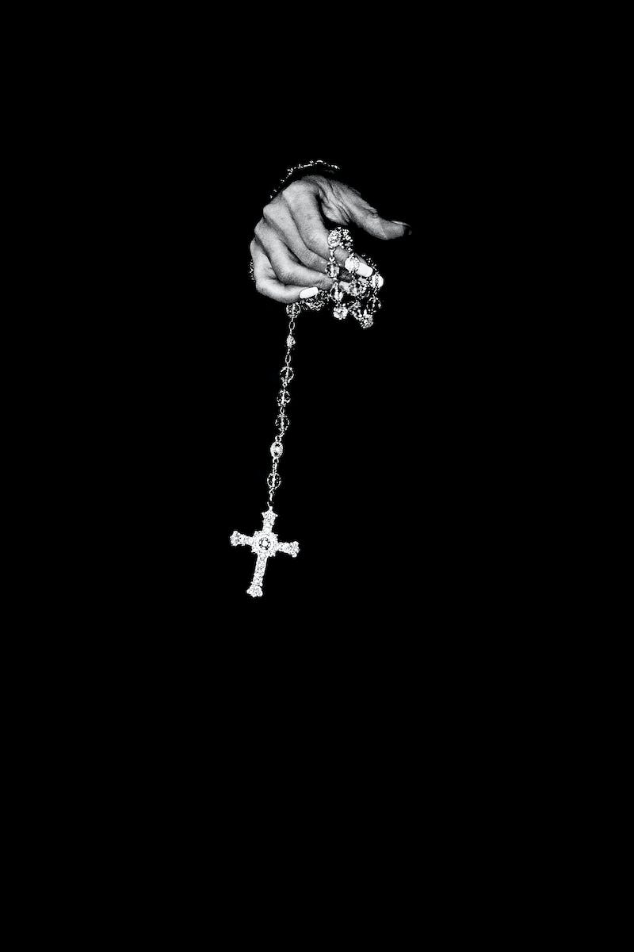
Hybrid Crosses and Phenotypic Ratios
• Hybrid crosses involve breeding individuals with different traits to study inheritance patterns.
• These crosses help determine phenotypic and genotypic ratios in offspring.
• For example, when crossing plants with yellow and green seeds, the ratio of dominant (yellow) to recessive (green) seeds can be analyzed.
• Understanding hybrid crosses provides insights into the inheritance of traits in organisms.
Photo by Pexels

Slide 11
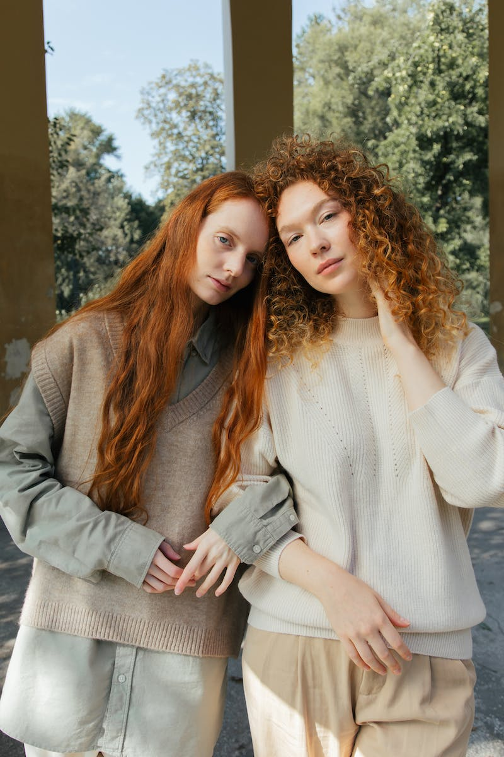
Beyond Mendelian Genetics - The Complexity of Genetic Variation
• While Mendelian genetics provides a useful framework, it is important to recognize that genetic variation is more complex than simple dominant and recessive traits.
• Factors such as multiple alleles, polygenic inheritance, and environmental influences contribute to the diversity of traits.
• Understanding the complexity of genetic variation allows us to appreciate the vast array of traits observed in living organisms.
• This knowledge has applications in fields such as medicine, agriculture, and evolutionary biology.
Photo by Pexels

Slide 12
Conclusion
• In conclusion, heredity and genetics play a fundamental role in shaping the traits and characteristics of living organisms.
• By understanding the principles of inheritance, we gain insights into the mechanisms that contribute to genetic variation.
• This knowledge has broad implications in fields such as medicine, agriculture, and evolutionary biology.
• Continued research and exploration in genetics will deepen our understanding of life's complexities.
Photo by Pexels

