Slide 1


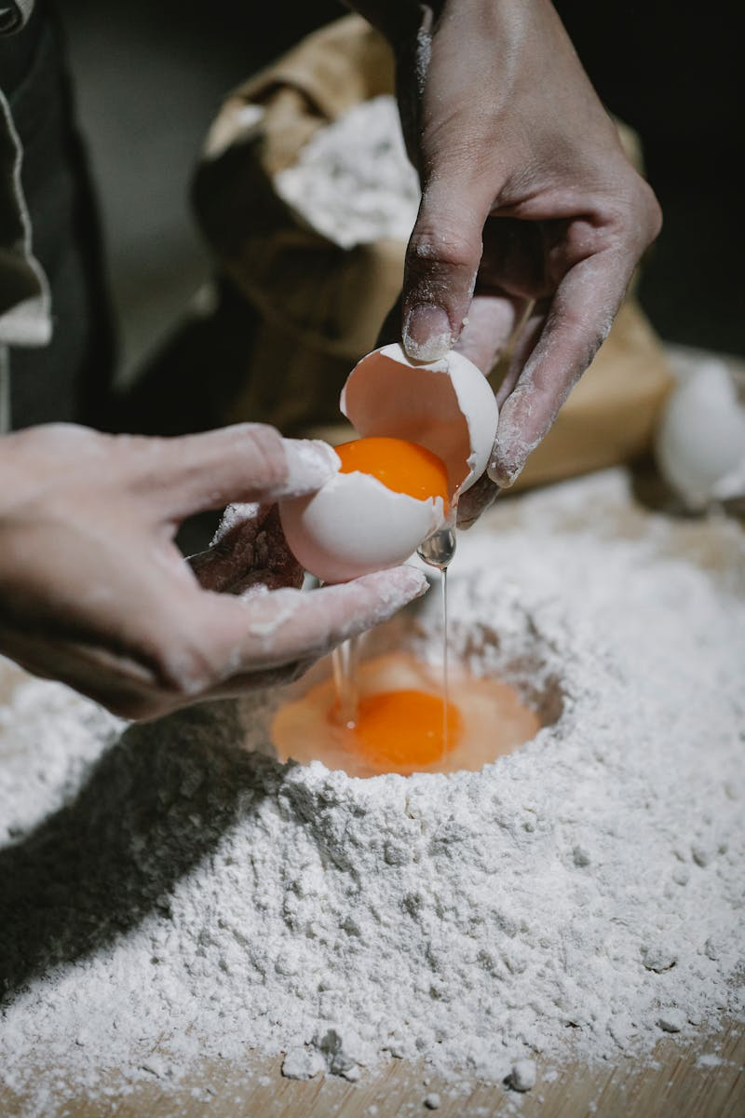
A Baker from Goa: A Taste of India
Exploring Culture Through Baking
Photo by Pexels
September 2024

Slide 2

Table of Contents
1
The Essence of Goa
5
Festivals and Celebrations
2
Meet the Baker
6
Cultural Significance
3
Daily Routine of a Baker
7
The Art of Baking
4
Traditional Goan Bread
8
Challenges Faced

Slide 3
9
Future of Goan Baking
10
Thank You!

Slide 4
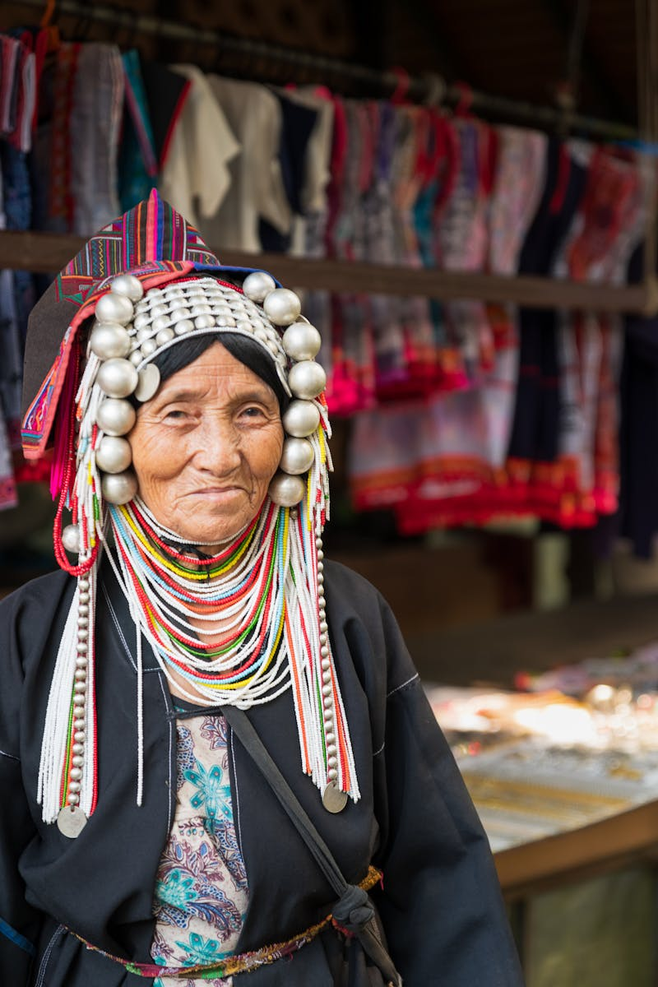
The Essence of Goa
Goa, known for its vibrant culture, is a melting pot of traditions and cuisines.
The blend of Indian and Portuguese influences shapes the unique lifestyle of the Goan people.
Goa’s rich history and scenic beauty attract travelers and food enthusiasts alike.
Exploring Goa reveals its special bakeries, a vital part of its cultural fabric.
Photo by Pexels
01

Slide 5
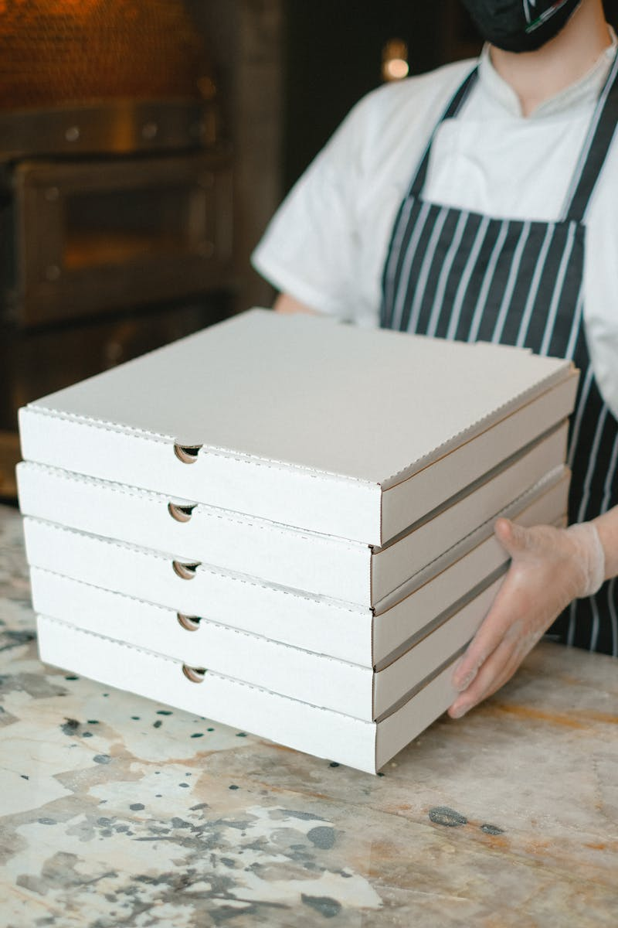
Meet the Baker
The baker embodies the spirit of Goa, providing fresh bread and pastries daily.
Baking has been a family tradition, often passed down through generations in Goa.
Bakers are not just vendors; they play a critical role in social gatherings and festivals.
This vital profession showcases the art of baking as both a skill and a passion.
Photo by Pexels
02

Slide 6

Daily Routine of a Baker
A day in the life of a Goan baker starts before dawn, ensuring freshness for the community.
The rhythmic sound of kneading dough is synonymous with morning routines in Goa.
Bakers engage with locals, fostering relationships over the shared love for baked goods.
Their day is filled with anticipation, as each batch of bread reflects their dedication.
Photo by Pexels
03

Slide 7
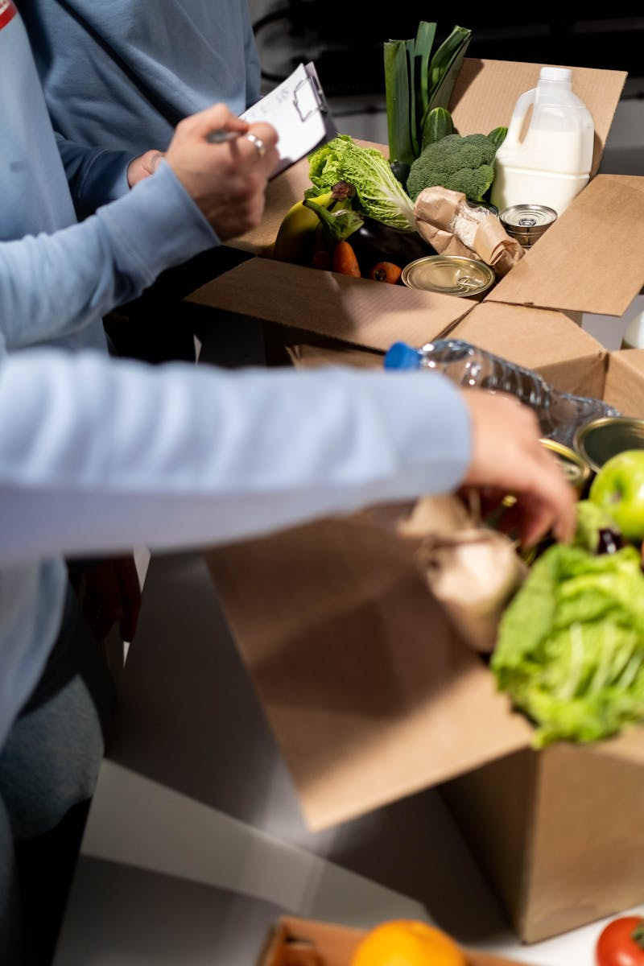
Traditional Goan Bread
Goan bread varieties like 'pav' and 'poee' are staples in the Goan diet.
These breads are often enjoyed with curries, showcasing a perfect balance of flavors.
The unique preparation methods result in textures that are both soft and crusty.
Understanding these breads reveals the deeper connection between food and culture.
Photo by Pexels
04

Slide 8
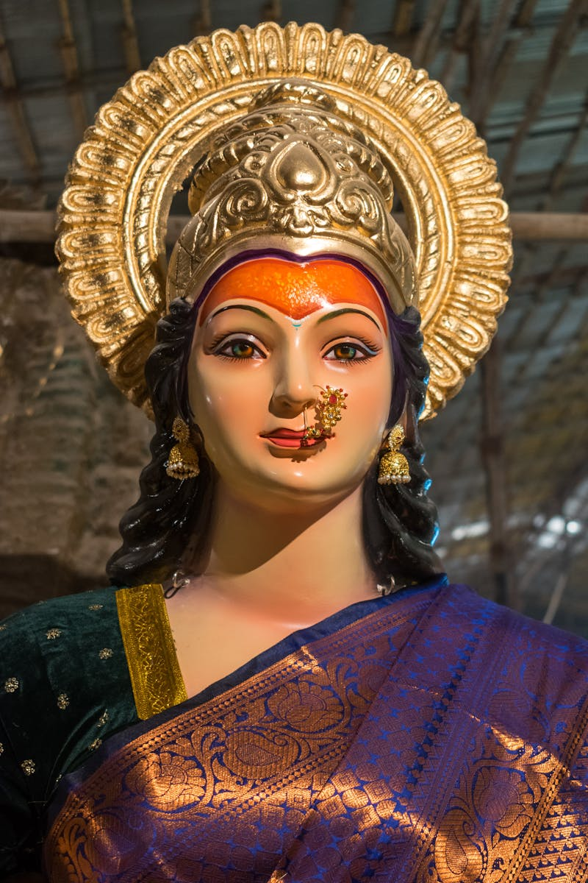
Festivals and Celebrations
Bakers are integral during festivals, providing sweet and savory treats for ceremonies.
Events like Christmas and Easter see an increase in demand for festive goodies.
Traditional recipes often include unique spices and ingredients that reflect Goa's heritage.
These occasions highlight the baker’s role in community celebrations and unity.
Photo by Pexels
05

Slide 9
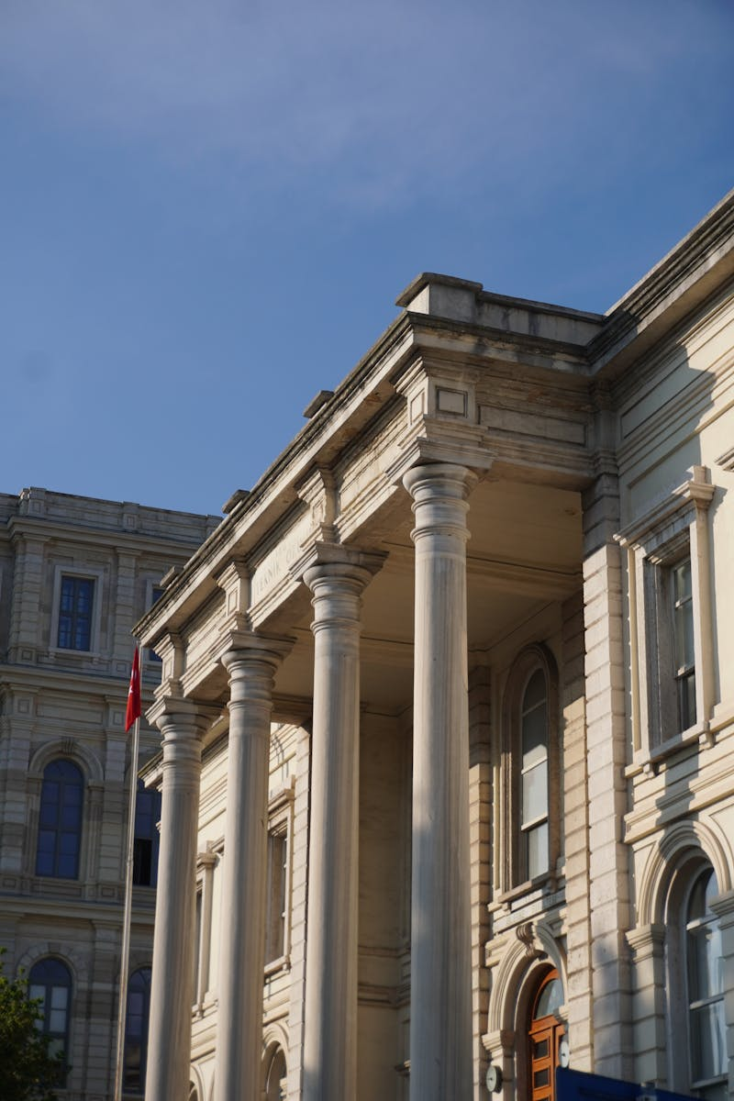
Cultural Significance
Bakers not only provide food but also preserve traditions through their craft.
Their work symbolizes Goa’s cultural identity, blending flavors of various heritages.
Encounters with bakers offer insights into the history and evolution of Goan cuisine.
Every loaf and pastry tells a story, enriching the cultural tapestry of India.
Photo by Pexels
06

Slide 10

The Art of Baking
Baking in Goa involves artistry, combining flavors, techniques, and regional ingredients.
It requires precision and a deep understanding of the baking process.
The baker becomes an artist, creating visual and flavorful masterpieces.
Learning this craft is a journey of patience, creativity, and passion.
Photo by Pexels
07

Slide 11
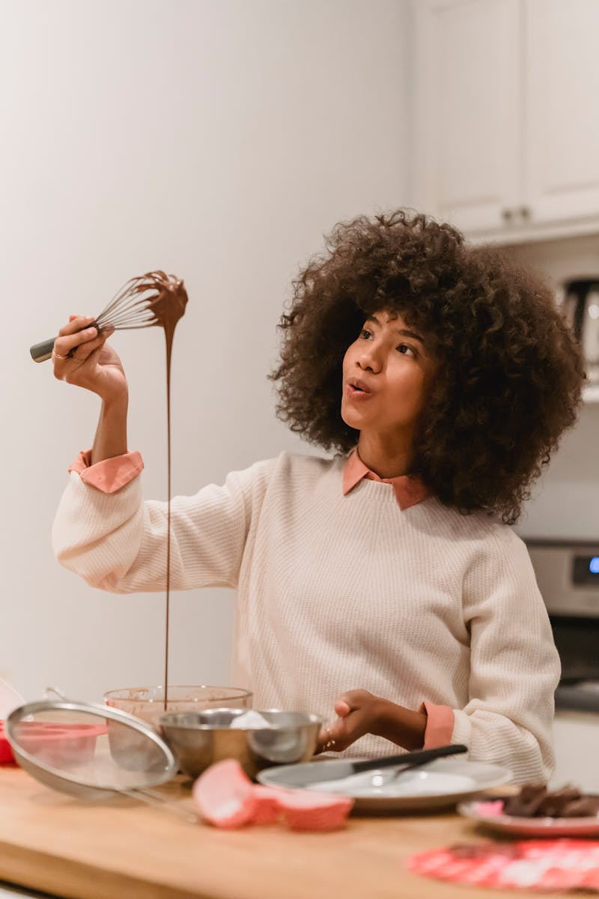
Challenges Faced
Despite tradition, bakers face challenges like competition from industrial bakeries.
Adapting to modern tastes while retaining authenticity is a continuous struggle.
Economic changes impact local businesses, affecting the livelihood of bakers.
Yet, their resilience is inspiring, showcasing the importance of local culture.
Photo by Pexels
08

Slide 12
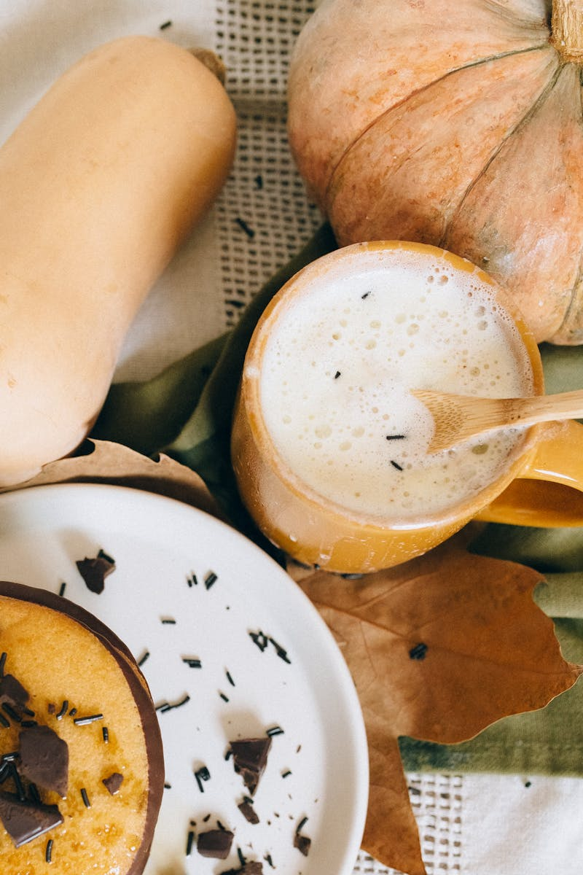
Future of Goan Baking
The future of baking in Goa lies in sustainability and innovation.
Bakers are beginning to embrace organic and local ingredients in their products.
Educating the next generation about baking is crucial to preserving heritage.
With evolving tastes, Goan baking will continue to thrive and evolve.
Photo by Pexels
09

Slide 13

Thank You!
Thank you for exploring the world of Goan baking with us today.
Let’s engage in a discussion about what inspires you in the culinary arts.
Feel free to ask any questions regarding baking traditions and recipes.
Your participation enriches this journey through Goa’s vibrant culture.
Photo by Pexels
10

