Slide 1


AI & Data Science in Customer Support
Simplified Explanation

Slide 2


Table of Contents
1
Introduction: AI and Data Science in Customer Support
2
AI-Powered Customer Support Tools
3
How Data Science Helps
4
Example: Using AI to Answer Questions
5
The Future of AI and Data Science in Support

Slide 3

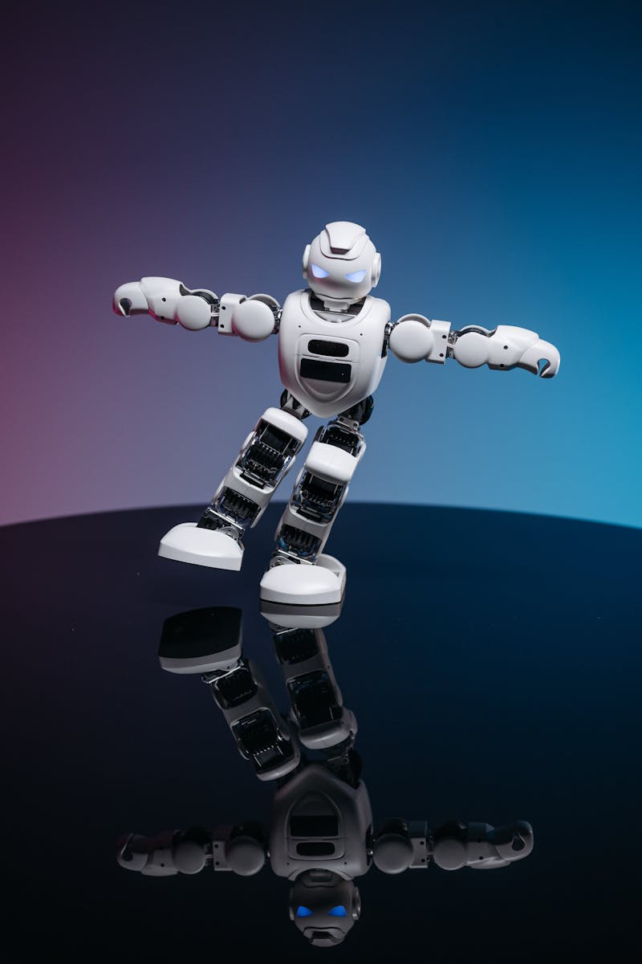
Introduction: AI and Data Science in Customer Support
Artificial Intelligence (AI) makes computers think and learn like humans.
Data Science uses data to find patterns and insights.
To provide faster, better, and more personalized support.
Improve customer satisfaction and efficiency.
Photo by Google

Slide 4

AI-Powered Customer Support Tools
AI-powered assistants that answer common questions instantly.
AI detects the customer's mood (happy, angry, sad) to prioritize responses.
AI suggests relevant solutions based on customer history and needs.
AI sends support requests to the right agent, saving time.
Photo by Google

Slide 5

How Data Science Helps
Data analysis reveals frequent problems customers face.
Data helps anticipate what customers might need in the future.
Data identifies bottlenecks and areas for improvement in the support workflow.
Track metrics like resolution time and satisfaction scores using data.
Photo by Google

Slide 6

Example: Using AI to Answer Questions
"How do I reset my password?"
Understands the question using Natural Language Processing (NLP).
Provides step-by-step instructions or a link to password reset page.
Customer gets immediate help without waiting for an agent.
Photo by Google

Slide 7

The Future of AI and Data Science in Support
AI will provide even more tailored support experiences.
AI will anticipate and solve problems before customers even notice them.
AI will automate more tasks, freeing up agents for complex issues.
Data science will reveal even deeper insights into customer needs and behavior.
Photo by Google

