Slide 1

AI-Driven Predictive Maintenance for Distribution Transformers Revolutionizing Power Grid Reliability Through Intelligent Monitoring
Photo by Pexels

Slide 2
01
Introduction to AI-Driven Predictive Maintenance
Table of Contents
02
Traditional vs AI-Powered Maintenance
03
Key Technologies and Data Sources
04
Implementation Benefits and ROI
05
Future Trends and Industry Impact

Slide 3
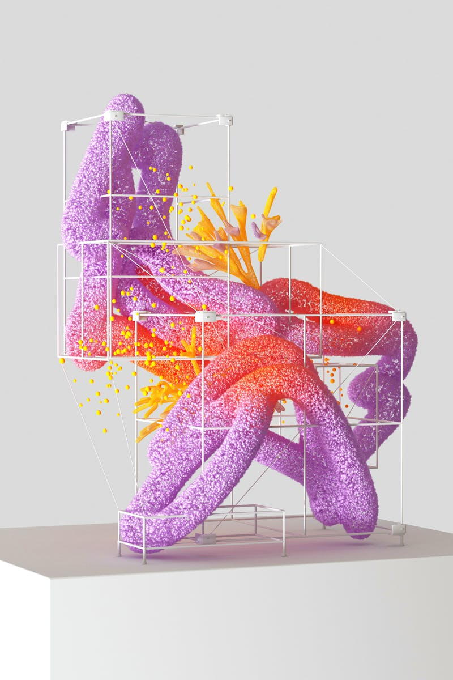
1
Introduction to AI-Driven Predictive Maintenance
The Future of Power Grid Management
AI-powered predictive maintenance replaces reactive approaches with proactive monitoring, significantly reducing transformer failures and extending equipment lifespan. Advanced algorithms continuously analyze sensor data to detect anomalies and predict potential failures before they occur, enabling timely interventions. By preventing catastrophic failures and optimizing maintenance schedules, utilities can achieve substantial cost savings while improving service reliability. Early detection of potential hazards through AI monitoring ensures safer operations and protects both infrastructure and personnel from unexpected failures.

Slide 4

2
Traditional vs AI-Powered Maintenance
A Paradigm Shift in Asset Management
Traditional reactive maintenance addresses problems only after failures occur, leading to unplanned outages, higher costs, and safety risks. Scheduled maintenance often results in unnecessary interventions or misses critical issues, creating inefficiencies and operational disruptions. Machine learning algorithms analyze historical and real-time data to identify patterns and predict failures with unprecedented accuracy and precision. AI systems transform raw sensor data into actionable insights, enabling maintenance teams to prioritize resources and optimize intervention timing.

Slide 5

3
Key Technologies and Data Sources
The Foundation of Intelligent Monitoring
Distributed sensors continuously monitor temperature, vibration, oil quality, and electrical parameters, providing comprehensive transformer health data. Advanced AI models process complex datasets to identify subtle patterns and correlations that indicate potential failure modes and degradation trends. Scalable cloud infrastructure enables real-time processing of massive datasets and supports sophisticated predictive analytics across entire power networks. Virtual replicas of physical transformers allow simulation of various operating conditions and testing of maintenance strategies without risk to actual equipment.

Slide 6

4
Implementation Benefits and ROI
Measuring Success in Power Grid Modernization
Predictive maintenance strategies can reduce unplanned outages by up to 70%, ensuring continuous power delivery and minimizing customer disruptions. By extending equipment lifespan and reducing emergency repairs, utilities can achieve 20-30% cost savings compared to traditional maintenance approaches. Early detection and intervention can extend transformer operational life by 15-25%, maximizing return on infrastructure investments. Reduced failures and optimized operations lead to lower energy consumption and fewer replacement units, contributing to sustainability goals.

Slide 7
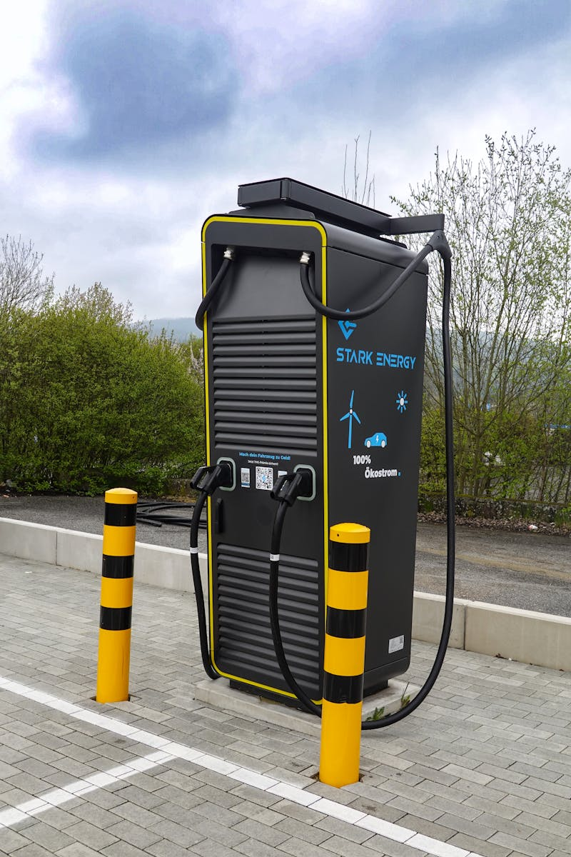
5
Future Trends and Industry Impact
Shaping the Next Generation of Power Infrastructure
Future systems will enable self-diagnosing transformers with automated maintenance scheduling and robotic intervention capabilities. On-site AI processing will enable faster response times and reduced dependency on cloud infrastructure for critical monitoring functions. Integration with smart grid technologies and digital transformation initiatives will create comprehensive ecosystem-wide monitoring solutions. The rise of AI-driven maintenance will transform utility operations, requiring new skill sets and creating opportunities for data-driven technical roles.

