Slide 1
AI Marketing Presentation Strategy 2026 Revolutionizing marketing workflows through intelligent and automated slide design.
Photo by Google

Slide 2
01
The AI Design Revolution
Table of Contents
02
The Manual Slide Bottleneck
03
Top AI Presentation Tools
04
Ensuring Brand Consistency
05
Data-Driven Marketing Insights
06
Streamlined Team Collaboration
07
Strategic Marketing Use Cases
08
The Future of Presentations
09
Implementing Your AI Strategy
10
Thank You

Slide 3
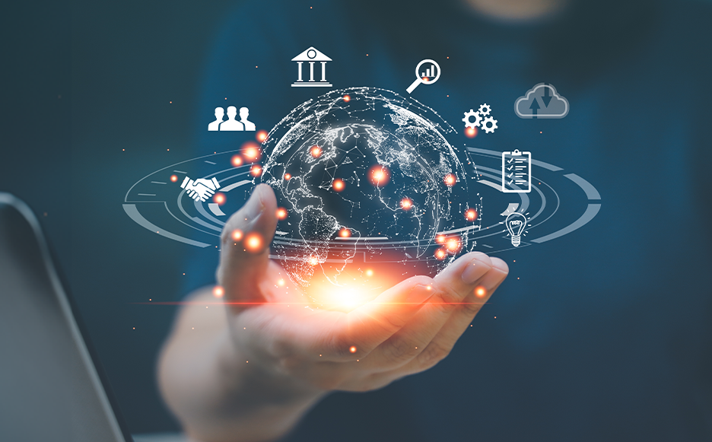
1
The AI Design Revolution
How to make ppt from ai for high-impact marketing.
Artificial intelligence transforms raw campaign ideas into structured visual narratives, allowing marketing teams to generate professional slide decks from simple text prompts in minutes. Traditional slide creation is a manual bottleneck that slows down strategy. AI eliminates the need for dragging text boxes and manually aligning complex design elements. Modern AI tools can reduce presentation preparation time by up to 70 percent, freeing marketers to focus on strategic messaging and core campaign execution. AI-powered platforms allow every team member to create designer-quality decks without formal training, ensuring high-quality visual output across all marketing departments and roles.
Photo by Google

Slide 4
2
The Manual Slide Bottleneck
Understanding the hidden costs of traditional presentation design.
Research shows marketing teams spend over five hours weekly building presentations, which accounts for approximately 12 percent of their total available working time. Manual formatting often leads to mismatched fonts and off-brand logos, which can damage a company's professional image during critical client pitches or reports. Traditional slides require manual chart building and updates, making it difficult to maintain real-time accuracy during fast-paced quarterly business reviews or performance meetings. Passing files between creative, legal, and leadership teams creates version control issues and delays essential approvals during high-stakes brand launches and campaign cycles.
Photo by Google

Slide 5
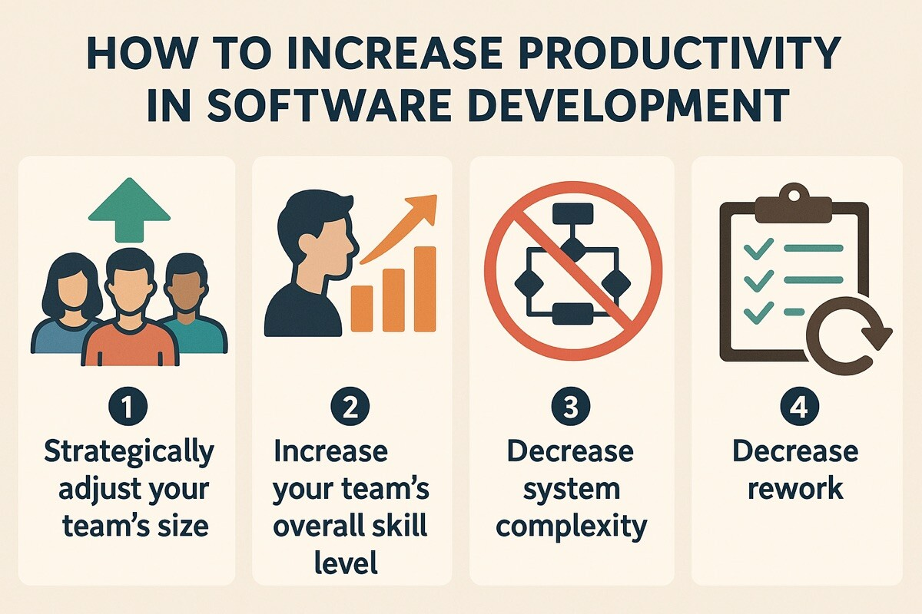
3
Top AI Presentation Tools
Selecting the best platforms for modern marketing teams.
This platform uses smart design heuristics to automatically rebalance layouts and enforce typography rules, making it perfect for rapid, high-quality professional corporate decks. Ideally suited for teams already in the Canva ecosystem, this tool generates presentation drafts that integrate seamlessly with existing brand kits and asset libraries. Gamma reimagines presentations as scrollable, card-based web content, providing a modern aesthetic and built-in analytics to track how viewers engage with shared materials. A powerful add-on for Google Workspace users that brings AI generation directly into Google Slides and PowerPoint, maintaining familiar workflows while adding automation.
Photo by Google

Slide 6
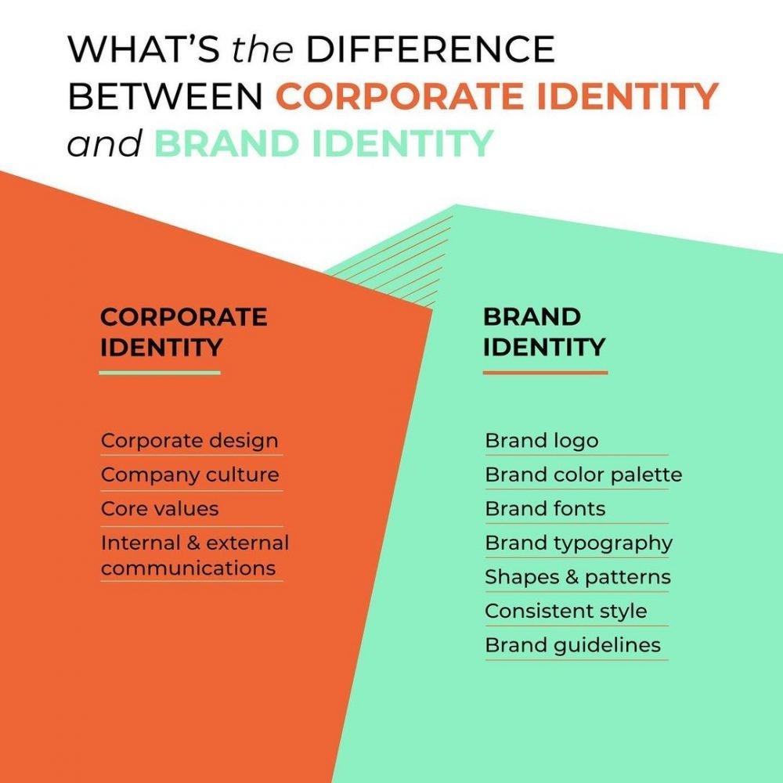
4
Ensuring Brand Consistency
Maintaining visual integrity across every marketing asset.
AI tools allow teams to save logos, hex codes, and fonts once, ensuring every generated slide automatically adheres to the company's established visual identity. Enterprise-level features enable managers to lock specific slides and elements, preventing team members from accidentally modifying approved brand content or critical legal disclaimers. Intelligent style engines learn brand preferences over time, suggesting visuals and layouts that remain perfectly aligned with the professional image of the marketing organization. By automating the design process, marketing teams ensure a consistent and professional brand voice across diverse materials, from internal reports to external pitches.
Photo by Google

Slide 7
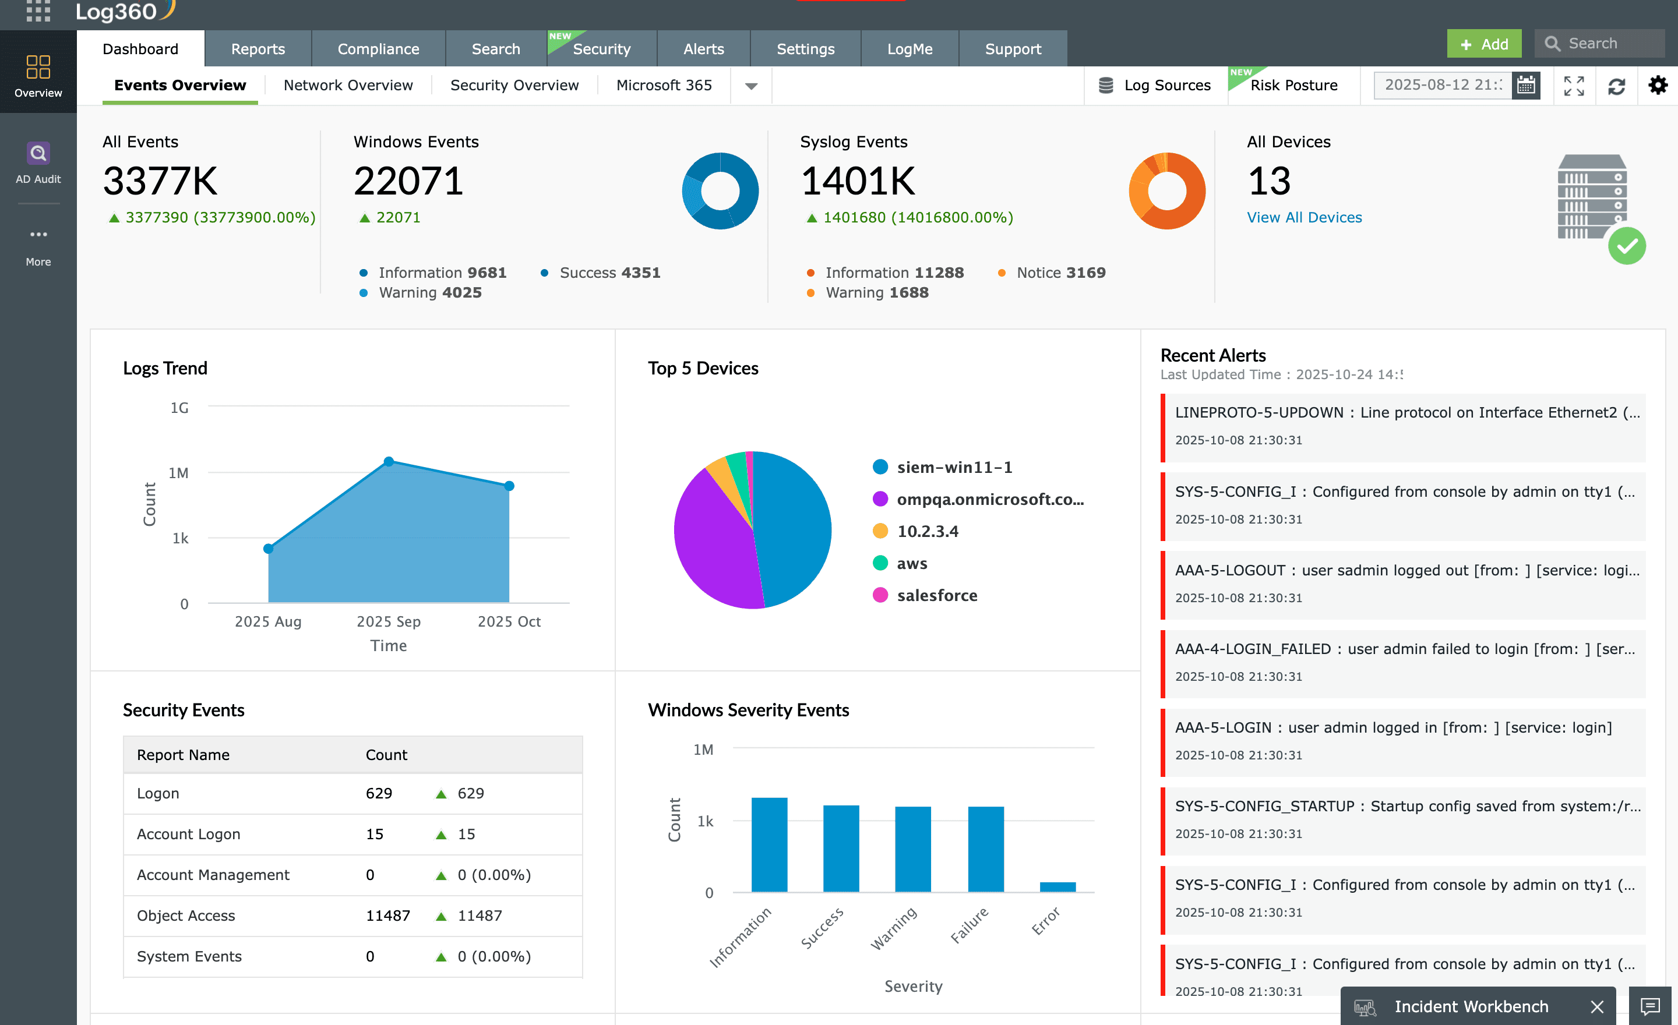
5
Data-Driven Marketing Insights
Transforming complex analytics into clear visual stories.
AI simplifies the creation of charts and infographics from raw data, eliminating the need for manual data entry and ensuring accurate performance reporting. Advanced tools like Plus AI offer live data connections that automatically update slides with the latest metrics, ensuring meetings always feature current marketing performance. Integrated tracking features show who viewed your presentation and how long they spent on each slide, providing actionable intelligence for sales enablement strategies. Marketing teams can enhance engagement by embedding clickable buttons, hover effects, and live websites directly into their digital strategy presentations for deeper impact.
Photo by Google

Slide 8

6
Streamlined Team Collaboration
Enhancing productivity through real-time AI partnership.
Cloud-based AI platforms support simultaneous editing and in-context commenting, which significantly streamlines the feedback loop between creative and management team members. AI enables teams to complete multiple improvement cycles in the time it previously took to build a single draft, supporting faster campaign testing and refinement. The best AI presentation tools connect with existing infrastructure like Slack and Salesforce, fitting into current marketing stacks without causing any workflow disruption. Centralized libraries for slides and media ensure that all team members have instant access to approved assets, further accelerating the creation of marketing materials.
Photo by Google

Slide 9
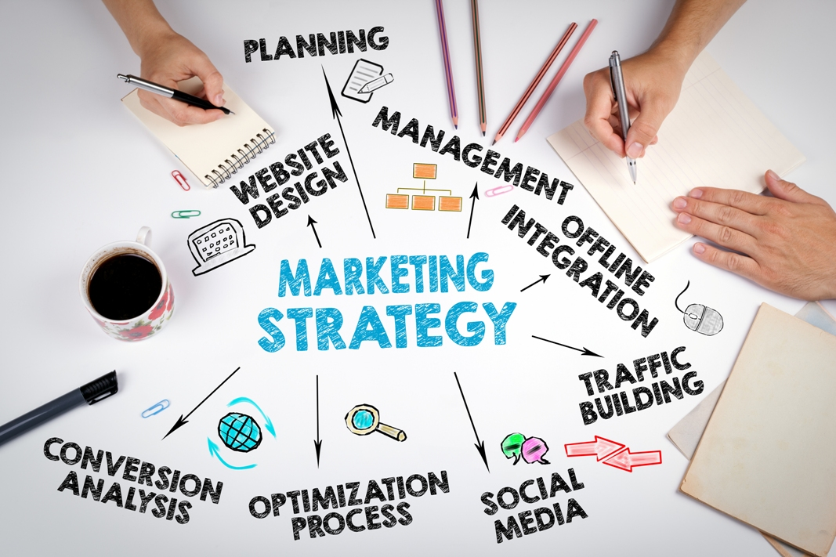
7
Strategic Marketing Use Cases
Applying AI automation to diverse presentation needs.
Automate the creation of weekly reports that visualize multi-channel results, providing stakeholders with clear and professional overviews of marketing ROI and success. Generate visually stunning pitch decks in minutes, allowing marketing agencies to respond to new opportunities with unprecedented speed and polished professional design. Ensure perfect brand alignment during product launches with templates that enforce visual identity across all materials, from executive overviews to tactical enablement decks. Streamline QBR preparation by using AI to summarize dense performance data into concise, high-level summaries that resonate with executive leadership and key stakeholders.
Photo by Google

Slide 10
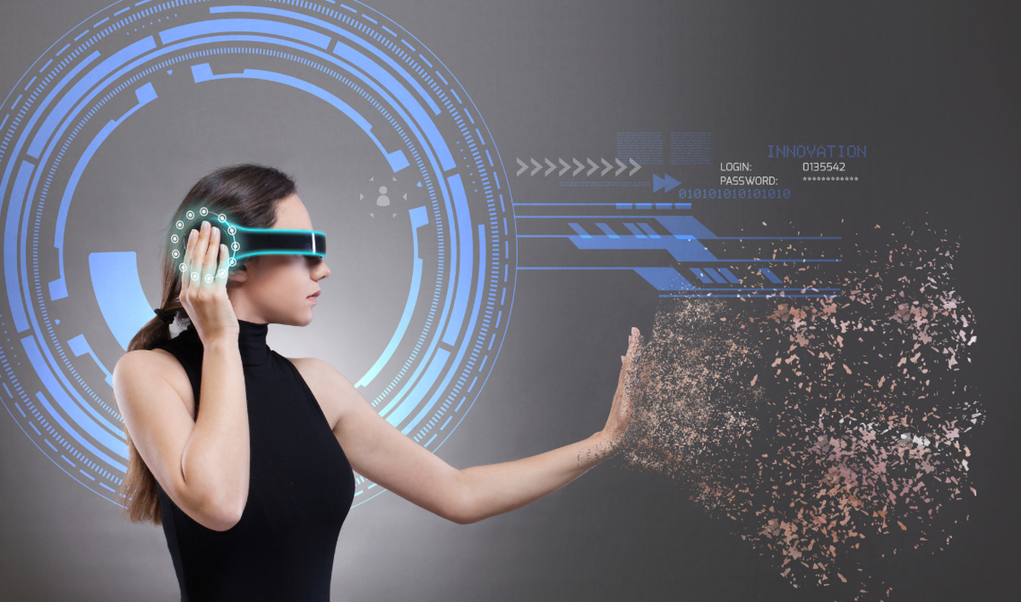
8
The Future of Presentations
Evolving beyond static slides into digital experiences.
The shift toward scrollable, card-based formats allows for more fluid storytelling and better viewing experiences on modern mobile and desktop web browsers. Emerging tools support the inclusion of realistic AI avatars to present content, which is ideal for scalable internal training or personalized customer marketing messages. AI enables the rapid creation of personalized presentation versions for different stakeholders, automatically adapting the communication style and data depth to each audience. Future AI tools will focus on bridging the storytelling gap, helping marketers craft meaningful narratives that persuade audiences and leave a lasting emotional impact.
Photo by Google

Slide 11
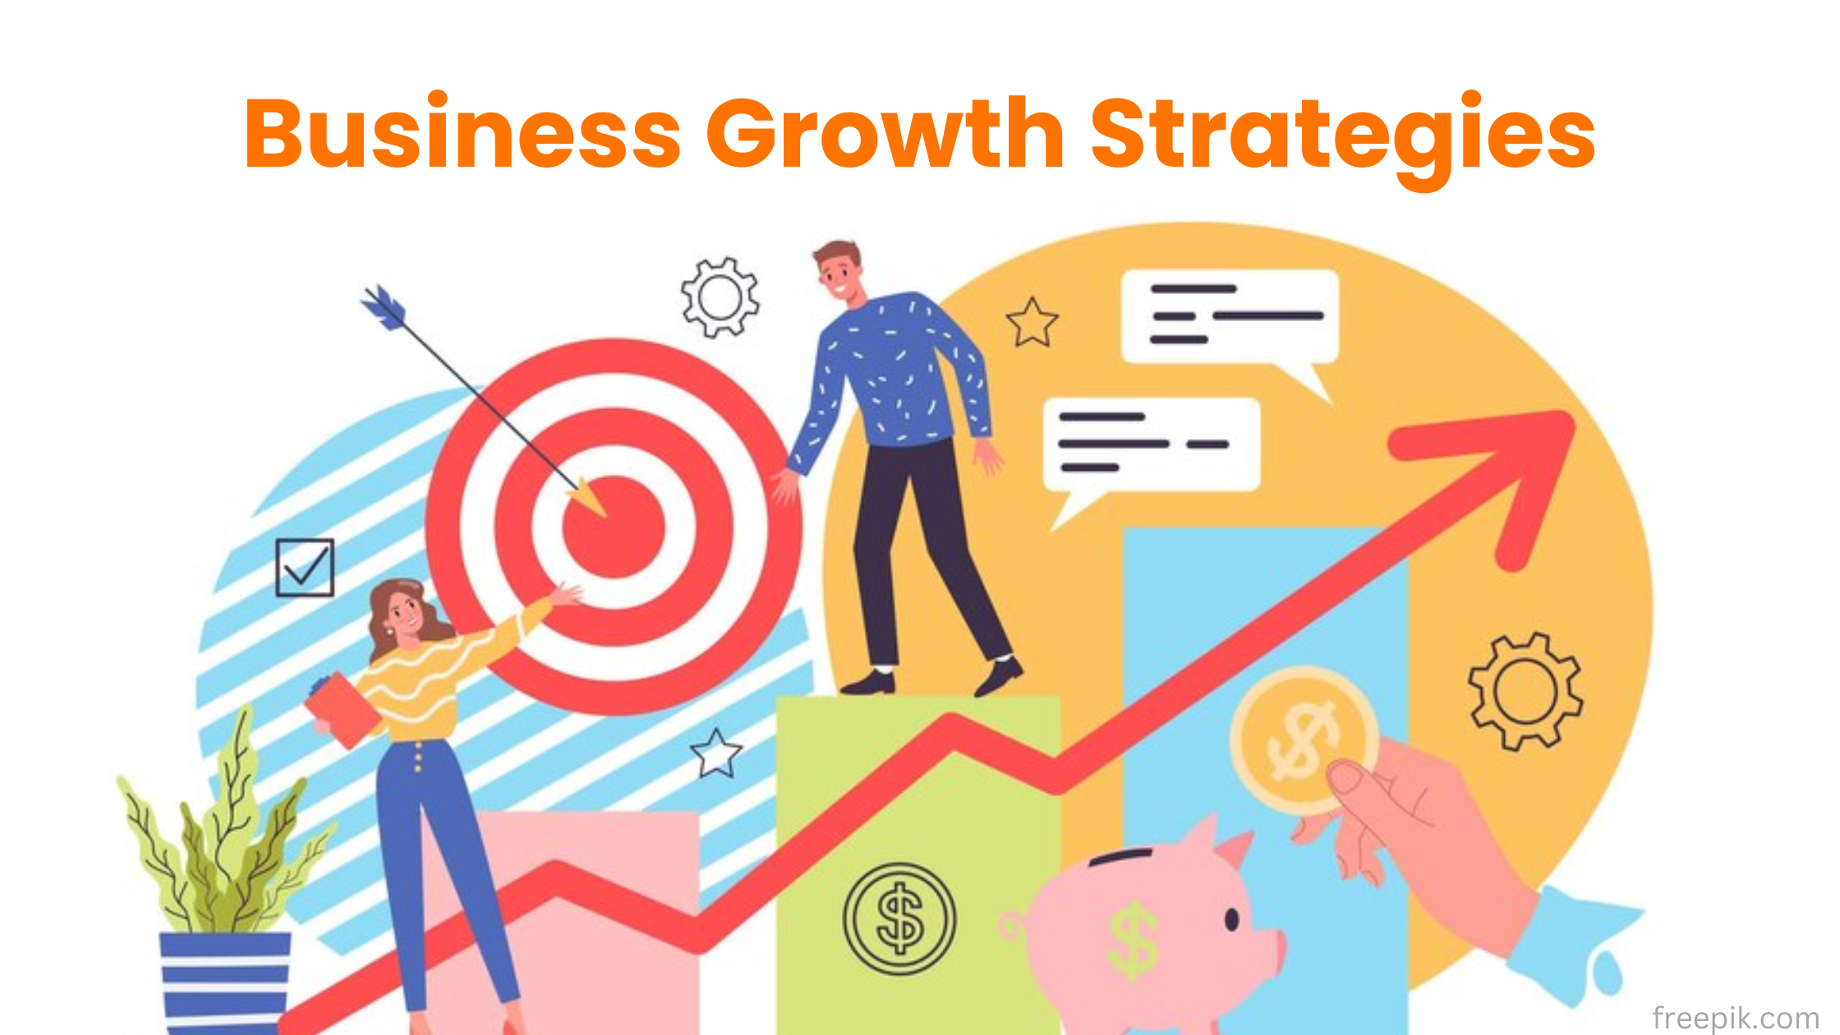
9
Implementing Your AI Strategy
Steps to integrate AI tools into your marketing team.
Evaluate your team's specific needs, such as data visualization or brand control, to choose the AI platform that best fits your existing marketing workflow. Set up centralized brand kits and locked templates within your chosen AI tool to ensure all future presentations remain consistent and professionally aligned. Provide training on effective AI prompting and collaborative features to maximize the productivity gains and design quality of your new presentation workflow. Track the time saved and engagement metrics of your new AI-powered presentations to continuously refine your strategy and demonstrate the value to leadership.
Photo by Google

Slide 12

10
Thank You
Let's revolutionize your marketing presentations together.
We are excited to help you implement these AI strategies. Please reach out to our team for a personalized demo or a professional consultation. Visit our website to download our comprehensive guide on the best AI tools and templates specifically designed for professional marketing teams in 2026. Book a follow-up meeting with our experts to discuss how AI-powered presentations can be integrated into your team's specific campaign goals and workflows. Thank you for your time and attention today. We look forward to seeing the incredible, high-impact marketing presentations your team will create using AI.
Photo by Google

