Slide 1

AI in Landscape Architecture Transforming Design Through Intelligent Solutions
Photo by Pexels

Slide 2
01
AI Revolution in Landscape Design
Table of Contents
02
Design Optimization & Analysis
03
Sustainability & Environmental Impact
04
Client Communication & Visualization
05
Implementation & Future Trends

Slide 3

1
AI Revolution in Landscape Design
The Future of Intelligent Landscaping
AI is revolutionizing traditional landscape architecture by introducing digital tools that enhance creativity and efficiency in design processes. Advanced algorithms now assist landscape architects in creating innovative designs that blend technology with natural elements seamlessly. AI-powered tools provide architects with new possibilities for creative expression while maintaining professional standards and environmental considerations. The landscape architecture field is experiencing significant evolution as AI becomes an integral part of modern design methodologies and practices.

Slide 4
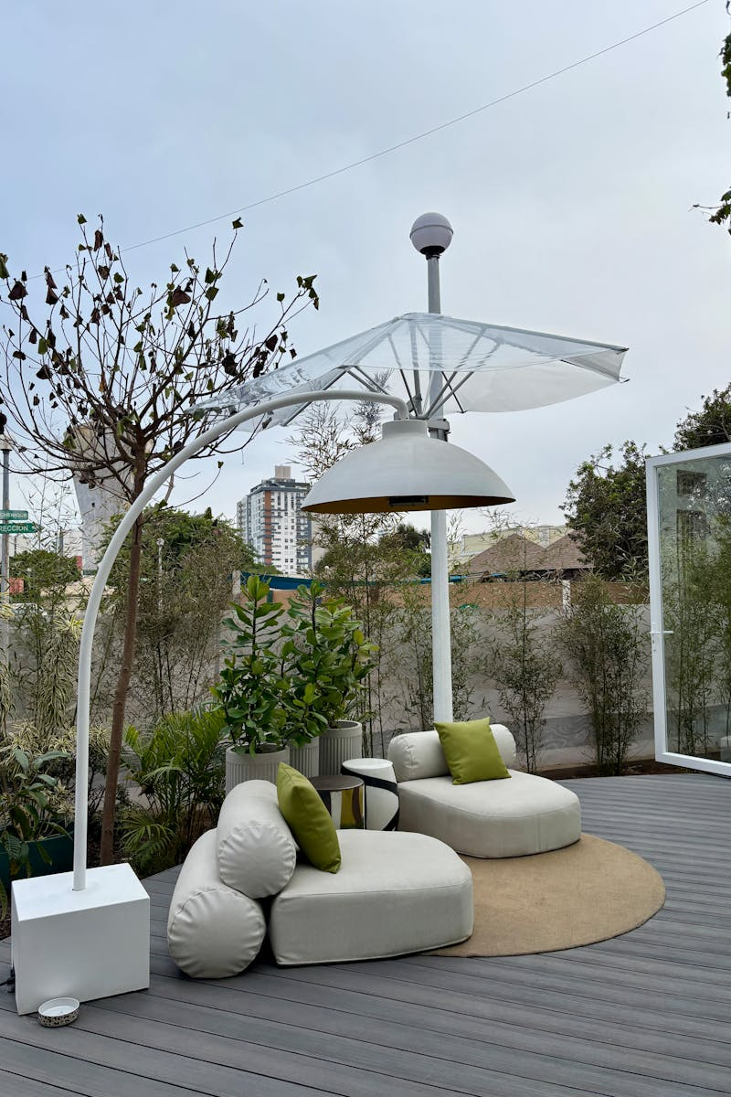
2
Design Optimization & Analysis
Precision Through Intelligent Computing
AI enables sophisticated simulations that predict how landscape designs will perform under various environmental conditions and usage scenarios. Machine learning algorithms analyze spatial data to optimize site layouts, ensuring efficient use of available land and resources. Automated systems provide continuous feedback on design choices, helping architects refine their work based on objective performance metrics. AI-driven optimization reduces material waste and construction costs while maintaining design integrity and aesthetic quality.

Slide 5

3
Sustainability & Environmental Impact
Eco-Conscious Design Intelligence
AI tools analyze environmental data to create sustainable landscape designs that minimize ecological impact while maximizing biodiversity. Intelligent systems optimize water usage, plant selection, and maintenance schedules to create environmentally responsible landscapes. Machine learning helps landscape architects design resilient spaces that can adapt to changing climate conditions and environmental challenges. AI-powered design strategies contribute to reducing carbon emissions through sustainable material choices and energy-efficient landscape planning.

Slide 6

4
Client Communication & Visualization
Enhanced Client Experience Through Technology
AI-generated visualizations allow clients to experience landscape designs in immersive, interactive formats before implementation. Machine learning analyzes client preferences to create customized landscape designs that meet individual needs and aesthetic desires. AI-powered platforms facilitate seamless communication between architects, clients, and stakeholders throughout the design process. Advanced visualization tools provide realistic virtual tours of proposed landscapes, helping clients make informed decisions about their projects.

Slide 7
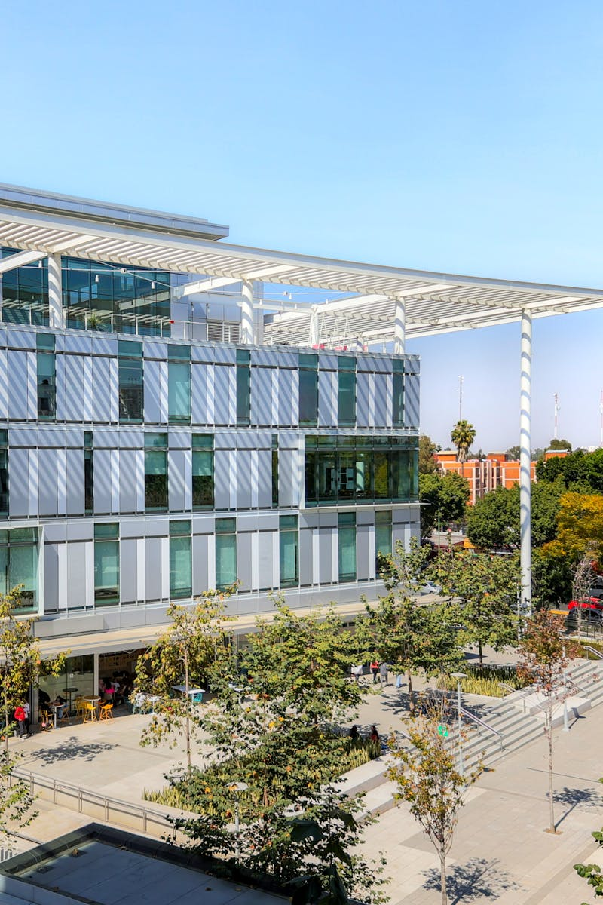
5
Implementation & Future Trends
The Next Generation of Landscape Architecture
AI systems are being integrated with IoT devices to create intelligent landscapes that respond to environmental conditions and user interactions. Machine learning algorithms predict landscape maintenance needs, ensuring optimal care and longevity of designed spaces. AI tools are transforming landscape architecture education, preparing students for technology-driven careers in the field. The future of landscape architecture lies in embracing AI technologies to create more sustainable, efficient, and beautiful outdoor spaces for generations to come.

