Slide 1
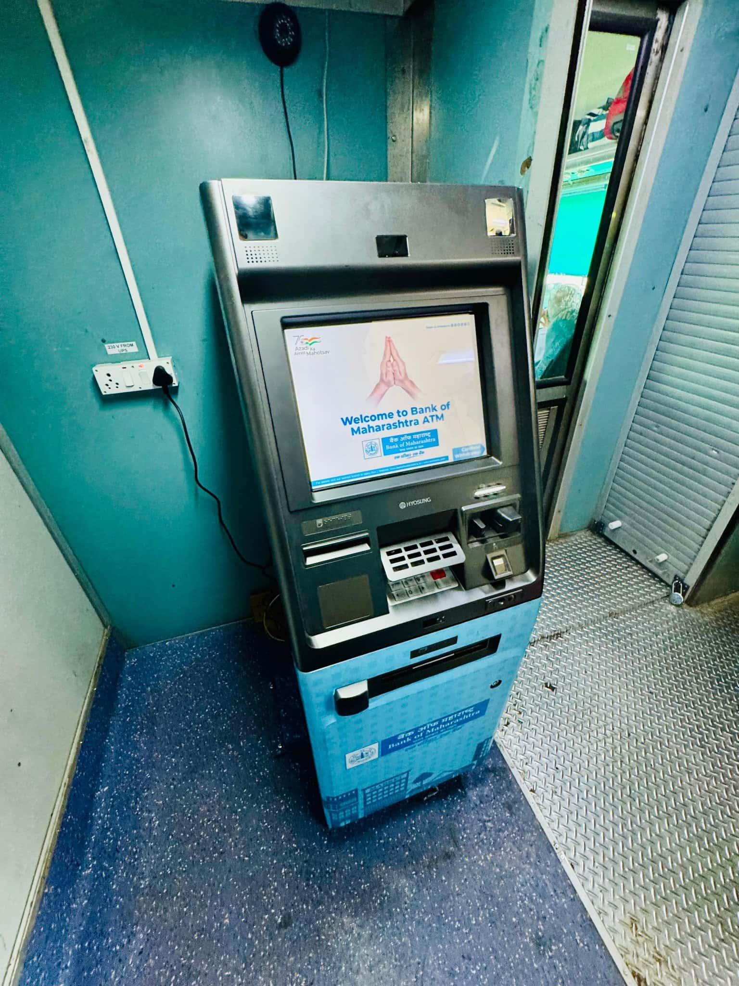
ATM on Rails: Revolutionizing Banking Accessibility
Exploring Indian Railways' innovative trial of ATMs on moving trains and its impact.
Photo by Google

Slide 2
01
Banking on the Move: A New Era
Table of Contents
02
Panchavati Express: The Pioneering Route
03
Bank of ...: Empowering Rail Passengers
04
Addressing Challenges: Connectivity and Security
05
Impact on Passengers: Convenience and Accessibility
06
Future Prospects: Expanding the Network
07
Addressing Concerns: Privacy and Data Protection
08
Economic Impact: Boosting Rural Economies
09
Global Perspective: Similar Initiatives Worldwide
10
Thank You

Slide 3
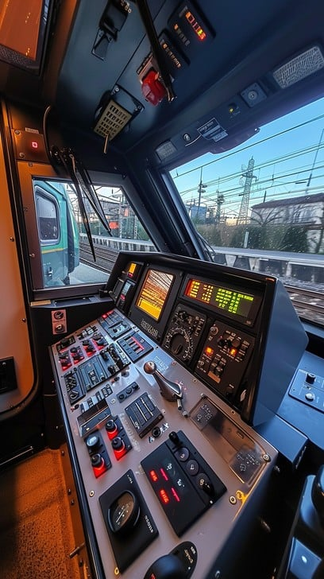
1
Banking on the Move: A New Era
Indian Railways pioneers ATM service on trains, bringing convenience to passengers.
Indian Railways partnered with Bank of ... to launch the first ATM on the Panchavati Express, marking a significant step in passenger convenience.
Passengers can now access banking services during their journey, eliminating the need to search for ATMs at stations or destinations.
This initiative promotes financial inclusion by extending banking services to remote areas connected by the railway network.
The on-train ATM offers a seamless and convenient way for passengers to withdraw cash and manage their finances while traveling.
Photo by Google

Slide 4
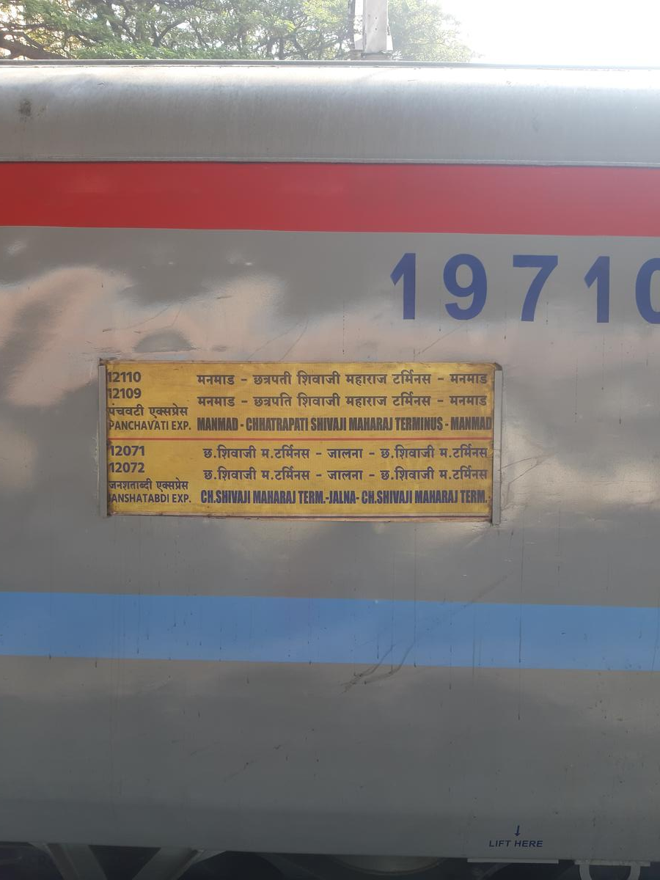
2
Panchavati Express: The Pioneering Route
The Panchavati Express becomes the first train to host an ATM, setting a precedent for future expansion.
The successful trial on the Panchavati Express demonstrated the feasibility and potential of ATMs on trains, paving the way for wider implementation.
The Panchavati Express was chosen for its high passenger volume and diverse routes, ensuring maximum impact and feedback.
Initial feedback from passengers has been overwhelmingly positive, highlighting the convenience and value of the on-train ATM service.
Based on the trial's success, Indian Railways plans to extend the ATM service to other major train routes across the country.
Photo by Google

Slide 5
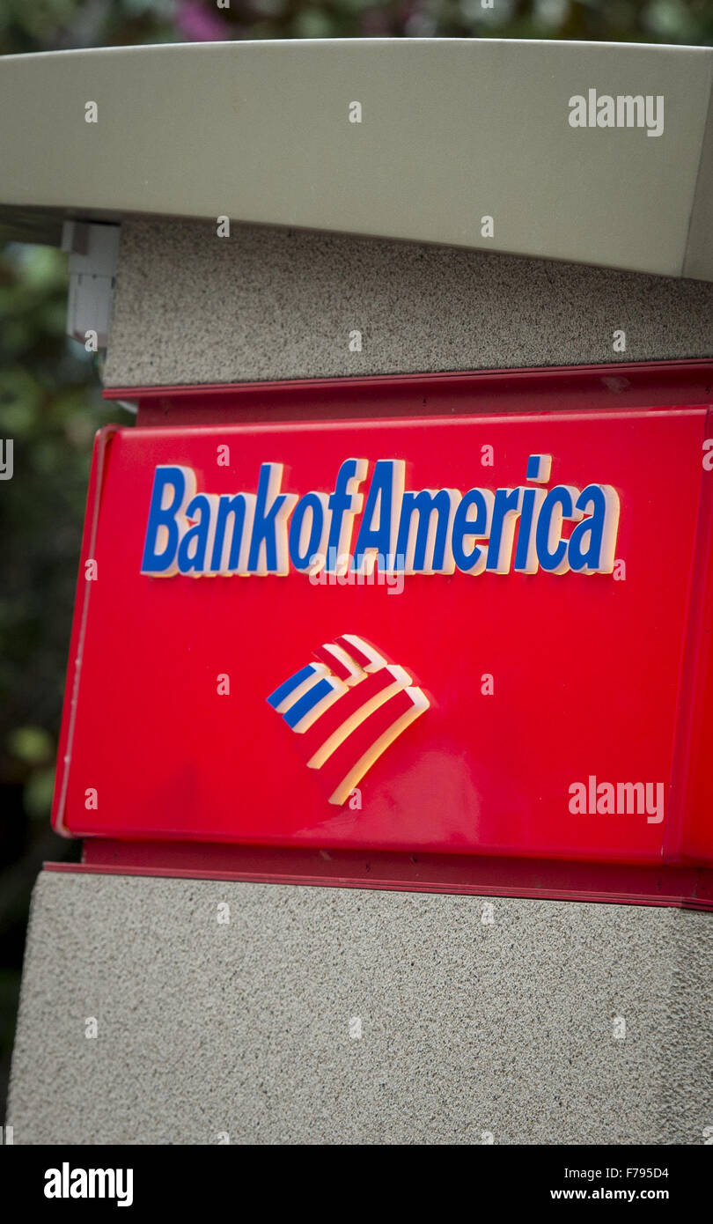
3
Bank of ...: Empowering Rail Passengers
Details about the Bank involved in the project.
Bank of ... collaborated with Indian Railways to provide the ATM infrastructure and ensure seamless banking services on the Panchavati Express.
The bank implemented robust security measures and reliable connectivity to ensure secure and uninterrupted ATM services for passengers.
Bank of ... provides customer support and maintenance for the on-train ATM, ensuring a positive banking experience for rail passengers.
This partnership underscores Bank of ... commitment to innovation and expanding banking services to underserved communities.
Photo by Google

Slide 6
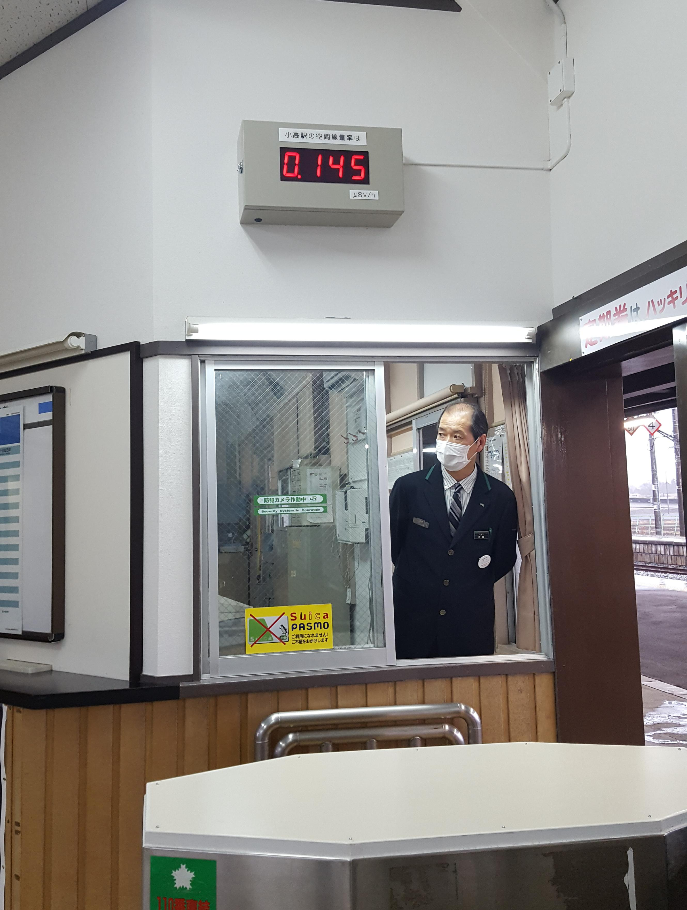
4
Addressing Challenges: Connectivity and Security
Ensuring seamless and secure ATM operations on a moving train.
Maintaining consistent connectivity on a moving train required innovative technological solutions, including satellite communication and mobile networks.
Stringent security measures, such as surveillance cameras, biometric authentication, and secure data encryption, were implemented to protect the ATM and passenger transactions.
A reliable power supply system was installed to ensure uninterrupted ATM operation, even during power outages or fluctuations.
A dedicated maintenance team provides regular inspections and timely repairs to ensure the ATM functions optimally throughout its journey.
Photo by Google

Slide 7

5
Impact on Passengers: Convenience and Accessibility
The benefits of having ATMs on trains for travelers.
Passengers no longer need to rely solely on ATMs at railway stations, providing them with greater financial independence and flexibility.
The on-train ATM provides a valuable resource for passengers who need cash in emergencies or unexpected situations during their journey.
Passengers can avoid long queues and delays at station ATMs, saving valuable time and enhancing their travel experience.
Having an ATM on the train reduces the risk of carrying large amounts of cash, improving passenger safety and security.
Photo by Google

Slide 8
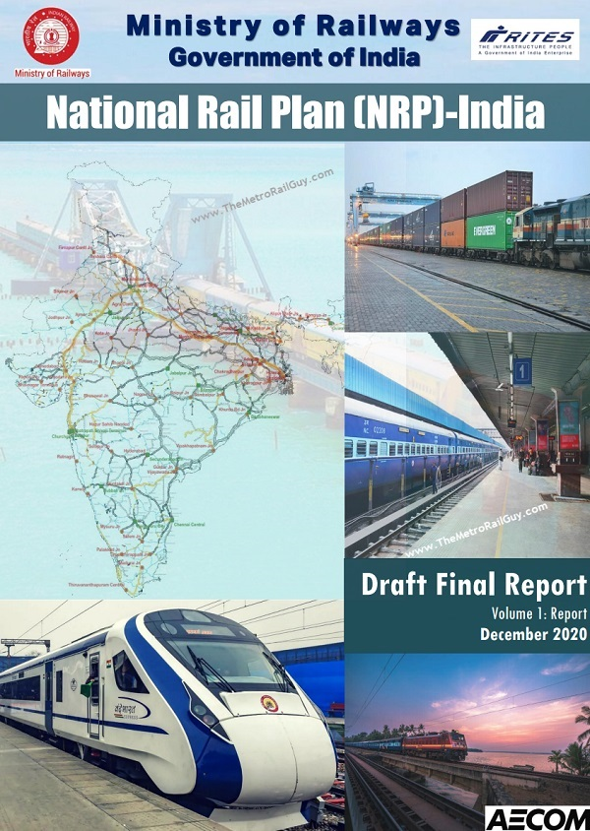
6
Future Prospects: Expanding the Network
Plans for scaling up ATM services on Indian Railways.
Indian Railways aims to expand the ATM service to more trains and routes, catering to a larger segment of passengers across the country.
Collaborations with other banks and financial institutions are being explored to further expand the ATM network and enhance service offerings.
Continuous technological upgrades are planned to improve connectivity, security, and the overall user experience of the on-train ATMs.
Integration of other banking services, such as mobile banking and digital payments, is being considered to provide a comprehensive financial solution for rail passengers.
Photo by Google

Slide 9
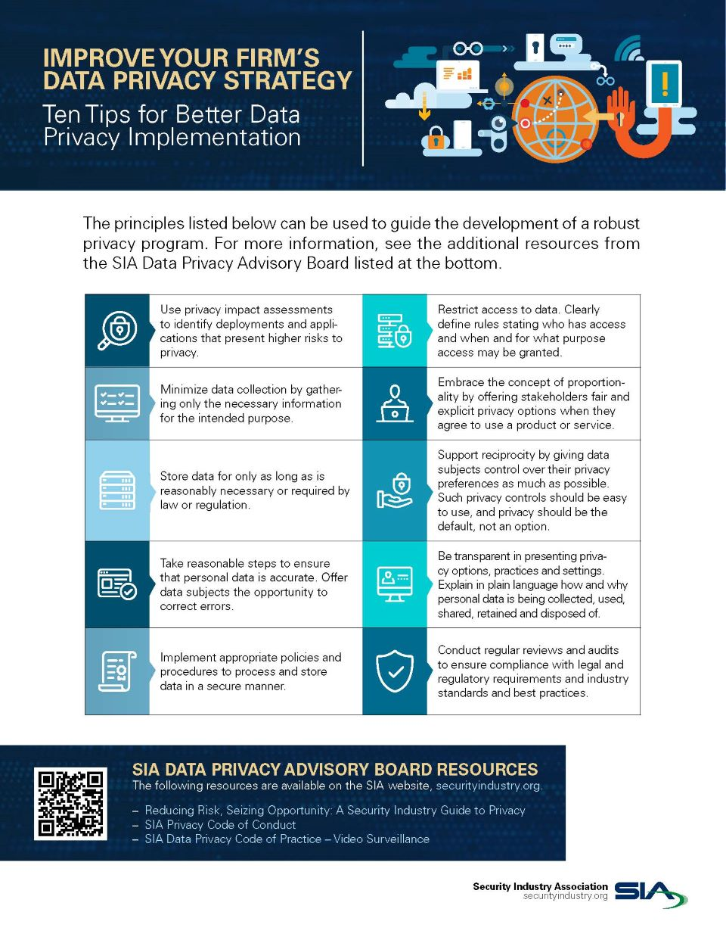
7
Addressing Concerns: Privacy and Data Protection
Safeguarding passenger data and ensuring privacy.
All passenger data transmitted through the ATM is encrypted using state-of-the-art technology to prevent unauthorized access.
Clear and transparent privacy policies are implemented to inform passengers about how their data is collected, used, and protected.
The ATM service adheres to all relevant data protection laws and regulations, ensuring compliance with industry standards.
Independent audits are conducted regularly to assess and improve the security and privacy measures of the ATM service.
Photo by Google

Slide 10

8
Economic Impact: Boosting Rural Economies
How ATMs on trains can stimulate economic growth in rural areas.
ATMs on trains facilitate financial inclusion in rural areas by providing access to banking services for underserved communities.
Small businesses along railway routes can benefit from increased access to cash, enabling them to expand their operations and serve more customers.
The expansion of ATM services on trains can create employment opportunities in maintenance, security, and customer support.
Improved financial access can contribute to overall rural development by promoting economic growth and reducing poverty.
Photo by Google

Slide 11
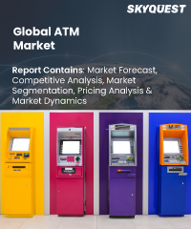
9
Global Perspective: Similar Initiatives Worldwide
Examining ATM and Banking access worldwide.
The initiative can be compared with banking access and similar technology used worldwide.
Analysis of benchmarks across different countries and areas
An overview of what the future could look like in various countries.
Highlighting new and current trends used globally for ATM and banking.
Photo by Google

Slide 12

10
Thank You
Appreciation for your attention
Thank you for your time and attention. We appreciate the opportunity to present this information.
We welcome any questions or comments you may have regarding this topic.
Please feel free to reach out to us for further information or assistance.
We hope this presentation has provided valuable insights into the future of banking convenience on Indian Railways.
Photo by Google

