Slide 1
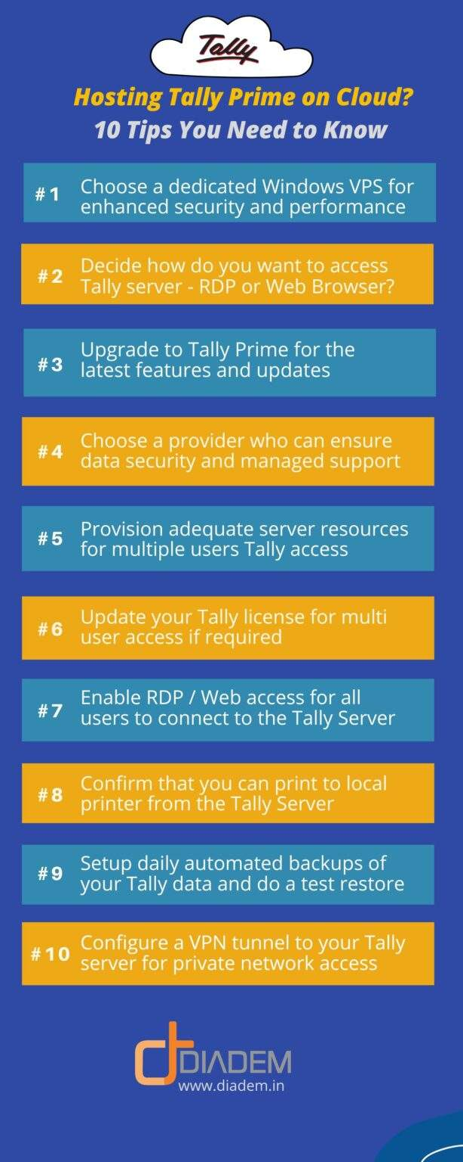
Antra Cloud: Premium Cloud Hosting for Tally Secure, Reliable, and Accessible Tally Solutions
Photo by Google

Slide 2
01
Introducing Antra Cloud – Premium Cloud Hosting for ...
Table of Contents
02
Challenges with Traditional Tally Access
03
How Antra Cloud Solves These Challenges
04
Smart Investment with Real ROI
05
Trusted by 1000+ Clients Across India

Slide 3
1
Introducing Antra Cloud – Premium Cloud Hosting for Tally
Revolutionize your Tally experience with cloud-based accessibility and security.
Host your Tally on our robust and secure cloud infrastructure. Utilizing Yotta & L&T data centers for unparalleled performance. Experience 99.99% uptime, high-speed access, and 24/7 monitoring. Access Tally from anywhere with ease and efficiency.
Photo by Google

Slide 4
2
Challenges with Traditional Tally Access
Uncover the limitations of accessing Tally without the cloud.
Teams struggle with restricted access to Tally data from different locations. Traditional systems are vulnerable to data loss due to inadequate backup procedures. Reliance on local hardware leads to maintenance hassles and potential downtime. Local systems are susceptible to security threats, compromising sensitive Tally data.
Photo by Google

Slide 5
3
How Antra Cloud Solves These Challenges
Transform your Tally experience with our innovative cloud solutions.
Access Tally securely from any location, at any time, enhancing productivity. Ensure data safety with automatic daily backups, eliminating the risk of data loss. Protect sensitive financial data with robust bank-grade security measures. Eliminate the burden of server maintenance, allowing you to focus on your core business.
Photo by Google

Slide 6
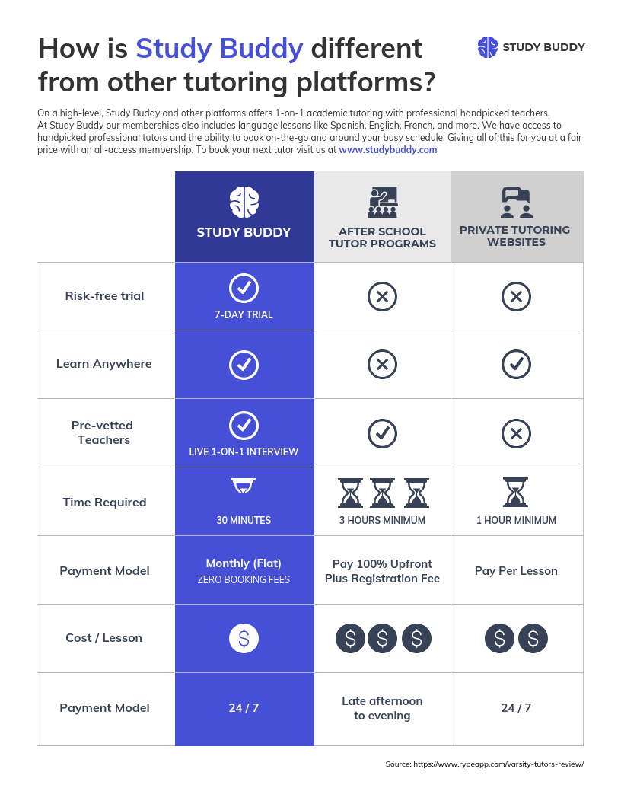
4
Smart Investment with Real ROI
Maximize your returns with our cost-effective cloud solutions.
Reduce capital expenditure by eliminating the need for expensive hardware. Lower operational costs by reducing IT maintenance and support expenses. Boost productivity with work-from-anywhere capabilities, enhancing team collaboration. Minimize downtime and ensure business continuity with our 99.99% uptime guarantee.
Photo by Google

Slide 7
5
Trusted by 1000+ Clients Across India
Join our growing community of satisfied Antra Cloud users.
“Antra Cloud gave us peace of mind with secure Tally access across our offices.” Serving a diverse range of clients across various industries in India. Ensuring data protection and accessibility, fostering trust among our clientele. Providing a smooth and efficient Tally experience, empowering businesses nationwide.
Photo by Google

