Slide 1

BEX in Mobile Communication Understanding Modern Communication Technologies
Photo by PDF

Slide 2
01
Introduction to Mobile Communication
Table of Contents
02
Types of Mobile Communication
03
Mobile Communication Process
04
Mobile Applications in Daily Life
05
Advantages and Challenges

Slide 3

1
Introduction to Mobile Communication
The Foundation of Digital Connection
Communication is the process of sharing information, ideas, or feelings between individuals or groups. It plays a vital role in personal, social, and professional life. Modern communication relies heavily on technology. Mobile phones have transformed how we connect, share information, and interact with the world around us. From traditional methods to mobile-first approaches, communication has evolved to become more accessible, instant, and globally connected through mobile technology. Mobile communication has revolutionized how we share ideas, conduct business, and maintain relationships in our increasingly digital world.

Slide 4
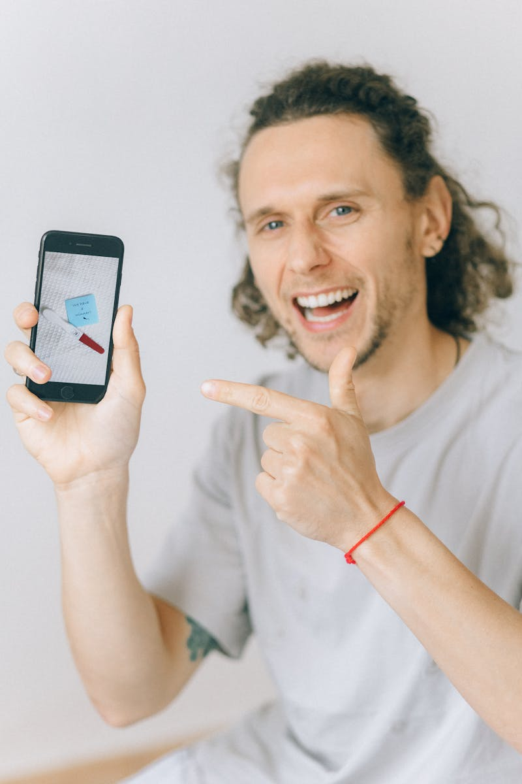
2
Types of Mobile Communication
Diverse Methods of Digital Interaction
Spoken or written words through mobile devices including voice calls, video calls, and text messaging applications. Body language and gestures shared through mobile platforms including emojis, stickers, and visual expressions in digital conversations. Images, videos, and symbols shared via mobile applications including social media, messaging apps, and visual content platforms. Letters, emails, and reports created and shared through mobile devices, enabling formal and informal digital documentation.

Slide 5

3
Mobile Communication Process
How Digital Messages Flow
Person who sends the message using mobile devices such as smartphones, tablets, or other portable communication tools. Information or idea being shared through mobile platforms including text, voice, video, or multimedia content. Medium used to send the message including mobile networks, internet connectivity, and various communication applications. Person who receives the message and provides response through mobile devices, completing the communication cycle.

Slide 6

4
Mobile Applications in Daily Life
Communication Tools for Modern Living
WhatsApp, Telegram, and similar apps for instant messaging, group chats, and multimedia sharing on mobile devices. Zoom, Google Meet, and other platforms for virtual meetings, online classes, and remote collaboration through mobile technology. Email and professional apps for team collaboration, customer relations, marketing, and leadership in mobile business environments. Google Classroom and learning platforms for sharing study materials, assignments, and facilitating teacher-student collaboration.

Slide 7

5
Advantages and Challenges
Balancing Benefits and Concerns
Faster information sharing, better connectivity, and global communication capabilities through mobile technology. Miscommunication risks, information overload, and privacy and security issues in mobile communication environments. Communication applications continue to transform how we connect, learn, and work in our increasingly mobile-first world. Thank you for your attention

