Slide 1
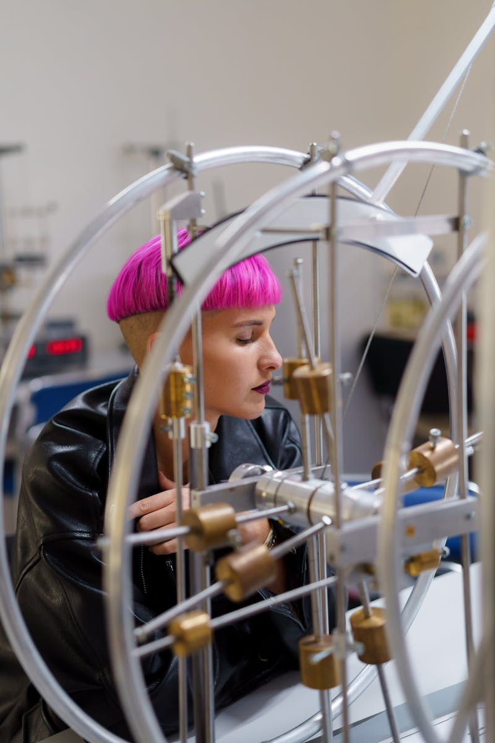
Bihar Board 2026 MCQ Physics
Mastering Multiple Choice Questions in Hindi Medium
Photo by Pexels

Slide 2
01
Welcome to MCQ Excellence
Table of Contents
02
MCQ Mastery Approach
03
Physics Concepts Focus
04
2026 Exam Preparation
05
Success Pathway

Slide 3

1
Welcome to MCQ Excellence
Your Journey to Bihar Board 2026 Success
Bhautik Vigyan MCQ preparation for Bihar Board 2026 exam in Hindi medium language.
Focus on multiple choice question patterns and techniques specific to Bihar Board examination system.
Comprehensive approach to mastering physics concepts through MCQ format for 2026 board examinations.
Leverage Hindi medium understanding to excel in physics MCQ questions with confidence.

Slide 4

2
MCQ Mastery Approach
Understanding the Bihar Board Pattern
Familiarize yourself with various MCQ formats commonly appearing in Bihar Board physics examinations.
Learn how to maximize scores through strategic approach to multiple choice questions in physics.
Develop efficient techniques to solve physics MCQ questions within exam time constraints.
Identify recurring question patterns and physics concepts frequently tested in Bihar Board exams.

Slide 5
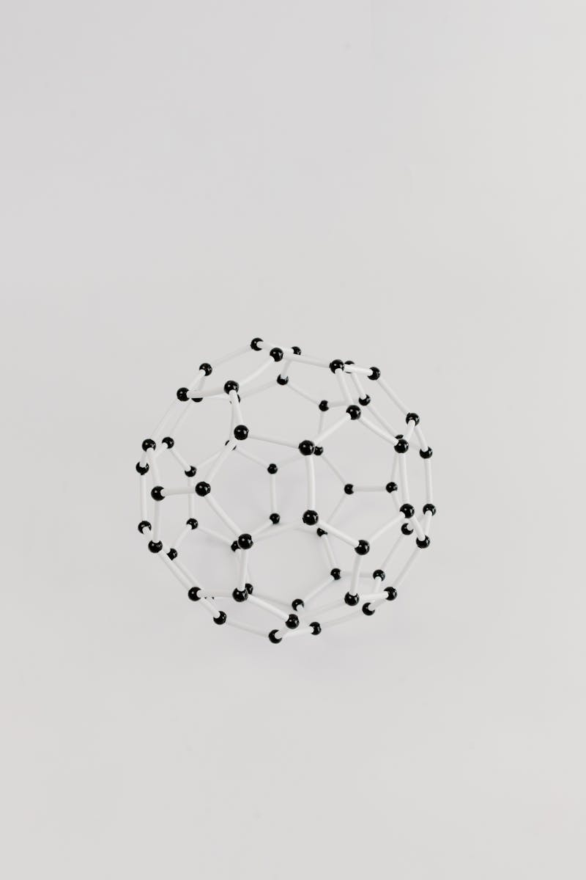
3
Physics Concepts Focus
Core Topics for MCQ Preparation
Master fundamental mechanics principles through targeted MCQ practice in Hindi language.
Understand heat and energy concepts with comprehensive MCQ coverage for board exam success.
Build strong foundation in electrical concepts through strategic multiple choice question solving.
Explore contemporary physics topics with MCQ approach designed for Bihar Board examination pattern.

Slide 6

4
2026 Exam Preparation
Strategic Planning for Success
Systematic approach to complete physics syllabus through MCQ methodology for 2026 board exams.
Regular MCQ practice sessions designed to enhance physics understanding and exam performance.
Simulate actual exam conditions with physics MCQ mock tests aligned with Bihar Board standards.
Effective revision techniques focusing on physics MCQ patterns for optimal board exam preparation.

Slide 7

5
Success Pathway
Achieving Excellence in Physics MCQ
Develop self-assurance in solving physics MCQ questions through systematic preparation approach.
Transform physics knowledge into excellent exam results through strategic MCQ techniques.
Strengthen Hindi language skills to effectively communicate physics concepts in MCQ format.
Achieve outstanding results in Bihar Board 2026 physics examination through dedicated MCQ preparation.

