Slide 1

Blockchain Personal Data Vault
Secure and User-Controlled Personal Data Management

Slide 2


Table of Contents
01
Overview of Blockchain PDV
02
Architecture - Core Components
03
Features - Part 1
04
Features - Part 2
05
Use Cases - Part 1
06
Use Cases - Part 2
07
Benefits of Blockchain PDV
08
Challenges of Blockchain PDV

Slide 3
Table of Contents
09
Examples of Blockchain PDV

Slide 4

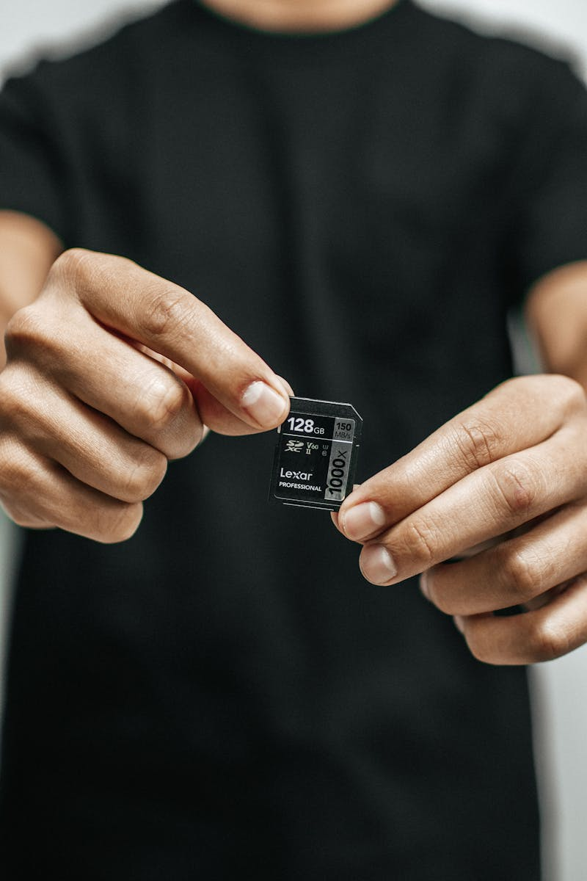
Overview of Blockchain PDV
01
A Personal Data Vault (PDV) is a secure personal datastore that gives individuals control over their own information.
02
In blockchain-based PDVs, personal records like identity data and health records are encrypted and stored in a distributed ledger under the user’s control.
03
Each user’s vault is associated with their cryptographic identity, such as a public key or decentralized identifier.
04
The PDV serves as a unified digital self, aggregating all personal data securely at the source.
Photo by PDF

Slide 5
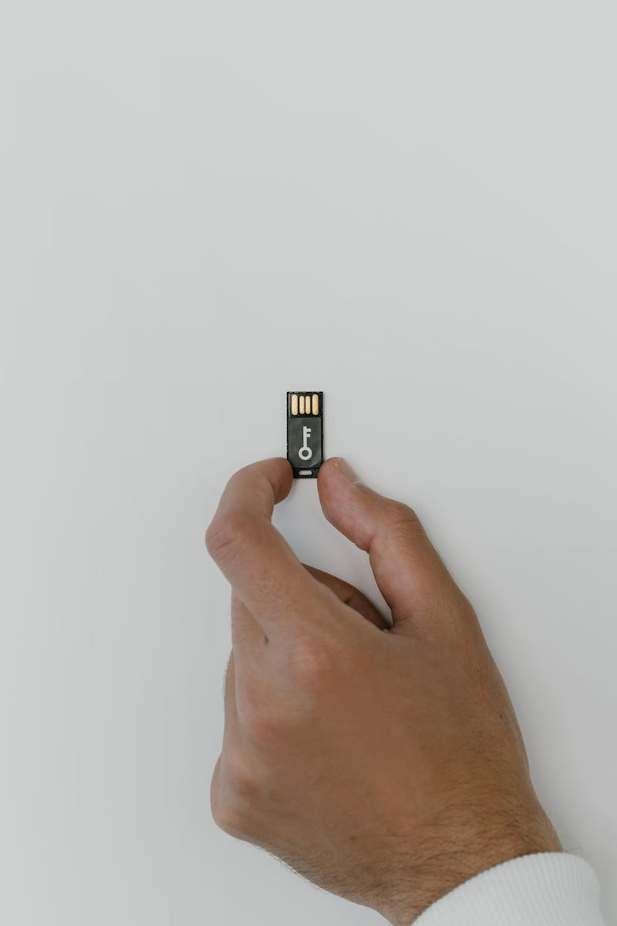
Architecture - Core Components
01
A permissioned or private blockchain that stores each user’s encrypted personal data, with access restricted to authorized parties.
02
A separate public or consortium chain that holds non-sensitive metadata or identifiers, linking to private vaults without exposing sensitive data.
03
Large personal files are stored off-chain, such as on IPFS, with only cryptographic references like hashes written on-chain to avoid blockchain bloat.
04
All personal data is encrypted with user-held keys, and access policies are enforced via smart contracts for fine-grained control.
Photo by PDF

Slide 6

Features - Part 1
01
Vault data is distributed across a blockchain network, making it tamper-resistant with no single point of failure.
02
Personal data is encrypted end-to-end, ensuring only the user and authorized parties can access it, maintaining privacy-by-design.
03
Users can share data on a need-to-know basis through smart contracts or verifiable credentials.
04
Every action involving the vault is recorded on-chain, creating an immutable audit log for transparency and accountability.
Photo by PDF

Slide 7
Features - Part 2
01
Large files are stored off-chain with hashes on-chain, combining blockchain security with scalable storage.
02
Mechanisms like revocation registries allow users to withdraw consent without altering the immutable blockchain.
03
Users manage their own cryptographic identities, ensuring they alone hold the keys to their encrypted data.
04
Smart contracts enable tagging and routing of data for precise control over access.
Photo by PDF

Slide 8

Use Cases - Part 1
01
Patients store medical histories and share them securely with doctors or researchers via their vaults.
02
Individuals hold official IDs and selectively disclose attributes for self-sovereign identity.
03
Consumers monetize their data by sharing profile parts with brands, ensuring consented and anonymous options.
04
Data from devices like smartwatches is stored in vaults and shared with apps or services as permitted.
Photo by PDF

Slide 9
Use Cases - Part 2
01
Vaults facilitate crowdsourced research or secure file transfers by allowing consented sharing of anonymized data.
02
Technologies like SolidPods enable on-demand sharing of data, such as career history with employers.
03
Examples like digi.me allow encrypted health data storage and sharing with consent.
04
Users control identity keys and disclose attributes selectively in systems like Web5.
Photo by PDF

Slide 10

Benefits of Blockchain PDV
01
Strong cryptography and immutability protect data from tampering or loss.
02
Individuals hold the keys, deciding who accesses their information and preserving privacy.
03
On-chain audit logs build trust by tracking all data accesses.
04
Decentralization ensures data remains available across nodes, with scalable off-chain storage.
Photo by PDF

Slide 11

Challenges of Blockchain PDV
01
Immutability conflicts with rights like the 'right to be forgotten,' requiring workarounds like revocation registries.
02
Pseudonymized data on public ledgers can be traced, necessitating careful design.
03
Limited blockchain throughput makes real-time access challenging, often relying on off-chain solutions.
04
Users must securely manage private keys, as loss leads to data inaccessibility.
Photo by PDF

Slide 12

Examples of Blockchain PDV
01
Encrypted pods for personal data, used in pilots for sharing career data and health metrics.
02
App for building and sharing profiles with brands, emphasizing anonymous and consented data disclosure.
03
Platform for storing and sharing medical records with explicit consent, meeting health regulations.
04
Hybrid system storing encrypted profiles on IPFS with hashes on Ethereum for secure identity logging.
Photo by PDF

