Slide 1

COMPUTER VISION How Machines Learn to See
Photo by Pexels

Slide 2
01
COMPUTER VISION
Table of Contents
02
Introduction to Computer Vision
03
History of Computer Vision
04
How Computer Vision Works
05
Key Technologies Used
06
Applications of Computer Vision
07
Computer Vision in Healthcare
08
Computer Vision in Security
09
Computer Vision in Self-Driving Cars
10
Advantages of Computer Vision
11
Challenges of Computer Vision
12
Future of Computer Vision

Slide 3
13
Conclusion
Table of Contents
14
Thank You

Slide 4

1
COMPUTER VISION
How Machines Learn to See
Presented By: Your Name Class / Subject: Date:
Photo by Pexels

Slide 5
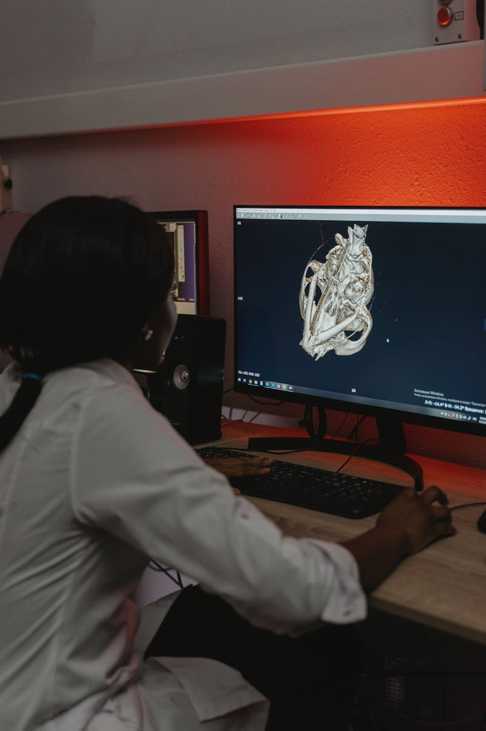
2
Introduction to Computer Vision
What is Computer Vision?
A branch of Artificial Intelligence (AI). Enables computers to see images and understand videos. Identifies objects and patterns. Makes decisions from visual data – like giving eyes and brain to a computer.
Photo by Pexels

Slide 6
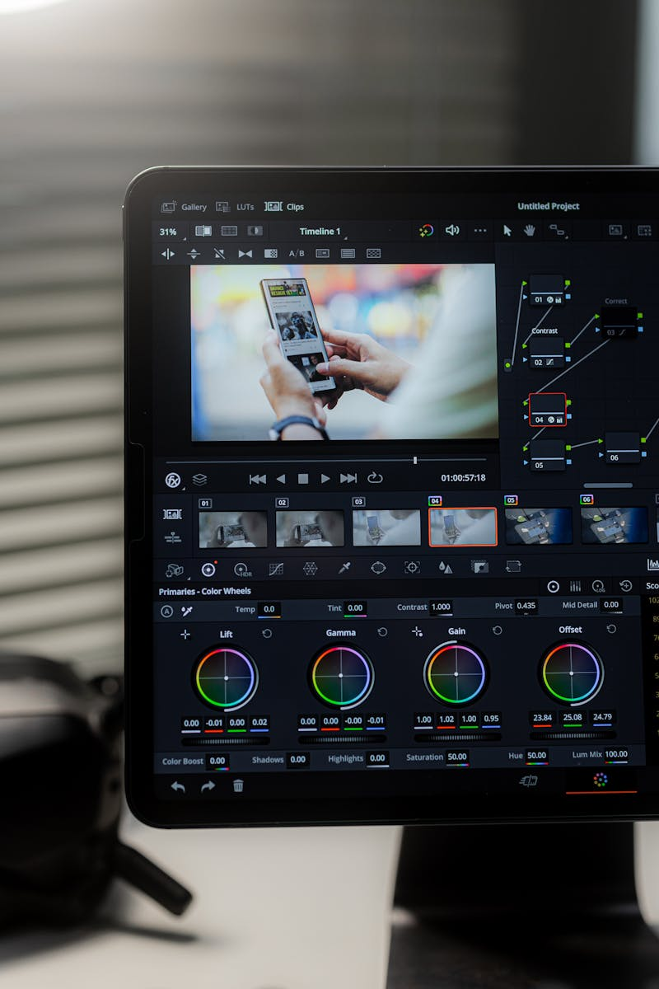
3
History of Computer Vision
Evolution Over Time
1960s – Basic image processing. 1980s – Pattern recognition improved. 2000s – Machine learning introduced. 2012 – Deep learning revolution. Today – Used everywhere.
Photo by Pexels

Slide 7

4
How Computer Vision Works
Step-by-Step Process
Image Capture (Camera/Sensors). Image Processing (Enhancement & Cleaning). Feature Extraction (Detecting Important Details). Pattern Recognition & Decision Making using AI algorithms.
Photo by Pexels

Slide 8

5
Key Technologies Used
Core Technologies
Machine Learning – Learns from data. Deep Learning – Uses Neural Networks. Convolutional Neural Networks (CNN) – Best for images. Image Processing – Enhancing and analyzing visuals.
Photo by Pexels

Slide 9

6
Applications of Computer Vision
Where Is It Used?
Self-Driving Cars. Face Recognition. Medical Diagnosis. Industrial Quality Check, Object Detection & Surveillance.
Photo by Pexels

Slide 10
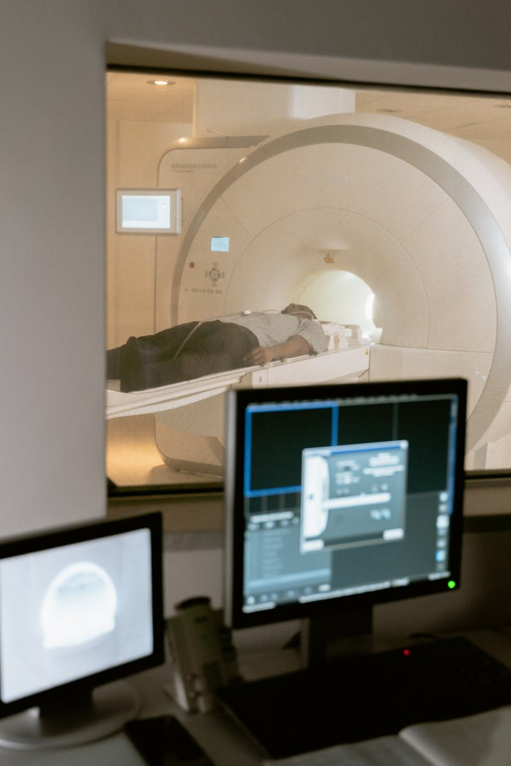
7
Computer Vision in Healthcare
Medical Applications
Cancer detection from X-rays. MRI and CT scan analysis. Tumor detection systems. AI-based disease diagnosis support.
Photo by Pexels

Slide 11

8
Computer Vision in Security
Security Systems
Face recognition technology. Biometric authentication. Smart surveillance cameras. Crime detection systems in airports and banks.
Photo by Pexels

Slide 12
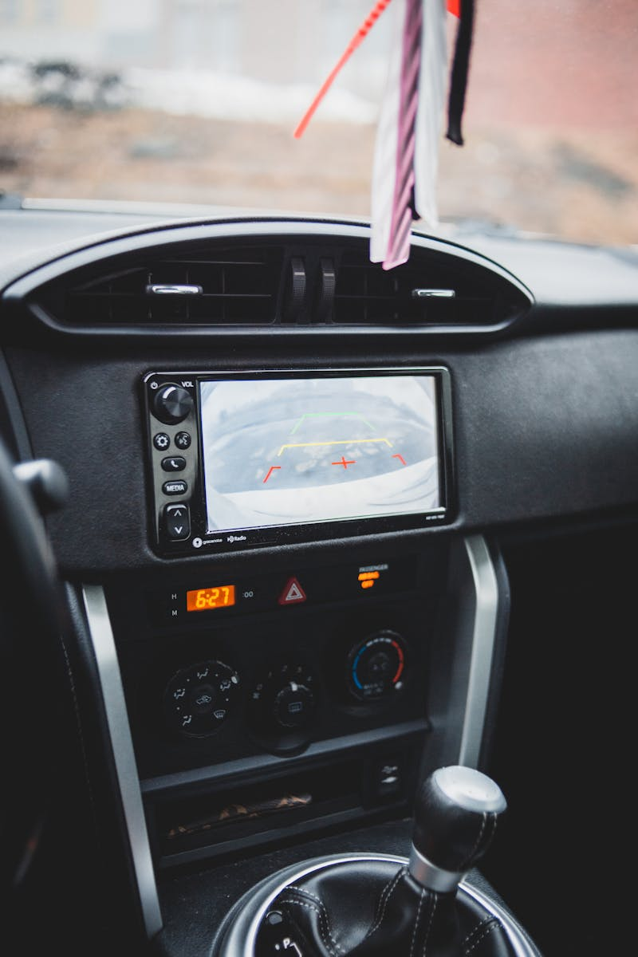
9
Computer Vision in Self-Driving Cars
Autonomous Vehicles
Detect pedestrians. Recognize traffic signs. Identify lanes. Avoid obstacles using real-time AI vision.
Photo by Pexels

Slide 13
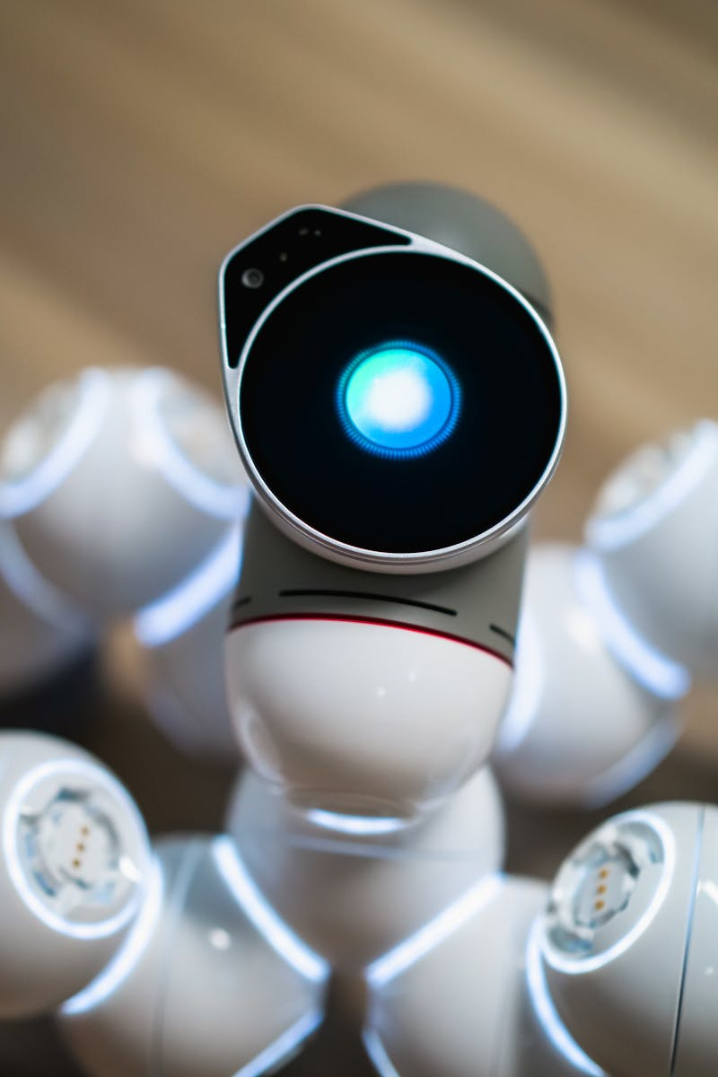
10
Advantages of Computer Vision
Benefits
High accuracy and precision. Fast data processing. Reduces human error. Operates 24/7 and boosts automation.
Photo by Pexels

Slide 14

11
Challenges of Computer Vision
Limitations
Privacy concerns. High development cost. Needs large training datasets. Struggles in poor lighting or complex scenes.
Photo by Pexels

Slide 15

12
Future of Computer Vision
What’s Next?
Smarter robots. Advanced healthcare AI. Fully autonomous vehicles. Smart cities & Augmented Reality integration.
Photo by Pexels

Slide 16
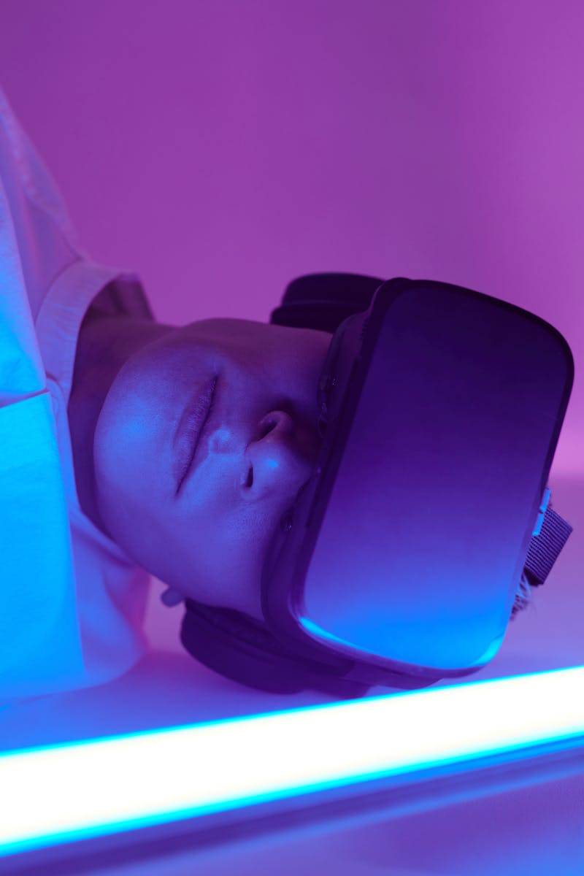
13
Conclusion
Final Thoughts
Machines can now see and understand the world. Computer Vision enables intelligent decisions. Used in healthcare, security, transport & industry. It is shaping the future of technology.
Photo by Pexels

Slide 17

14
Thank You
Questions?
Thank You! Any Questions?
Photo by Pexels

