Slide 1

Camelot - A Modern Legend
Reimagining the Luxury of the 12th Century
Photo by Pexels

Slide 2
01
Introduction to Eldeco Camelot
Table of Contents
02
Teaser Campaign
03
Camelot's Unique Offering
04
Concept 2 Introduction
05
Launch Campaign
06
Reality of Camelot
07
Living the Legend

Slide 3
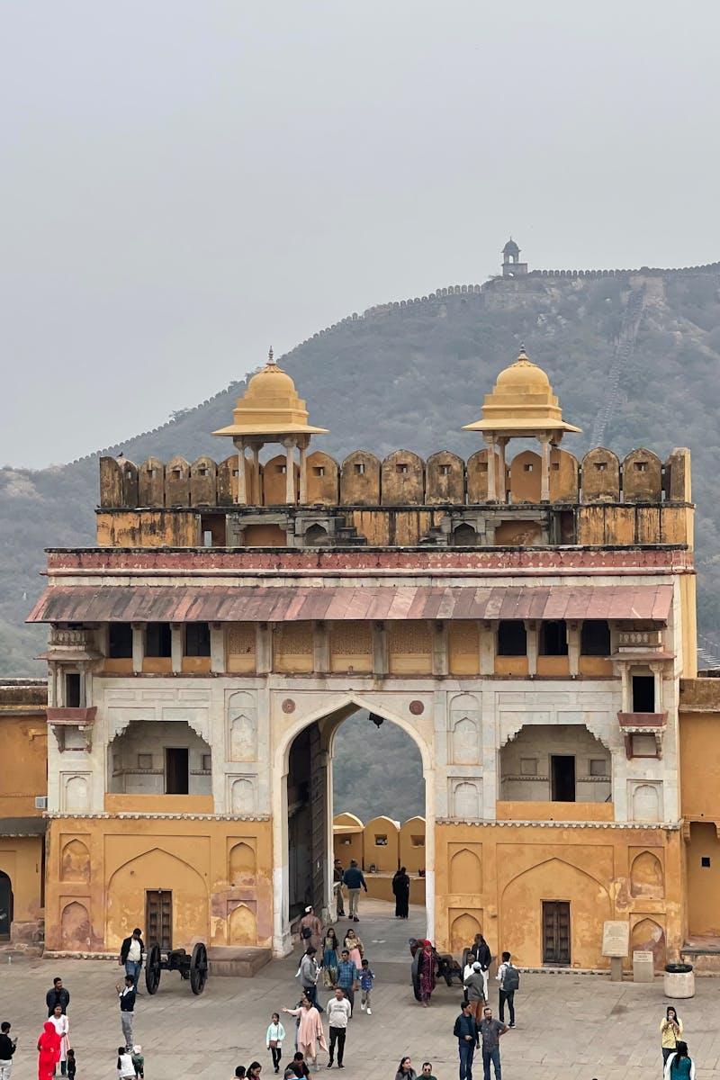
1
Introduction to Eldeco Camelot
An Overview of the Project
Eldeco Camelot
Concept 1
Camelot is the name of a castle associated with King Arthur - king of Britain, a folk hero and a central figure in the medieval literary tradition.
How can we leverage the legend in today’s time?

Slide 4

2
Teaser Campaign
Building Anticipation
Even King Arthur would approve of it. Coming soon.
Legends of royalty, growing over time. Coming soon.
The luxury of the 12th century, reimagined for today.
Introducing Camelot—where luxury meets legacy in Dwarka Sector 12A, Delhi.

Slide 5
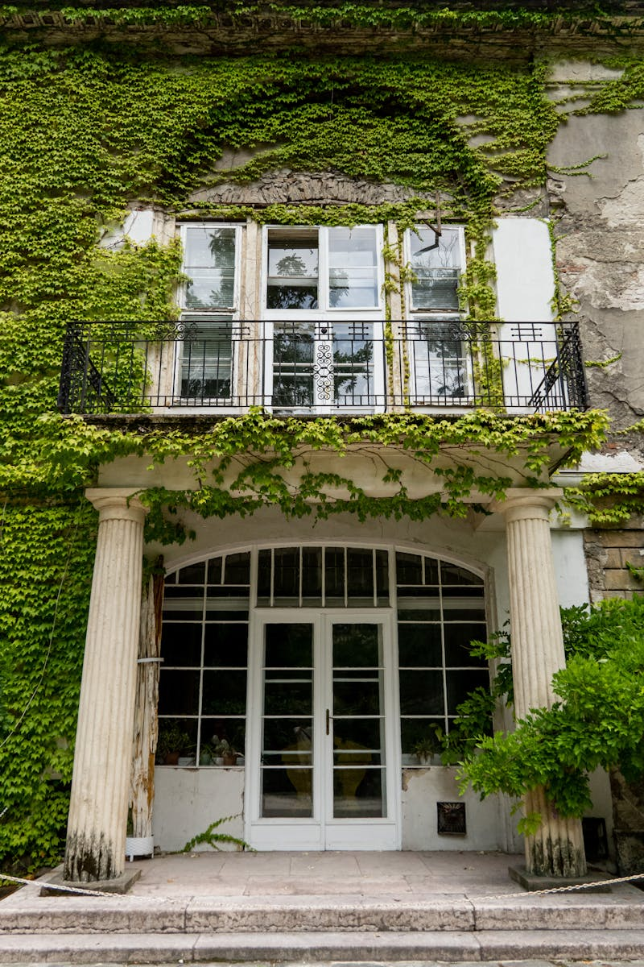
3
Camelot's Unique Offering
Luxury Meets Legacy
Dwarka Sector 12A, Delhi.
This iconic residence blends timeless grandeur of that era with modern elegance.
Even King Arthur would approve of it.
Welcome to Camelot.

Slide 6
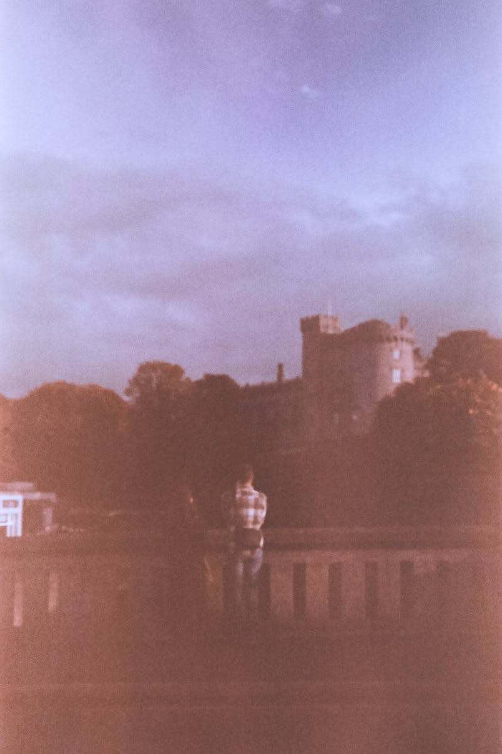
4
Concept 2 Introduction
Exploring New Ideas
Introduction to the second concept.
Staying with the legend of the Camelot, it is said that its exact location has always been unknown.
Can we use it to our advantage? Tease about the location being discovered.
Camelot – The legendary castle finds its modern address.

Slide 7

5
Launch Campaign
Announcing the New Home
The legendary castle finds its new home in Dwarka Sector 12.
The grandeur of the 12th-century castle arrives in Dwarka Sector 12.
Dwarka Sector 17, a thriving locality that perfectly blends convenience and prestige, is the ideal home for Camelot.
Inspired by the grandeur and timeless allure of King Arthur’s kingdom, Camelot redefines luxury living with modern elegance and regal charm.

Slide 8

6
Reality of Camelot
From Legend to Reality
It is said King Arthur and Camelot are all legends with little reality.
We counter that with a single campaign line.
Camelot It’s not a legend. It’s a reality. Coming soon.
Camelot—a residential masterpiece inspired by the grandeur of King Arthur’s legendary castle—is now a living reality in Delhi.

Slide 9

7
Living the Legend
Experience the Elegance
This iconic project brings together timeless elegance, modern luxury, and regal charm, offering a lifestyle fit for royalty.
With its unparalleled design and world-class amenities, Camelot redefines the art of fine living.
Welcome to the legend, reimagined.
Dwarka, Sector 12A.

