Slide 1

Carminatives & G.I Regulators
Pharmacognosy
Photo by Pexels

Slide 2
01
Introduction to Carminatives and G.I. Regulators
Table of Contents
02
Crude Drugs as Carminatives
03
Coriander - Overview
04
Coriander - Morphological & Chemical Details
05
Coriander - Uses
06
Fennel - Overview
07
Fennel - Morphological & Chemical Details

Slide 3

1
Introduction to Carminatives and G.I. Regulators
Substances that relieve flatulence (gas) in the gastrointestinal tract by preventing its formation or helping its expulsion.
They usually work by relaxing the intestinal smooth muscles and reducing spasms.
Agents that help regulate the functions of the gastrointestinal tract, such as motility, secretion, and absorption.
They can be used to treat constipation, diarrhea, indigestion, or irregular bowel movements.

Slide 4

2
Crude Drugs as Carminatives
1. Coriander
2. Fennel
3. Asafoetida, 4. Ginger
5. Black pepper, 6. Nutmeg, 7. Cinnamon, 8. Clove, 9. Cardamom

Slide 5
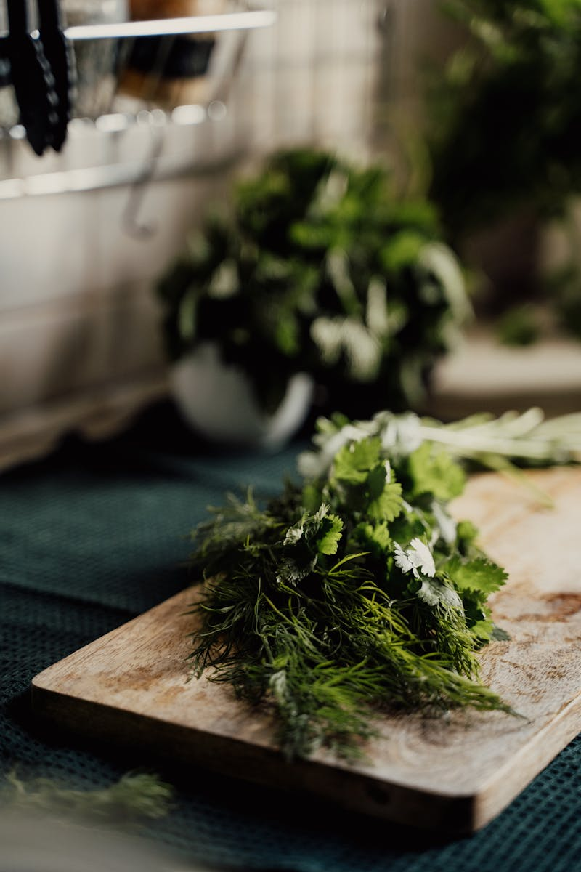
3
Coriander - Overview
Dhaniya fruits, Coriander fruits, Coriandrum.
Dried ripe fruits of Coriandrum Sativum Linn.
Umbelliferae.
Colour: Brownish yellow

Slide 6
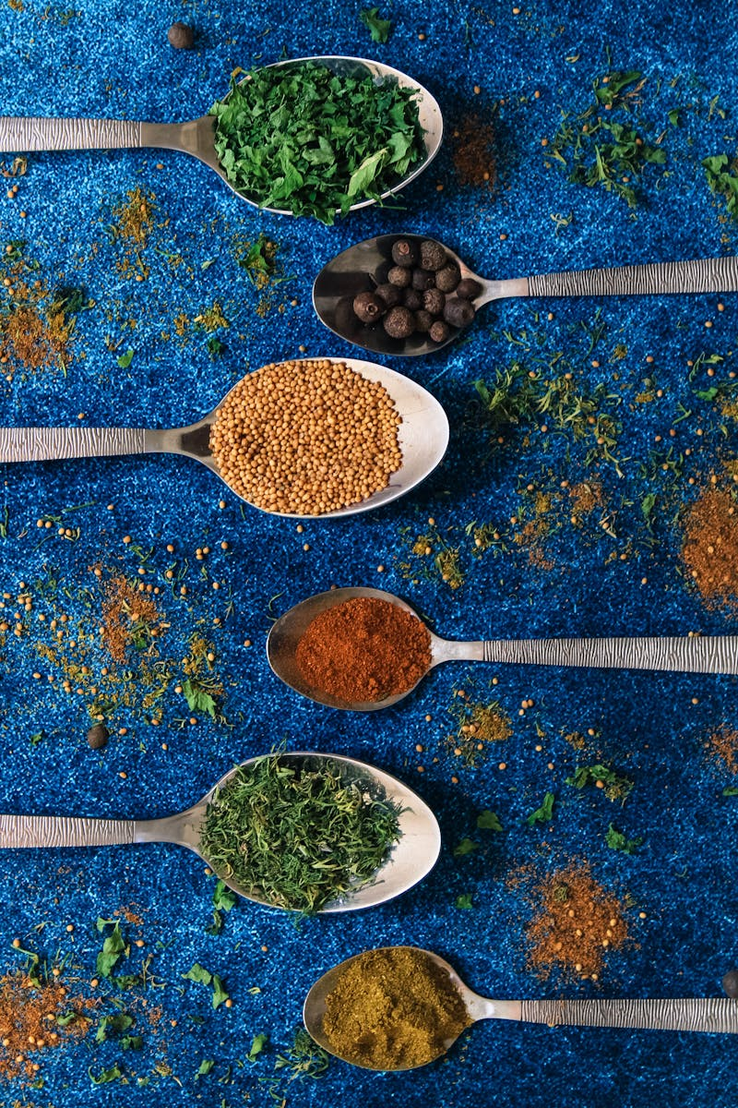
4
Coriander - Morphological & Chemical Details
Odour: Sweet, aromatic, Taste: Spicy
Size: 3 to 5 mm in diameter, Shape: Subspherical, fruit
Volatile oil (0.8 to 1 percent), fixed oil (13 percent) and proteins (20 percent).
Volatile oil contains nearly 90 per cent D-linalool (Coriandrol), coriandryl acetate etc. The other constituent is Vitamin A.

Slide 7
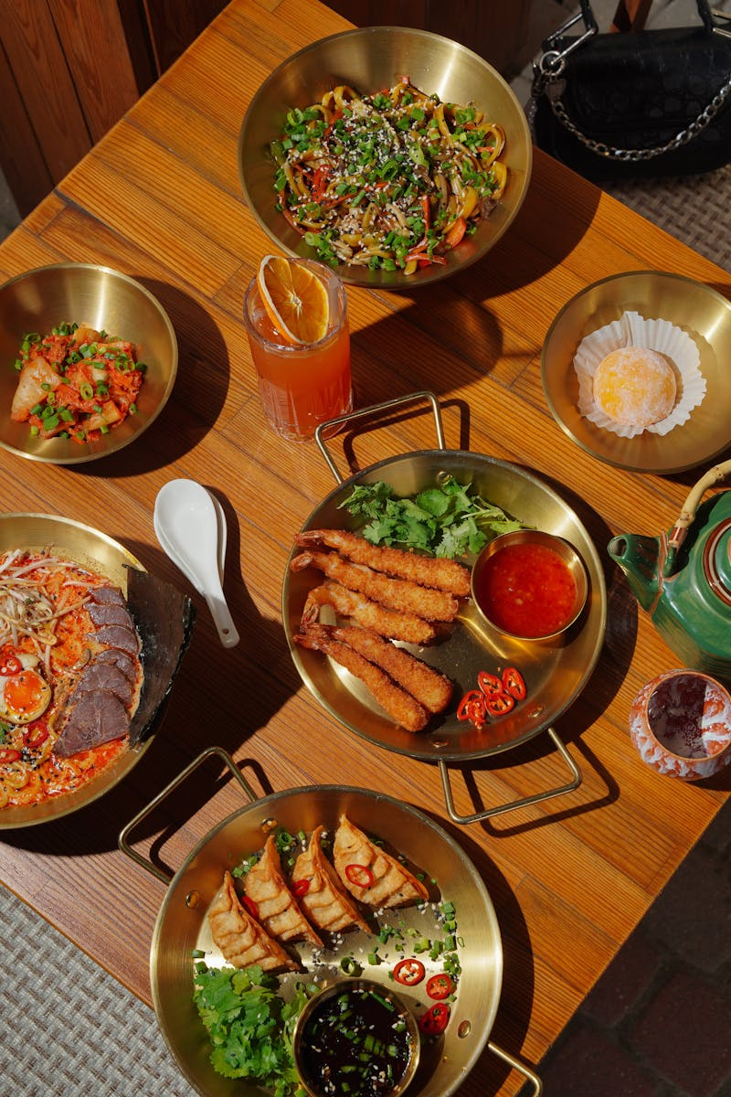
5
Coriander - Uses
The fruits and volatile oil.
It is used as carminative
It is used as flavouring agent.
The oil is used along with purgatives to prevent gripping.

Slide 8
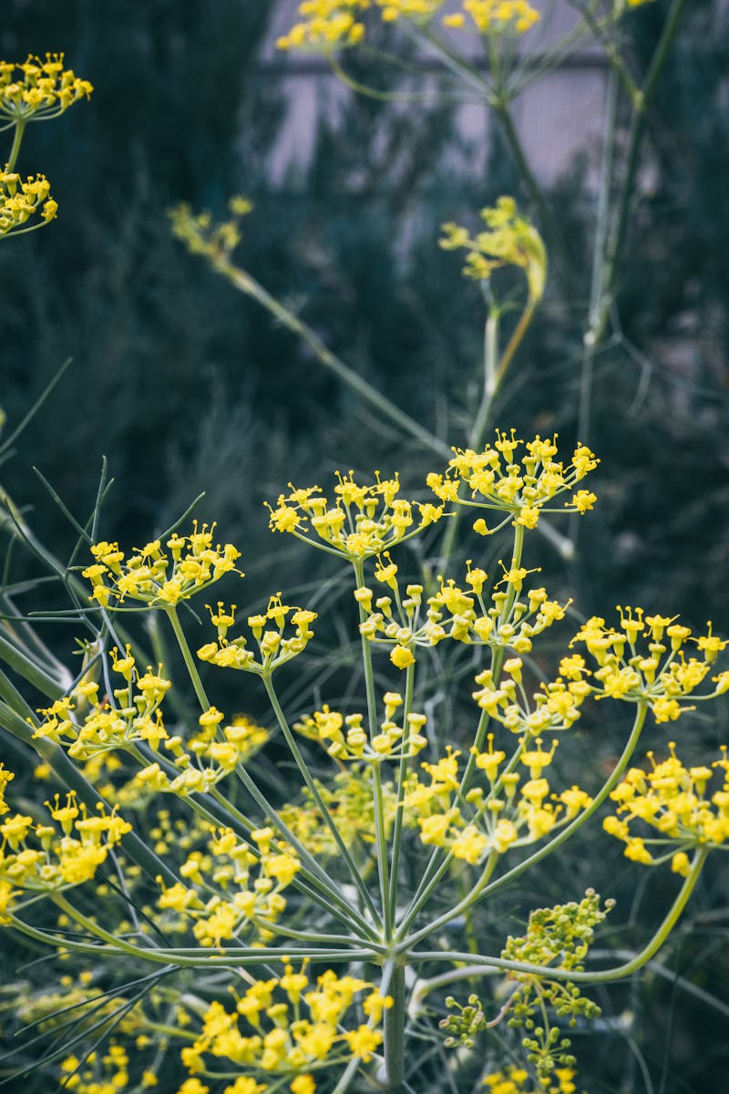
6
Fennel - Overview
Foeniculum species, Saunf, Fennel fruits.
It consist of dried ripe fruits obtained from cultivation of Foeniculum vulgare Miller.
Umbelliferae.
Colour: Green to yellow brown

Slide 9
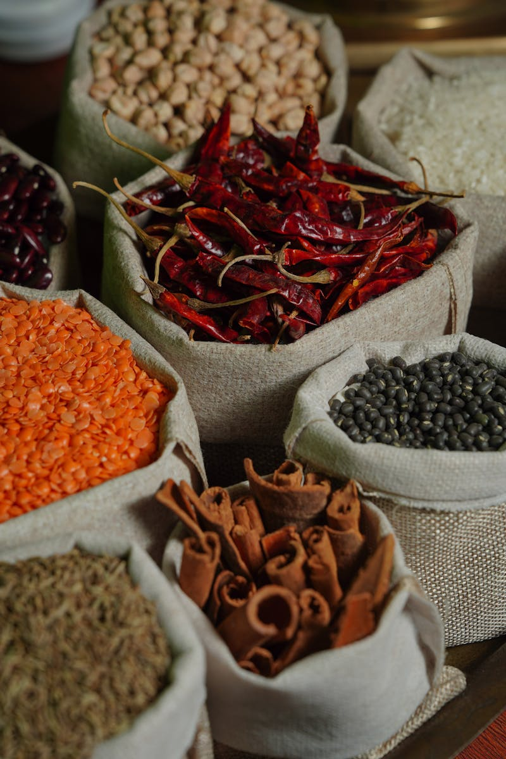
7
Fennel - Morphological & Chemical Details
Odour: Sweet, aromatic
Taste: Aromatic and slight sweetish
Size: Length 5 to 10 mm and width 2 to 4 mm, Shape: Straight or slightly curved
Fennel contains 2 -6.5% volatile oil and 12% fixed oil.

