Slide 1


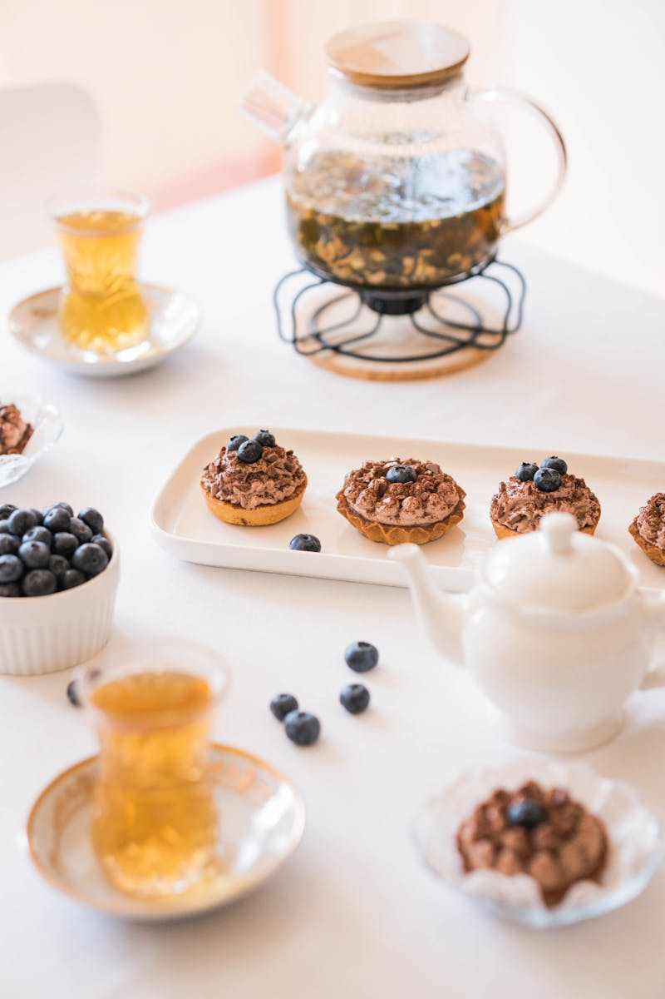
Chocolate Dreams: A Decadent Journey
Exploring the Irresistible World of Chocolate Desserts
Photo by AI
June 2025

Slide 2

Table of Contents
1
A Symphony of Sweetness
5
Irish Cream Indulgence
2
Cheesecake Nirvana
6
No-Bake Delight
3
Bundt Cake Bliss
7
Blackout Bliss
4
Fudge Cookie Fantasy
8
Beignet Bonanza

Slide 3
9
Banana Cake Bliss
13
Chocolate Filling
10
Thank You
14
Coconut-Pecan Topping
11
Pie Origins
15
Baking Process
12
Crust Creation
16
Flavor Profiles

Slide 4
17
Variations and Adaptations
18
Serving Suggestions
19
Troubleshooting Tips
20
Thank You

Slide 5
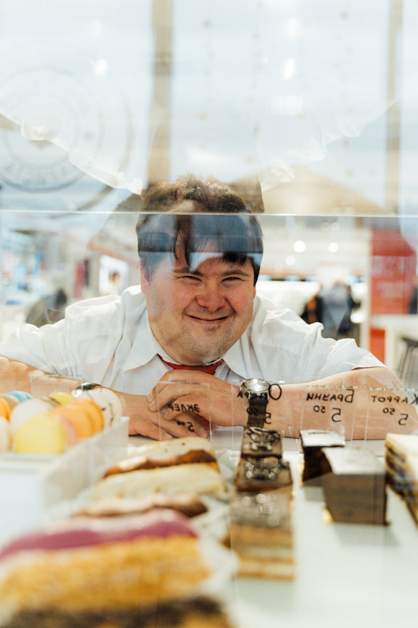
A Symphony of Sweetness
Welcome to a realm where chocolate dreams come true! This collection is designed to satiate every chocolate craving, offering a diverse range of delightful treats.
Discover familiar favorites and exciting new chocolate creations you never knew existed, promising a journey of delicious discovery and indulgence.
From elaborate cakes for grand celebrations to simple cookies for cozy nights, these recipes cater to every event, big or small, making every moment special.
This collection showcases the versatility of chocolate, providing inspiration for birthday parties, romantic desserts, and any occasion that calls for a sweet treat.
Photo by AI
01

Slide 6
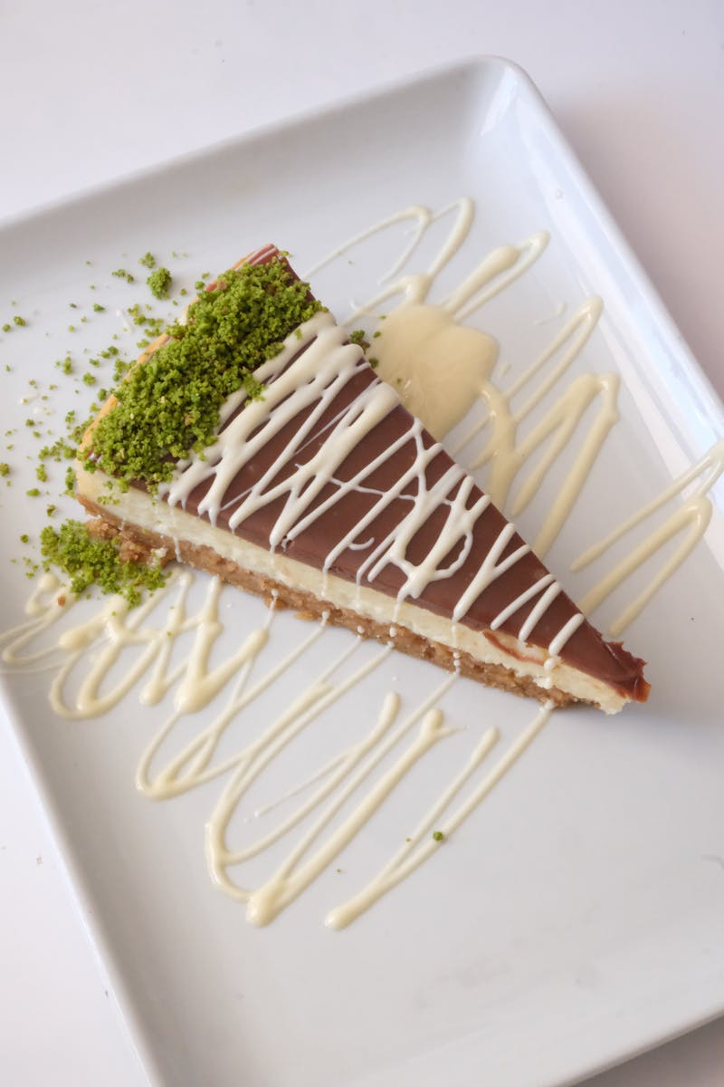
Cheesecake Nirvana
Find your chocolate cheesecake dreams with this ultimate recipe, featuring a creamy texture and intense chocolate flavor that will satisfy any sweet tooth.
The chocolate ganache and chocolate curls topping adds an exquisite touch, creating a visually stunning and delectable dessert that is both elegant and irresistible.
The ultimate chocolate cheesecake is easy to make and freezer friendly, that is ready whenever you need it. So don't need to worry about desserts when you have an unexpected guest.
The creamy and supremely flavorful chocolate cheesecake is the way to the chocolate lover's heart. It will surely to steal your chocolate loving heart.
Photo by AI
02

Slide 7
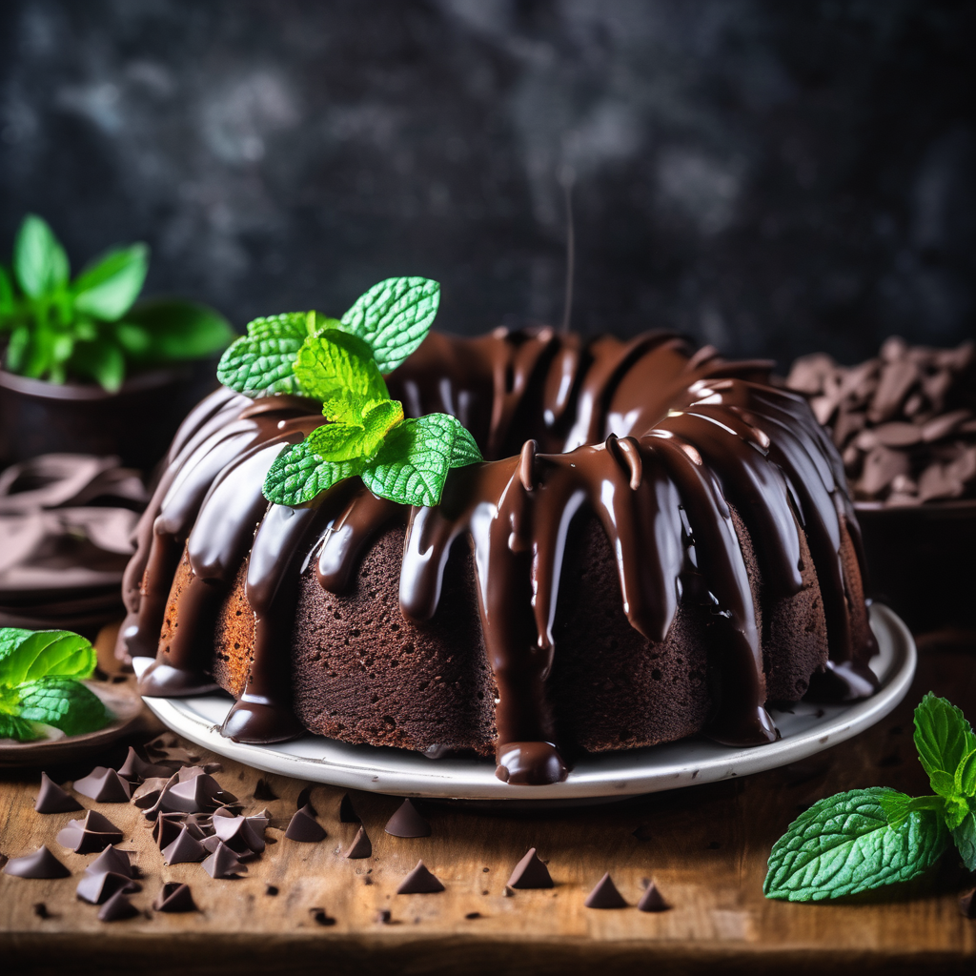
Bundt Cake Bliss
This bundt cake is loaded with chocolate chips, delivering a burst of rich chocolate flavor in every bite and making it a hit among kids and adults alike.
Topped with a luscious chocolate glaze, this bundt cake offers an extra layer of sweetness and indulgence, enhancing the overall chocolate experience.
Loved by both children and adults, the chocolate chip bundt cake is suitable for parties, potlucks, and can be enjoyed in any occasion.
Perfect for any day of the week, and it is a great way to bring joy and deliciousness to the table, making every moment a celebration.
Photo by AI
03

Slide 8
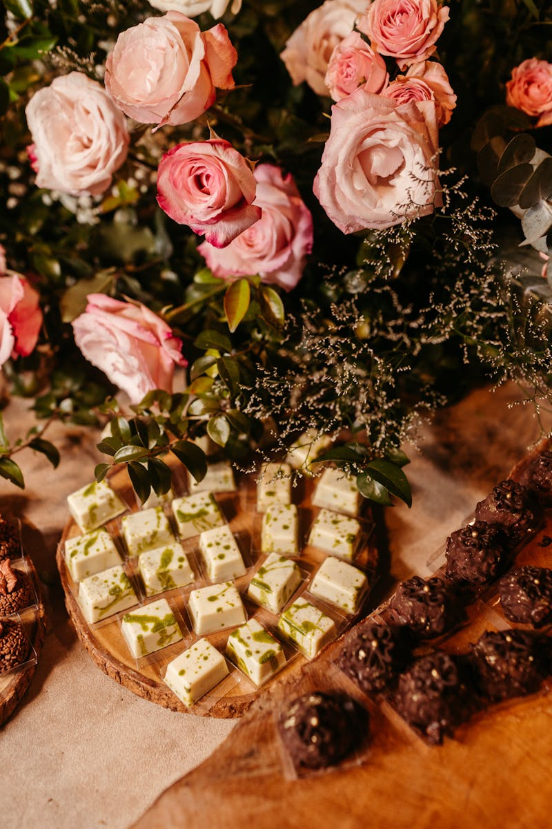
Fudge Cookie Fantasy
These cookies are an upgrade from classic chocolate chip, delivering a rich and intense chocolate flavor that will leave you craving more.
Enjoy these cookies in a vanilla ice cream to create amazing sandwiches, making them the perfect base for ice cream sandwiches, with a sweet combination.
Simply stuff with vanilla ice cream. Vanilla and chocolate is one of the most delicious food that is suitable for your ice cream sandwiches.
It has a very rich chocolate flavor. These Soft Batch Double Chocolate Fudge Cookies are the perfect gifts for your family, friends, and your love one.
Photo by AI
04

Slide 9
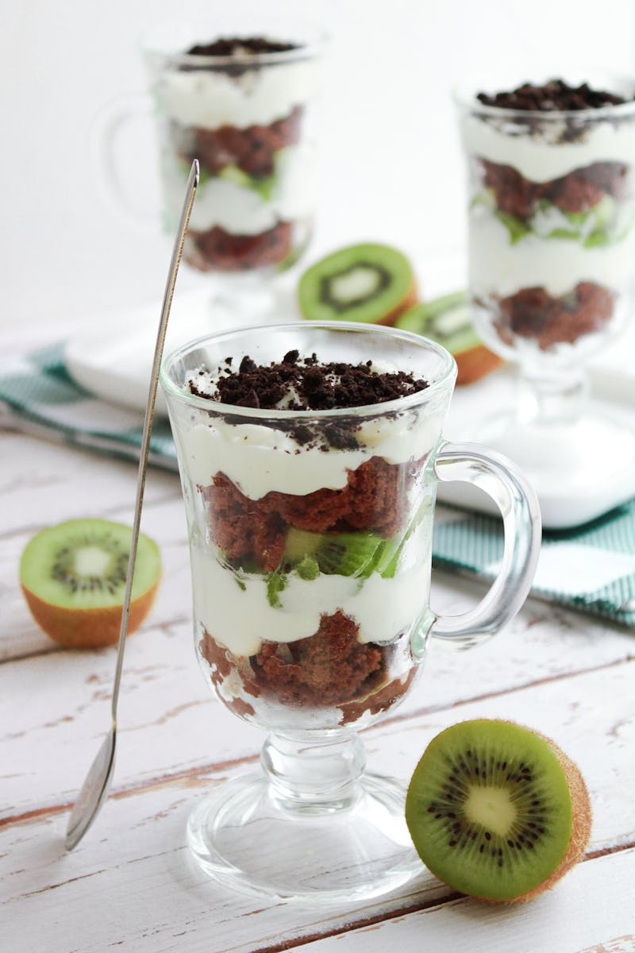
Irish Cream Indulgence
This sweet puddings are a delightful splash of baileys Irish cream elevates classic chocolate pudding, creating a harmonious blend of flavors that is both comforting and sophisticated.
Perfect for St. Patrick’s Day parties, these pudding cups add a touch of Irish flair to your dessert table, celebrating the holiday with a creamy and indulgent treat.
These pudding cups are perfect for St. Patrick’s Day. These chocolate puddings will add sweetness to your St. Patrick's Day parties.
The only thing that can improve classic chocolate pudding? A hearty splash of baileys Irish cream! These sweet little puds are perfect for St. Patrick’s Day parties!
Photo by AI
05

Slide 10
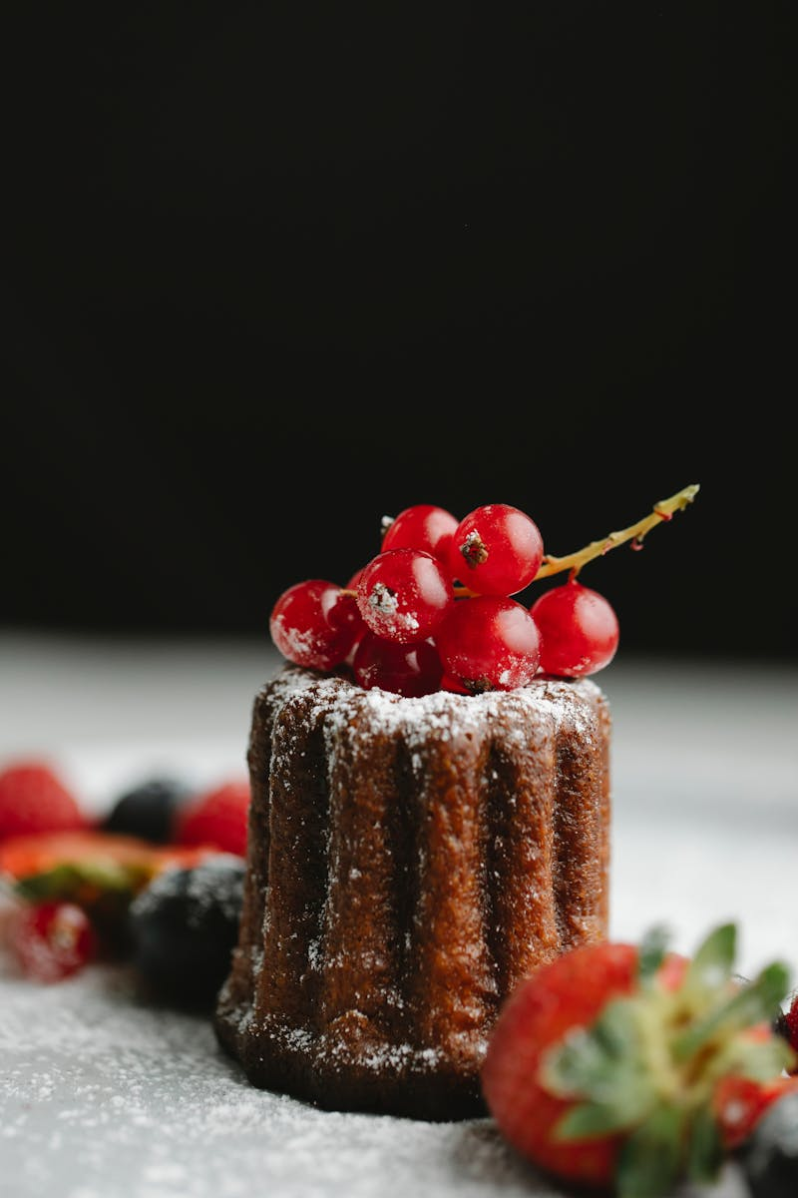
No-Bake Delight
Enjoy the simplicity of this no-bake dessert, perfect for quick and easy preparation, ensuring a delightful treat without the hassle of baking.
The pie is ultra rich and creamy, with a decadent flavor profile that promises a satisfying dessert experience, making it a go-to chocolate treat.
Be sure to become your go-to chocolate pudding pie because it is ultra rich and creamy. Surely you will love this super delicious dessert.
Three cheers for no-bake desserts! This one is ultra rich, creamy, and decadent. Sure to become your go-to chocolate pudding pie.
Photo by AI
06

Slide 11

Blackout Bliss
These cupcakes are ultra moist, delivering a delightful texture that melts in your mouth, making every bite a memorable experience and a guaranteed crowd-pleaser.
Stuffed with chocolate pudding and topped with chocolate frosting and cake crumbs, these cupcakes offer a triple dose of chocolate, perfect for satisfying intense cravings.
These require a little advance planning, but are sure to be a showstopper at your next event! Enjoy these yummy, mouth watering cupcakes.
No other chocolate cupcake can compare! These are ultra moist, stuffed with chocolate pudding, topped with chocolate frosting, and chocolate cake crumbs.
Photo by AI
07

Slide 12
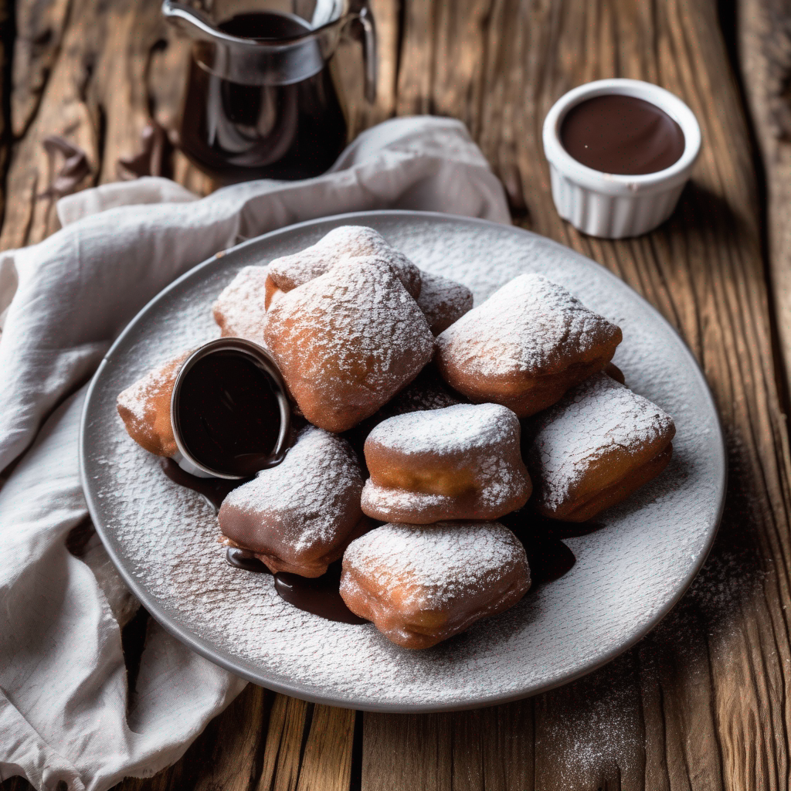
Beignet Bonanza
Experience an elevated version of classic beignets, featuring rich chocolate flavor that enhances the fluffy texture and adds a touch of decadence.
Perfect for Mardi Gras or an indulgent weekend brunch, these beignets bring joy to any celebration, making every moment a sweet and memorable occasion.
The only thing better than classic beignets? CHOCOLATE BEIGNETS! Perfect for Mardi Gras or an indulgent weekend brunch.
Perfect for Mardi Gras or an indulgent weekend brunch. The only thing better than classic beignets? CHOCOLATE BEIGNETS!
Photo by AI
08

Slide 13
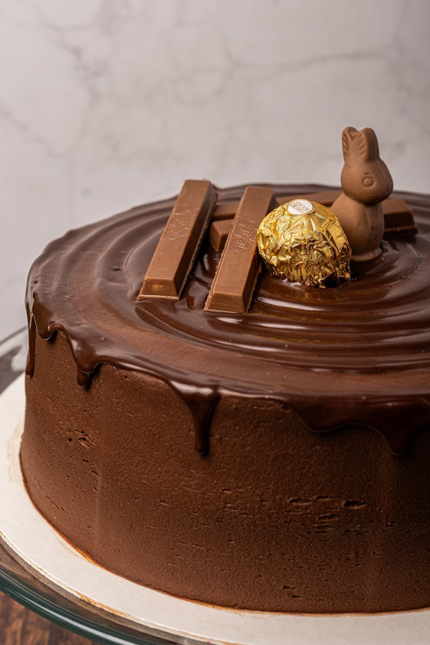
Banana Cake Bliss
Transform overly ripe bananas into something extraordinary with this double chocolate banana cake, offering a delicious alternative to traditional banana bread.
Topped with espresso fudge frosting, this cake delivers a rich and complex flavor profile, enhancing the sweetness of the banana and the intensity of the chocolate.
Next time you have overly ripe bananas sitting around, treat yourself to this recipe. This double chocolate banana cake will never disappoint you!
Baked in a load pan, this is a great snacking cake! A great recipe for the when you have ripe bananas and want to bake something other than banana bread!
Photo by AI
09

Slide 14

Thank You
Thank you for joining me on this chocolatey adventure! I hope these recipes bring joy and delicious moments to your kitchen.
May your days be filled with sweet success and delectable delights. Happy baking!
Hopefully these recipes bring joy and delicious moments to your kitchen. Happy baking!
It has been a pleasure sharing these recipes with you. We hope you have a great chocolate journey.
Photo by AI
10

Slide 15
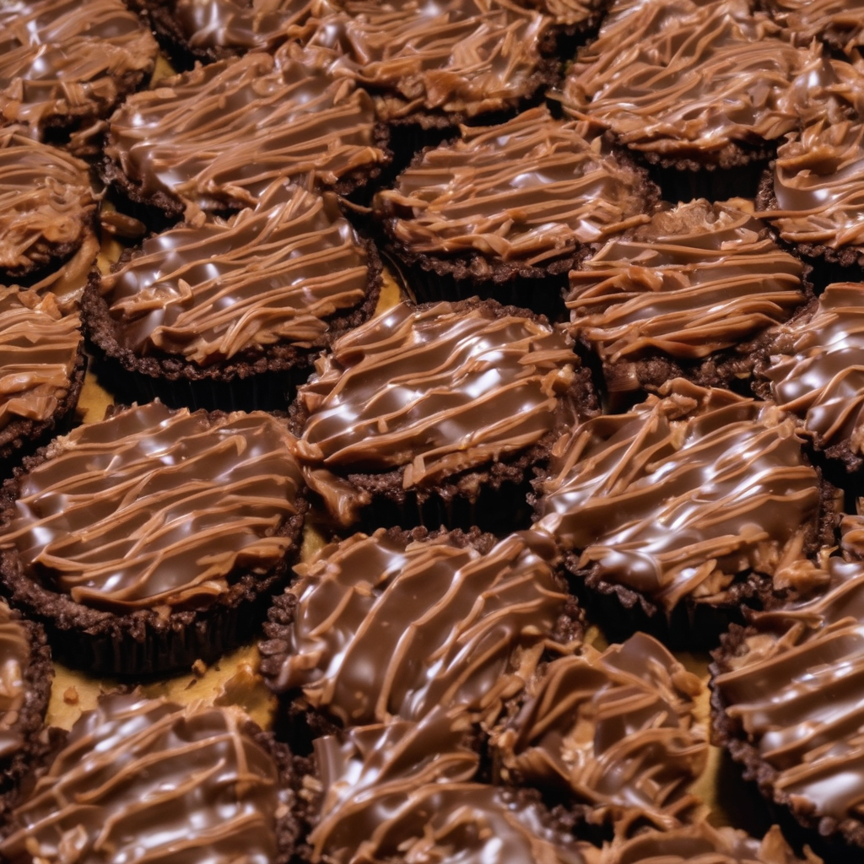
Pie Origins
Pie's invention is a gradual process spanning centuries. It began with early forms like galettes and evolved into the pies we recognize today.
Chocolate's addition to pies is a relatively recent phenomenon. It reflects the increased availability and popularity of chocolate as a dessert ingredient.
The term 'German' in German Chocolate Pie doesn't refer to Germany. It honors Sam German, who developed a baking chocolate used in the original recipe.
The recipe's popularity grew after it was published in a newspaper. Its unique combination of chocolate and coconut-pecan frosting captured the public's imagination.
Photo by AI
11

Slide 16
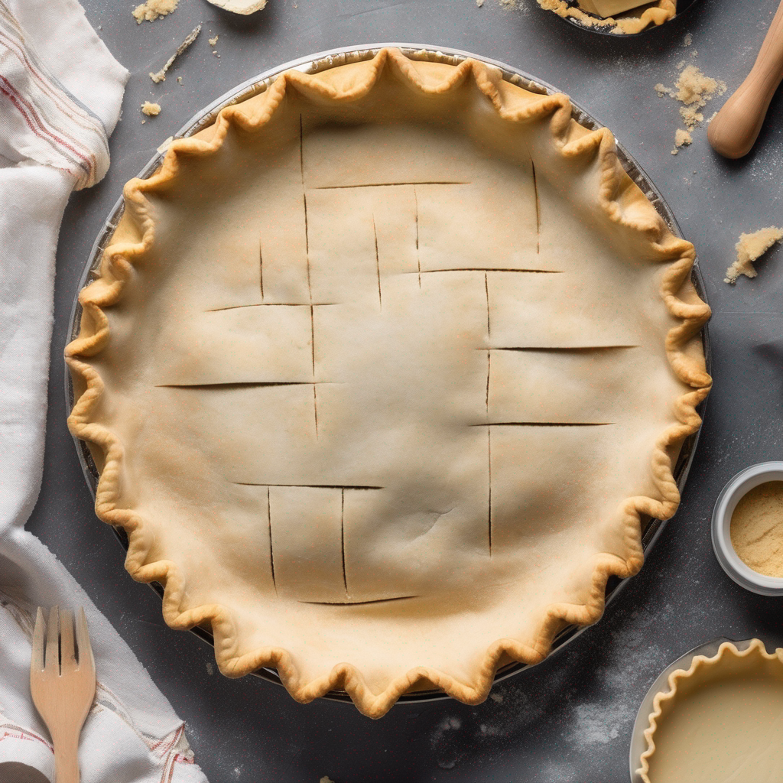
Crust Creation
Flour choice significantly impacts the crust's texture. All-purpose or pastry flour are common, each yielding slightly different results.
Fat creates tenderness and flakiness. Cold butter or shortening are often used, cut into the flour to form small, separate pieces.
Liquid (usually ice water) binds the dry ingredients. It's added gradually until the dough just comes together, preventing gluten development.
Chilling the dough relaxes the gluten, preventing shrinkage. Rolling it out to the desired thickness requires a gentle touch to avoid toughness.
Photo by AI
12

Slide 17
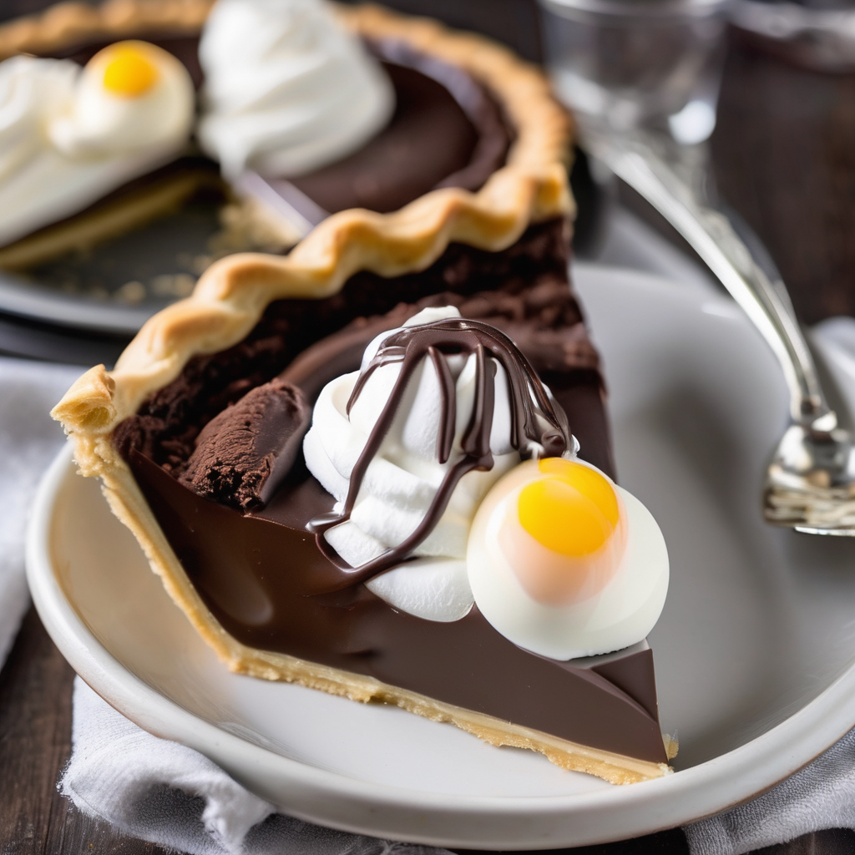
Chocolate Filling
German's chocolate provides a distinct flavor. Using high-quality chocolate contributes to a rich, complex taste in the filling.
Balancing sweetness is crucial. Sugar complements the chocolate's bitterness, creating a harmonious flavor profile without being cloying.
Eggs and cream contribute to the filling's creamy texture. They provide richness and body, ensuring a smooth and decadent result.
Vanilla extract enhances the chocolate flavor. A touch of salt balances the sweetness and accentuates the other ingredients.
Photo by AI
13

Slide 18
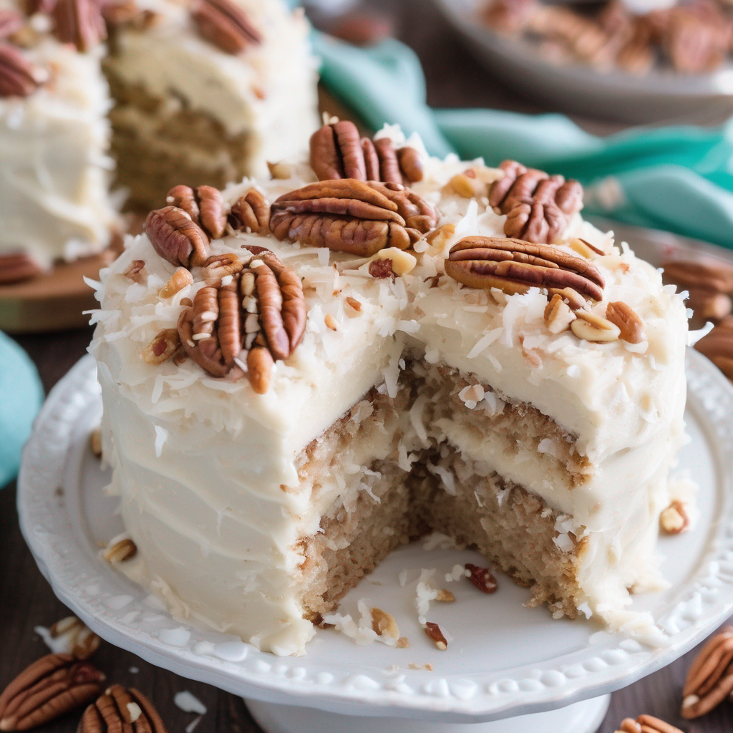
Coconut-Pecan Topping
Shredded coconut adds texture and flavor. Sweetened or unsweetened coconut can be used, adjusting the sugar accordingly to avoid excess sweetness.
Pecans provide a nutty crunch. Toasting them beforehand enhances their flavor and adds depth to the topping's overall profile.
A custard base binds the coconut and pecans. Eggs, butter, and sugar create a rich, creamy mixture that coats the nuts and coconut evenly.
Broiling the topping caramelizes the sugars. It creates a golden-brown crust with a toasty flavor, adding visual appeal and enhancing the taste.
Photo by AI
14

Slide 19
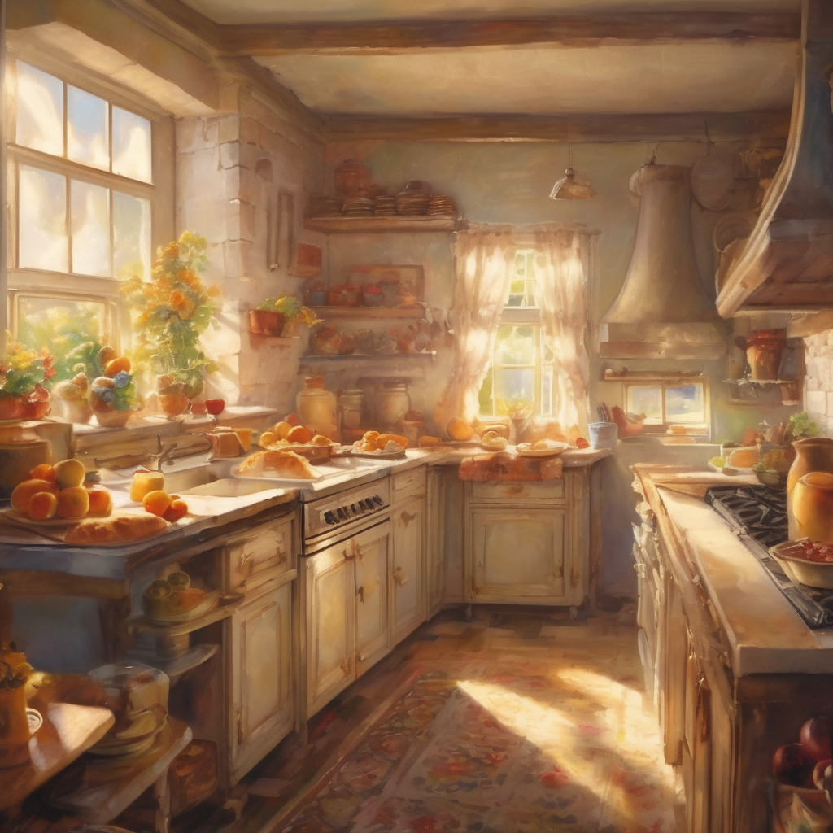
Baking Process
Temperature control is key for even baking. A moderate oven temperature ensures the crust browns without burning and the filling sets properly.
Preventing burning the crust involves shielding it with foil. This allows the filling to cook without over-browning the crust's edges.
Checking for doneness involves observing the filling's set. It should be firm around the edges but still slightly jiggly in the center.
Cooling the pie allows the filling to set completely. It prevents a runny texture and ensures a clean slice when served.
Photo by AI
15

Slide 20
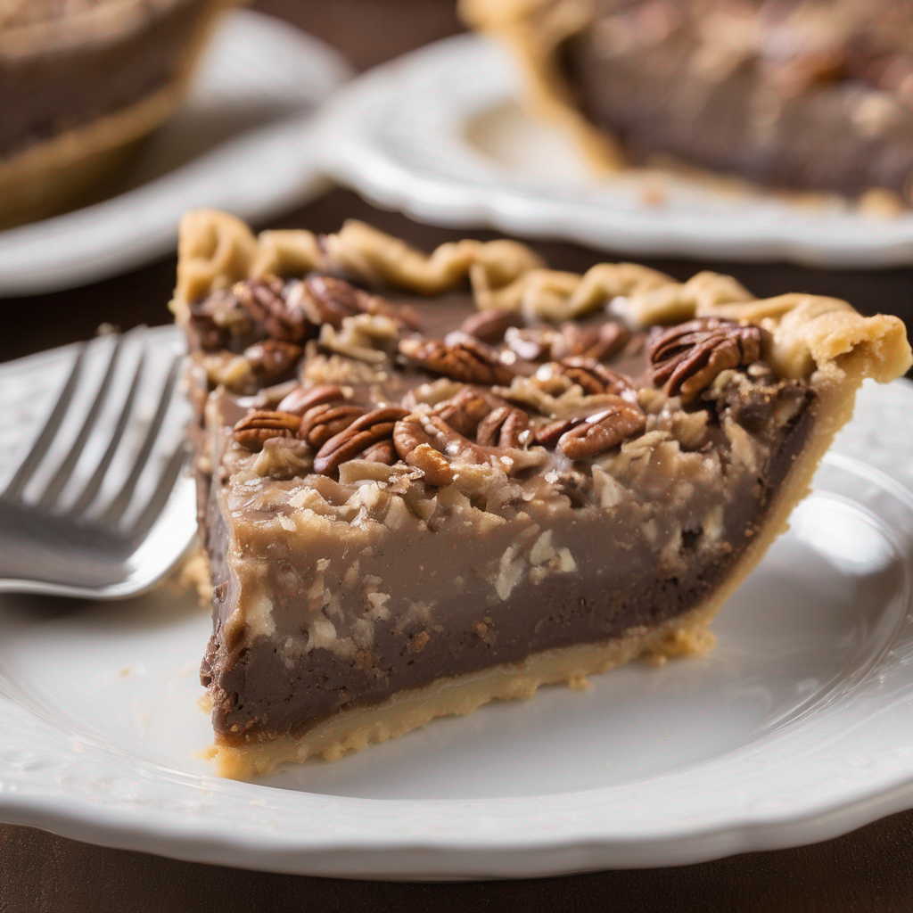
Flavor Profiles
Bittersweet chocolate provides depth and complexity. It balances the sweetness of the other ingredients, preventing a one-dimensional flavor.
Sweet coconut adds a tropical note. Its chewy texture complements the creamy filling and crunchy pecans, creating a pleasant mouthfeel.
Nutty pecans contribute a rich, earthy flavor. Their buttery texture enhances the overall richness of the pie, adding a satisfying crunch.
The custardy base provides a creamy foundation. It binds the ingredients together, creating a cohesive and harmonious flavor profile.
Photo by AI
16

Slide 21
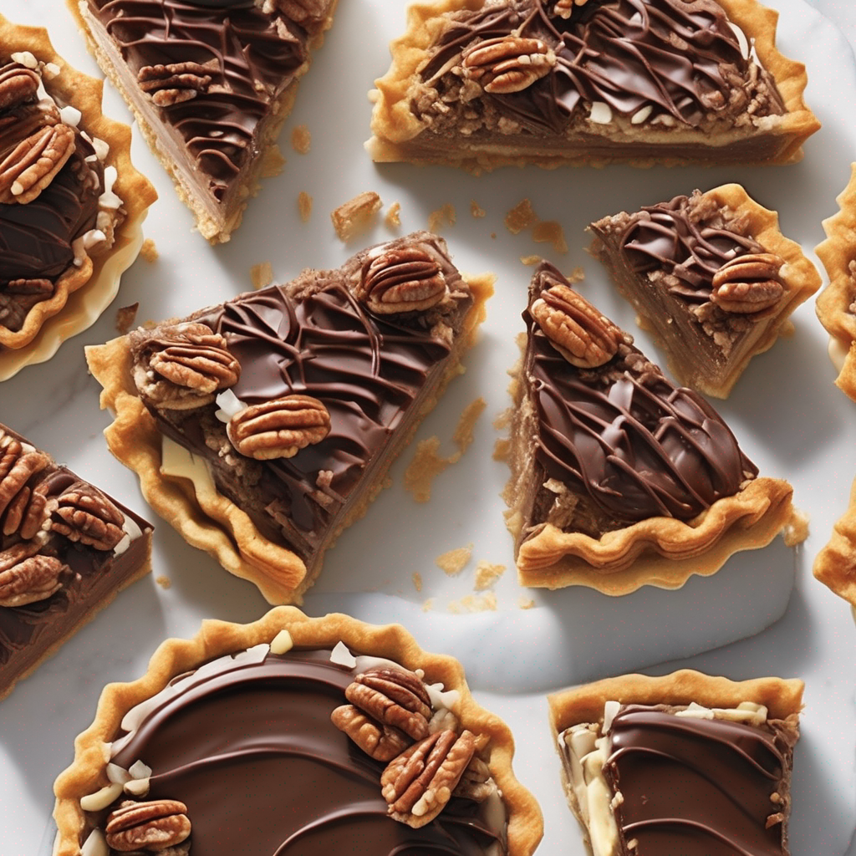
Variations and Adaptations
Crust alternatives include graham cracker crusts. These offer a different texture and flavor profile, providing a twist on the classic recipe.
Filling modifications involve adding coffee extract. It enhances the chocolate flavor and adds a subtle mocha note to the pie.
Topping innovations include adding caramel sauce. This elevates the sweetness and richness, creating a decadent and indulgent dessert.
Vegan options use plant-based substitutes. Coconut milk and vegan chocolate offer a dairy-free and animal-friendly alternative.
Photo by AI
17

Slide 22
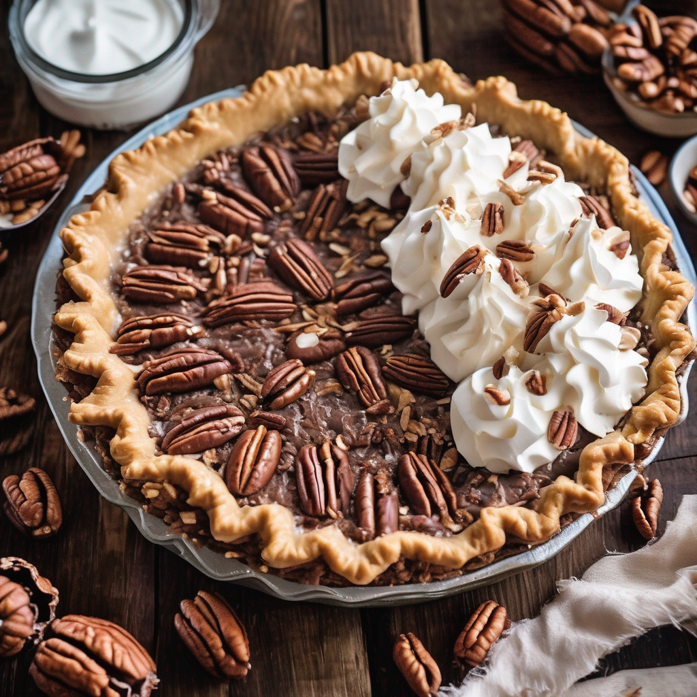
Serving Suggestions
Serving at room temperature enhances the flavors. It allows the filling to soften slightly, creating a smoother and more enjoyable texture.
Garnish options include whipped cream. It adds a light and airy element, complementing the richness of the pie and providing visual appeal.
Complementary pairings include vanilla ice cream. The cold ice cream contrasts with the warm pie, creating a delightful sensory experience.
Coffee or milk are perfect beverage accompaniments. Their flavors enhance the pie's taste, providing a balanced and satisfying pairing.
Photo by AI
18

Slide 23
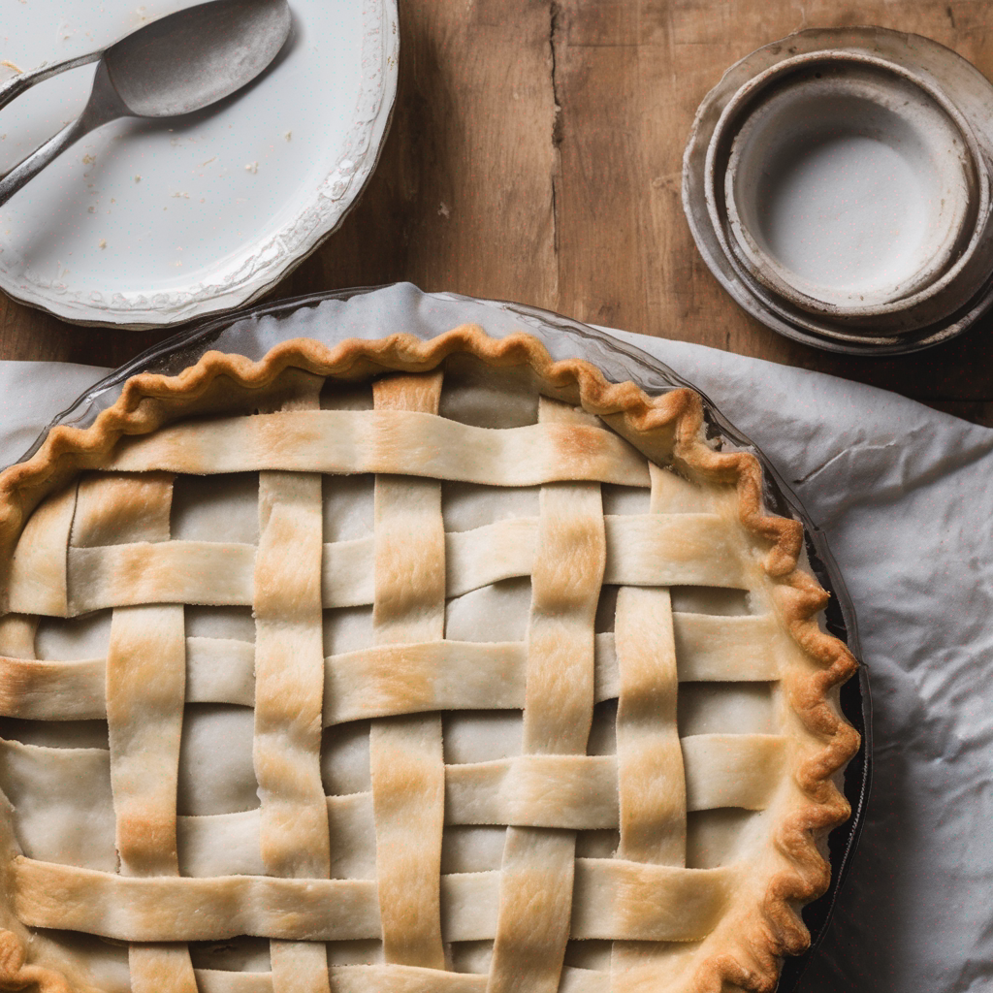
Troubleshooting Tips
A tough crust results from overworking the dough. Avoid over-mixing and handle the dough gently to prevent excessive gluten development.
A runny filling indicates underbaking. Ensure the pie is baked until the filling is set but still slightly jiggly in the center.
A burnt topping results from excessive heat. Shield the crust with foil to prevent over-browning and reduce the oven temperature if necessary.
Uneven baking requires rotating the pie during baking. It ensures the heat is distributed evenly, preventing one side from browning too quickly.
Photo by AI
19

Slide 24

Thank You
Thank you for your time and attention.
We hope this presentation has been informative.
Feel free to reach out with any questions.
We encourage you to explore further into the world of baking!
Photo by AI
20

