Slide 1
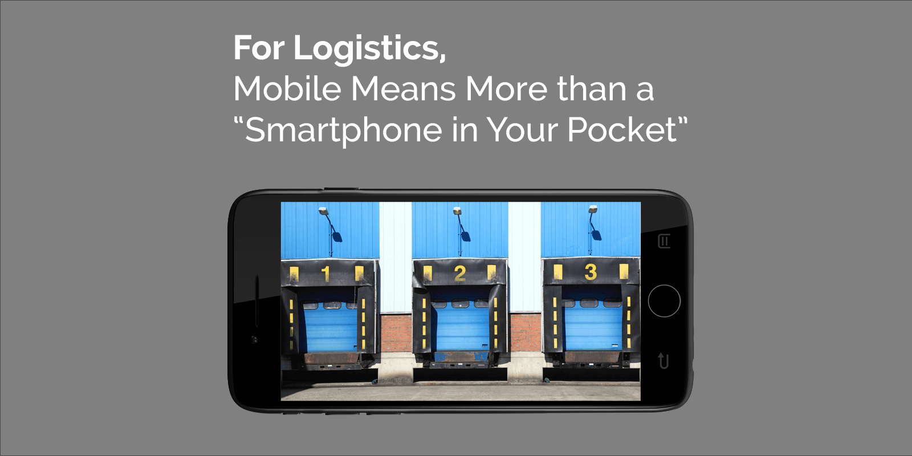
Churpur: Travel and Earn
Revolutionizing urban parcel delivery through an innovative Travel & Earn Free concept.
Photo by Google

Slide 2
01
The Digital Transformation
Table of Contents
02
Introducing Churpur Platform
03
Technical Architecture
04
Background of Study
05
The Core Concept
06
Current Market Problems
07
The Proposed Solution
08
Impact on Commuters
09
Sender Advantages
10
Thank You

Slide 3
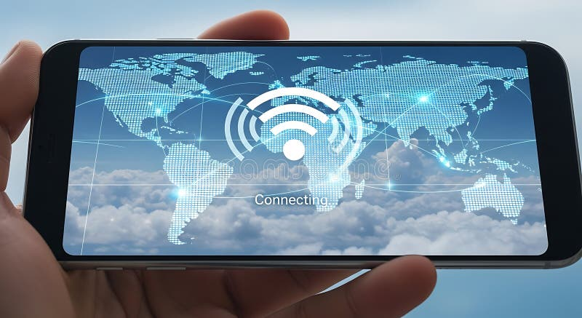
1
The Digital Transformation
How mobile applications change daily life
In the modern digital era, mobile applications and web-based systems have transformed the way people travel, communicate, and conduct daily activities across the globe.
Transportation and delivery services have particularly evolved due to the increasing use of smartphones, location-based services, and widespread internet connectivity in modern urban environments.
Despite this progress, many challenges still exist in daily commuting and parcel delivery systems, especially regarding cost, time, and accessibility in various regions.
In developing countries, the efficiency of transportation remains a major concern, requiring new innovative solutions to bridge the gap between technology and daily needs.
Photo by Google

Slide 4
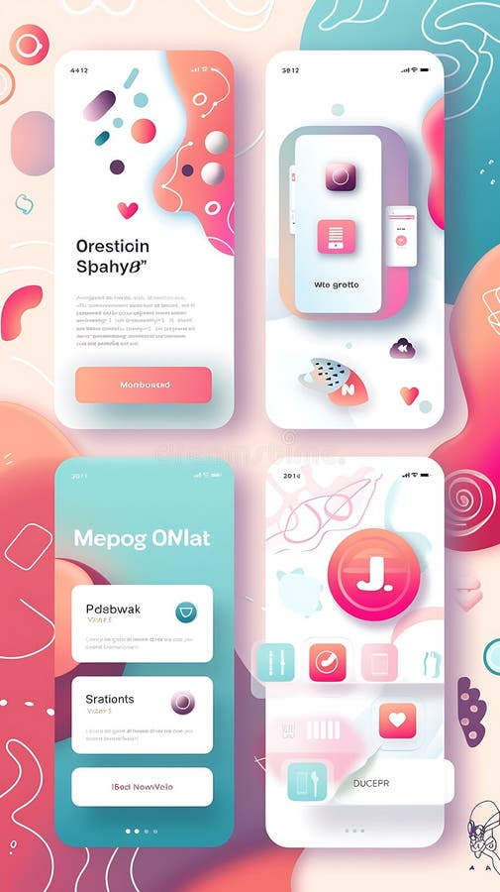
2
Introducing Churpur Platform
An innovative solution for modern commuting
Churpur is an innovative Android and web-based platform designed to address commuting challenges by introducing a unique Travel & Earn Free concept for users.
The system allows users to send parcels within the same day using travelers who are already commuting on similar routes toward their destinations.
Daily travelers can earn money by delivering parcels during their routine travel, thereby reducing or completely covering their personal travel expenses through the platform.
The Churpur system efficiently connects parcel senders and travelers, creating a streamlined process for local logistics and peer-to-peer delivery services.
Photo by Google

Slide 5

3
Technical Architecture
The technology powering the platform
The Churpur system is developed using an Android mobile application written in Java to ensure a smooth and reliable user experience for mobile users.
The platform features a backend web system based on PHP RESTful APIs to manage data flow and connectivity between different user types effectively.
Churpur leverages mobile technology and GPS tracking to create a reliable and cost-effective delivery ecosystem for all participants in the network.
The integration of mobile applications and backend web services provides a practical solution for providing on-demand services to a growing population.
Photo by Google

Slide 6

4
Background of Study
Understanding the need for change
Urbanization and population growth have significantly increased the demand for transportation and delivery services in modern cities where speed is a primary requirement.
People frequently need to send documents, packages, and goods within cities, often requiring same-day delivery to meet their personal or professional obligations.
Traditional courier services usually involve high charges and fixed delivery schedules, which may not be suitable for urgent or low-cost delivery requirements.
Millions of people travel daily for work, education, and personal activities, following fixed routes and schedules that remain largely underutilized for other purposes.
Photo by Google

Slide 7
5
The Core Concept
Combining travel and delivery needs
The idea behind Churpur originates from combining two essential needs—daily travel and parcel delivery—into a single, efficient, and user-friendly digital platform.
While millions travel daily, their travel potential remains underutilized; Churpur seeks to tap into this resource to facilitate faster parcel movement.
With the rapid growth of smartphone usage and Android-based devices, mobile applications have become a practical solution for providing these on-demand services.
By utilizing existing travelers, the system reduces the overhead costs typically associated with dedicated delivery fleets and traditional logistics infrastructure.
Photo by Google

Slide 8
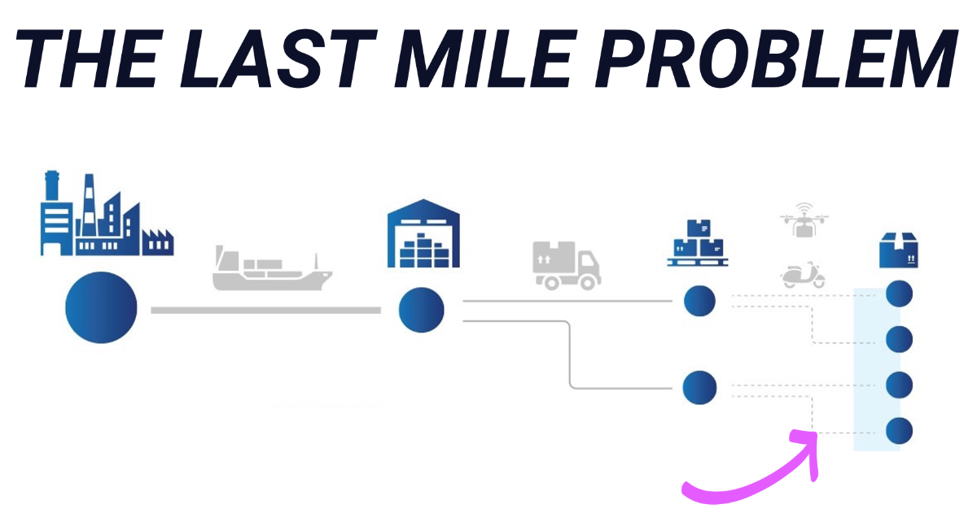
6
Current Market Problems
Identifying gaps in existing services
Despite the availability of ride-hailing and courier services, same-day parcel delivery services are often expensive for the average daily user.
Traditional courier services lack flexibility and speed, making them less effective for the dynamic needs of modern urban residents and businesses.
Cost, time, and accessibility remain major concerns in developing countries where the logistics infrastructure may not be fully optimized for everyone.
Rigid delivery schedules in existing systems often fail to accommodate the urgent nature of same-day package and document transport needs.
Photo by Google

Slide 9
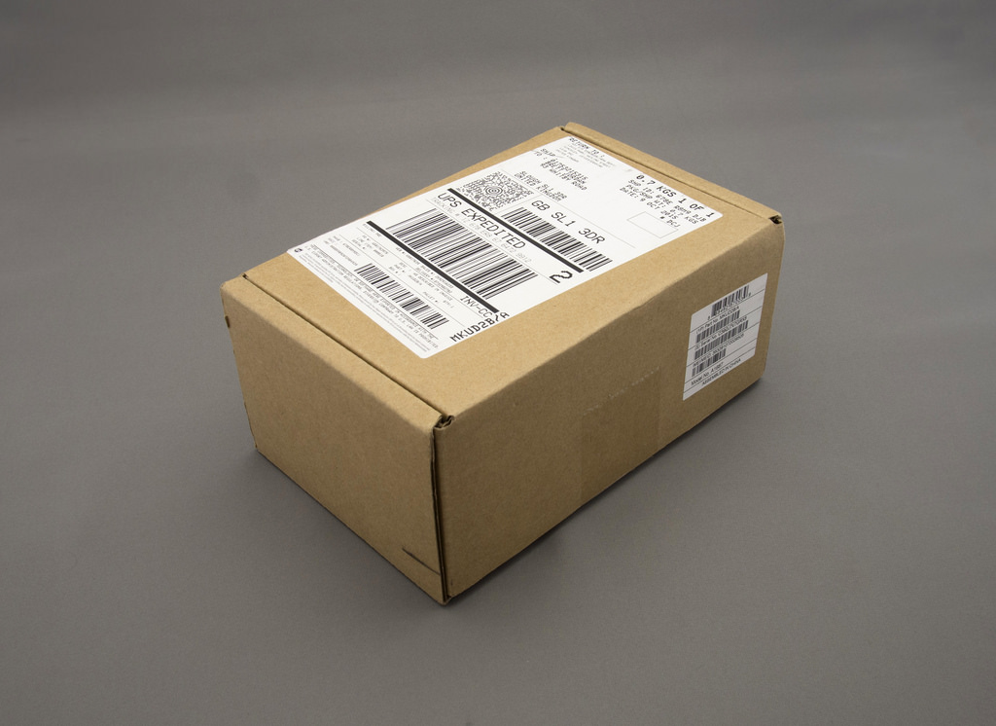
7
The Proposed Solution
A new delivery ecosystem
The proposed solution consists of an Android application for parcel sending, designed to be intuitive and accessible for all mobile device users.
The system ensures that parcels can be delivered within the same day by matching them with travelers already heading in that direction.
The platform provides a way for routine commuters to turn their daily travel into a source of income to cover their expenses.
By leveraging backend web services and mobile technology, the platform creates a reliable and cost-effective delivery ecosystem for urban environments.
Photo by Google

Slide 10

8
Impact on Commuters
Benefits for the daily traveler
Travelers can earn money during their routine travel, thereby reducing or completely covering their travel expenses while performing simple delivery tasks.
The delivery process is integrated into the traveler's existing routine, requiring no significant changes to their fixed routes or daily schedules.
The system unlocks the underutilized potential of daily commuters, turning every trip into a productive opportunity for the platform participants.
Churpur empowers travelers to become active participants in the logistics economy, providing them with financial benefits for their regular movement.
Photo by Google

Slide 11
9
Sender Advantages
Benefits for parcel senders
Senders gain access to same-day delivery options that are more suitable for urgent packages and documents compared to traditional services.
By using travelers already on the route, the system offers a lower-cost alternative to expensive professional courier and ride-hailing services.
The platform efficiently connects parcel senders with travelers on similar routes, ensuring that the delivery process is logical and fast.
People frequently needing to send documents and goods within cities can now rely on a peer-to-peer network for quick transit.
Photo by Google

Slide 12

10
Thank You
Conclusion of the Churpur presentation
Thank you for your time and attention. We appreciate your interest in the Churpur platform and its innovative Travel & Earn Free concept.
Thank you for exploring how our Java and PHP based system addresses modern commuting and parcel delivery challenges in developing countries.
We thank you for learning about our delivery ecosystem. Please feel free to reach out with any inquiries regarding the Churpur application.
Thank you for joining us today to discuss how mobile technology can transform urban logistics and empower daily travelers everywhere.
Photo by Google

