Slide 1
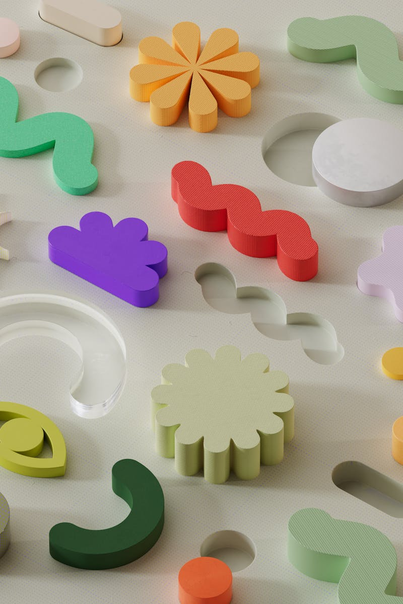
CineMind: Revolutionizing Your Movie Experience
A Smart Recommendation System Tailored Just For You
Photo by Pexels

Slide 2
01
Drowning in Choices?
Table of Contents
02
Meet CineMind
03
How CineMind Works
04
Why CineMind Stands Out
05
Your Personalized Dashboard
06
Real User Benefits
07
Privacy by Design
08
The Tech Inside
09
Future Developments
10
Thank You

Slide 3

1
Drowning in Choices?
The Modern Movie Dilemma
Viewers face thousands of films across streaming platforms, making selection time-consuming and frustrating.
Users spend 15+ minutes scrolling through options, often abandoning the search without watching anything.
Quality content gets buried in algorithms promoting popular titles, hiding personalized matches.
Standard platforms recommend based on broad categories, ignoring individual taste nuances.

Slide 4
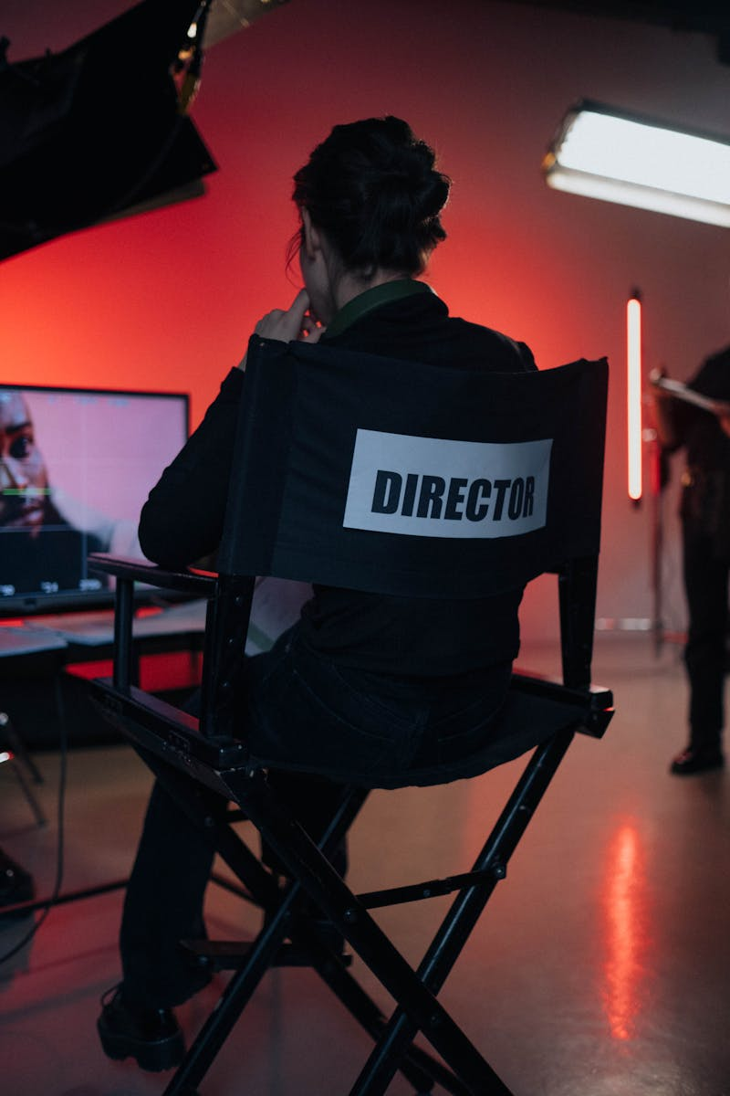
2
Meet CineMind
Your Personal Movie Concierge
CineMind uses advanced algorithms to analyze viewing patterns and preferences for tailored suggestions.
Considers mood, pacing, themes, and overlooked elements like cinematography or dialogue style.
Continuously refines predictions based on user feedback and new content additions.
Works seamlessly with major platforms to deliver ready-to-watch recommendations instantly.

Slide 5
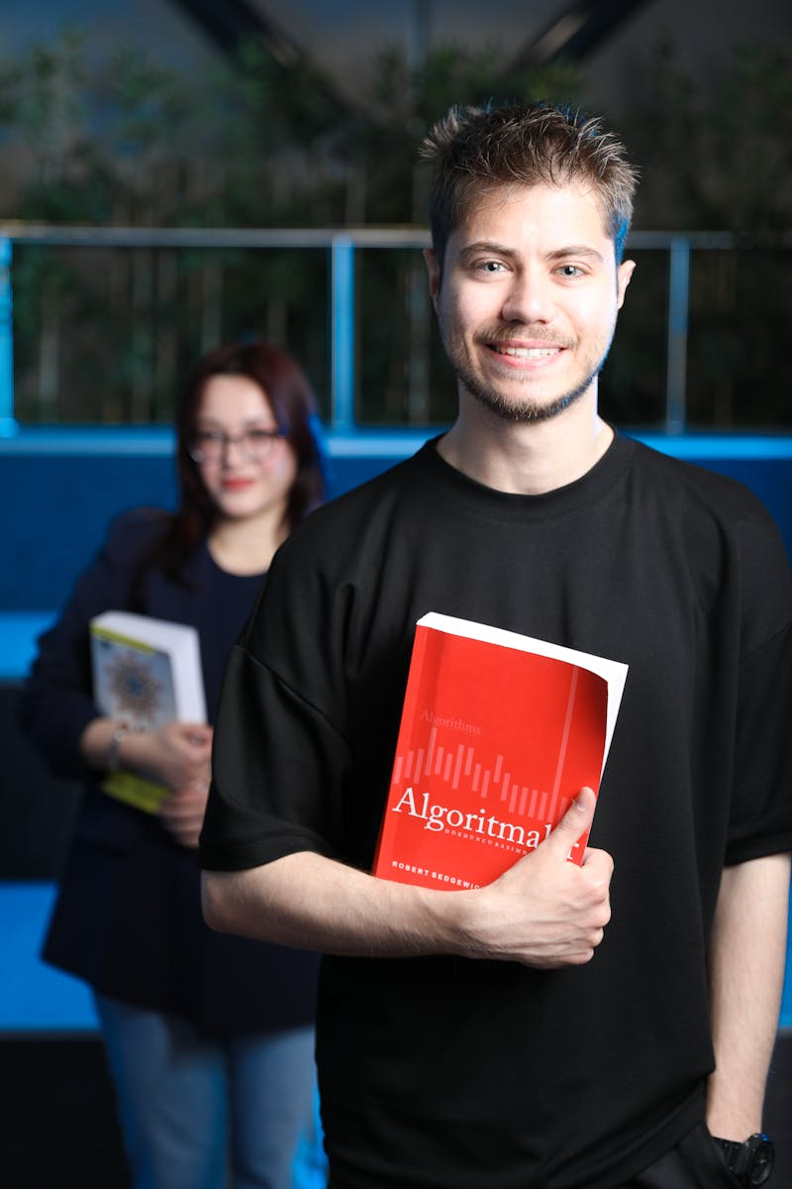
3
How CineMind Works
Intelligence Behind the Scenes
Creates unique taste fingerprints from ratings, watch history, and skipped titles.
Identifies hidden connections between films using metadata and user behavior clusters.
Matches preferences with similar user profiles to discover niche recommendations.
Adjusts suggestions based on time of day, viewing duration, and seasonal trends.

Slide 6

4
Why CineMind Stands Out
Beyond Standard Algorithms
Recognizes subtle preferences like indie vibes or specific director styles missed by others.
Prioritizes hidden gems over mainstream hits to expand cinematic horizons.
Suggests films aligning with current emotions using tone analysis and user feedback.
Minimizes popularity bias to surface diverse and underrepresented content.

Slide 7

5
Your Personalized Dashboard
Control at Your Fingertips
Generates themed lists like 'Underrated 90s Thrillers' updated with new matches.
Visualizes preference evolution and genre exploration through interactive charts.
Allows temporary adjustments like 'Less Romance' or 'More International' with sliders.
Unifies recommendations from Netflix, Hulu, and Prime in one clickable interface.

Slide 8

6
Real User Benefits
Transforming Viewing Habits
Reduces selection time from minutes to seconds with curated 'Play Now' options.
Reignites love for cinema through unexpectedly perfect matches and deep cuts.
Encourages exploration beyond comfort zones with trusted niche suggestions.
Generates group recommendations accommodating diverse tastes for movie nights.

Slide 9
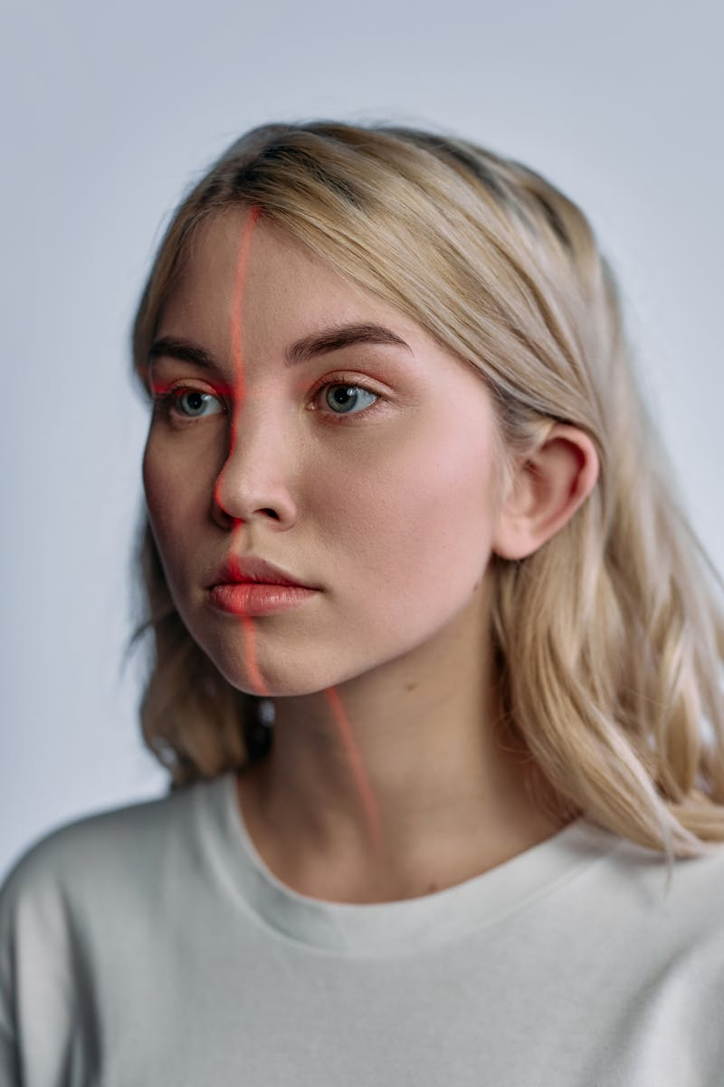
7
Privacy by Design
Your Data, Protected
Analyzes preferences on-device when possible, minimizing cloud data transfers.
Clear toggles for data sharing with opt-out options for sensitive categories.
Aggregates patterns without personally identifiable details for algorithm training.
Viewing data never sold to third parties or used for external advertising.

Slide 10
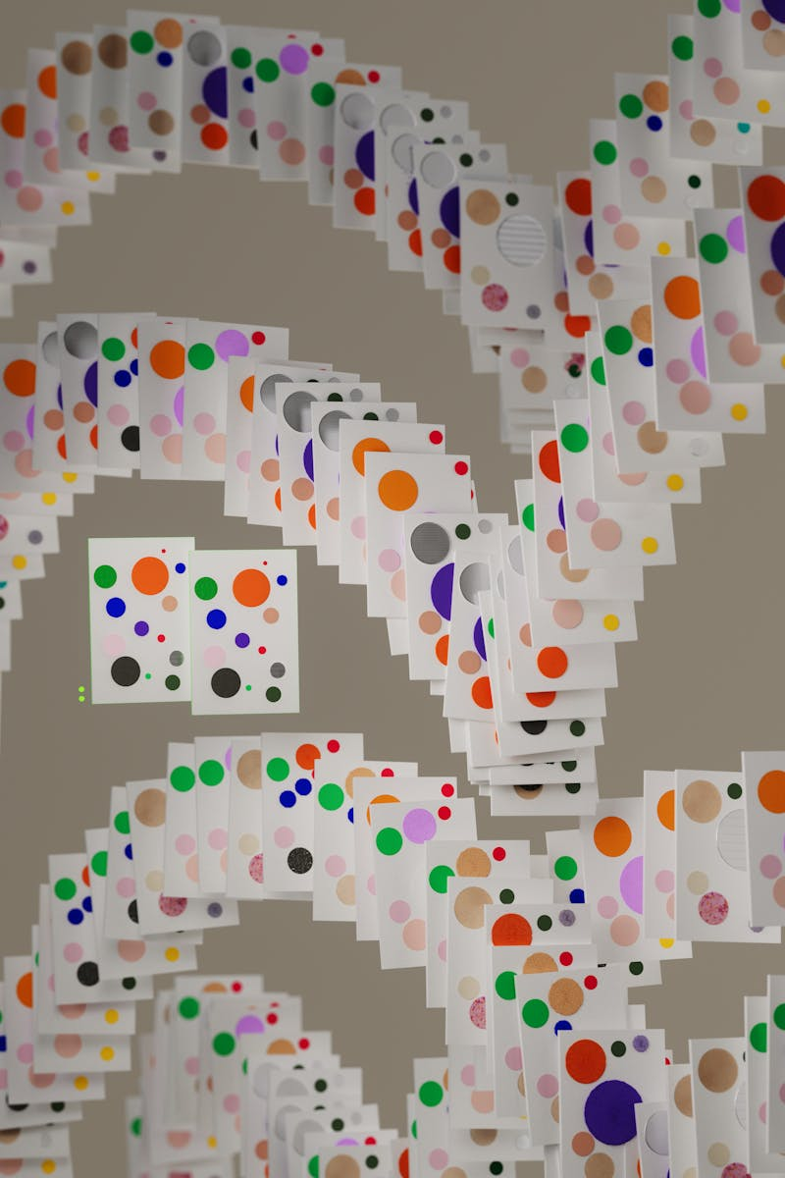
8
The Tech Inside
Cutting-Edge Machine Learning
Combines collaborative and content-based filtering for balanced suggestions.
Processes reviews and synopses to understand thematic and tonal qualities.
Uses multiple specialized algorithms voting on recommendations for accuracy.
Updates predictions during sessions if users pause or skip content frequently.

Slide 11

9
Future Developments
What's Next for CineMind
Incorporating regional cinema traditions and local storytelling preferences.
Suggestions based on subtitle needs, audio descriptions, or trigger warnings.
Tracking stylistic evolution across a filmmaker's career for deep dives.
Taste-compatibility matching for watch parties and friend recommendations.

Slide 12

10
Thank You
Questions?
We appreciate your time exploring how CineMind transforms movie discovery.
Your next perfect film awaits – let the credits roll on decision fatigue.
Follow our journey as we continue refining intelligent entertainment curation.
Now go enjoy your personalized movie night with CineMind's perfect pick!

