Slide 1
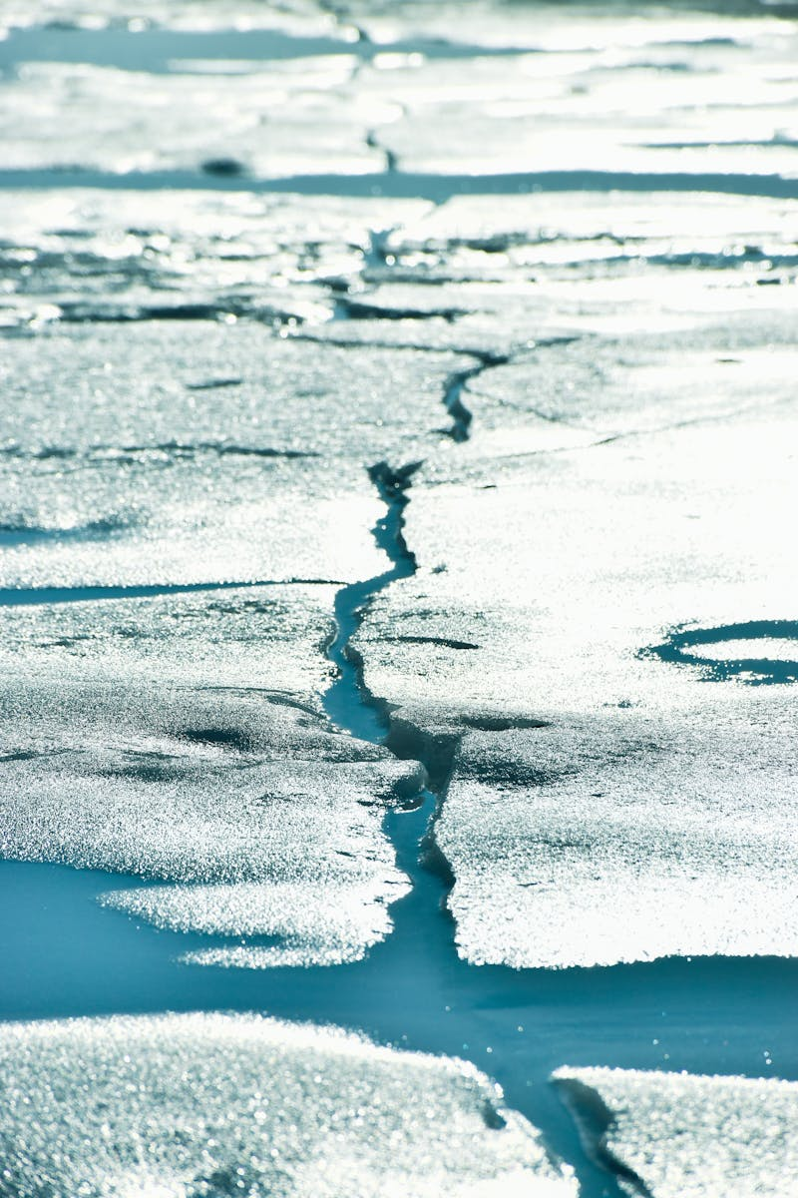
Climate Change: YouTube Perspective Understanding Climate Change Through Digital Media
Photo by Pexels

Slide 2
01
YouTube's Climate Change Landscape
Table of Contents
02
Content Creators' Role
03
Viewer Engagement Patterns
04
Content Diversity
05
Future Implications

Slide 3
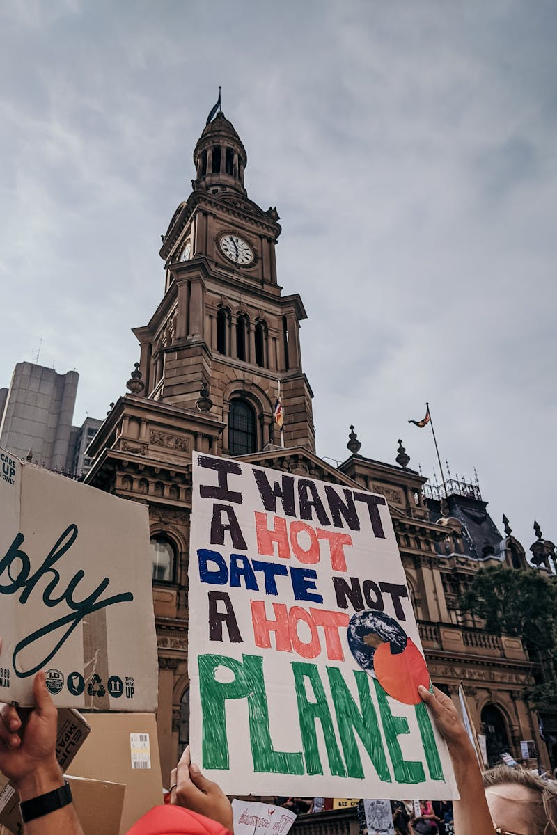
1
YouTube's Climate Change Landscape
The Digital Platform for Climate Discourse
YouTube hosts thousands of videos addressing climate change from various creators and perspectives. Climate change videos on YouTube reach millions of viewers worldwide, transcending geographical boundaries. YouTube serves as a primary educational tool for learning about climate change through visual content. YouTube creates communities around climate change topics, fostering discussion and awareness.

Slide 4
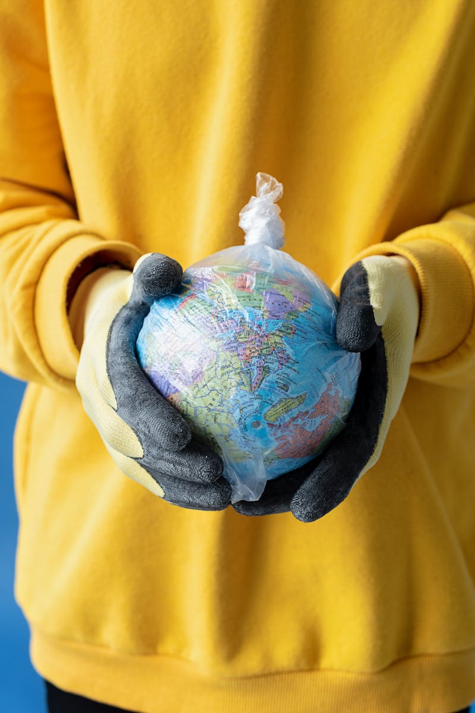
2
Content Creators' Role
YouTube Influencers in Climate Advocacy
YouTube creators translate complex climate science into accessible and engaging content. Climate activists use YouTube to amplify their message and mobilize audiences for environmental causes. YouTube documentary creators showcase real-world climate impacts through compelling visual storytelling. Specialized YouTube channels focus on climate education, providing in-depth analysis and information.

Slide 5

3
Viewer Engagement Patterns
How YouTube Audiences Interact with Climate Content
YouTube comment sections reveal diverse perspectives and debates on climate change topics. Climate change videos on YouTube frequently get shared across social platforms, extending their reach. YouTube's algorithm influences which climate content gets prioritized and recommended to viewers. Viewers engage with climate content through likes, subscriptions, and participation in creator communities.

Slide 6

4
Content Diversity
Variety of Climate Change Perspectives on YouTube
YouTube features videos breaking down climate data, research findings, and scientific consensus. Climate change narratives on YouTube often include personal experiences and local impacts. YouTube hosts debates and discussions about climate policies and governmental responses. Many YouTube channels emphasize practical solutions and actionable steps for addressing climate change.

Slide 7

5
Future Implications
YouTube's Evolving Role in Climate Communication
YouTube continues to grow as a vital platform for climate education and awareness building. Climate change content on YouTube is becoming more sophisticated and nuanced over time. YouTube faces increasing responsibility in curating accurate climate information and combating misinformation. YouTube's influence on climate discourse continues to expand, shaping public understanding and action.

