Slide 1

CoPilot-Driven Transformation: Progress & Strategy Empowering Development Across Accessibility, Testing, Security & Feature Delivery
Photo by Pexels

Slide 2
01
Strategic Overview: CoPilot Implementation
Table of Contents
02
Progress Across Pillars & Next Steps

Slide 3
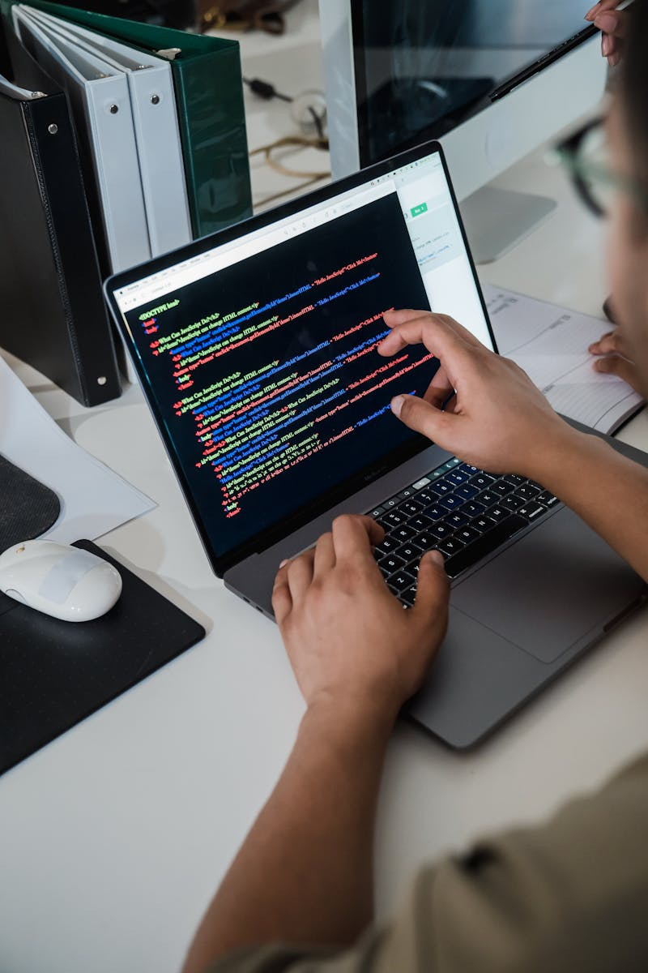
1
Strategic Overview: CoPilot Implementation
Driving Holistic DevOps Transformation
**Objective:** Leverage GitHub CoPilot to optimize software delivery across 4 pillars – Accessibility, Testing, Security & Feature Development. **Current Initiatives:** - Building Prompt Template Libraries for all pillars - Embedding CoPilot into end-to-end workflows (TDD, Compliance, Docs) - VS Code Agent Mode under evaluation - Repository-driven Security and Accessibility compliance in progress **Involved Teams:** - Impelsys Architects, Tech & Dev Leads - NCLEX & PHX sub-teams (Prompt Design) - Internal CoPilot Task Force - Liaison with PSE Associate Director for accelerated adoption **Benefits So Far:**
- Increased UT coverage via CP prompts
- Secure code analysis using Blackduck & SonarQube
- Accessible system design aligning with WCAG 2.1 AA
Photo by Pexels

Slide 4

2
Progress Across Pillars & Next Steps
From Prototypes to Enterprise Integration
**Accessibility:** - Prompts aligned with WCAG 2.1 AA - Focus on HTML semantics, color, mobility, ARIA - Cypress testing under review **Testing:** - UTs via TDD & regular workflows - Mandatory prompt standards defined - Focus on edge cases and untested code **Security:** - CoPilot-first review of vulnerabilities - DoD integration under evaluation - Focus on Blackduck, SonarQube error analysis **Feature Development:**
- Full feature prototyping underway
- Prompts built for Tech Plans, TDD, CICD
**Next Steps:**
- Expand prompt coverage
- Weekly demos to showcase progress
- Finalize prompt standards
- Drive adoption with ongoing stakeholder engagement
Photo by Pexels

