Slide 1
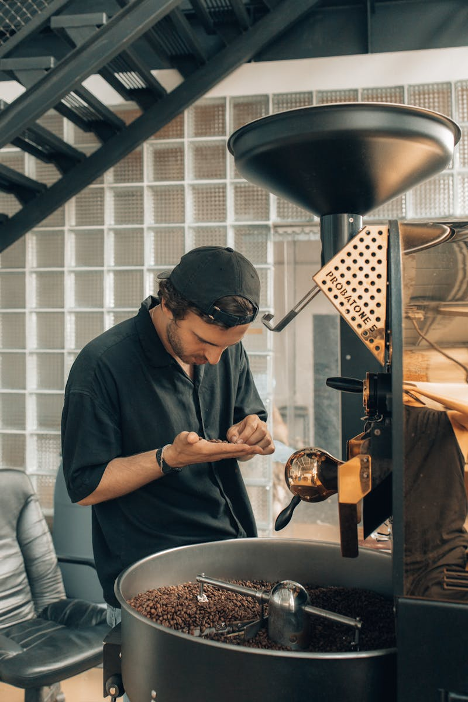
Coffee Post-Harvest Process Flow Full Washed Method
Photo by Pexels

Slide 2
01
Introduction to Full Washed Coffee Processing
Table of Contents
02
Fermentation: The Critical Transformation
03
Final Cleaning & Preparation
04
Final Processing & Quality Control
05
Final Journey to Market

Slide 3
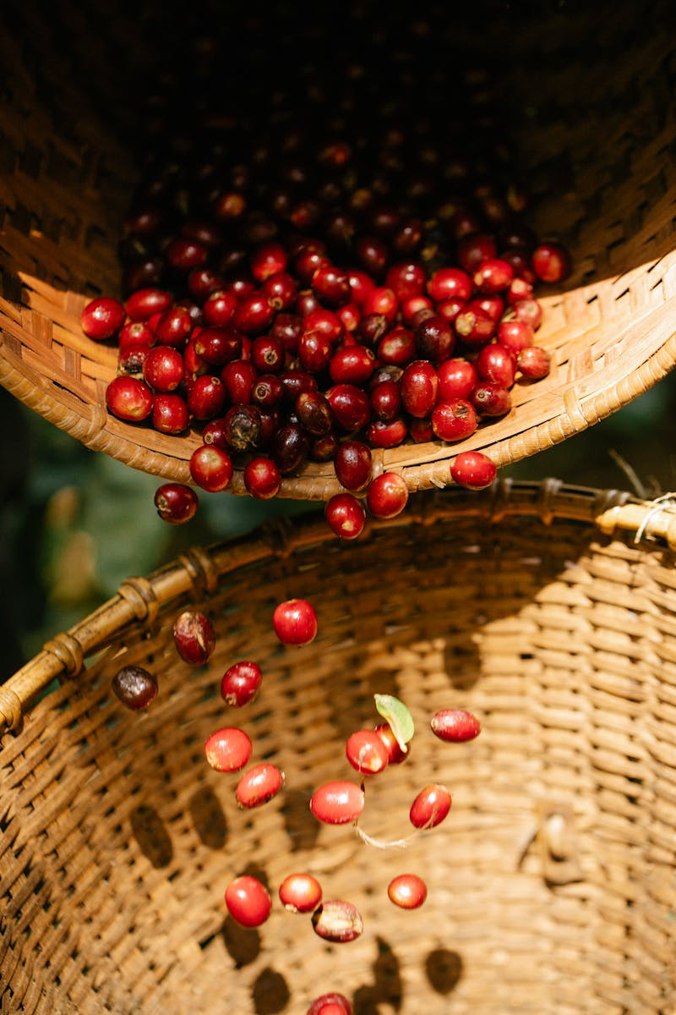
1
Introduction to Full Washed Coffee Processing
Understanding the Complete Journey from Cherry to Green Bean
Carefully picking only the ripe coffee cherries to ensure optimal quality and flavor development in the final product. Separating defective cherries and removing impurities through thorough washing to maintain cleanliness and consistency. Mechanically removing the outer skin of cherries using pulpers to expose the beans for further processing steps. These initial steps establish the foundation for premium coffee quality by starting with the best raw materials and proper preparation.

Slide 4
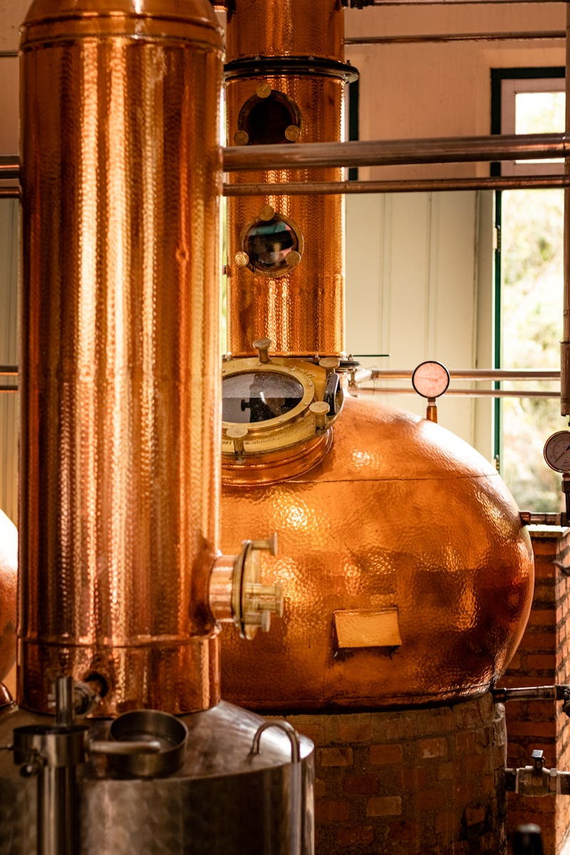
2
Fermentation: The Critical Transformation
Where Chemistry Meets Coffee Quality
Allowing beans to ferment for 12-36 hours under controlled conditions to break down the mucilage layer naturally. Microorganisms work to dissolve the sticky mucilage coating, preparing beans for final washing and drying stages. Proper fermentation timing and conditions directly influence the final flavor profile and cup quality of the coffee. Monitoring temperature, time, and moisture levels is crucial to prevent over-fermentation or under-fermentation issues.

Slide 5
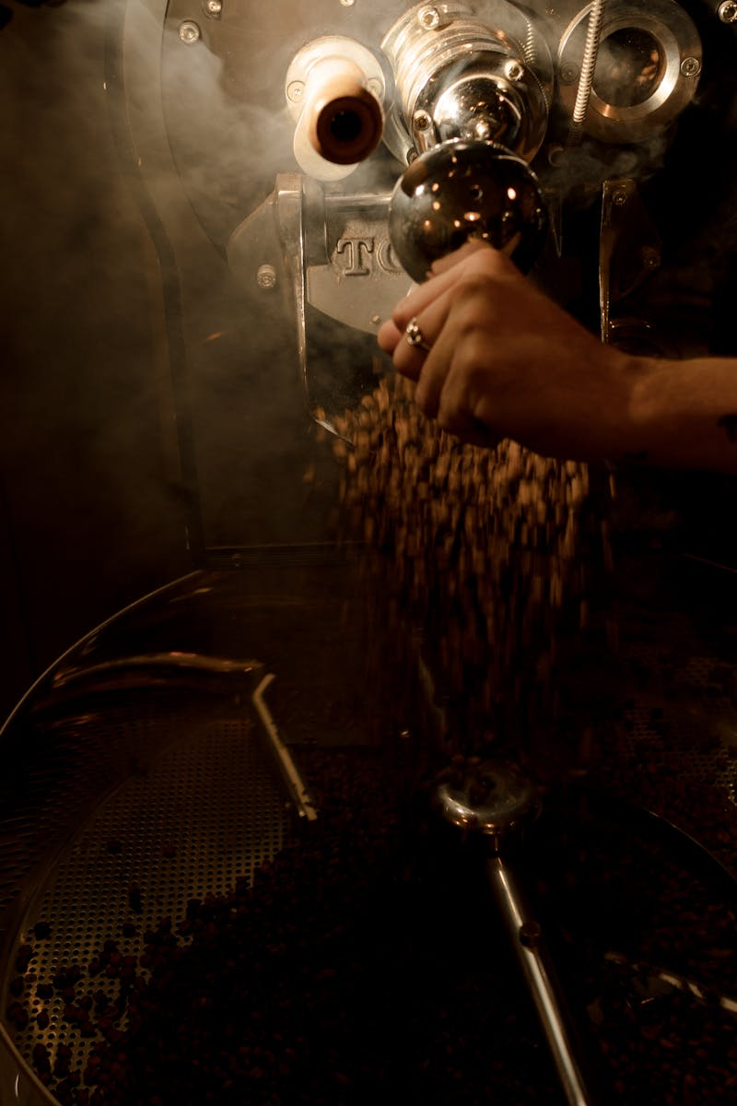
3
Final Cleaning & Preparation
Preparing Beans for Long-Term Storage
Completely removing any remaining mucilage residue through multiple washing cycles to ensure bean cleanliness. Drying beans for 7-14 days until reaching optimal moisture content of 10-12% for proper storage stability. Maintaining proper drying conditions with good airflow and protection from contamination during the critical drying period. Regular monitoring during drying ensures uniform moisture content and prevents mold or spoilage development.

Slide 6

4
Final Processing & Quality Control
Transforming Dried Beans into Premium Green Coffee
Removing the final parchment layer (husk) from dried beans to reveal the green coffee bean underneath. Carefully evaluating and categorizing beans by size, density, and defects to establish quality grades for market. Eliminating beans with imperfections, damage, or irregularities that could affect brewing quality and consistency. Implementing strict quality control measures to ensure only the best beans meet export and market specifications.

Slide 7
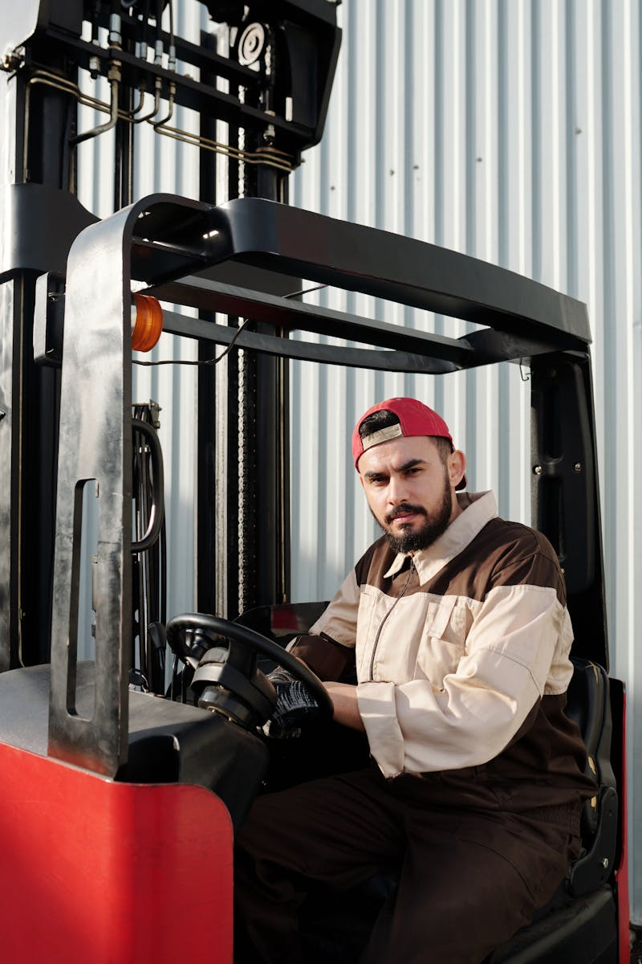
5
Final Journey to Market
From Processing to Distribution Excellence
Properly storing green beans in controlled environments to preserve freshness and prevent quality degradation over time. Preparing coffee for international markets through proper packaging, documentation, and quality certification processes. Coordinating efficient logistics and distribution networks to deliver premium coffee to roasters and consumers worldwide. Maintaining the integrity of processed coffee through careful handling and transportation to ensure optimal freshness upon arrival.

