Slide 1
Comparative Study: Sikkim vs Maharashtra Exploring the Cultural and Geographical Differences
Photo by Pexels

Slide 2
01
Introduction to Sikkim and Maharashtra
Table of Contents
02
Geographical Features
03
Cultural Heritage
04
Language and Literature
05
Economic Landscape
06
Political Structure
07
Social Dynamics
08
Education and Innovation
09
Future Prospects
10
Conclusion

Slide 3
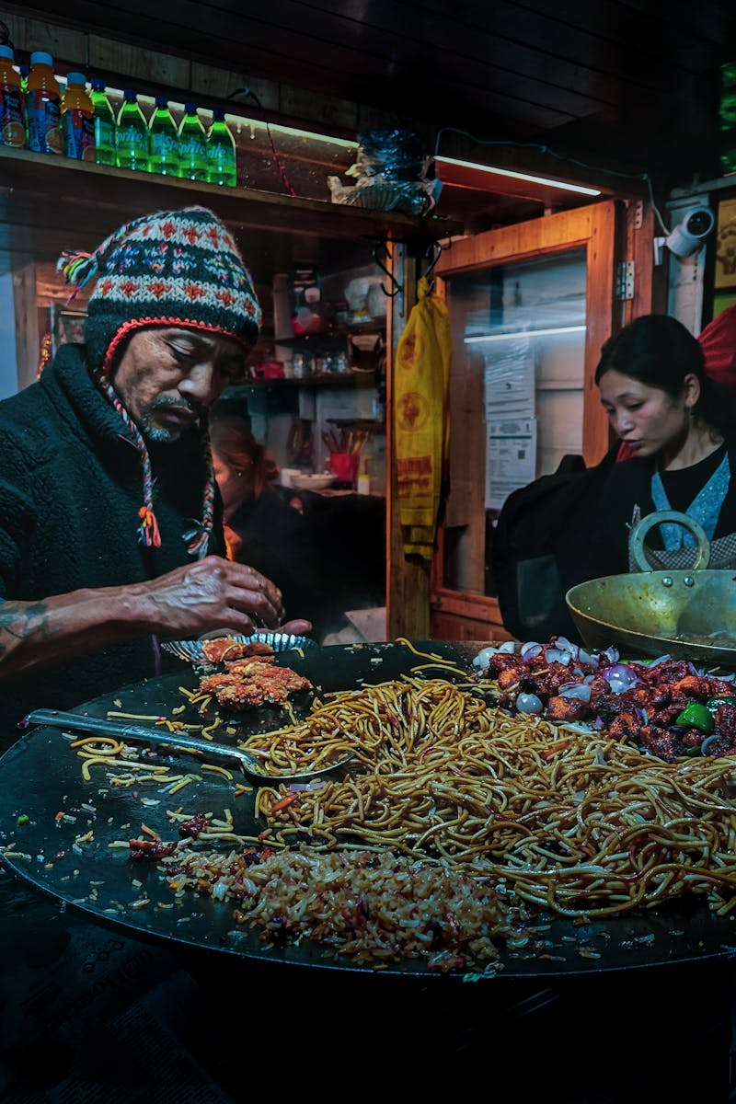
1
Introduction to Sikkim and Maharashtra
A Glimpse into Two Diverse States
Sikkim is a small, mountainous state in the northeastern part of India, while Maharashtra is a large state located in the western region. Sikkim is known for its rich Buddhist culture, whereas Maharashtra is famous for its Maratha heritage and Bollywood influence. Sikkim has a small population with a mix of ethnic groups, while Maharashtra is one of the most populous states with diverse communities. Sikkim's economy is driven by agriculture and tourism, whereas Maharashtra is an industrial powerhouse with a strong financial sector.
Photo by Pexels

Slide 4
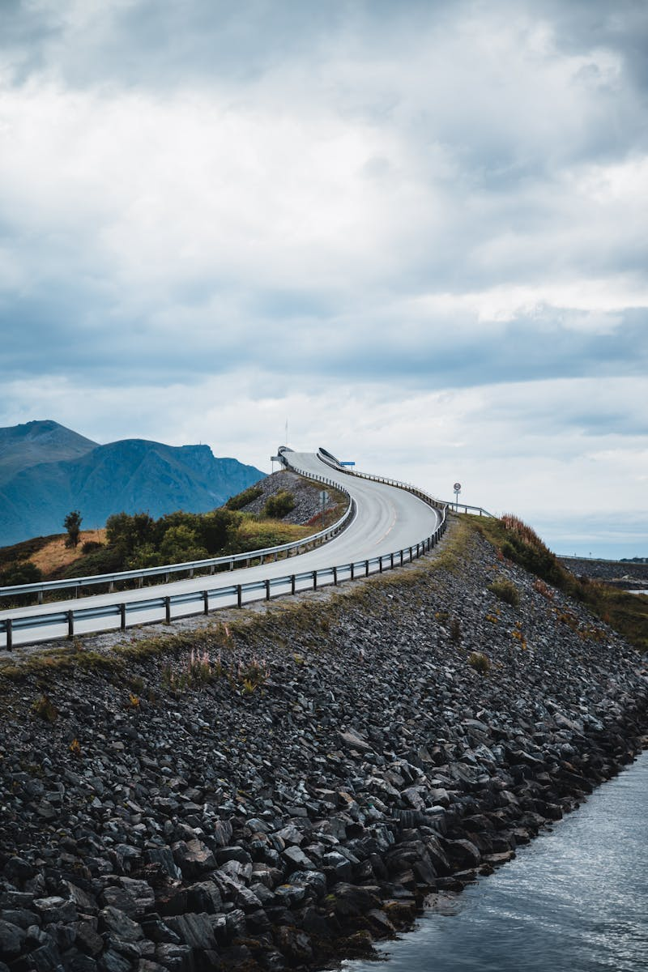
2
Geographical Features
Mountains vs Plains and Coastlines
Sikkim is characterized by its mountainous terrain, including the majestic Kanchenjunga, while Maharashtra features a mix of coastal plains and the Western Ghats. Sikkim experiences a temperate climate with heavy rainfall, whereas Maharashtra has a tropical climate with distinct wet and dry seasons. Sikkim is rich in biodiversity and natural beauty, while Maharashtra has significant mineral resources and fertile land. Sikkim faces challenges like landslides and deforestation, while Maharashtra deals with urban pollution and water scarcity.
Photo by Pexels

Slide 5
3
Cultural Heritage
Traditions and Festivals
Sikkim celebrates unique festivals like Losar and Saga Dawa, reflecting its Buddhist heritage. Maharashtra is known for grand celebrations of Ganesh Chaturthi and Diwali, showcasing its vibrant culture. Sikkimese traditional dress includes Bakhu and Kho, while Maharashtrians wear Paithani sarees and dhotis. Sikkim is famous for its Thangka paintings, whereas Maharashtra is known for its Warli art and Paithani weaving.
Photo by Pexels

Slide 6
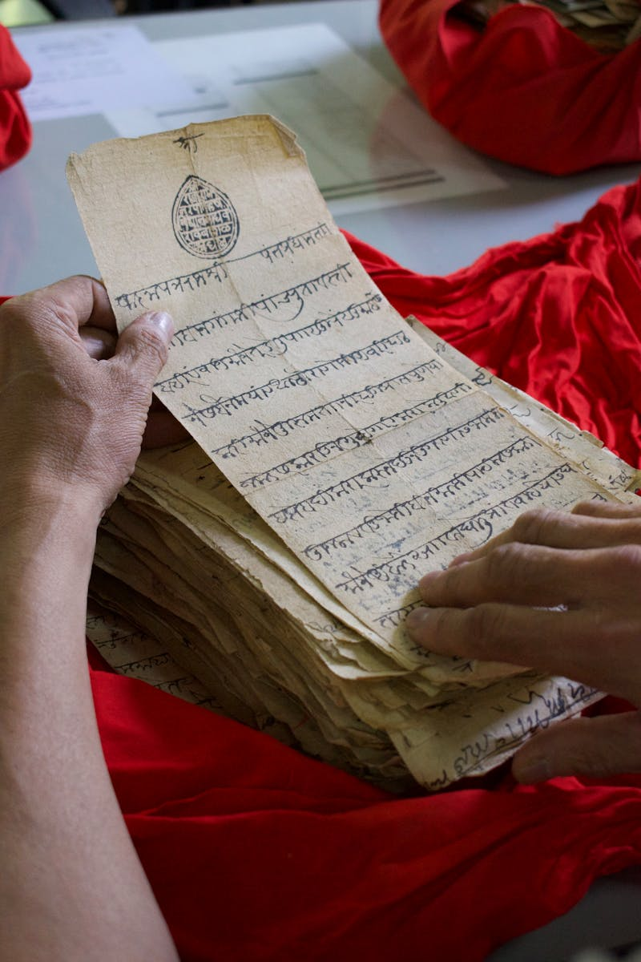
4
Language and Literature
Linguistic Diversity
Sikkim has multiple languages including Nepali, Bhutia, and Lepcha, while Marathi is the predominant language in Maharashtra. Sikkim has a rich tradition of oral literature, whereas Maharashtra has produced renowned literary figures like P.L. Deshpande. Sikkim relies on local newspapers and radio, while Maharashtra has a robust media industry including Bollywood. Sikkim focuses on inclusive education with emphasis on local culture, while Maharashtra has a wide network of educational institutions.
Photo by Pexels

Slide 7
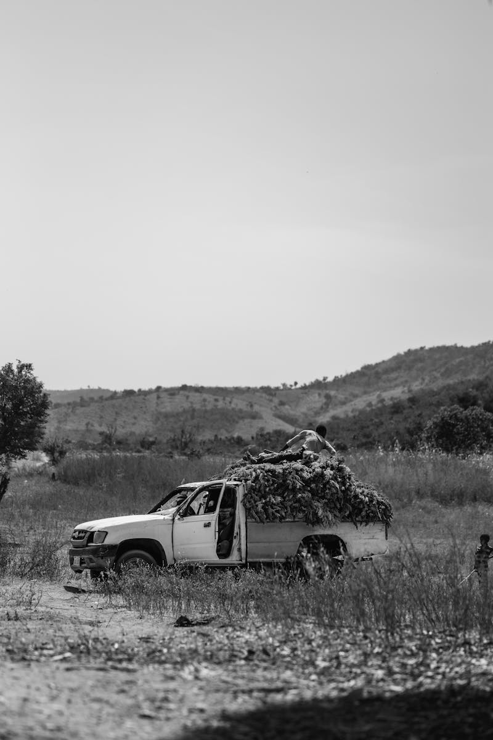
5
Economic Landscape
Agriculture vs Industry
Sikkim is known for organic farming, especially cardamom and tea, while Maharashtra grows sugarcane, cotton, and grapes. Maharashtra is a hub for industries like textiles, automobiles, and IT, whereas Sikkim has limited industrial activity. Sikkim attracts tourists with its natural beauty and monasteries, while Maharashtra offers historical sites and beaches. Maharashtra boasts advanced infrastructure with major ports and airports, while Sikkim is developing its connectivity.
Photo by Pexels

Slide 8
6
Political Structure
Governance and Administration
Sikkim has a unicameral legislature, while Maharashtra has a bicameral system with a Legislative Assembly and Council. Sikkim's politics is dominated by regional parties, whereas Maharashtra has a mix of national and regional parties. Sikkim is divided into four districts, while Maharashtra has 36 districts with a complex administrative setup. Sikkim is known for its peaceful environment, while Maharashtra faces challenges in urban law enforcement.
Photo by Pexels

Slide 9
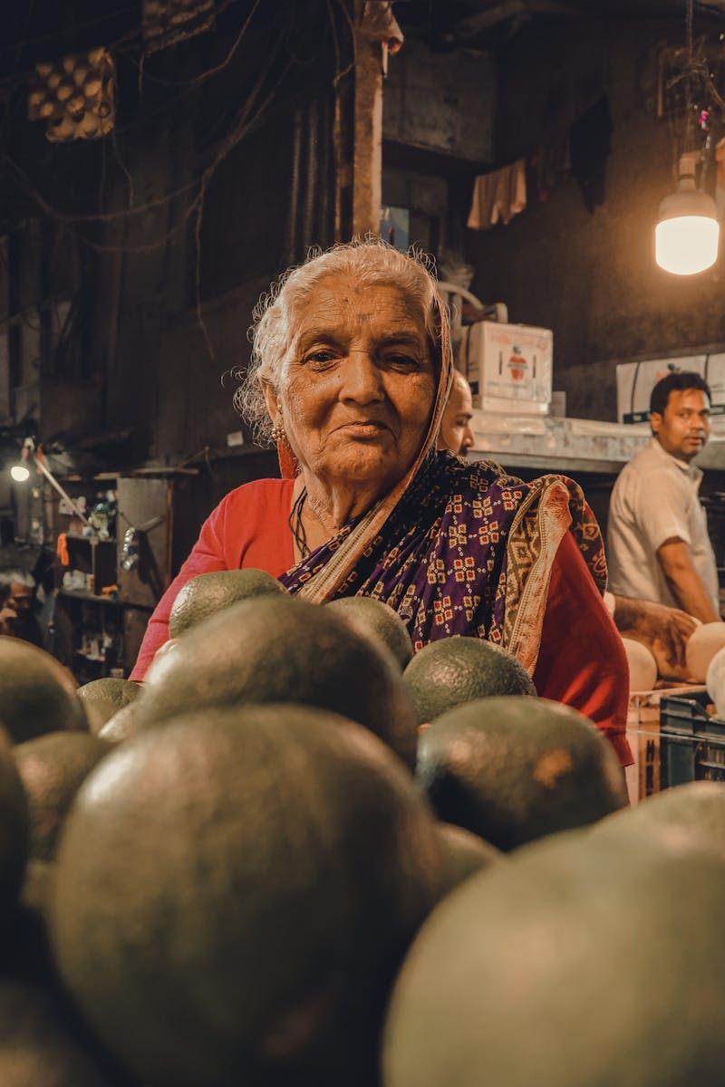
7
Social Dynamics
Community and Lifestyle
Sikkim has close-knit communities with a focus on traditional lifestyles, while Maharashtra is urbanized with diverse social dynamics. Sikkim provides basic healthcare with focus on traditional medicine, whereas Maharashtra has advanced medical facilities. Sikkim promotes adventure sports like trekking, while Maharashtra is passionate about cricket and kabaddi. Sikkim addresses issues like youth migration, while Maharashtra deals with urban poverty and slum development.
Photo by Pexels

Slide 10
8
Education and Innovation
Learning and Development
Sikkim emphasizes local culture in education, while Maharashtra has a diverse curriculum with emphasis on technology. Maharashtra is home to prestigious universities, whereas Sikkim is developing its higher education sector. Maharashtra leads in research with institutions like IIT Bombay, while Sikkim focuses on sustainable development. Sikkim promotes vocational training, while Maharashtra offers a wide range of skill development programs.
Photo by Pexels

Slide 11
9
Future Prospects
Growth and Development
Sikkim aims to boost tourism and organic farming, while Maharashtra focuses on industrial growth and urban development. Sikkim is a leader in organic farming and eco-tourism, whereas Maharashtra is working on renewable energy projects. Maharashtra is rapidly urbanizing with smart city projects, while Sikkim is balancing development with environmental conservation. Sikkim faces challenges like infrastructure development, while Maharashtra deals with urban congestion and pollution.
Photo by Pexels

Slide 12
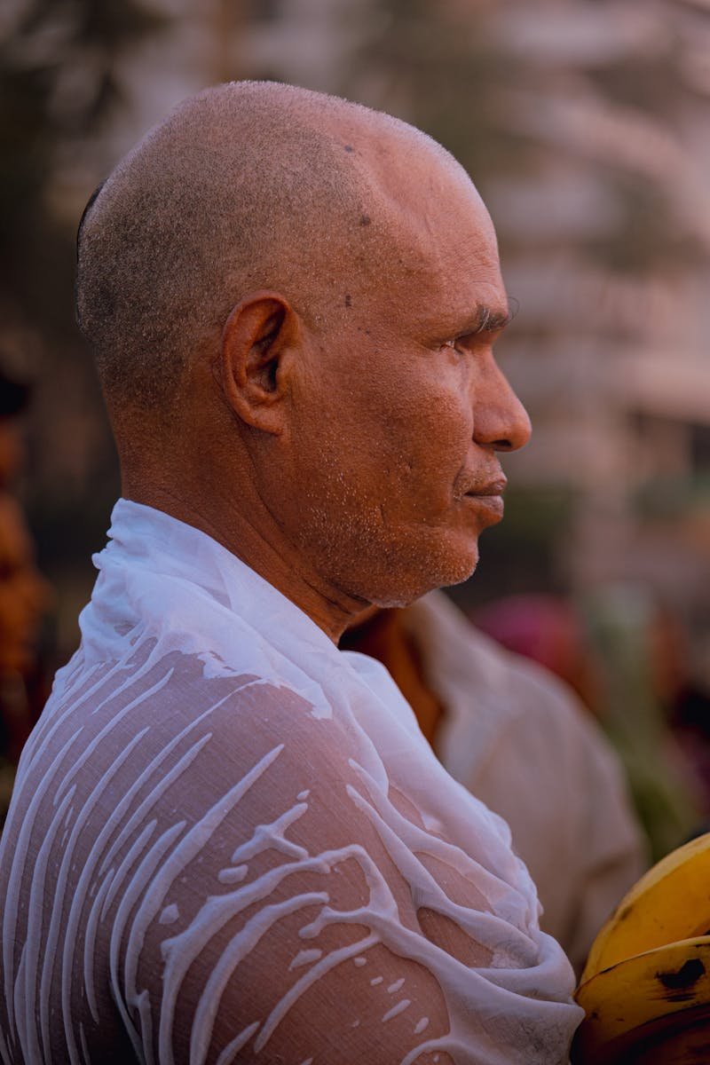
10
Conclusion
Reflecting on the Differences and Similarities
Highlighting the major differences and similarities between Sikkim and Maharashtra in terms of culture, geography, and economy. Understanding the unique strengths and challenges of each state and how they contribute to India's diversity. Exploring opportunities for collaboration between Sikkim and Maharashtra in tourism, education, and sustainable development. Reflecting on the importance of appreciating and preserving the diverse cultural and geographical landscapes of India.
Photo by Pexels

