Slide 1

Computer Vision
How Machines Learn to See
Photo by Pexels

Slide 2
01
COMPUTER VISION
Table of Contents
02
Introduction to Computer Vision
03
History of Computer Vision
04
How Computer Vision Works
05
Key Technologies Used
06
Applications of Computer Vision
07
Computer Vision in Healthcare
08
Computer Vision in Security
09
Computer Vision in Self-Driving Cars
10
Advantages of Computer Vision
11
Challenges of Computer Vision
12
Future of Computer Vision

Slide 3
13
Conclusion
Table of Contents
14
Thank You

Slide 4

1
COMPUTER VISION
How Machines Learn to See
Presented By: Your Name
Class / Subject:
Date:
An Introduction to Artificial Intelligence Vision Systems
Photo by Pexels

Slide 5

2
Introduction to Computer Vision
What is Computer Vision?
Computer Vision is a branch of Artificial Intelligence (AI).
It enables computers to see images and understand videos.
It helps identify objects and patterns.
It allows machines to make decisions from visual data. Like giving eyes and brain to a computer.
Photo by Pexels

Slide 6

3
History of Computer Vision
Evolution Over Time
1960s – Basic image processing started.
1980s – Pattern recognition improved.
2000s – Machine learning introduced.
2012 – Deep learning revolution. Today – Used in self-driving cars, face recognition, and medical diagnosis.
Photo by Pexels

Slide 7

4
How Computer Vision Works
Basic Working Process
1. Image Capture using cameras.
2. Image Processing to enhance quality.
3. Feature Extraction to find important details.
4. Pattern Recognition and Decision Making using Machine Learning and Deep Learning algorithms.
Photo by Pexels

Slide 8

5
Key Technologies Used
Core Technologies Behind Computer Vision
1. Machine Learning – Computers learn from data.
2. Deep Learning – Uses Neural Networks.
3. Convolutional Neural Networks (CNN) – Specialized for image recognition.
4. Image Processing – Enhancing and analyzing images.
Photo by Pexels

Slide 9
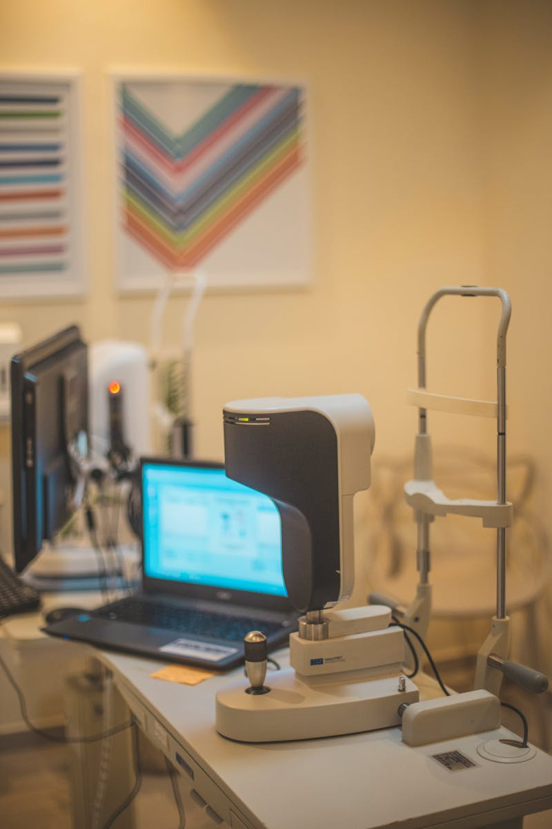
6
Applications of Computer Vision
Where is it Used?
Self-Driving Cars
Face Recognition Systems
Medical Diagnosis
Industrial Quality Check, Object Detection, Surveillance Systems
Photo by Pexels

Slide 10
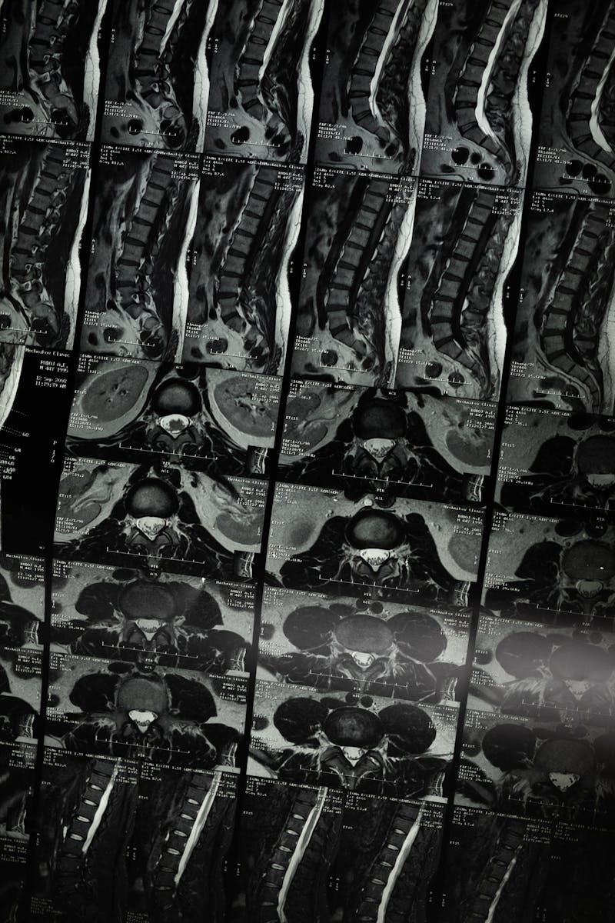
7
Computer Vision in Healthcare
Medical Applications
Detecting cancer from X-rays.
MRI scan analysis.
Tumor detection.
Disease diagnosis with high accuracy. Helps doctors make faster decisions.
Photo by Pexels

Slide 11
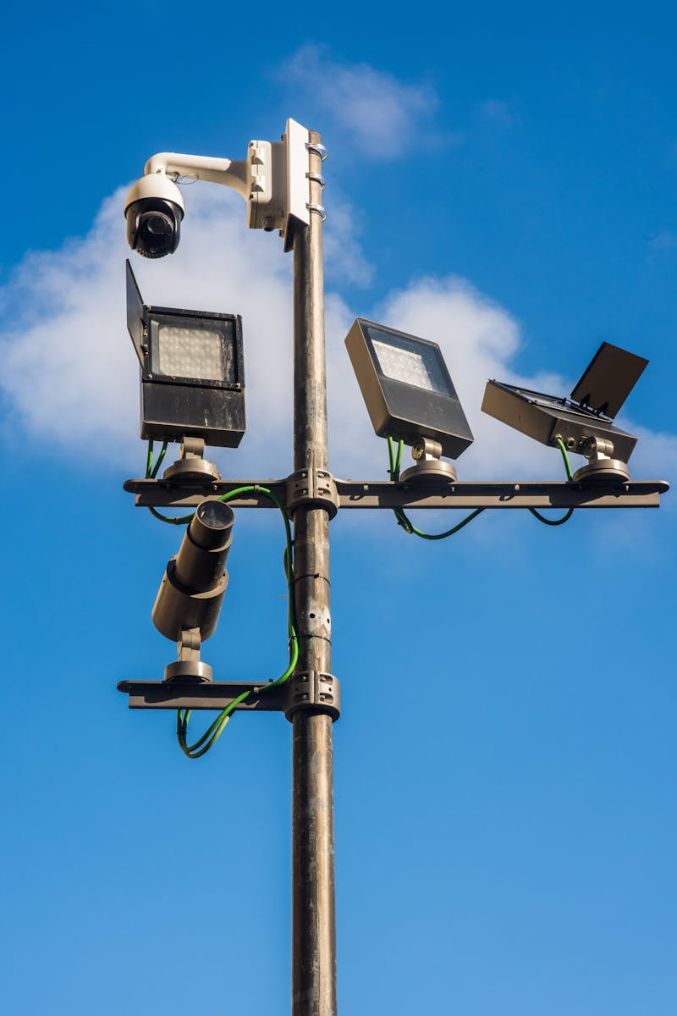
8
Computer Vision in Security
Security and Surveillance
Face recognition systems.
Biometric authentication.
Smart surveillance cameras.
Crime detection systems used in airports, banks, and smartphones.
Photo by Pexels

Slide 12

9
Computer Vision in Self-Driving Cars
Autonomous Vehicle Technology
Detects pedestrians.
Identifies traffic signs.
Recognizes lanes.
Avoids obstacles. Used by companies like Tesla and Waymo.
Photo by Pexels

Slide 13
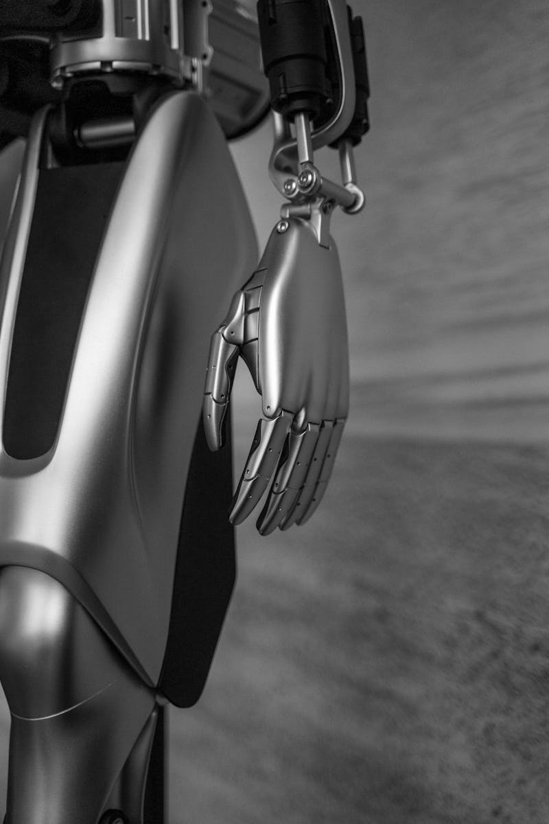
10
Advantages of Computer Vision
Benefits
High accuracy.
Faster processing.
Reduces human error.
Works 24/7 and improves automation.
Photo by Pexels

Slide 14

11
Challenges of Computer Vision
Limitations
Privacy concerns.
High development cost.
Requires large amounts of data.
May make mistakes in poor lighting or complex environments.
Photo by Pexels

Slide 15

12
Future of Computer Vision
What’s Next?
Smarter robots.
Advanced healthcare diagnosis.
Fully autonomous vehicles.
Smart cities and Augmented Reality systems. Computer Vision will become part of daily life.
Photo by Pexels

Slide 16
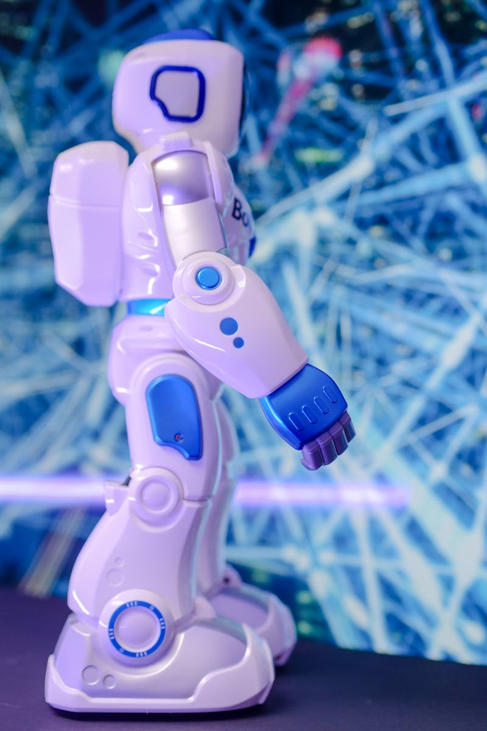
13
Conclusion
Final Thoughts
Computer Vision allows machines to see and understand the world.
It analyzes visual data intelligently.
It makes smart decisions.
It plays a major role in healthcare, security, transportation, and industry.
Photo by Pexels

Slide 17

14
Thank You
End of Presentation
Thank You!
Any Questions?
Computer Vision – The Future of AI Vision Systems
Photo by Pexels

