Slide 1

Computer Vision How Machines Learn to See and Understand the World
Photo by Pexels

Slide 2
01
Computer Vision
Table of Contents
02
What is Computer Vision?
03
Evolution of Computer Vision
04
How Computer Vision Works
05
Key Technologies Behind Computer Vision
06
Applications in Healthcare
07
Applications in Security
08
Self-Driving Cars
09
Industrial and Business Applications
10
Advantages of Computer Vision
11
Challenges and Limitations
12
Future of Computer Vision

Slide 3
13
Conclusion
Table of Contents

Slide 4

1
Computer Vision
Teaching Machines to Interpret Visual Data
Computer Vision is a field of Artificial Intelligence (AI) that enables computers to interpret and understand images and videos. It simulates human vision to analyze visual data and make intelligent decisions. It combines algorithms, data, and computational power to extract meaningful information from visuals. Today, it powers many real-world technologies across industries.
Photo by Pexels

Slide 5

2
What is Computer Vision?
Core Concept
Allows computers to capture, process, and analyze visual data. Identifies objects, faces, text, and activities in images and videos. Transforms raw images into actionable insights. Acts as the 'eyes and brain' of intelligent systems.
Photo by Pexels

Slide 6
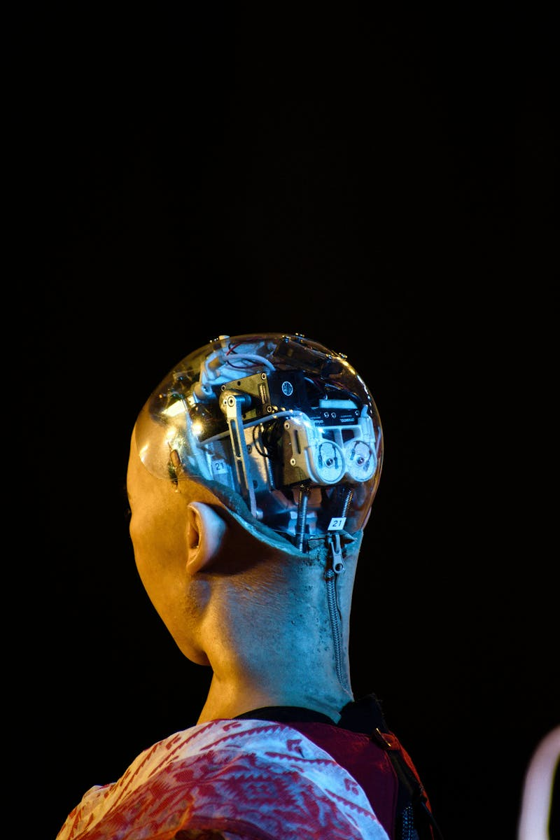
3
Evolution of Computer Vision
From Simple Processing to Deep Learning
1960s: Basic image processing research began. 1980s–1990s: Pattern recognition and feature engineering improved. 2000s: Machine learning algorithms enhanced accuracy. 2012–Present: Deep learning revolutionized image recognition performance.
Photo by Pexels

Slide 7

4
How Computer Vision Works
Step-by-Step Process
1. Image Acquisition – Capturing images using cameras or sensors. 2. Preprocessing – Enhancing image quality and removing noise. 3. Feature Extraction – Identifying important patterns and shapes. 4. Recognition & Decision – Classifying objects and generating outputs.
Photo by Pexels

Slide 8

5
Key Technologies Behind Computer Vision
Core Technical Foundations
Machine Learning – Systems learn patterns from data. Deep Learning – Multi-layer neural networks improve accuracy. Convolutional Neural Networks (CNNs) – Specialized for image analysis. Image Processing – Enhancing and transforming images for analysis.
Photo by Pexels

Slide 9
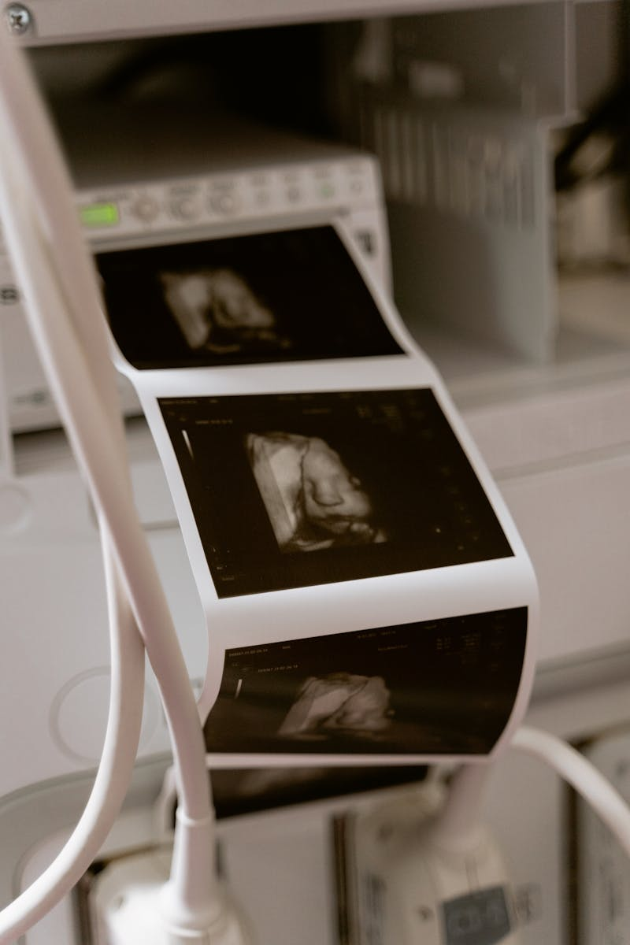
6
Applications in Healthcare
Improving Diagnosis and Treatment
Detecting diseases from X-rays and MRI scans. Early cancer and tumor detection. Automated medical image analysis. Supports doctors with faster and more accurate decisions.
Photo by Pexels

Slide 10

7
Applications in Security
Enhancing Safety Systems
Face recognition systems for identity verification. Biometric authentication in smartphones and airports. Smart surveillance and anomaly detection. Real-time monitoring for improved public safety.
Photo by Pexels

Slide 11
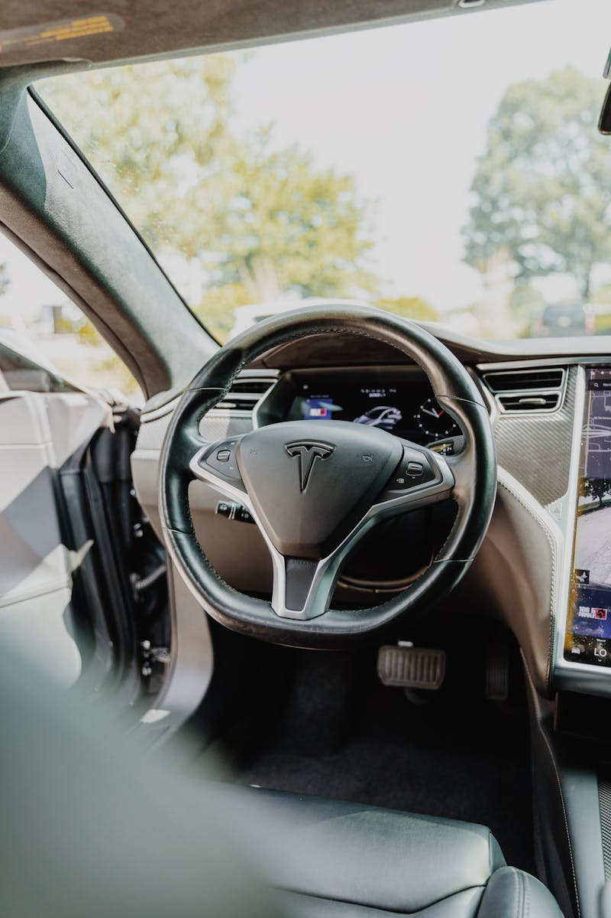
8
Self-Driving Cars
Vision-Based Autonomous Navigation
Detects pedestrians and vehicles in real time. Recognizes traffic signs and signals. Identifies road lanes and obstacles. Enables safe and autonomous navigation decisions.
Photo by Pexels

Slide 12

9
Industrial and Business Applications
Automation and Quality Control
Automated inspection in manufacturing. Product defect detection. Inventory and object tracking. Retail analytics and customer behavior insights.
Photo by Pexels

Slide 13

10
Advantages of Computer Vision
Why It Matters
High accuracy in image-based tasks. Processes large volumes of data quickly. Reduces human error and operational costs. Operates continuously without fatigue.
Photo by Pexels

Slide 14

11
Challenges and Limitations
Areas for Improvement
Privacy and ethical concerns. High computational and development costs. Requires large, high-quality datasets. Performance can drop in poor lighting or complex environments.
Photo by Pexels

Slide 15

12
Future of Computer Vision
What Lies Ahead
Smarter robots and intelligent assistants. Advanced healthcare diagnostics. Fully autonomous transportation systems. Integration with Augmented Reality and Smart Cities.
Photo by Pexels

Slide 16
13
Conclusion
Transforming the Way Machines See
Computer Vision enables machines to see, analyze, and understand visual information. It is transforming healthcare, security, transportation, and industry. Powered by AI and deep learning technologies. Its impact will continue to grow in the coming years.
Photo by Pexels

