Slide 1


Concrete: Key Concepts
Workability, Segregation, Green State, Setting Time, Production & Placing
Photo by Google
July 2025

Slide 2

Table of Contents
1
Workability of Concrete
5
Setting Time of Concrete
2
Segregation in Concrete
6
Factors Affecting Setting Time
3
Consequences of Segregation
7
Production & Placing: Batching & Mixing
4
Green State of Concrete
8
Production & Placing: Transporting & Placing

Slide 3
9
Production & Placing: Finishing
10
Summary: Key Takeaways
11
Visual Aids (Optional)

Slide 4
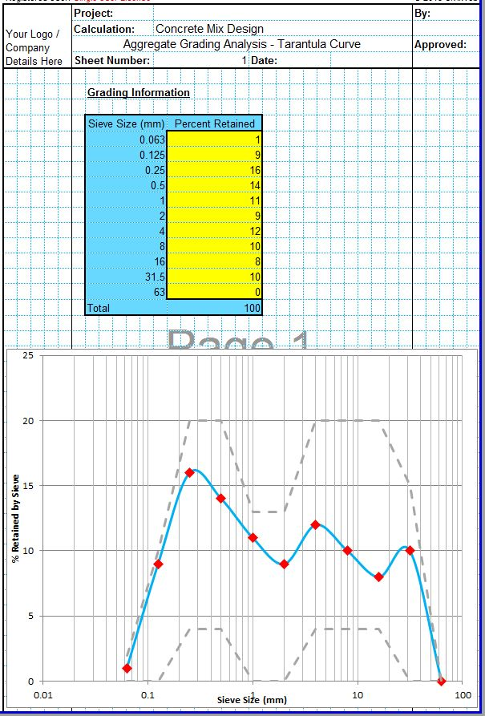
Workability of Concrete
Ease of mixing, placing, compacting, and finishing concrete.
Water content significantly influences the workability of concrete. More water generally increases workability.
Aggregate size and shape affect workability. Rounded aggregates improve it compared to angular ones.
Certain admixtures can be used to enhance workability without increasing water content.
Photo by Google
01

Slide 5
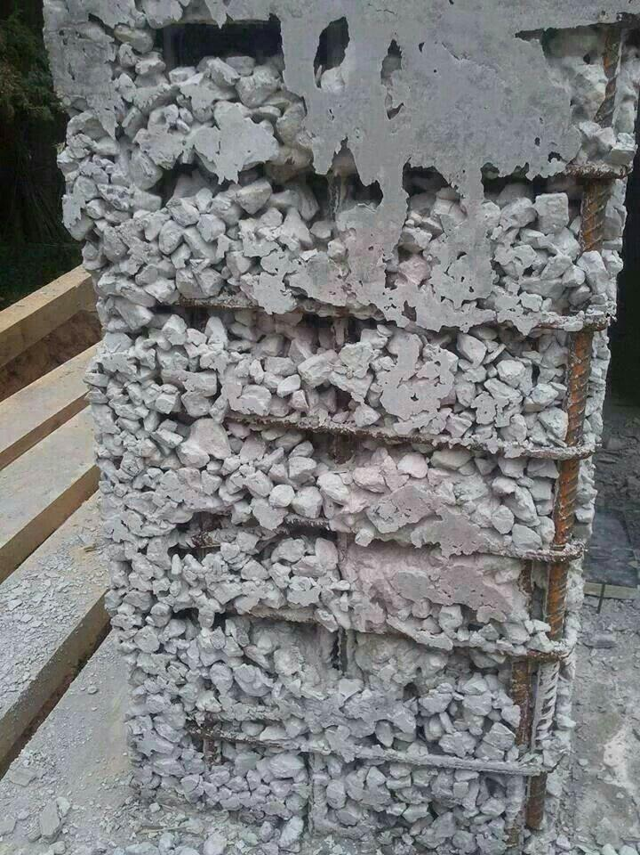
Segregation in Concrete
Separation of coarse aggregates from the cement paste, leading to non-uniformity.
Over-vibration causes heavier aggregates to sink, leading to segregation.
A high water-cement ratio reduces cohesion and increases the risk of segregation.
Dropping concrete from a height causes coarse aggregates to separate from the paste.
Photo by Google
02

Slide 6
Consequences of Segregation
Segregation results in areas with insufficient cement paste, leading to reduced strength.
Segregated concrete has variable composition, causing inconsistent performance.
Segregation can increase permeability, making concrete more susceptible to deterioration.
Segregation can lead to surface defects such as honeycombing.
Photo by Google
03

Slide 7
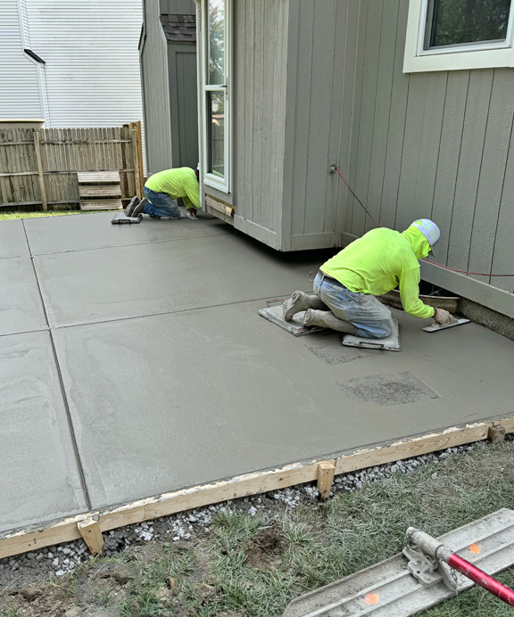
Green State of Concrete
The stage after placing concrete but before it has significantly hardened.
Concrete in its green state is still plastic and easily moldable.
This stage is crucial for shaping, texturing, and finishing the concrete surface.
The concrete is susceptible to damage from external factors during this stage.
Photo by Google
04

Slide 8
Setting Time of Concrete
The point when concrete begins to stiffen (approximately 30–90 minutes).
The point when concrete loses plasticity and can bear some load (approximately 6–10 hours).
Higher temperatures accelerate setting, while lower temperatures retard it.
Higher water-cement ratios can slightly delay the setting process.
Photo by Google
05

Slide 9
Factors Affecting Setting Time
Retarding admixtures can extend setting time, while accelerating admixtures shorten it.
Different types of cement have varying setting times.
Low humidity environments can accelerate surface drying, potentially affecting setting.
Fine aggregates can lead to flash setting if proper care is not taken.
Photo by Google
06

Slide 10
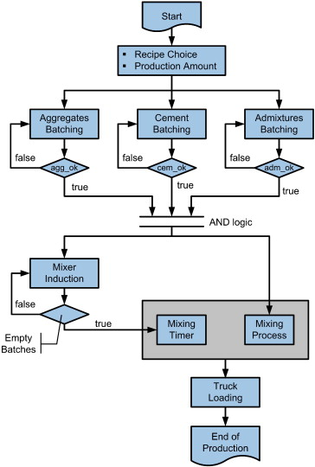
Production & Placing: Batching & Mixing
Accurately measuring all the constituent materials (cement, aggregates, water, admixtures).
Combining the batched materials thoroughly, either by hand or using a mechanical mixer.
Proper mixing is essential for achieving a homogeneous concrete mix.
Verifying the mixture based on required strength and workability.
Photo by Google
07

Slide 11
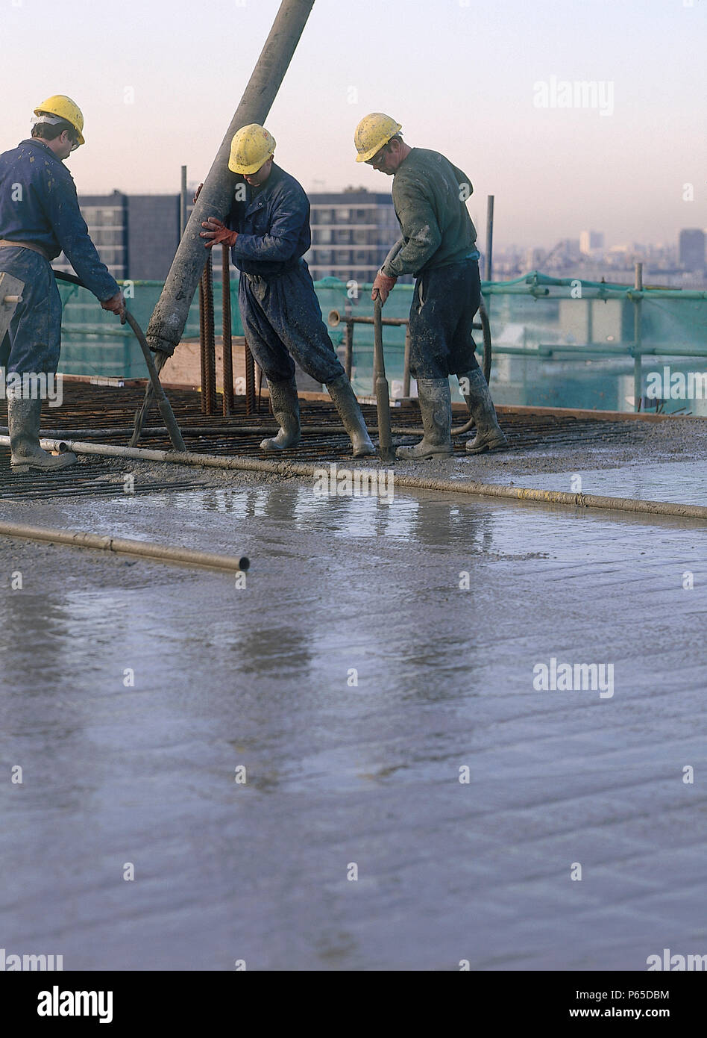
Production & Placing: Transporting & Placing
Moving the mixed concrete from the mixer to the construction site, using equipment like trucks or pumps.
Discharging the concrete into prepared formwork or designated areas.
Removing entrapped air from freshly poured concrete by using vibrators or other methods.
Ensuring the concrete is placed at the desired level.
Photo by Google
08

Slide 12
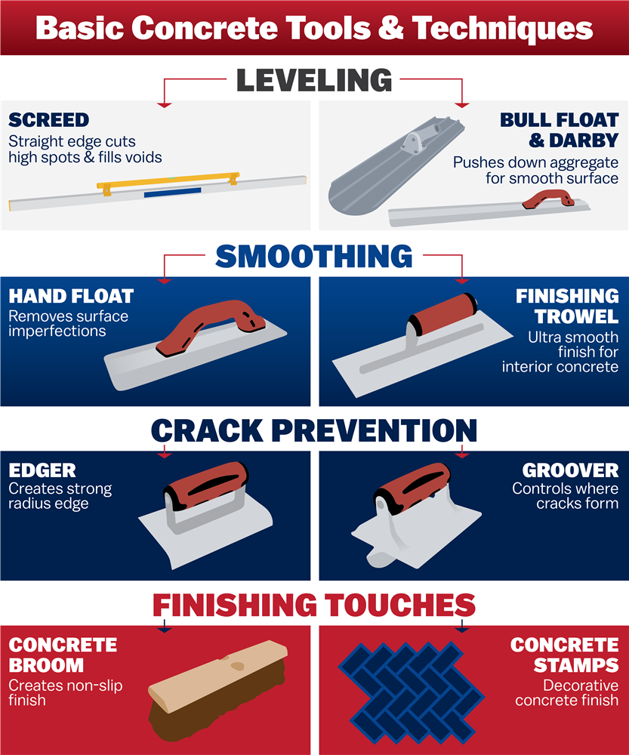
Production & Placing: Finishing
Smoothing and texturing the concrete surface to achieve the desired appearance and functionality.
Using hand tools such as trowels to make smooth surfaces.
Creating slip-resistant and other surface patterns.
Providing moisture to concrete in its early stages to continue hydration.
Photo by Google
09

Slide 13
Summary: Key Takeaways
Ensures ease of handling concrete.
Avoid segregation for uniform strength and quality.
The green state is critical for shaping and finishing.
Proper setting time is essential for durability and structural integrity.
Photo by Google
10

Slide 14
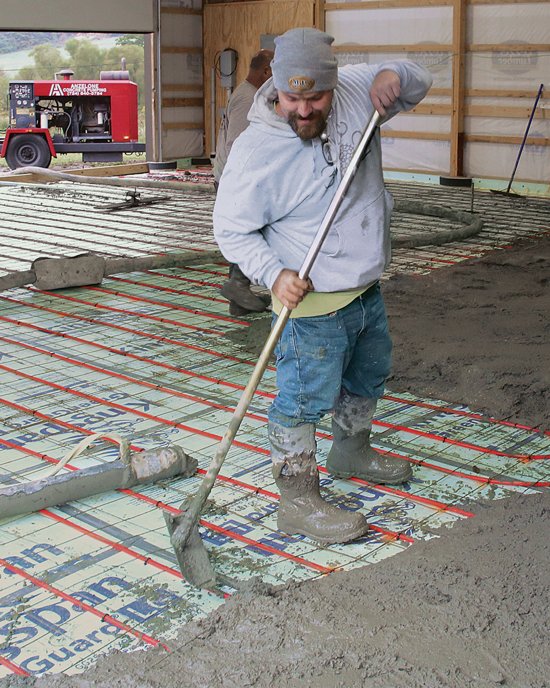
Visual Aids (Optional)
Short clips showing various concrete mixing techniques.
Demonstrations of concrete placement in different formwork scenarios.
Tutorials on different concrete finishing methods and tools.
Illustrate processes step-by-step, such as hydration and setting, etc.
Photo by Google
11

