Slide 1
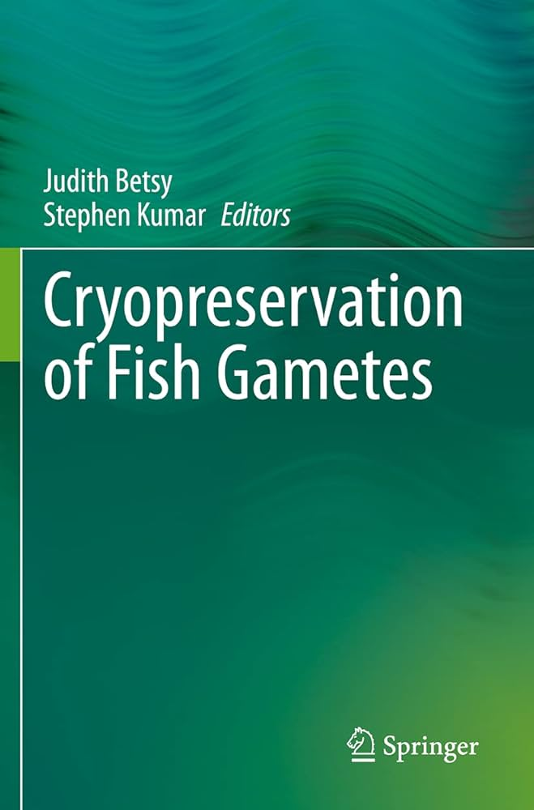
Cryopreservation: Freezing Fish Gametes for the Future
Preserving Genetic Diversity and Advancing Aquaculture Through Gamete Cryopreservation
Photo by Google

Slide 2
01
A Frozen Ark: Why Cryopreserve Fish Gametes?
Table of Contents
02
The Cryopreservation Process: A Step-by-Step Guide
03
Sperm Cryopreservation: A Closer Look
04
Egg Cryopreservation: A Greater Challenge
05
Factors Affecting Cryopreservation Success
06
Applications in Aquaculture
07
Conservation Applications: Saving Endangered Species
08
Future Directions: Advancements and Innovations
09
Challenges and Considerations
10
Thank You

Slide 3
1
A Frozen Ark: Why Cryopreserve Fish Gametes?
Safeguarding Aquatic Biodiversity for Generations to Come
Cryopreservation ensures the long-term storage of valuable genetic material, preserving biodiversity and unique traits. It offers the best way to preserve our biodiversity.
It facilitates selective breeding programs, improving disease resistance, growth rates, and overall quality in farmed fish populations. Best way to improve fish populations.
Cryopreservation aids in the recovery of endangered species by providing a source of genetic diversity for future breeding programs. This can save many endangered species.
Cryopreserved gametes are invaluable for research in genetics, reproductive biology, and toxicology studies. These methods help in researching fish life cycle.
Photo by Google

Slide 4
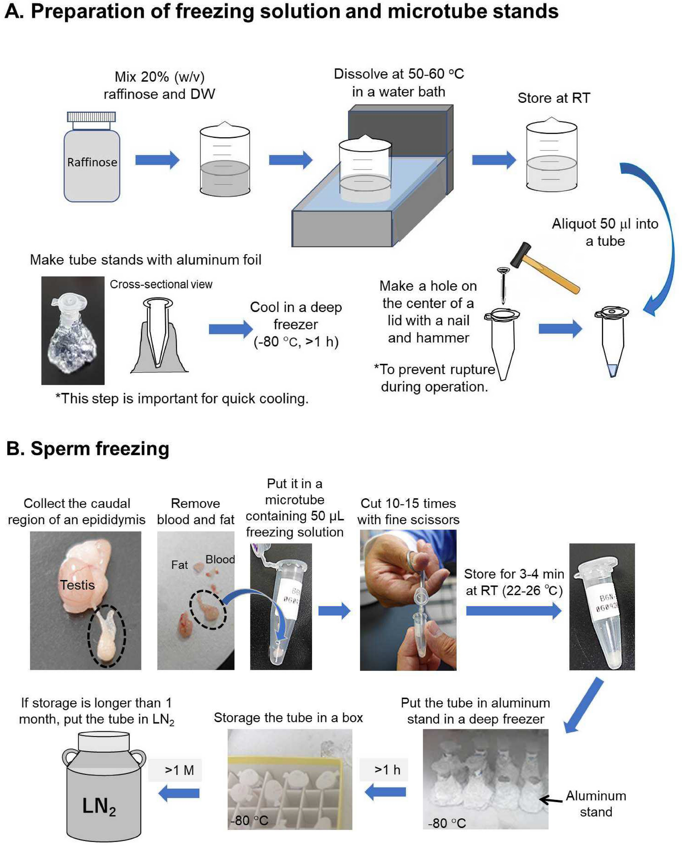
2
The Cryopreservation Process: A Step-by-Step Guide
From Collection to Revival: Understanding the Key Stages
Careful collection of sperm and eggs from selected fish, ensuring viability and minimizing contamination. This requires a experienced person.
Mixing gametes with cryoprotective agents (CPAs) like glycerol or DMSO to prevent ice crystal formation. CPAs are necessary for cryopreservation.
Controlled rate freezing, typically using liquid nitrogen, to slowly cool gametes to ultra-low temperatures. Slow freezing protects gametes.
Long-term storage in liquid nitrogen (-196°C) and rapid thawing when needed for fertilization. Correct thawing is critical for success.
Photo by Google

Slide 5
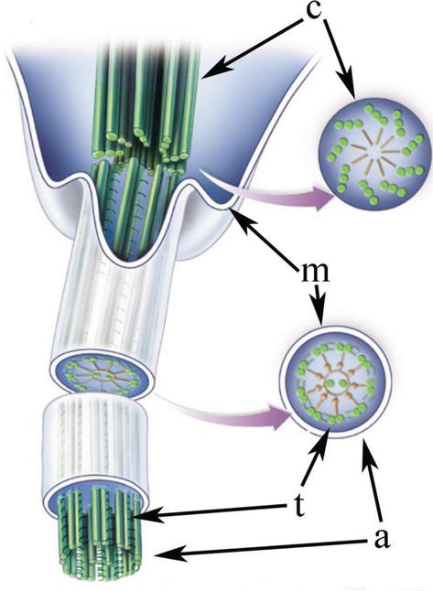
3
Sperm Cryopreservation: A Closer Look
Optimizing Protocols for Male Gamete Preservation
Evaluating sperm motility and concentration before and after cryopreservation to assess sperm quality. Sperm quality is crucial for fertilization.
Choosing the optimal CPA (e.g., glycerol, DMSO) and concentration for specific fish species. Selection depends on the fish species.
Determining the ideal cooling rate to minimize ice crystal damage during freezing. The cooling rate will help to preserve gametes.
Optimizing thawing methods to maximize sperm viability and fertilization potential. The thawing methods will help the gametes.
Photo by Google

Slide 6
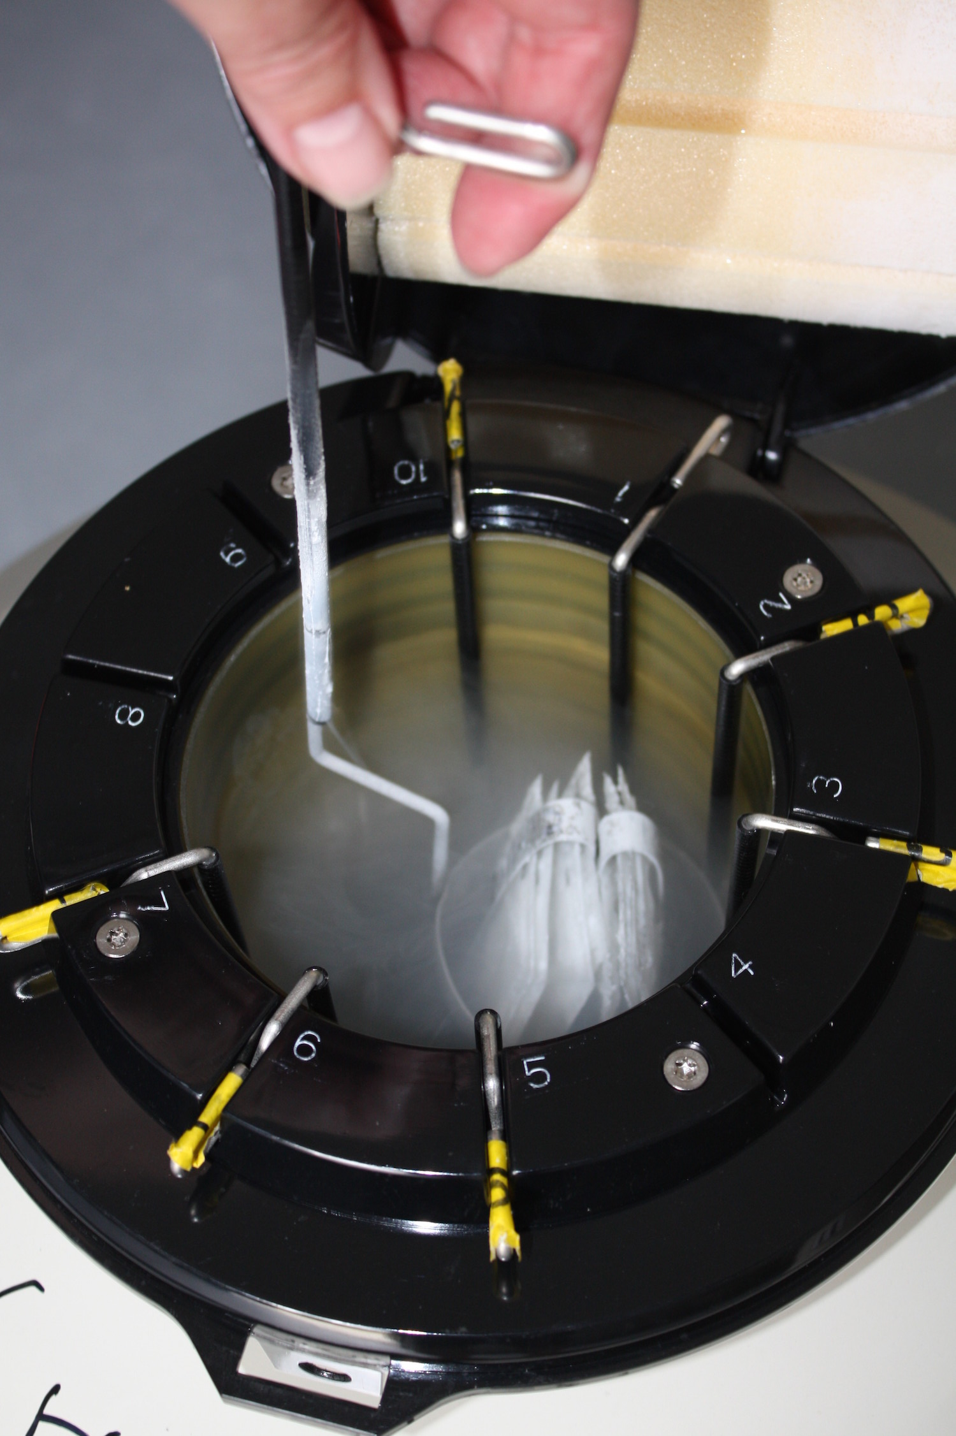
4
Egg Cryopreservation: A Greater Challenge
Overcoming Obstacles in Female Gamete Preservation
The larger size and higher water content of eggs make them more susceptible to ice crystal damage. Ice crystals can easily damage egg.
Ensuring adequate CPA penetration into the egg while minimizing toxicity. CPA penetration is essential for the process.
Ultra-rapid cooling to achieve a glass-like state, avoiding ice crystal formation (a promising technique). No ice crystals are formed in this process.
Controlled dehydration of oocytes before freezing to reduce intracellular ice formation. This process reduces the ice formation.
Photo by Google

Slide 7
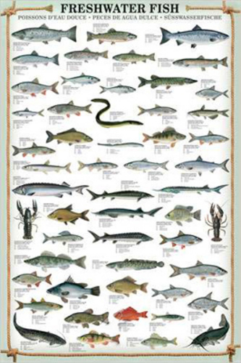
5
Factors Affecting Cryopreservation Success
Species, Protocol, and Individual Variation
Cryopreservation protocols must be tailored to the specific physiological characteristics of each fish species. Every fish species requires specific protocols.
The initial quality of gametes significantly impacts cryopreservation success. High-quality gametes have a better chance of surviving.
Balancing the protective effects of CPAs with their potential toxicity to gametes. Balance is really important to not damage gametes.
Using high-quality equipment and employing skilled personnel are crucial for optimal results. Skilled personnel are important for preserving.
Photo by Google

Slide 8
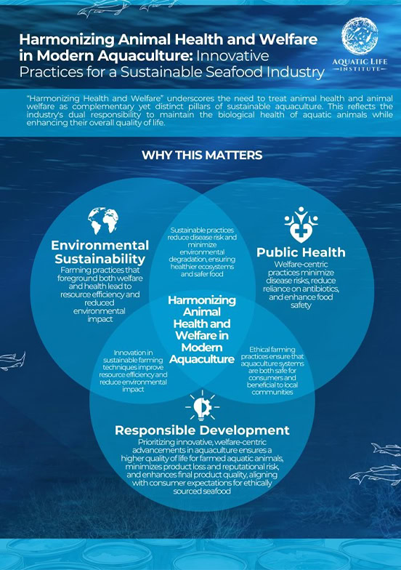
6
Applications in Aquaculture
Improving Breeding Programs and Stock Management
Cryopreservation allows for the long-term storage of sperm from superior males for use in breeding programs. Sperm preservation is a really good option.
Facilitates the introduction of desirable traits into farmed fish populations. It helps to have a population of high-quality fish.
Decreases the need to collect wild fish for breeding purposes, promoting sustainable aquaculture. This method promotes sustainable aquaculture.
Preserves disease-resistant strains for future use, enhancing biosecurity in aquaculture operations. It enhances the biosecurity in farms.
Photo by Google

Slide 9
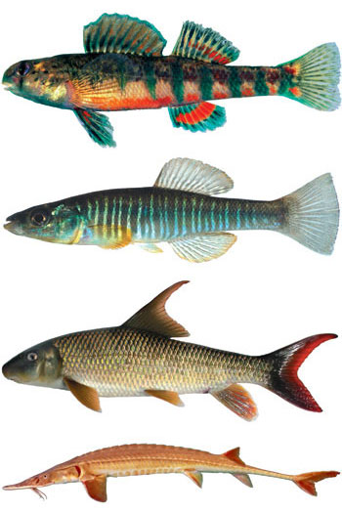
7
Conservation Applications: Saving Endangered Species
Using Cryopreservation to Protect Vulnerable Fish Populations
Establishing gene banks to store the genetic material of endangered fish species. This helps to preserve fish gene.
Using cryopreserved gametes to re-establish or augment declining fish populations. It re-establishes declining fish population.
Preventing genetic mixing between closely related species through controlled breeding programs. It prevents the genetic mixing.
Providing a source of genetic diversity in the event of environmental disasters or disease outbreaks. Protects against environmental disasters.
Photo by Google

Slide 10
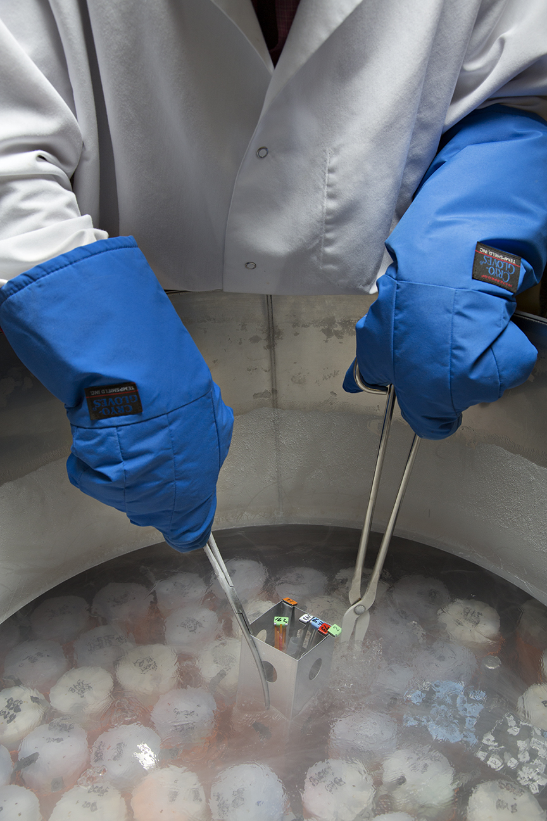
8
Future Directions: Advancements and Innovations
Exploring New Technologies and Optimizing Existing Methods
Using nanoparticles to deliver cryoprotectants more efficiently and reduce toxicity. Reduces toxicity with the help of nanoparticles.
Automating cryopreservation processes to improve efficiency and reduce human error. Reduces error with the help of automation.
Combining genomic data with cryopreservation techniques to select and preserve individuals with desirable traits. Select and preserve individuals.
Researching on different warming strategies to have a maximum benefit from the preservation. This will maximize the benefit.
Photo by Google

Slide 11
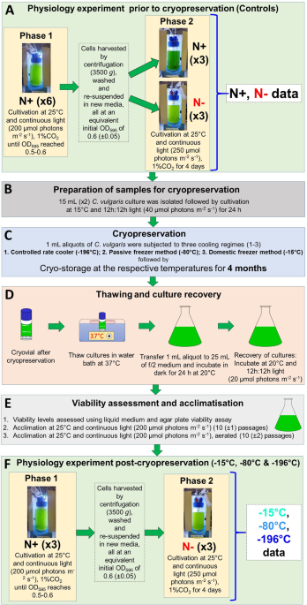
9
Challenges and Considerations
Addressing the Hurdles in Gamete Cryopreservation
Developing tailored protocols for a wider range of fish species. Helps different fish species to be preserved.
Reducing the cost of cryopreservation and establishing accessible infrastructure for widespread application. Help in easy application.
Addressing ethical concerns related to genetic resource management and conservation. Help in resource management and conservation.
Providing training and education to ensure proper implementation of cryopreservation techniques. Proper training is really important.
Photo by Google

Slide 12

10
Thank You
Thank you for your attention! I hope this presentation has provided valuable insights into the world of cryopreservation.
I welcome any questions you may have.
Your engagement is highly appreciated!
Thank you again for your time and participation.
Photo by Google

