Slide 1
Cursor AI: Accelerating Code Development
Enhancing Developer Productivity with AI-Powered Code Completion

Slide 2
Table of Contents
1
Unlock Your Coding Potential
5
Boosting Productivity
2
What is Cursor AI?
6
The Future of Coding
3
Cursor AI Pitch Deck: The Vision
7
Cursor AI: Key Benefits
4
VS Code Integration
8
Getting Started with Cursor AI

Slide 3
9
Real-World Applications
10
Thank You

Slide 4
Unlock Your Coding Potential
In today's fast-paced tech world, developer productivity is key. Cursor AI helps you write code faster and more efficiently.
Cursor AI leverages artificial intelligence to provide intelligent code completion and suggestions, boosting your coding speed.
It's designed to integrate smoothly into your existing workflow, making adoption easy and enhancing your current coding practices.
With Cursor AI handling routine tasks, you can focus on more complex problem-solving and innovative solutions.
Photo by Google

Slide 5
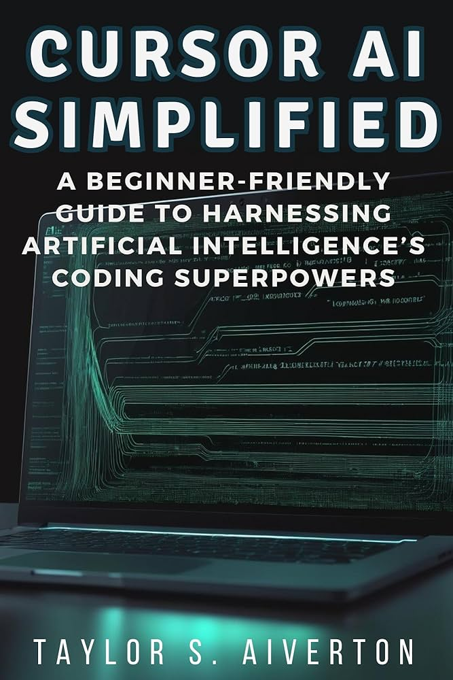
What is Cursor AI?
Cursor AI goes beyond basic auto-complete, offering context-aware suggestions that understand your code intent.
Built upon the foundation of VS Code, Cursor AI maintains a familiar environment while adding powerful AI features.
The core goal is to make developers significantly faster and more productive, reducing time spent on repetitive tasks.
It analyzes your code in real-time to provide accurate and relevant suggestions, minimizing errors and speeding up development.
Photo by Google

Slide 6
Cursor AI Pitch Deck: The Vision
The pitch deck aims to showcase the potential of Cursor AI and attract investors to support its continued development.
It emphasizes the tangible benefits of using Cursor AI, such as increased developer productivity and faster project completion.
The deck will discuss the growing market for AI-powered development tools and Cursor AI's position within it.
A clear vision for future development and expansion, including new features and integration possibilities are being showcased.
Photo by Google

Slide 7
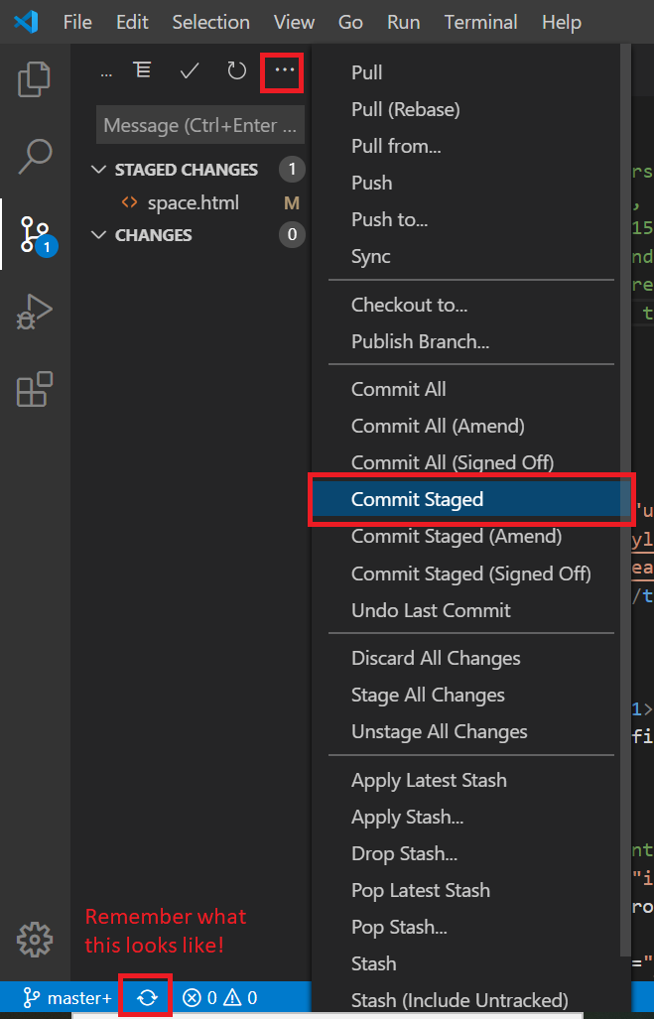
VS Code Integration
Because Cursor AI is a fork of VS Code, developers can use it while retaining their existing working environment.
The familiar interface ensures a smooth transition, minimizing the learning curve and maximizing immediate productivity gains.
Benefit from the extensive VS Code plugin ecosystem, enhancing Cursor AI's capabilities even further.
Customize your coding environment with themes and settings that match your personal preferences and coding style.
Photo by Google

Slide 8
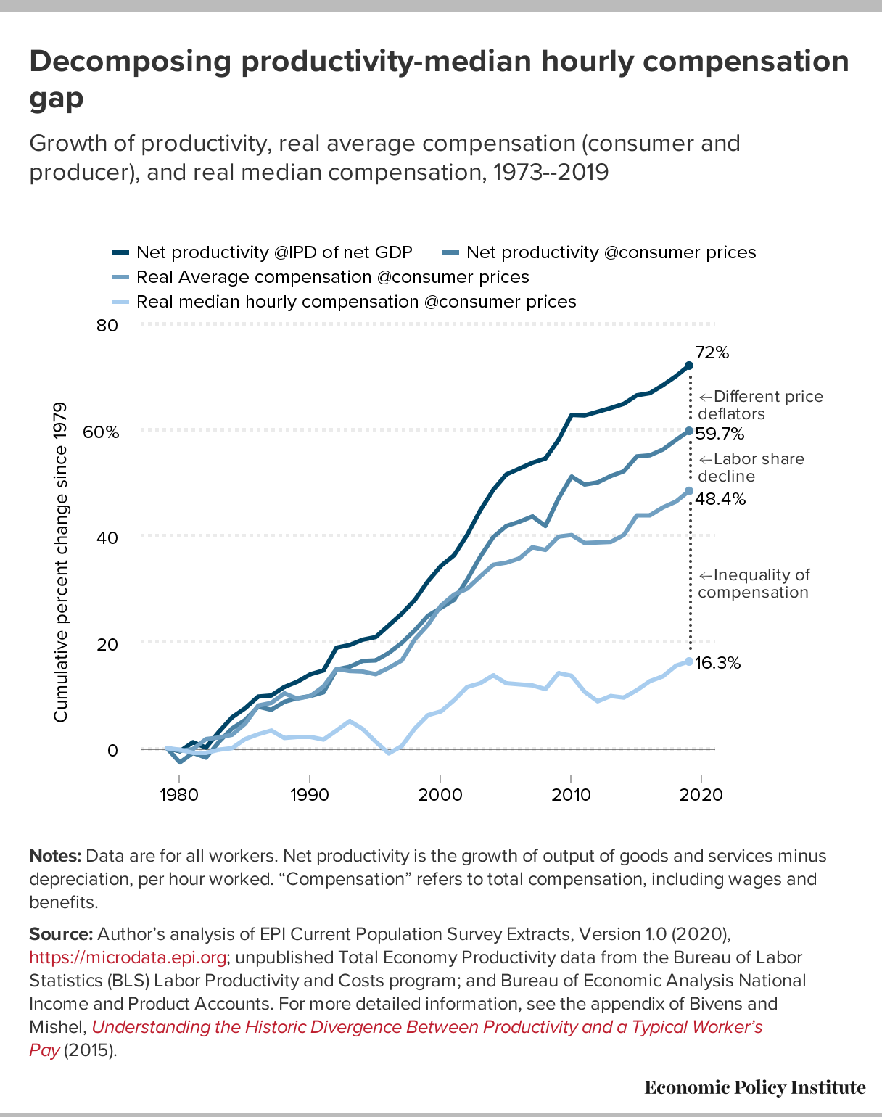
Boosting Productivity
Cursor AI helps you write code faster by predicting your code and offering relevant suggestions in real-time.
The intelligent code completion minimizes errors, leading to cleaner code and fewer debugging sessions.
By automating repetitive tasks, Cursor AI streamlines your workflow, allowing you to focus on critical aspects of your projects.
The improved code quality and consistency make it easier to collaborate with other developers.
Photo by Google

Slide 9
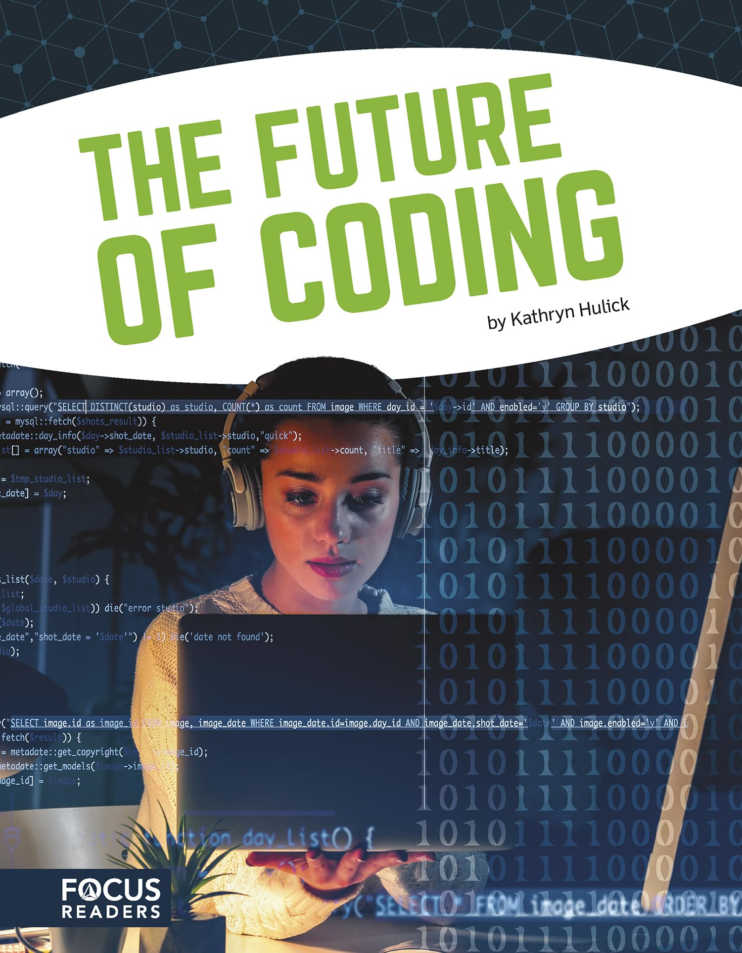
The Future of Coding
Cursor AI represents a shift towards AI-driven development, where AI assists in every stage of the software creation process.
The technology is constantly evolving, with ongoing improvements to code completion and AI-powered features being made.
It brings the power of AI to everyday developers, making advanced tools more accessible and easier to use.
Cursor AI has the potential to transform the software development industry, making it faster, more efficient, and more innovative.
Photo by Google

Slide 10
Cursor AI: Key Benefits
Write code significantly faster with AI-powered auto-completion and suggestions.
Minimize errors and improve code quality with intelligent code analysis.
Streamline your development workflow and focus on core tasks.
Improve collaboration with cleaner, more consistent code.
Photo by Google

Slide 11
Getting Started with Cursor AI
Download Cursor AI from the official website and follow the simple installation instructions.
Set up your preferred settings and customize the interface to your liking.
Begin coding with Cursor AI and experience the power of AI-assisted development firsthand.
Experiment with different features and discover how Cursor AI can enhance your specific coding tasks.
Photo by Google

Slide 12
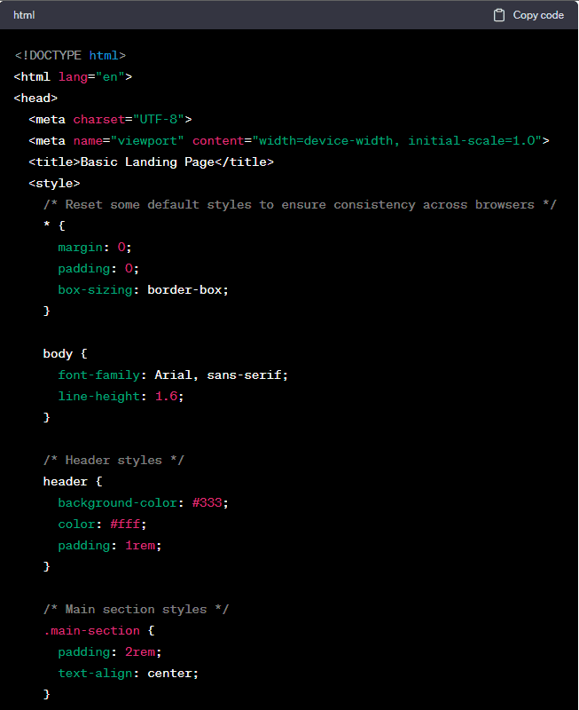
Real-World Applications
Speed up web development with intelligent auto-completion for HTML, CSS, and JavaScript.
Enhance mobile app development by generating efficient code for Android and iOS platforms.
Simplify data science projects with AI-powered suggestions for Python and R code.
Create games faster with intelligent support for game development languages like C# and C++.
Photo by Google

Slide 13
Thank You
We are grateful for your time and consideration of Cursor AI.
Visit our website to explore more features and resources.
Follow us on social media to stay updated on the latest news and developments.
Transform your coding workflow and unlock your full potential with Cursor AI.
Photo by Google

