Slide 1
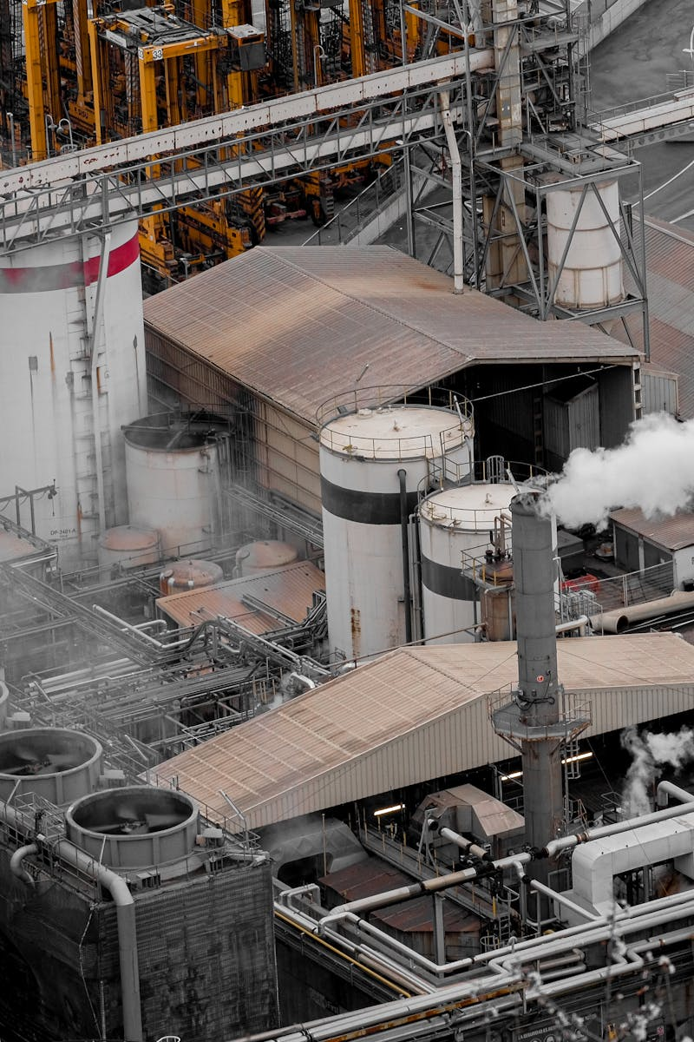
DRI Plants Revolutionary Iron Production Technology
Photo by Pexels

Slide 2
01
Introduction to DRI Plants
Table of Contents
02
Understanding DRI Technology
03
Environmental Advantages
04
Economic Benefits
05
Applications and Future

Slide 3
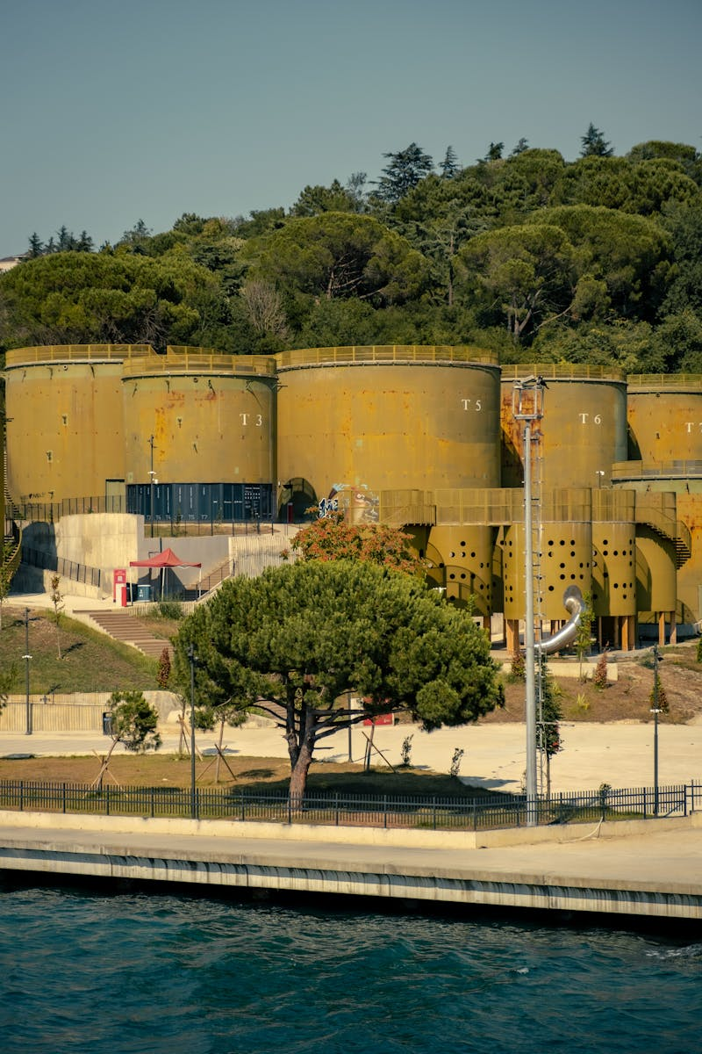
1
Introduction to DRI Plants
The Future of Iron Production
Direct Reduced Iron plants are industrial facilities that produce iron using natural gas instead of traditional coke-based methods. DRI plants represent a significant advancement in metallurgical engineering, offering cleaner and more efficient iron production. These facilities are transforming the steel industry worldwide by reducing carbon emissions and improving production efficiency. DRI plants showcase cutting-edge technology that addresses traditional steelmaking challenges with sustainable solutions.

Slide 4

2
Understanding DRI Technology
How Direct Reduced Iron Works
DRI plants utilize natural gas to reduce iron ore pellets into high-quality iron without the need for traditional blast furnaces. Precise temperature management ensures optimal reduction of iron ore while maintaining product quality and efficiency. The process involves reducing iron ore using reducing gases like hydrogen and carbon monoxide at controlled temperatures. State-of-the-art engineering systems enable continuous production with minimal environmental impact and maximum output.

Slide 5

3
Environmental Advantages
Sustainable Iron Production
DRI plants significantly lower carbon dioxide emissions compared to traditional steelmaking processes, contributing to cleaner air. These facilities consume less energy per ton of iron produced, making them more environmentally and economically sustainable. The elimination of coke ovens reduces harmful pollutants and creates a healthier working environment for employees. DRI plants are designed to incorporate renewable energy sources, positioning them as leaders in sustainable industrial production.

Slide 6
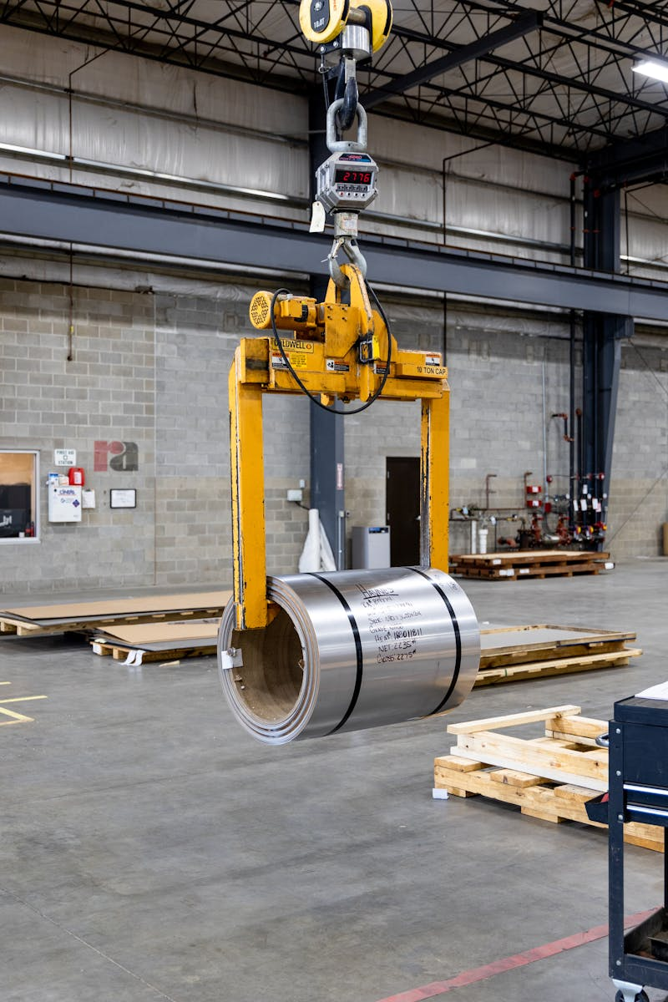
4
Economic Benefits
Cost-Effective Iron Production
DRI plants offer reduced operational expenses through efficient processes and lower energy consumption compared to traditional methods. Producers using DRI technology gain competitive advantages through higher quality products and lower environmental compliance costs. These facilities maximize resource utilization by using various iron ore grades and optimizing gas consumption for better economics. DRI plants can be designed for various production scales, offering flexibility for different market demands and investment levels.

Slide 7
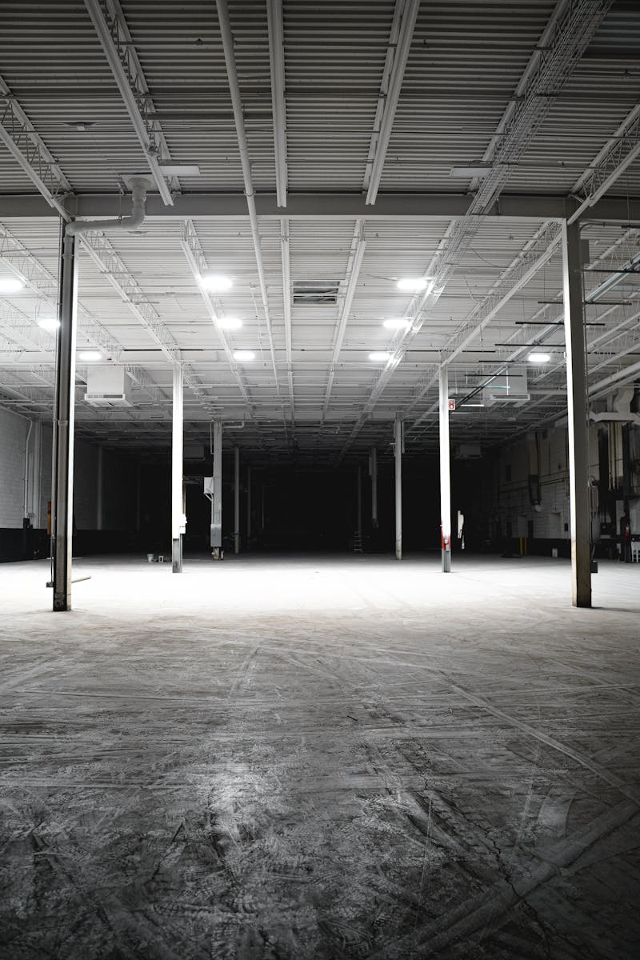
5
Applications and Future
DRI in Modern Industry
DRI serves as a primary raw material for electric arc furnaces, enabling high-quality steel production with reduced impurities. The high purity of DRI makes it ideal for specialized foundry applications requiring superior iron quality and consistency. Global demand for DRI continues to rise as industries seek cleaner, more efficient alternatives to traditional iron production methods. Future DRI plants will incorporate advanced automation, AI monitoring, and integration with hydrogen-based systems for even greater sustainability.

