Slide 1

DXN Natural Face Images
Exploring Natural Beauty Through 9 Captivating Images
Photo by Pexels

Slide 2
01
Introduction to DXN Natural Face Images
Table of Contents
02
Image 1-3: Expressions & Emotions
03
Image 4-6: Features & Characteristics
04
Image 7-9: Cultural & Natural Blend
05
The Impact of Natural Imagery

Slide 3
1
Introduction to DXN Natural Face Images
Discover the Essence of Natural Beauty
Nine carefully curated images showcasing authentic natural beauty and facial expressions.
How these images capture the true essence of human beauty without artificial enhancements.
A diverse selection of nine natural face images representing various expressions and features.
The importance of embracing natural beauty in today's image-conscious society.

Slide 4
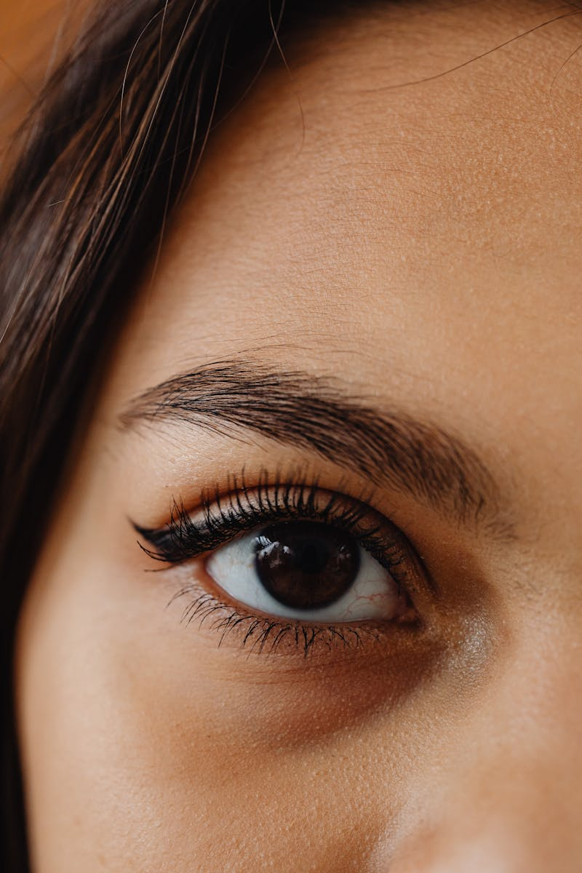
2
Image 1-3: Expressions & Emotions
Capturing Human Feelings Naturally
The first image captures genuine happiness and natural laughter in its purest form.
The second image shows peaceful thoughtfulness and natural calmness on the face.
The third image displays natural warmth and approachability in facial features.
How these three images collectively represent the spectrum of natural human emotions.

Slide 5
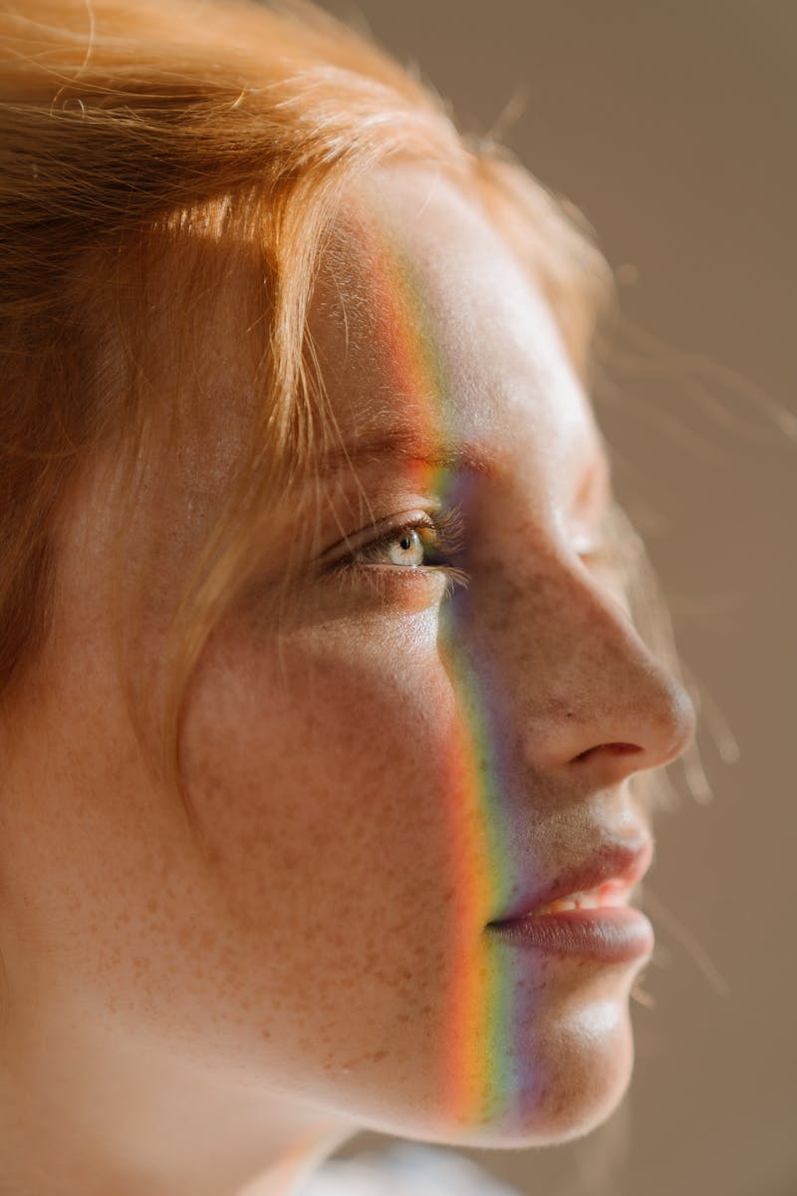
3
Image 4-6: Features & Characteristics
Celebrating Natural Facial Diversity
The fourth image highlights natural skin textures and unique facial characteristics.
The fifth image showcases the natural balance and harmony of facial features.
The sixth image represents natural aging and the beauty that comes with time.
How these three images celebrate the unique qualities that make each face naturally beautiful.

Slide 6

4
Image 7-9: Cultural & Natural Blend
Beauty Across Different Backgrounds
The seventh image reflects natural beauty influenced by cultural background and heritage.
The eighth image shows how natural surroundings influence facial expressions and beauty.
The ninth image represents the universal nature of natural beauty that transcends boundaries.
How these final three images demonstrate shared natural beauty across diverse backgrounds.

Slide 7

5
The Impact of Natural Imagery
Why DXN Natural Face Images Matter
How these nine images promote self-love and acceptance of natural facial features.
The importance of authentic natural images in media and advertising today.
How these images serve as educational tools about natural beauty standards.
The lasting impact of embracing natural face images in our visual culture.

