Slide 1

Decoding Informal Economies Understanding Dynamics and Transformations
Photo by PDF

Slide 2
01
Informality Unveiled
Table of Contents
02
Historical Roots
03
Defining Characteristics
04
Driving Factors
05
Thank You

Slide 3
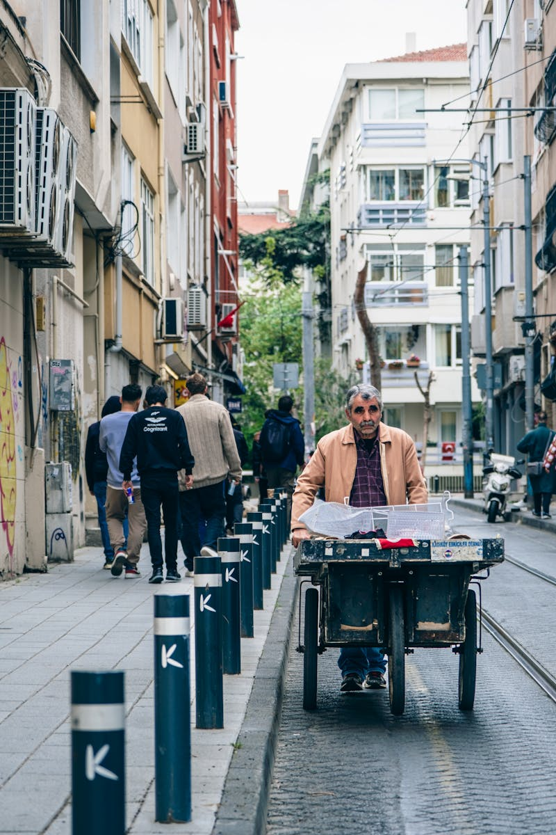
1
Informality Unveiled
Beyond Simplistic Views
Informal economies significantly influence economic, social, and institutional dynamics globally. It's a key aspect, not just in developing nations, but also in industrialized ones. Understanding requires moving past simple views of survival or lack of economic modernity. It involves multifaceted interactions between institutions and evolving strategies. It includes productive, commercial, and service activities that operate outside state regulatory frameworks. These are often legal but unregistered or undeclared activities. Unlike illegal activities, informal economies involve legal but unregistered actions. This distinction is crucial for analyzing socioeconomic determinants of productive organizations.

Slide 4
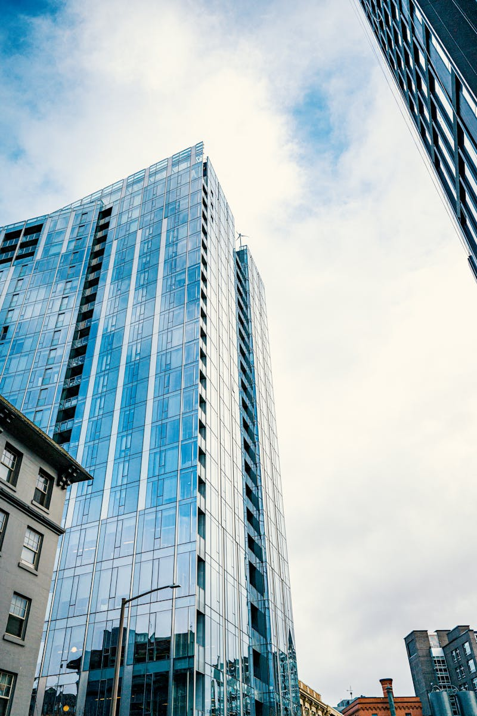
2
Historical Roots
Tracing the Rise of Informality
The rise of informal economies is linked to urban growth, incomplete industrialization, and recurring economic crises. Institutional rigidities and fragile political transitions also play a big role. In the 1970s and 1980s, informality was seen as a residual sector, indicating persistent underdevelopment. However, perceptions have changed with further understanding. With globalization and structural reforms, the sector is now understood to be a structural element of economies. Demographic shifts and labor changes also contribute to this perception. Informal sector isn't an economic accident but a structural component of modern economies. This evolution requires a deeper understanding of how economies function.

Slide 5
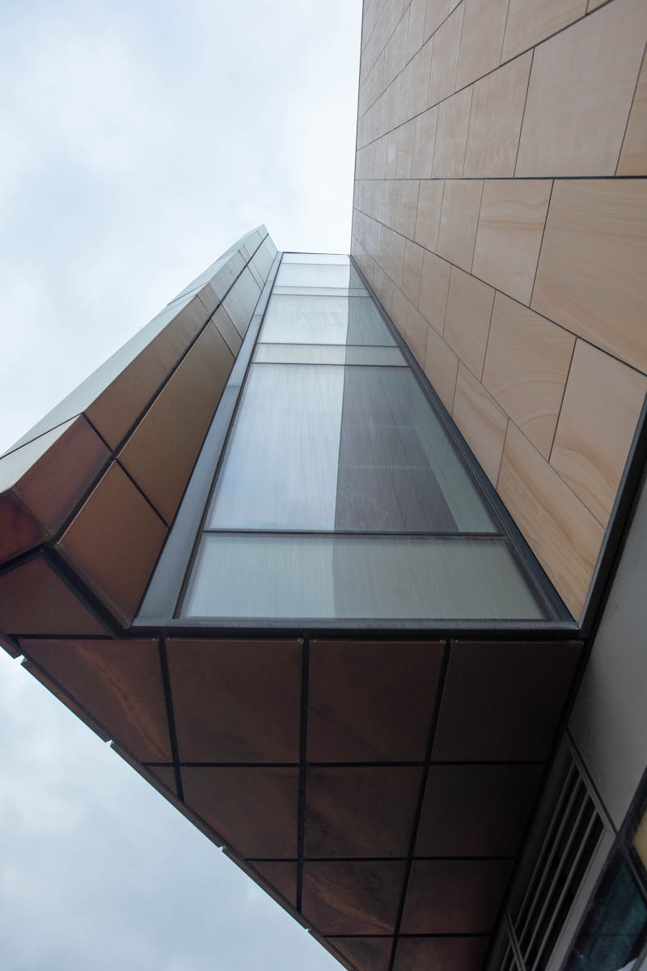
3
Defining Characteristics
Activities within the Informal Realm
The informal economy includes small artisanal units, street trading, undeclared domestic work, and family workshops. Growing microenterprises are also included in this sector. Some forms of platform work fall into this category when fiscal and social obligations aren't met. They are often legal but not registered with formal entities. Activities are generally licit, yet not registered or declared, differentiating them from criminal endeavors. This distinction is vital for detailed analysis. Avoiding confusion between informality and criminality is essential for accurate socioeconomic analysis. This requires a deeper look into organizational structure.

Slide 6
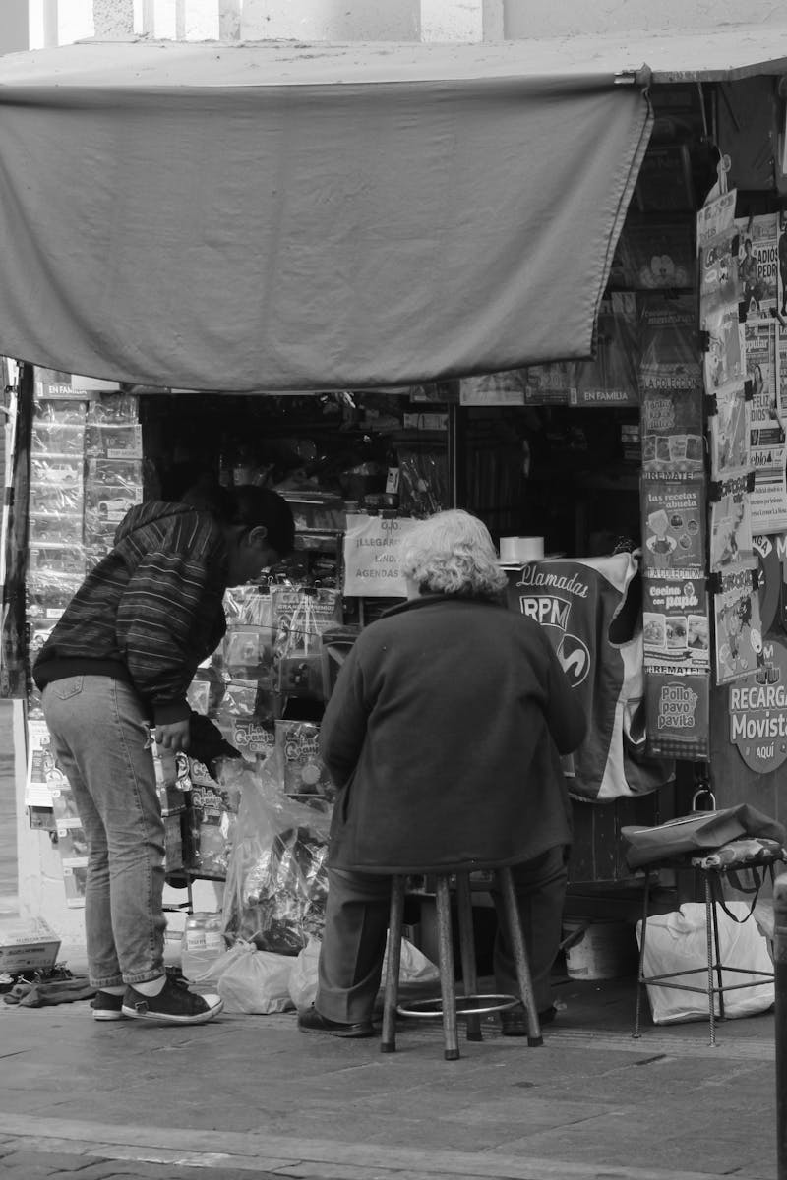
4
Driving Factors
Economic and Social Catalysts
Rapid urbanization has fueled the growth of the informal economy, especially in developing countries. Cities provide settings where unregulated businesses thrive. Economic downturns often push more people into informal work as formal sector opportunities diminish. This dynamic provides income when other sources are scarce. Rigid institutional frameworks can hinder formalization, leading businesses to operate informally. These frameworks can create barriers for small businesses. Poorly managed liberalization can increase informality if not accompanied by adequate regulations. This may lead to imbalances that grow this specific sector.

Slide 7

5
Thank You
Acknowledging Your Attention
Thank you for taking the time to explore the dynamics of informal economies. We appreciate your engagement. We hope this presentation has provided valuable insights into this complex subject. Further exploration is encouraged. We encourage you to continue researching and understanding the evolving nature of informal economies in our world. Understanding informality is essential for shaping effective policies and fostering inclusive economic growth. Thank you once again for your time.

