Slide 1
Decoding Tata Izo Cloud: A College Guide Unlocking the Potential of Tata Izo Cloud for Modern Computing
Photo by Google

Slide 2
01
Welcome to the Cloud Frontier!
Table of Contents
02
Tata Izo Cloud: What's New?
03
Infrastructure Edge
04
Real-World Impact
05
Fort Knox of the Cloud
06
Scale New Heights
07
Cloud Mastery
08
Key Takeaways
09
Words of Praise
10
Thank You!

Slide 3
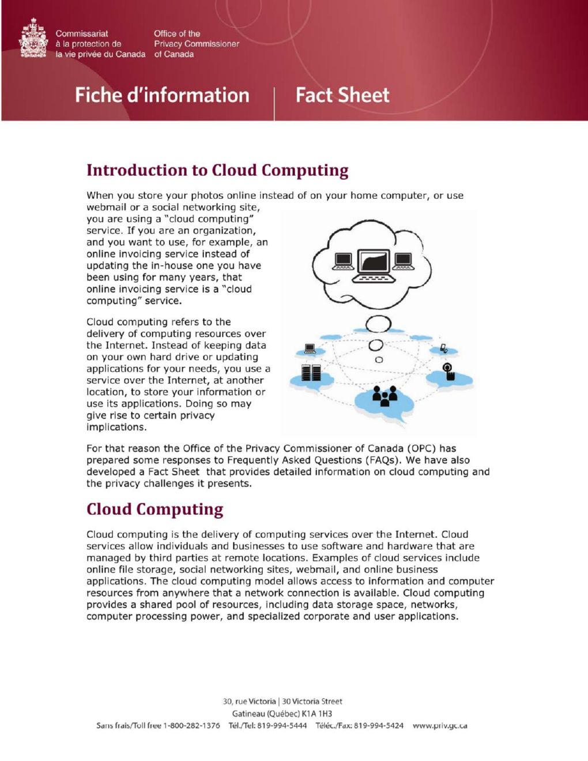
1
Welcome to the Cloud Frontier!
Exploring Tata Izo Cloud in the Modern Digital Era
Witness the evolution of cloud services and understand how Tata Izo Cloud provides flexible, scalable solutions to meet diverse enterprise needs. Discover the importance of Tata Izo Cloud in today’s digital landscape, enabling organizations to adapt swiftly to market demands. Explore automated scaling, enhanced security, data analytics tools, and seamless integration. Tata Izo Cloud provides powerful business solutions. Tata Izo Cloud represents a paradigm shift by providing robust solutions that support an array of services designed to optimize operations.
Photo by Google

Slide 4
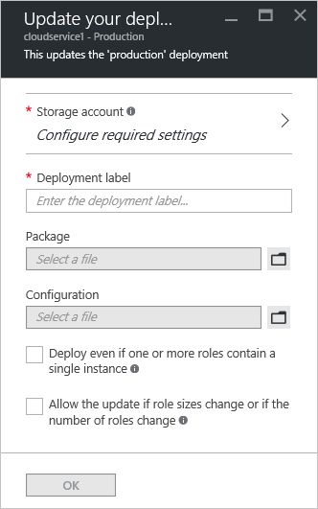
2
Tata Izo Cloud: What's New?
Exploring Recent Changes and Updates
Discover the latest enhancements in Tata Izo Cloud services that are designed to provide better performance and greater efficiency for users. Stay informed about the newest feature rollouts within the Tata Izo Cloud, improving usability and expanding functionalities. Understand how the cloud adapts to the newest technology, positioning itself as a future-ready platform with advanced capabilities. Dive into innovations in the Tata Izo Cloud, highlighting scalability improvements and security enhancements that protect businesses.
Photo by Google

Slide 5
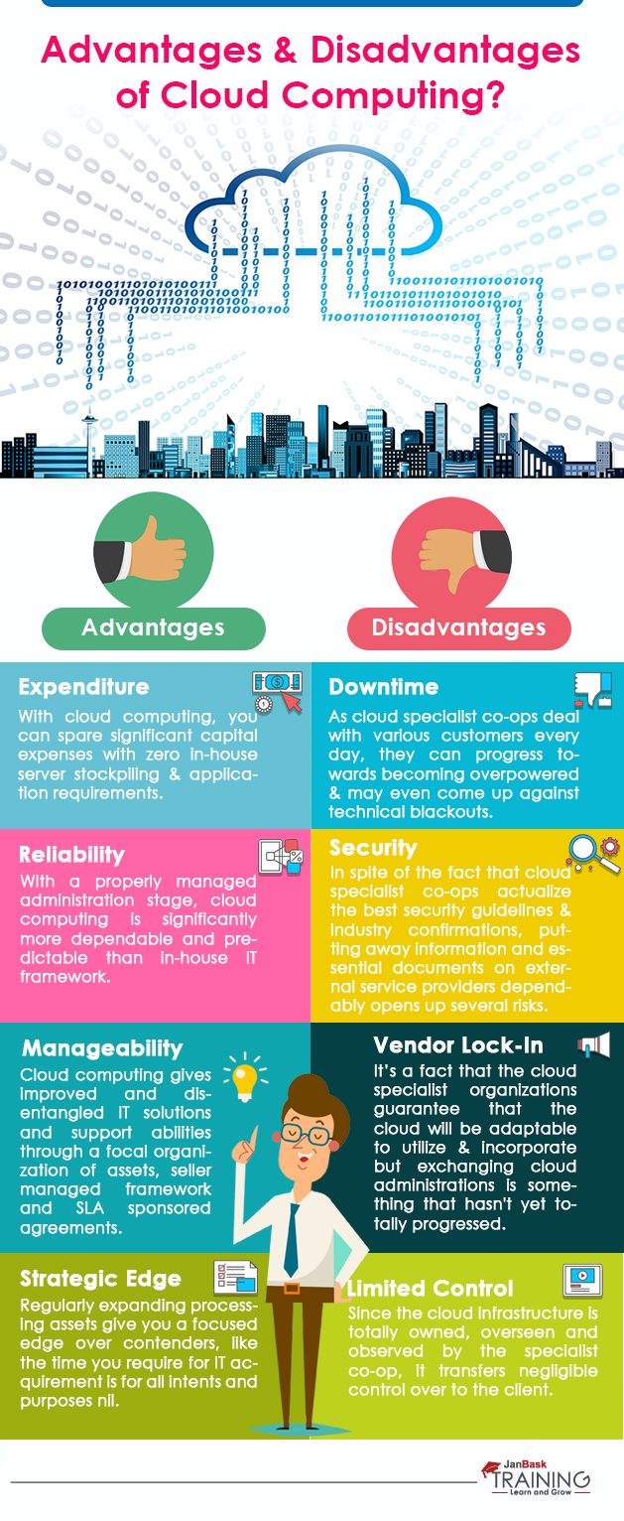
3
Infrastructure Edge
Unveiling the Advantages of Tata Izo Cloud Infrastructure
Learn how Tata Izo Cloud’s infrastructure provides resources for businesses to scale up or down easily, based on their operational requirements. Discover the reliable network infrastructure that supports Tata Izo Cloud, enabling businesses to access data and applications from anywhere. With its worldwide infrastructure, Tata Izo Cloud makes sure businesses can reach clients and partners around the world without any hitches. Tata Izo Cloud uses cutting-edge technology to give businesses the tools they need to innovate and compete in today's marketplace.
Photo by Google

Slide 6
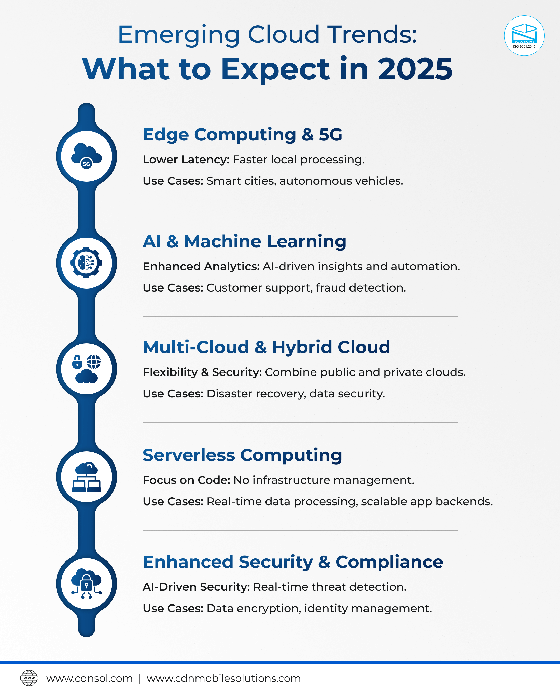
4
Real-World Impact
Use Cases of Tata Izo Cloud in Various Industries
See how the retail industry uses Tata Izo Cloud to improve the customer experience through cloud-based loyalty programs. Learn how financial institutions use Tata Izo Cloud to facilitate secure online transactions and manage vast data with safety and efficiency. Find out how healthcare providers leverage Tata Izo Cloud to manage patient records and use telehealth, improving health outcomes. The manufacturing sector uses Tata Izo Cloud to optimize supply chains, reduce costs, and scale operations with ease, improving productivity.
Photo by Google

Slide 7
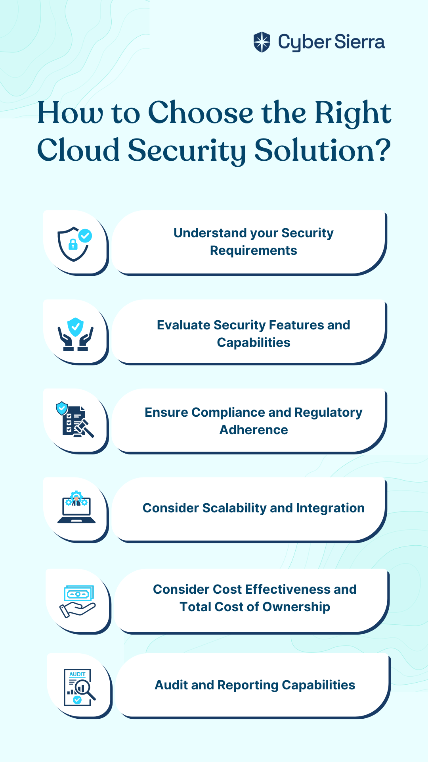
5
Fort Knox of the Cloud
Exploring Security Features of Tata Izo Cloud
Tata Izo Cloud protects sensitive information through strong data encryption methods, both when it's moving and when it's stored. Access control features help keep data secure, ensuring only authorized users can get to sensitive resources. Tata Izo Cloud is certified to meet key industry standards, proving its dedication to data protection and adherence to international regulations. Real-time threat detection systems continuously check for and neutralize any possible security threats, adding an additional layer of protection.
Photo by Google

Slide 8
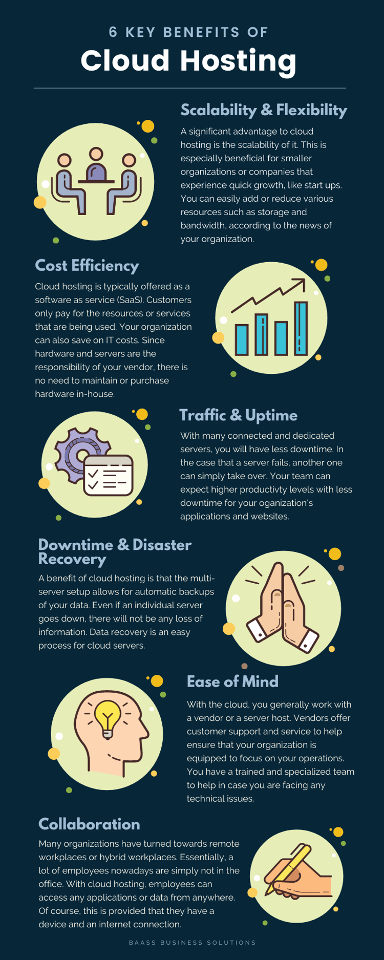
6
Scale New Heights
Understanding the Scalability Capabilities of Tata Izo Cloud
Learn how Tata Izo Cloud offers elastic resources, enabling businesses to adjust their computing capabilities in real-time based on demand. Discover the advantages of automated scaling, ensuring applications always have the required resources for optimal performance during peak times. Tata Izo Cloud makes it easy for businesses to expand their cloud infrastructure internationally, supporting global growth with reliable services. With dynamic scaling features, Tata Izo Cloud adapts easily to changing workload needs, helping businesses stay flexible and competitive.
Photo by Google

Slide 9
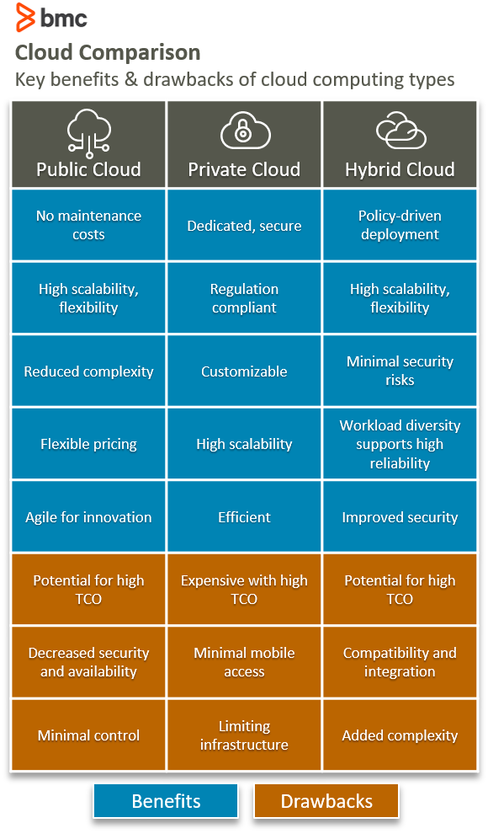
7
Cloud Mastery
Best Practices for Utilizing Tata Izo Cloud
Best practices include optimizing resource use, making sure resources are used effectively to lower costs and improve overall performance. Best practices involve implementing strict security measures to protect sensitive data and ensure compliance with industry standards. Continual monitoring of the cloud environment is essential for pinpointing performance bottlenecks and potential security risks, enhancing reliability. Implementing cost-efficient strategies helps businesses maximize their cloud investment, lowering operational expenses and improving ROI.
Photo by Google

Slide 10
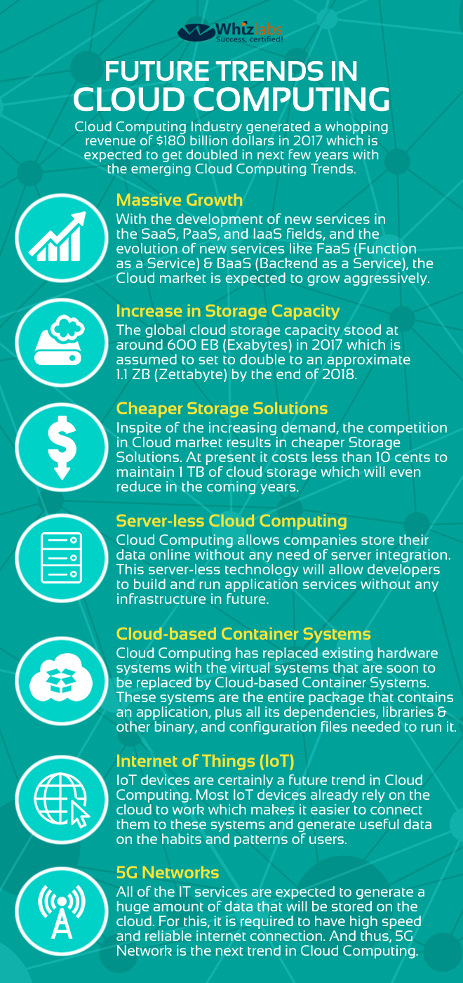
8
Key Takeaways
Key Takeaways and Future Directions of Tata Izo Cloud
Recap the importance of Tata Izo Cloud in cloud computing and its role in enabling digital transformation. Discuss future trends in cloud technology, including AI, machine learning, and edge computing, and how Tata Izo Cloud is preparing for these advances. Explore how Tata Izo Cloud is enhancing its services to meet the changing requirements of businesses, supporting innovation and scalability. Emphasize Tata Izo Cloud's continuous innovation, its mission to offer reliable, secure, and scalable cloud solutions that empower businesses to thrive.
Photo by Google

Slide 11
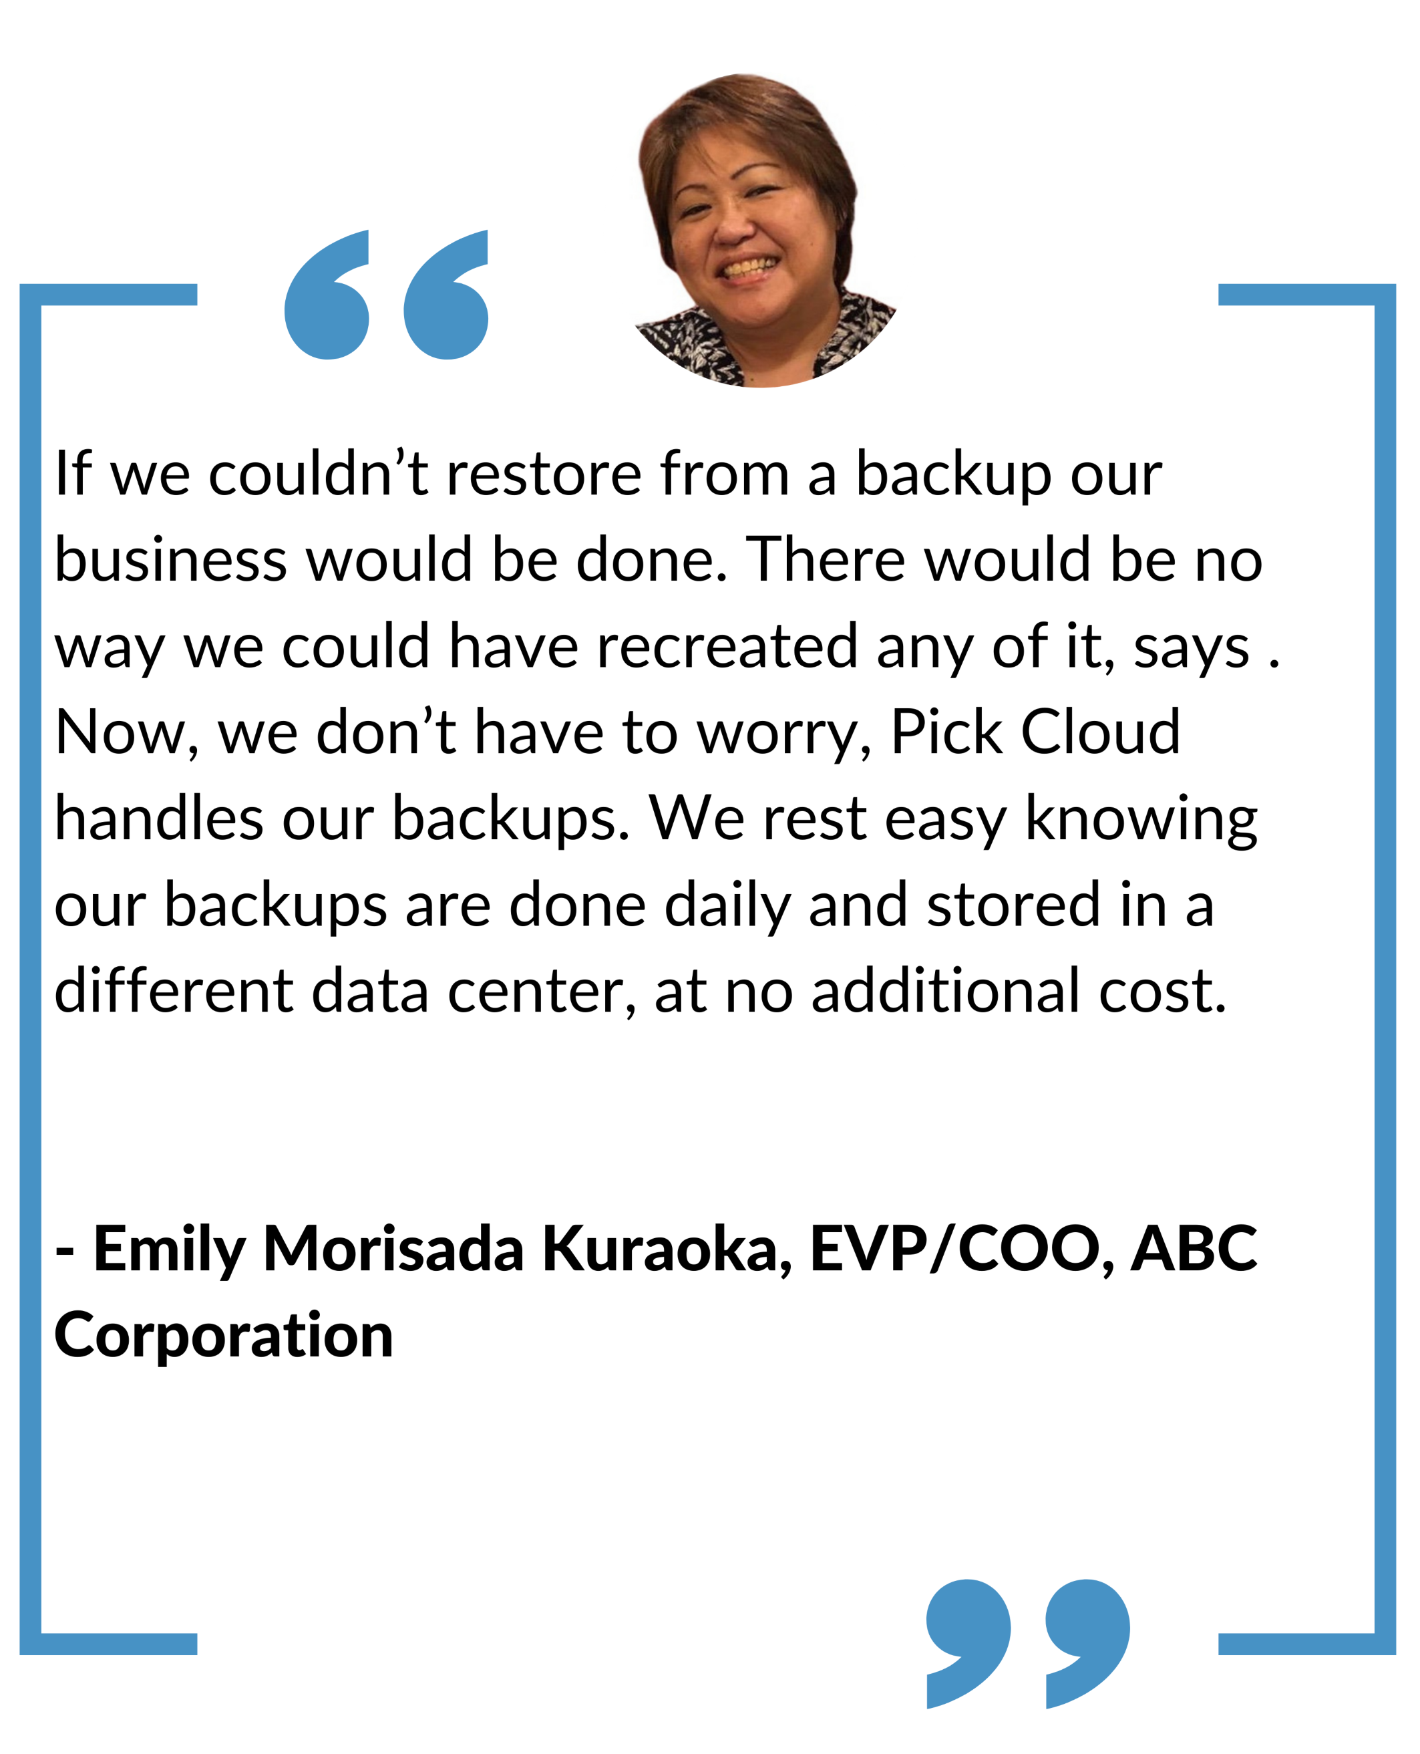
9
Words of Praise
Customer Testimonials about Tata Izo Cloud
Hear from retail clients who have greatly enhanced customer satisfaction with personalized shopping experiences using Tata Izo Cloud. Testimonials from the finance sector emphasize improved transaction security and regulatory compliance due to Tata Izo Cloud’s advanced features. Discover how healthcare providers are improving patient care and operational efficiency with Tata Izo Cloud’s reliable, secure solutions. Hear from manufacturing leaders who have streamlined operations, reduced costs, and scaled production effectively with Tata Izo Cloud.
Photo by Google

Slide 12
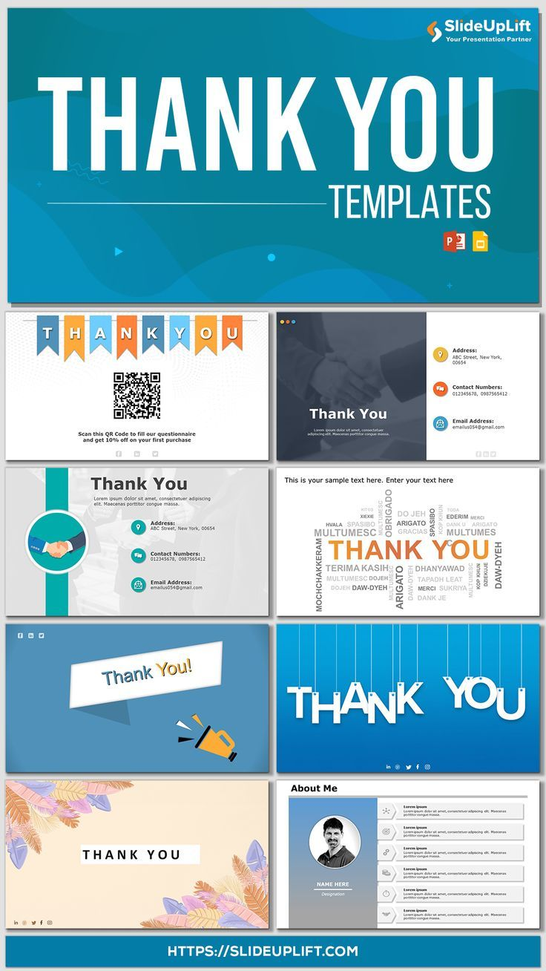
10
Thank You!
Grateful for Your Attention
Thank you for taking the time to explore Tata Izo Cloud. We appreciate your interest in learning more about how our cloud solutions can benefit your future success. If you have any questions or would like to explore partnership opportunities, please don't hesitate to contact us. We look forward to potentially collaborating with you and being a part of your journey towards achieving digital excellence.
Photo by Google

