Slide 1

Demystifying LLMs: From Theory to Hands-On with Llama-3 A Step-by-Step Workshop for Students
Photo by Pexels

Slide 2
01
Session Goal
Table of Contents
02
10:00 – 11:00 AM: The Mechanics (How LLMs Work)
03
Tokenization & The Math Problem
04
The Hardware Problem: Quantization
05
11:00 – 12:00 PM: The Hello World (Hands-On)
06
First Inference: Why ‘Hi’ Repeats
07
12:00 – 12:20 PM: Engineering Prompts
08
12:20 – 12:40 PM: Few-Shot Prompting
09
12:40 – 01:00 PM: Mini Hack – The Strict Librarian
10
Wrap-Up & Key Takeaways

Slide 3

1
Session Goal
By 1:00 PM: Llama-3 (or Phi-3) running in Google Colab
✅ Open a Google Colab notebook ✅ Load a 4-bit quantized Llama-3 or Phi-3 model ✅ Write a Python function to interact with the model Focus: From understanding LLM internals to building prompt-ready models
Photo by Pexels

Slide 4

2
10:00 – 11:00 AM: The Mechanics (How LLMs Work)
Demystifying the Magic
Goal: Understand that LLMs are not knowledge bases, but next-token predictors. Visual: Transformer Encoder-Decoder architecture. Core idea: Context determines meaning (e.g., 'Bank' in different sentences). Output: Predicts the most probable next word.
Photo by Pexels

Slide 5

3
Tokenization & The Math Problem
Why LLMs Struggle with Spelling and Arithmetic
Interactive Demo: Use the OpenAI Tokenizer. Example: 'Lollipop' is one token, not letters. Reason for errors: Models operate on tokens, not characters. Lesson: Break problems down for better results.
Photo by Pexels

Slide 6

4
The Hardware Problem: Quantization
Fitting Big Brains into Small GPUs
Challenge: Llama-3-8B needs ~16GB VRAM; Colab Free Tier gives 15GB. Solution: Quantization – compressing model weights. Analogy: FP16 = high-res pizza; INT4 = pixelated pizza. Takeaway: 4-bit quantization makes large models runnable in Colab.
Photo by Pexels

Slide 7

5
11:00 – 12:00 PM: The Hello World (Hands-On)
Setting Up and Running the Model
Step 1: Change runtime → T4 GPU. Step 2: Install dependencies: torch, transformers, bitsandbytes, accelerate. Step 3: Configure quantization and load pre-trained model. Troubleshoot: Common Colab errors and GPU disconnects.
Photo by Pexels

Slide 8
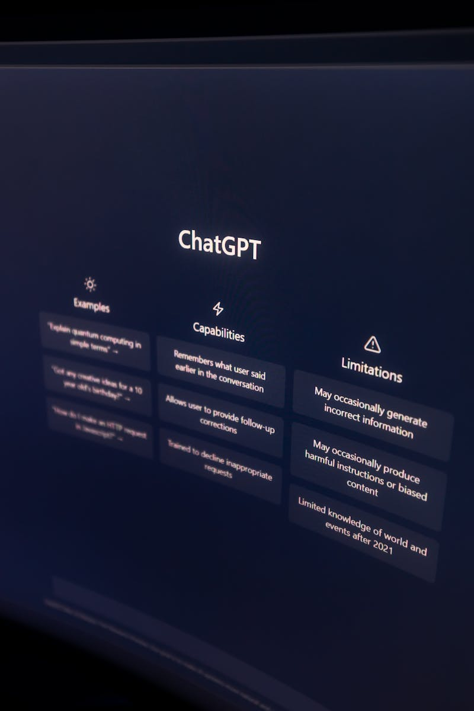
6
First Inference: Why ‘Hi’ Repeats
Understanding Model Behavior
Common mistake: Running model.generate('Hi') directly. Result: Repetitive or meaningless output. Lesson: Models need chat templates for structure. Next: Learn to use Llama-3’s chat format.
Photo by Pexels

Slide 9

7
12:00 – 12:20 PM: Engineering Prompts
Using Chat Templates for Llama-3
Concept: Templates tell the model who is speaking. Format includes system, user, and assistant tags. Activity: Build ask_llama(prompt) with tokenizer.apply_chat_template. Outcome: Consistent, context-aware model responses.
Photo by Pexels

Slide 10
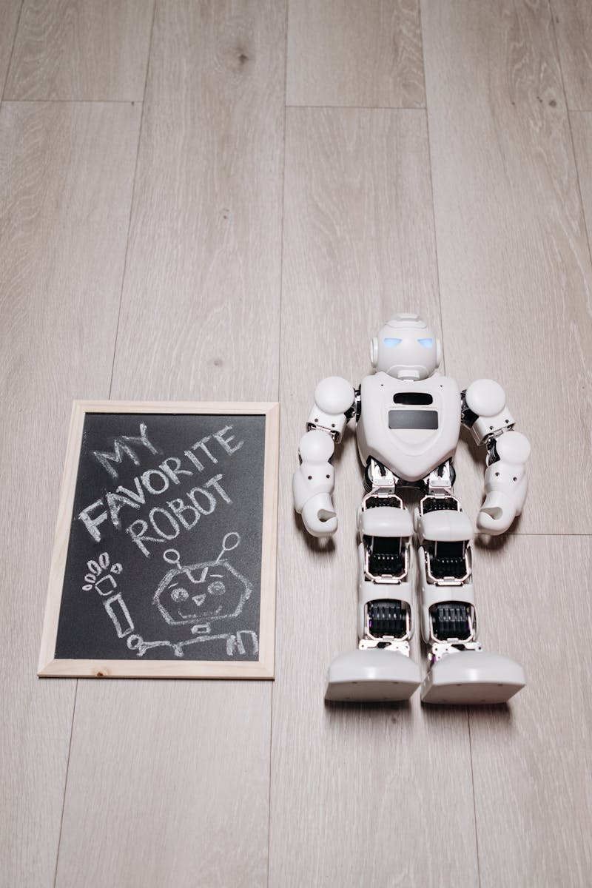
8
12:20 – 12:40 PM: Few-Shot Prompting
Teaching the Model Through Examples
Challenge: Translate Telugu to English JSON. Bad Prompt: Adds conversational fluff. Fix: Provide examples in the prompt (few-shot). Output: Precise, code-ready JSON response.
Photo by Pexels

Slide 11

9
12:40 – 01:00 PM: Mini Hack – The Strict Librarian
Building JSON-Ready Prompts
Task: System prompt to return JSON with genre and year for a book. Condition: If the book doesn’t exist → return null. Goal: Output must be parsable via json.loads() in Python. Why: Real-world AI apps depend on reliable JSON output.
Photo by Pexels

Slide 12

10
Wrap-Up & Key Takeaways
From Magic to Engineering
✔ LLMs = Predictors, not databases. ✔ Tokenization explains model quirks. ✔ Quantization enables on-device AI. ✔ Prompt engineering = Real control over output.
Photo by Pexels

