Slide 1

Differentiating Ship Inspections and Scenario Analysis
Applying Knowledge to MT Sea Serpent Scenario
Photo by Pexels

Slide 2
01
Title Slide
Table of Contents
02
Types of Ship Inspections
03
Scenario 5 Summary
04
Requirements of SIRE Inspection
05
Actions to Prepare and Pass Inspection

Slide 3

1
Title Slide
Group Members and Presentation Overview
Differentiate between ship inspections like SIRE, CDI, RightShip, and PSC, and apply to a scenario.
Explain specific requirements of these inspections based on the provided content.
Analyze the MT Sea Serpent case involving PSC and SIRE inspections.
Highlight preparation actions for successful inspections.

Slide 4
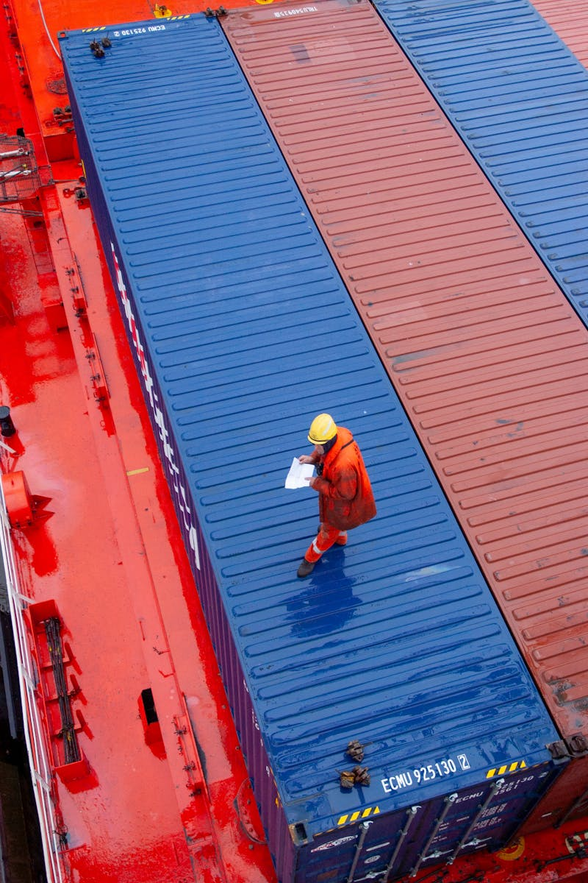
2
Types of Ship Inspections
Short Comparison of SIRE, CDI, RightShip, and PSC
Ship Inspection Report Programme by OCIMF, focusing on tanker safety, environmental protection, and operational standards.
Chemical Distribution Institute inspection, emphasizing safety and compliance for chemical tankers.
Quality assurance inspection for vessels, assessing risk and operational practices in shipping.
Port State Control inspection, verifying compliance with international maritime regulations and rectifying deficiencies.

Slide 5

3
Scenario 5 Summary
MT Sea Serpent Case Overview
A minor deficiency (missing warning sign near cargo pump) was noted and rectified on the MT Sea Serpent.
The PSC report was not integrated into the vessel’s Safety Management System (SMS) records.
During the SIRE inspection, the inspector requested evidence of deficiency discussion in safety committee meetings.
The Master acknowledged that the paperwork for tracking and discussing the deficiency was incomplete.

Slide 6

4
Requirements of SIRE Inspection
Specific Procedures and Standards
Integration of past deficiencies to ensure compliance with the ISM Code.
Confirmation of rectification and documentation of corrective and preventive actions.
Ensuring that PSC findings are recorded, discussed in safety meetings, and properly tracked.
Assessment of crew knowledge and shipboard procedures against the SIRE Vessel Inspection Questionnaire (VIQ).

Slide 7

5
Actions to Prepare and Pass Inspection
Steps for Vessel Owner/Operator
Ensure all PSC reports and deficiencies are recorded in the SMS with follow-up actions.
Hold and properly document safety committee meetings to discuss incidents and deficiencies.
Educate crew on the importance of documentation and fostering a strong safety culture.
Conduct a management review or internal audit before the SIRE inspection to verify compliance.

