Slide 1


Disaster Management
Understanding, Mitigation, and Response

Slide 2


Table of Contents
1
Cover Page
2
Certificate
3
Index
4
Introduction to Disaster Management
5
Types of Disasters
6
Man-Made Disasters: Fire - Causes

Slide 3
7
Man-Made Disasters: Fire - Vulnerability
8
Man-Made Disasters: Fire - Risk Management
9
Natural Disasters: Earthquake - Vulnerability
10
Natural Disasters: Earthquake - Risk Management
11
Role of NDRF
12
Role of NDRF (Continued)

Slide 4

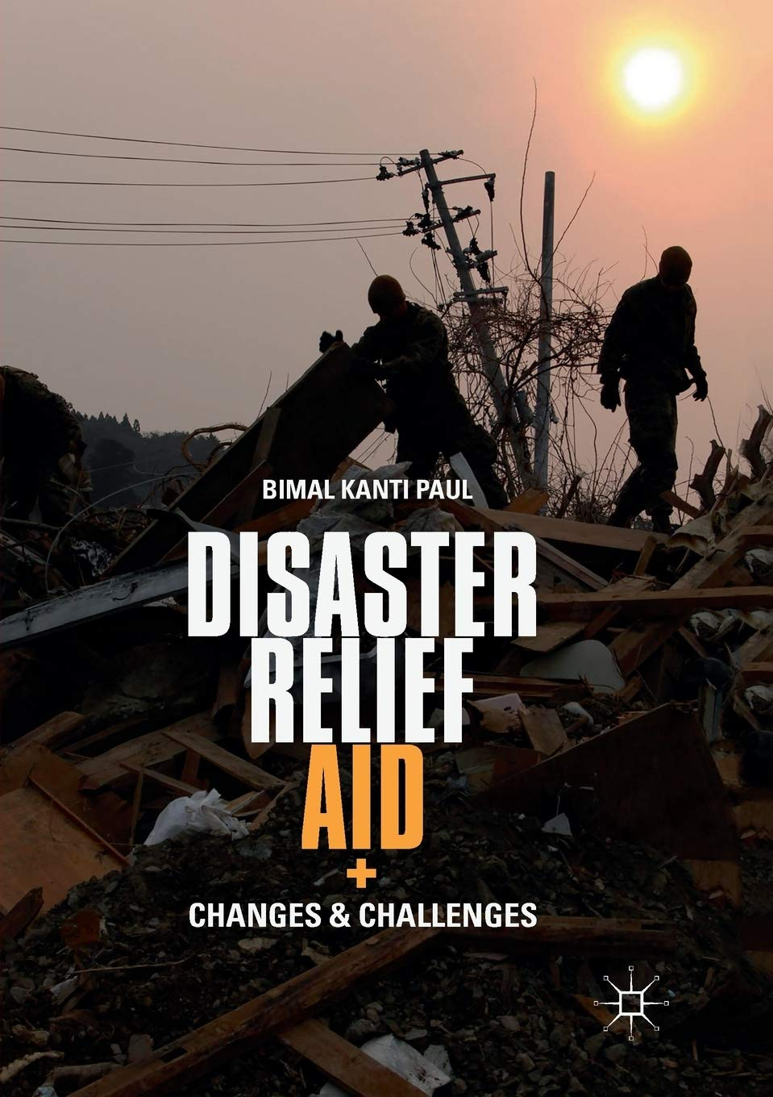
Cover Page
Prepared by: [Your Name]
[Your Course/Project Name]
[Date]
[Your Institution Name]
Photo by Google

Slide 5

Certificate
[Your Name]
A Project on Disaster Management
[Date]
[Your Institution Name/Logo]
Photo by Google

Slide 6
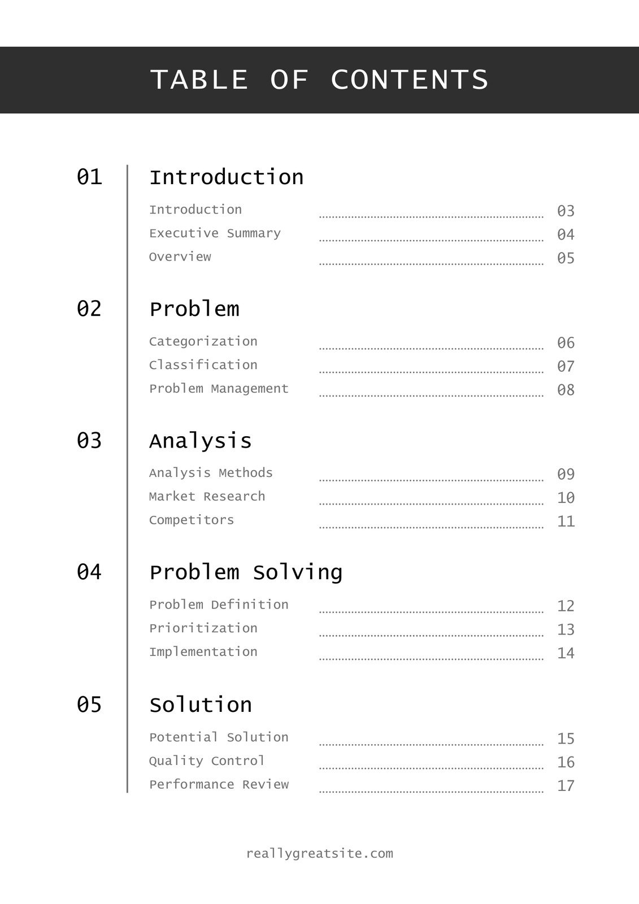
Index
Defining disasters and their impact.
Man-made and Natural Disasters
Causes, vulnerability, and risk management
Vulnerability and risk management
Photo by Google

Slide 7
Introduction to Disaster Management
A serious disruption of the functioning of a community or a society involving widespread human, material, economic or environmental losses and impacts, which exceeds the ability of the affected community or society to cope using its own resources.
Sudden onset, widespread impact, inability to cope.
Mitigation, Preparedness, Response, Recovery
Saving lives, reducing damage, and ensuring community resilience.
Photo by Google

Slide 8
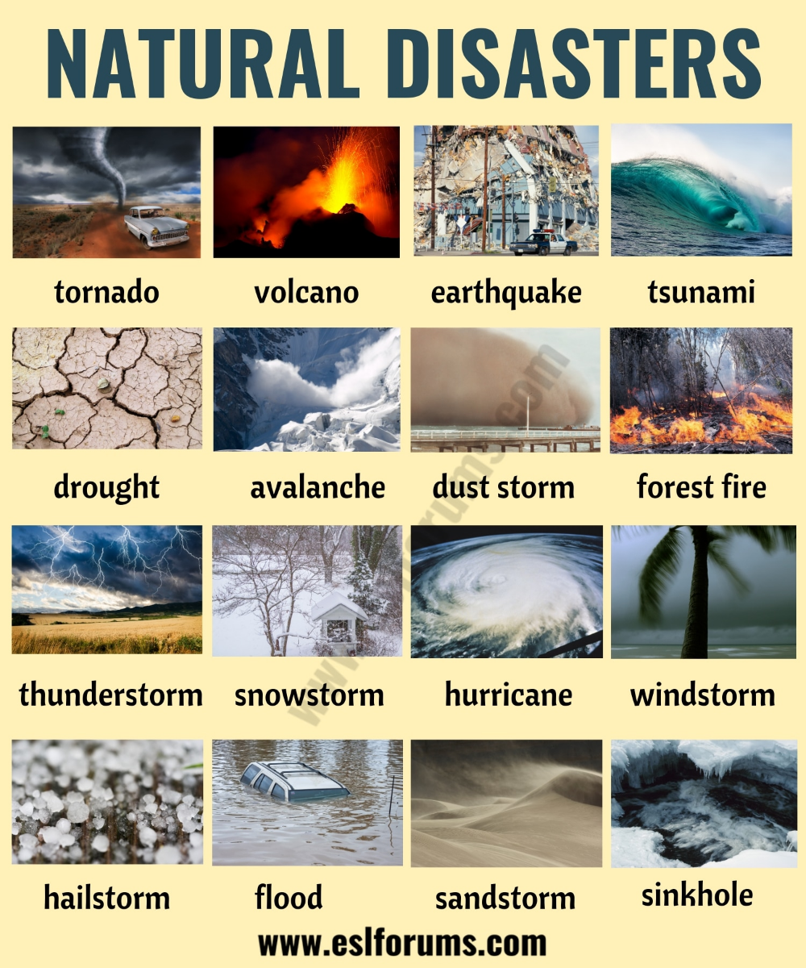
Types of Disasters
Caused by natural events (e.g., earthquakes, floods, hurricanes).
Caused by human actions (e.g., industrial accidents, fires).
Often involving both natural and man-made elements, with political instability.
Fire (Man-made) and Earthquake (Natural).
Photo by Google

Slide 9
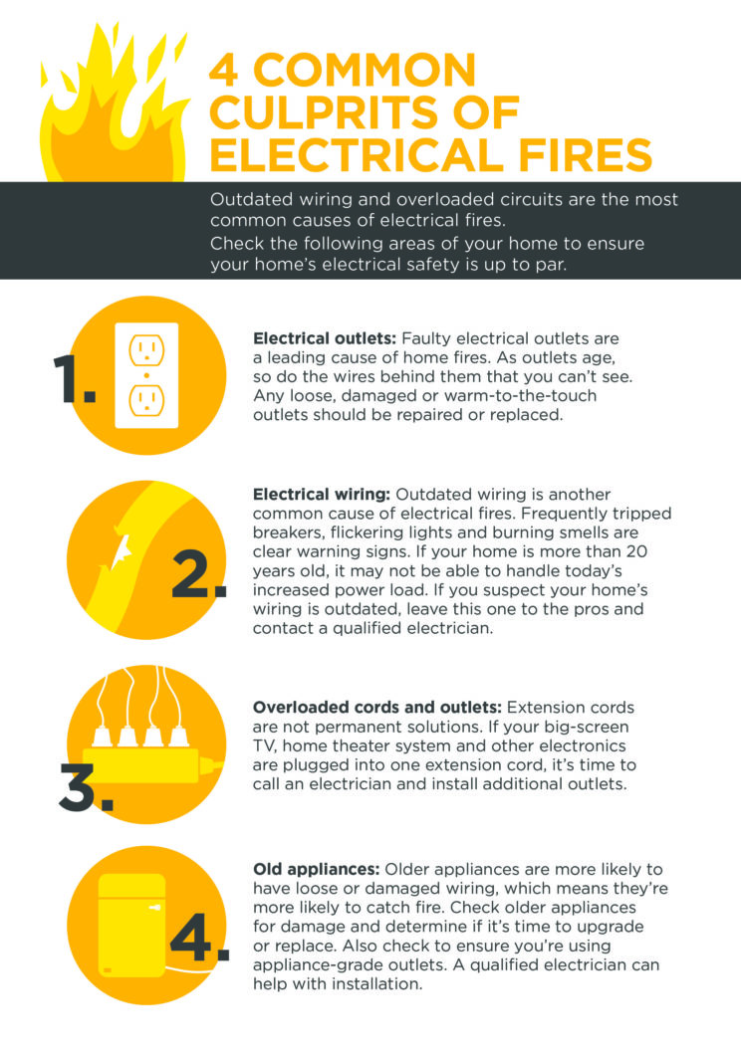
Man-Made Disasters: Fire - Causes
Short circuits, overloading, and faulty wiring.
Careless handling of flammable materials, unattended cooking.
Deliberate setting of fires.
Chemical leaks, explosions.
Photo by Google

Slide 10
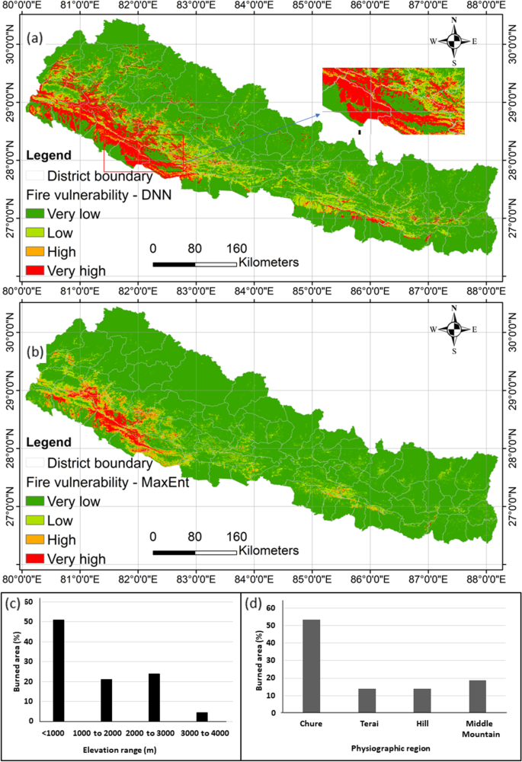
Man-Made Disasters: Fire - Vulnerability
Densely populated areas increase the risk of fire spread and casualties.
Absence of fire alarms, extinguishers, and escape routes.
Use of flammable materials in construction.
Difficulties in reaching affected areas quickly.
Photo by Google

Slide 11
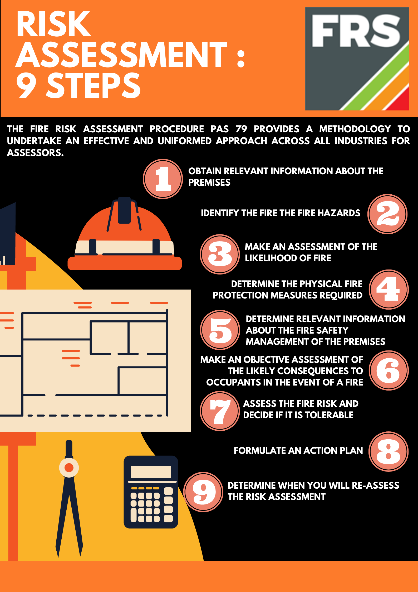
Man-Made Disasters: Fire - Risk Management
Training people on fire prevention and safety measures.
Enforcing strict fire safety standards in construction.
Installing fire alarms, sprinklers, and extinguishers.
Developing and practicing fire evacuation plans.
Photo by Google

Slide 12
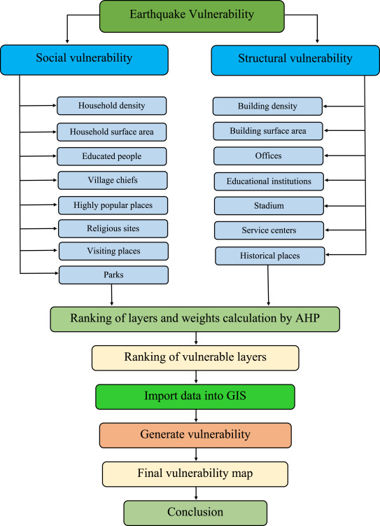
Natural Disasters: Earthquake - Vulnerability
Location in areas prone to earthquakes.
Poorly constructed buildings are more susceptible to collapse.
Higher population density leads to more casualties.
Insufficient knowledge about earthquake safety measures.
Photo by Google

Slide 13
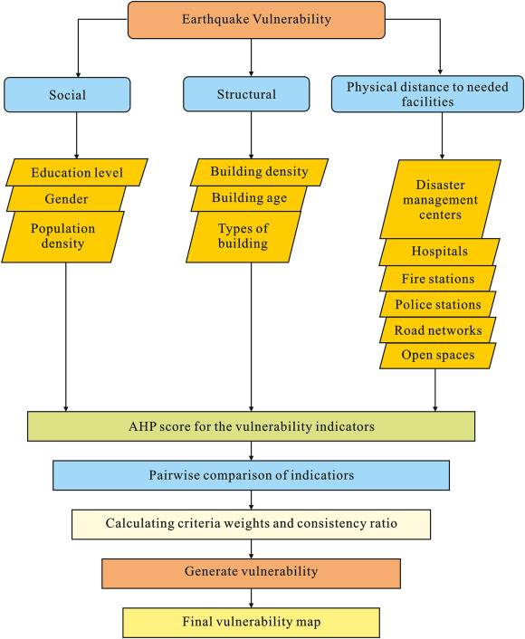
Natural Disasters: Earthquake - Risk Management
Designing and building structures that can withstand seismic forces.
Detecting and alerting communities before an earthquake strikes.
Educating people about earthquake safety and evacuation procedures.
Avoiding construction in areas with high seismic risk.
Photo by Google

Slide 14
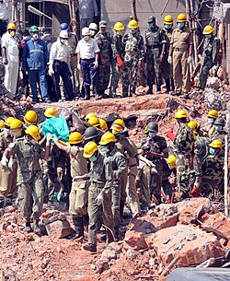
Role of NDRF
Specialized response to natural and man-made disasters.
Search and rescue, evacuation, medical assistance.
Trained and equipped personnel deployed across the country.
Works with state governments and other agencies during disaster response.
Photo by Google

Slide 15
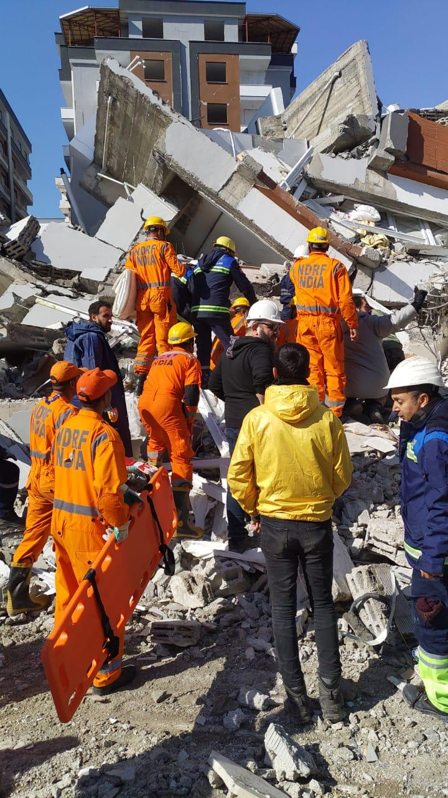
Role of NDRF (Continued)
Quickly mobilized to affected areas.
Highly skilled in disaster response techniques.
Equipped with advanced tools for search and rescue.
Provides training and awareness programs for disaster preparedness.
Photo by Google

