Slide 1
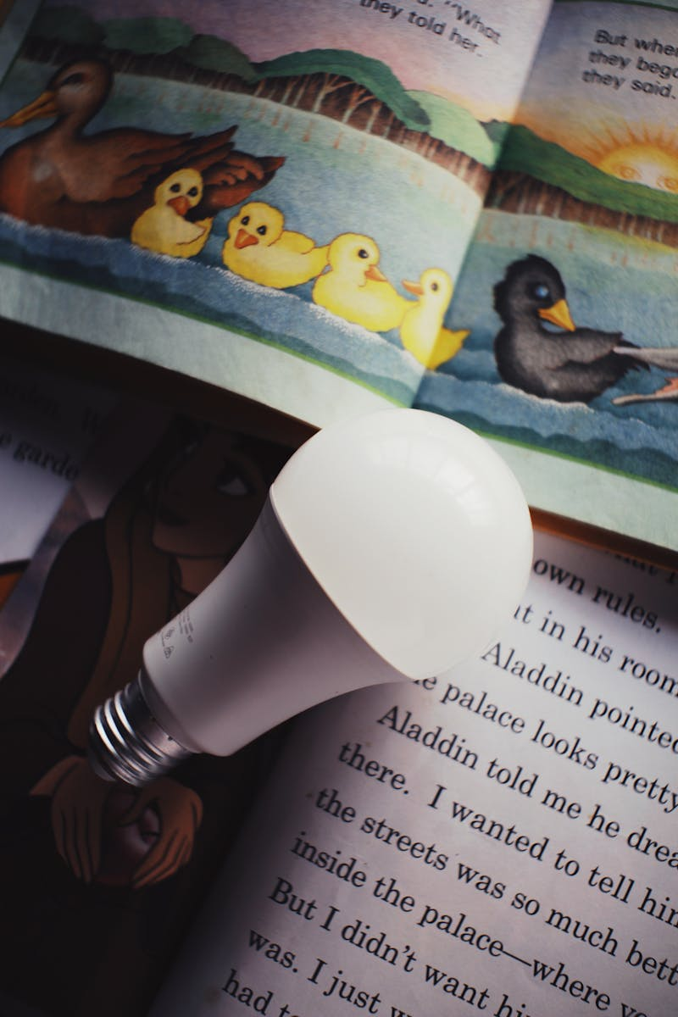
Dream Smart Home Transforming Living Spaces with Technology
Photo by Pexels

Slide 2
01
Introduction to Smart Homes
Table of Contents
02
Smart Home Devices: Lighting and Climate Control
03
Smart Home Devices: Security Systems
04
Smart Home Devices: Entertainment
05
Setting Up Your Smart Home
06
The Future of Smart Homes

Slide 3

1
Introduction to Smart Homes
Defining the Future of Living
A residence equipped with devices connected to the internet, allowing remote monitoring and management. Automation, remote control, energy efficiency, enhanced security, and personalized comfort. Increased convenience, cost savings, improved safety, and a more sustainable lifestyle. Rising demand due to technological advancements and increased awareness of energy conservation.

Slide 4
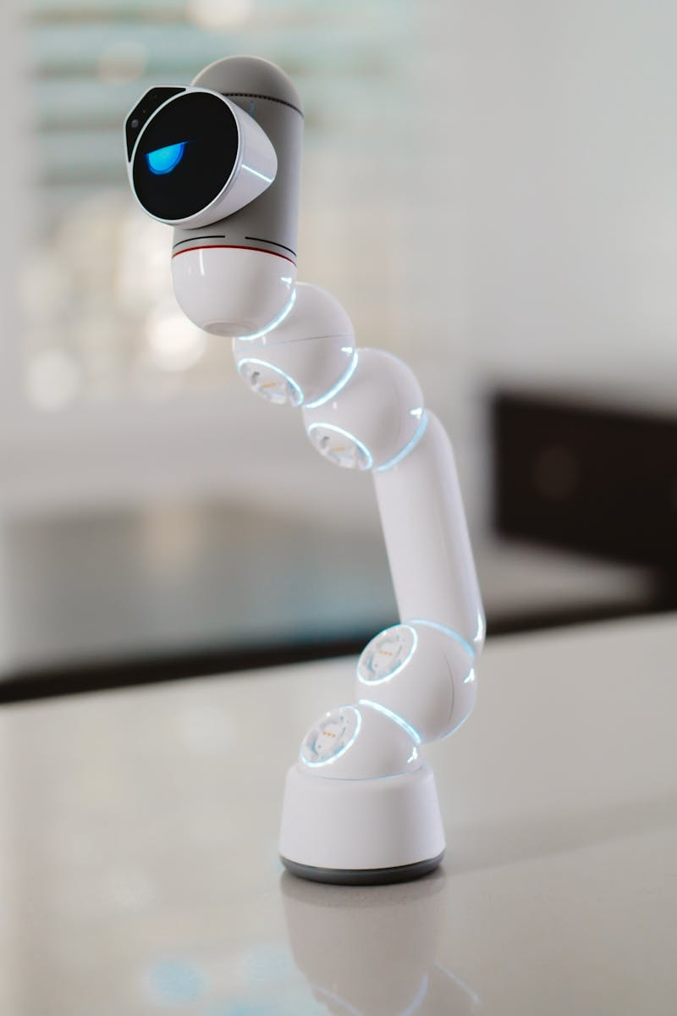
2
Smart Home Devices: Lighting and Climate Control
Creating the Perfect Ambiance
Automated lighting with dimming, color changing, and scheduling capabilities. Adjust lighting with voice commands for hands-free operation. Learning thermostats that optimize temperature settings based on user preferences and occupancy. Adjust heating and cooling remotely via smartphone or tablet.

Slide 5

3
Smart Home Devices: Security Systems
Protecting Your Home and Family
Real-time video monitoring with motion detection and night vision capabilities. Keyless entry with remote locking and unlocking features. Door and window sensors that trigger alerts upon unauthorized entry. Comprehensive security solutions with professional monitoring services.

Slide 6

4
Smart Home Devices: Entertainment
Immersive Entertainment Experiences
Streaming content, voice control, and integration with other smart devices. Voice-activated assistants for music streaming, information retrieval, and smart home control. Synchronized audio playback throughout the home. Automated control of projectors, screens, and audio systems for a cinematic experience.

Slide 7

5
Setting Up Your Smart Home
A Step-by-Step Guide
Identify your needs and create a plan for your smart home setup. Select devices that are compatible with your chosen smart home platform. Install and configure your smart devices according to the manufacturer's instructions. Test your smart home system and optimize settings for optimal performance.

Slide 8

6
The Future of Smart Homes
Trends and Innovations
AI-powered smart homes that learn and adapt to user behavior. Expansion of IoT devices and seamless integration across platforms. Smart homes that prioritize energy conservation and sustainability. Customized smart home experiences tailored to individual needs and preferences.

