Slide 1

Dream smart Home PPT Transforming Living Spaces Through Technology
Photo by Pexels

Slide 2
01
Welcome to the Future
Table of Contents
02
Core Technologies
03
Benefits & Advantages
04
Implementation Guide
05
Future Vision

Slide 3

1
Welcome to the Future
Introduction to Smart Home Revolution
Dream smart Home PPT represents the transformation of traditional houses into intelligent living spaces with automated systems and connected devices. Dream smart Home PPT showcases how technology is revolutionizing our daily living experiences through interconnected devices and intelligent automation. Dream smart Home PPT demonstrates how smart homes are becoming the new standard for comfortable, efficient, and secure contemporary living environments. Dream smart Home PPT illustrates the seamless integration of various technologies to create cohesive and responsive home ecosystems.

Slide 4
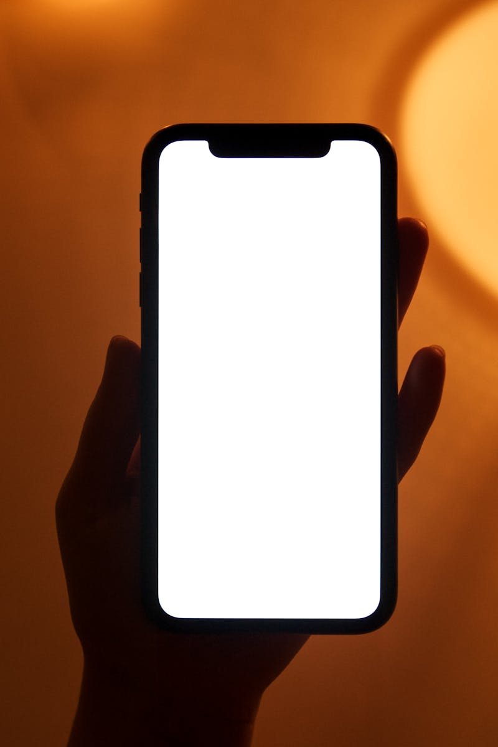
2
Core Technologies
Building Blocks of Smart Homes
Dream smart Home PPT explores the Internet of Things framework that enables devices to communicate and work together harmoniously. Dream smart Home PPT demonstrates how voice assistants are making home control more intuitive and accessible through natural language processing. Dream smart Home PPT explains the various communication protocols that enable different smart devices to work together seamlessly. Dream smart Home PPT highlights how sensor technologies provide real-time data for intelligent decision-making and automated responses.

Slide 5
3
Benefits & Advantages
Why Choose Smart Living
Dream smart Home PPT illustrates how smart systems optimize energy usage, reducing costs while maintaining comfort levels throughout the home. Dream smart Home PPT demonstrates comprehensive security solutions including surveillance, access control, and automated safety features. Dream smart Home PPT showcases how automation simplifies daily routines, saving time and effort through intelligent task management. Dream smart Home PPT presents integrated health systems that track wellness metrics and create healthier living environments.

Slide 6
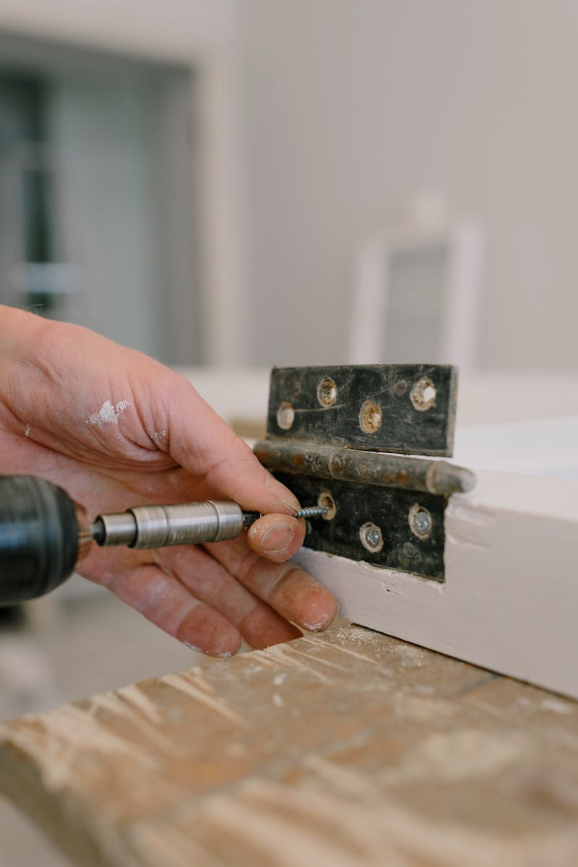
4
Implementation Guide
Making Your Home Smart
Dream smart Home PPT outlines the essential planning steps including needs assessment, budget considerations, and technology selection. Dream smart Home PPT provides detailed guidance on proper installation techniques and integration of various smart home components. Dream smart Home PPT explains how to connect different devices and systems to create a unified smart home experience. Dream smart Home PPT offers practical advice for maintaining optimal performance and longevity of smart home systems.

Slide 7

5
Future Vision
The Next Generation of Smart Homes
Dream smart Home PPT explores how artificial intelligence will create truly adaptive homes that learn and respond to residents' preferences. Dream smart Home PPT presents eco-friendly technologies that minimize environmental impact while maximizing comfort and efficiency. Dream smart Home PPT demonstrates how future homes will prioritize wellness through advanced air quality, lighting, and environmental controls. Dream smart Home PPT illustrates how smart homes will connect with broader community systems for enhanced safety and resource sharing.

