Slide 1



Drones: Taking Flight into the Future
Revolutionizing Industries
Photo by Pexels
September 2024

Slide 2

Table of Contents
1
The Future is Now
5
Agricultural Revolution
2
Package Delivery Revolution
6
Rescue Operations Enhanced
3
Building Inspections Made Easy
7
Thermal Imaging Advancements
4
Oil and Gas Surveillance
8
Aerial Photography Transformation

Slide 3
9
The Road Ahead
10
Thank You!

Slide 4
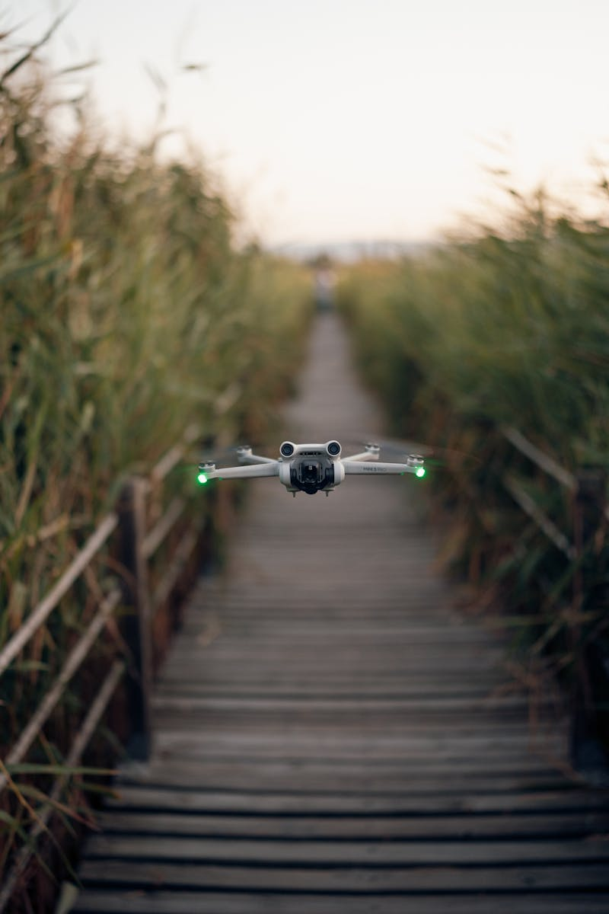
The Future is Now
Drones are not just a trend; they represent a significant shift across industries, transforming how we operate and interact.
Their ability to access hard-to-reach areas allows professionals to gather data and visuals that were once impossible or dangerous to obtain.
From deliveries to inspections, drones are enhancing efficiency and reducing costs for businesses worldwide.
As technology advances, their applications will continue to expand, shaping our future in remarkable ways.
Photo by Pexels
01

Slide 5

Package Delivery Revolution
Drones are set to transform delivery services, providing a quick and effective solution for transporting goods.
Companies like Amazon and Google are exploring drone delivery options to speed up logistics and reach isolated locations.
This technology promises reduced delivery times, bringing your favorite products right to your doorstep in an instant.
Imagine receiving your online shopping within minutes, making shopping more convenient than ever before.
Photo by Pexels
02

Slide 6

Building Inspections Made Easy
Drones are proving invaluable in building inspections, significantly improving safety for inspectors and workers alike.
With drones, high-rise buildings and bridges can be inspected from above, minimizing risks and enhancing data accuracy.
They can capture detailed images and videos, allowing for comprehensive assessments without scaffolding or ladders.
This technology saves time, money, and enhances the overall quality of inspections.
Photo by Pexels
03

Slide 7

Oil and Gas Surveillance
In the oil and gas industry, drones are playing a crucial role in inspection and monitoring operations.
They can swiftly inspect pipelines, tanks, and other infrastructure, identifying leaks or damages without extensive manual labor.
This technology enhances safety by reducing the need for personnel in hazardous environments.
Drones provide real-time data, allowing companies to respond more rapidly to potential issues.
Photo by Pexels
04

Slide 8

Agricultural Revolution
Drones are transforming agriculture by enabling farmers to monitor crops with precision.
They provide aerial imagery that helps in assessing plant health, soil conditions, and irrigation needs.
This data-driven approach allows for more efficient use of resources, ultimately increasing yields.
Drones can also aid in pest management, reducing chemical usage and promoting sustainable practices.
Photo by Pexels
05

Slide 9

Rescue Operations Enhanced
In emergencies, drones can be deployed quickly to assess situations and assist search and rescue teams.
They provide real-time imagery that can help locate missing persons or assess disaster-struck areas.
Drones can transport medical supplies to inaccessible locations, saving lives during critical moments.
This technology is reshaping how we respond to emergencies, bringing help more efficiently.
Photo by Pexels
06

Slide 10
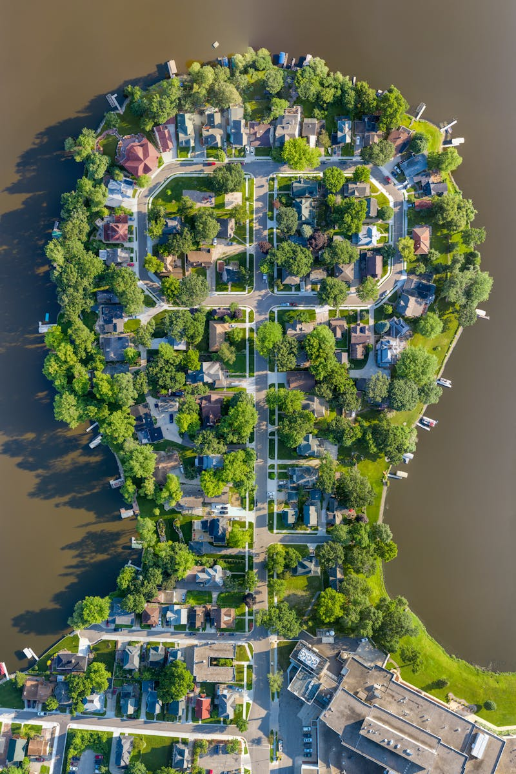
Thermal Imaging Advancements
Drones equipped with thermal imaging technology allow for inspections and surveillance in ways never before possible.
They can detect heat loss in buildings, identify overheating electrical components, and assist in wildlife monitoring.
This advanced technology provides crucial data that can prevent accidents and improve system efficiencies.
Drones with thermal capabilities are redefining how we approach inspections and assessments.
Photo by Pexels
07

Slide 11
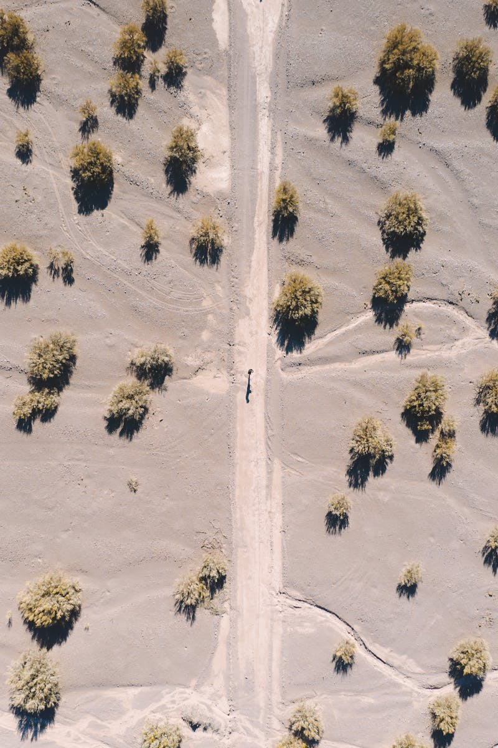
Aerial Photography Transformation
Drones have revolutionized aerial photography, offering stunning views and unique perspectives for various projects.
From real estate to events, drones capture high-quality images that enhance visual storytelling.
This technology is democratizing aerial photography, making it accessible to a broader audience.
As creativity meets technology, the possibilities are endless for stunning visual content creation.
Photo by Pexels
08

Slide 12

The Road Ahead
As technology develops, the capabilities of drones will only grow, opening doors to new possibilities.
The integration of AI and machine learning will enhance drone efficiency and functionality across fields.
Future applications could include urban air mobility, emergency response drones, and beyond.
The evolution of drones promises to reshape industries, making our world more connected and efficient.
Photo by Pexels
09

Slide 13

Thank You!
Thank you for exploring the remarkable future of drones with us today.
As we embrace this technology, we look forward to seeing its impact across all sectors.
Stay tuned for more updates and innovations in the world of drones!
Photo by Pexels
10

