Slide 1

E Hotel Management Excellence
Digital Transformation in Hospitality
Photo by Pexels

Slide 2
01
Introduction to E Hotel Management
Table of Contents
02
Digital Tools and Systems
03
Guest Experience Enhancement
04
Operational Efficiency
05
Future Trends and Innovations

Slide 3

1
Introduction to E Hotel Management
The Digital Revolution in Hospitality
E hotel management represents the complete digital transformation of traditional hotel operations through technology integration.
This approach leverages digital tools to streamline every aspect of hotel management from booking to guest services.
Implementing e hotel management provides hotels with significant competitive advantages in today's digital marketplace.
E hotel management serves as the essential foundation for modern hospitality success and guest satisfaction.

Slide 4

2
Digital Tools and Systems
Technology Infrastructure for Hotels
E hotel management utilizes comprehensive integrated software systems that connect all hotel departments seamlessly.
Advanced automation solutions within e hotel management reduce manual processes and minimize human error.
Powerful data analytics tools in e hotel management provide insights for better decision-making and strategic planning.
Modern e hotel management relies on cloud-based systems for accessibility, scalability, and real-time information sharing.

Slide 5

3
Guest Experience Enhancement
Personalized Digital Services
E hotel management enables seamless booking experiences through intuitive digital platforms and mobile applications.
Guest preferences and history are tracked through e hotel management to deliver highly personalized service experiences.
Mobile check-in and keyless entry systems revolutionize the guest experience through e hotel management innovations.
E hotel management provides round-the-clock digital support ensuring guest needs are met anytime, anywhere.

Slide 6
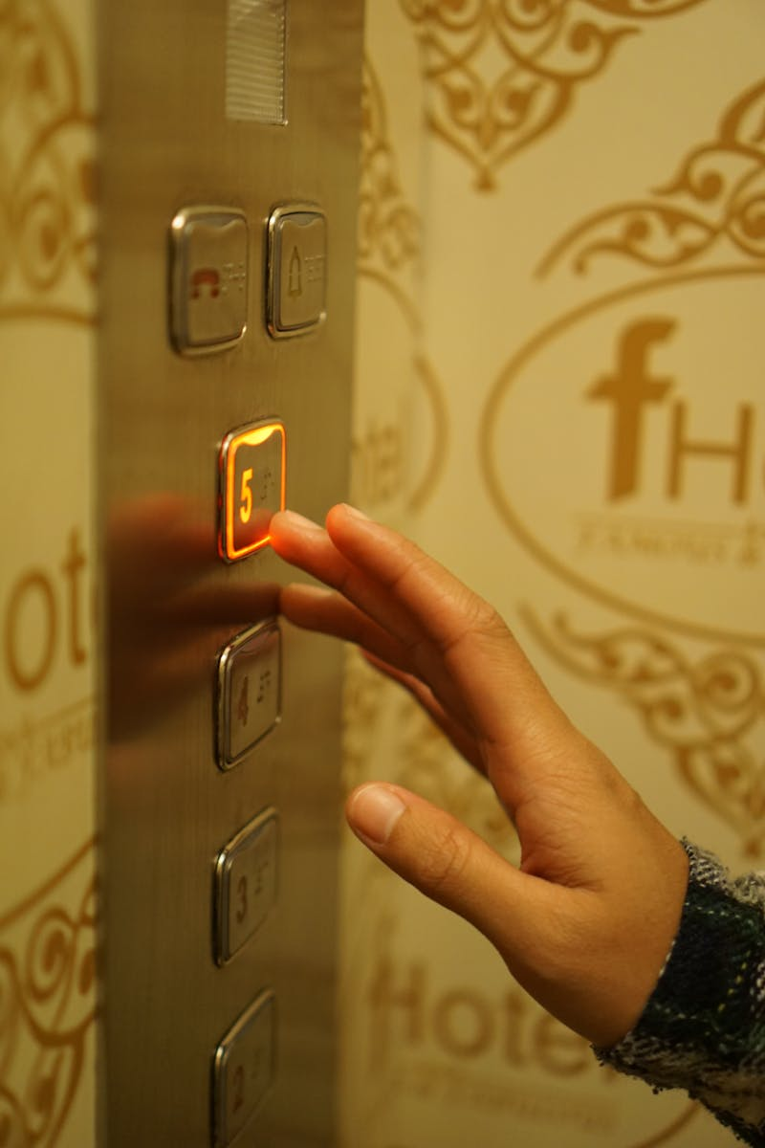
4
Operational Efficiency
Streamlined Hotel Operations
E hotel management optimizes resource allocation through intelligent scheduling and inventory control systems.
Significant cost reductions are achieved through e hotel management by eliminating waste and improving efficiency.
E hotel management enhances staff productivity by automating routine tasks and providing better workflow management.
Consistent quality standards are maintained through e hotel management's monitoring and reporting capabilities.

Slide 7

5
Future Trends and Innovations
The Evolution of E Hotel Management
Artificial intelligence is becoming integral to e hotel management, enabling smarter decision-making and personalized guest interactions.
Internet of Things devices are transforming e hotel management through connected room systems and smart building technologies.
E hotel management is increasingly incorporating sustainable practices and energy-efficient technologies for environmental responsibility.
The future of e hotel management promises continuous innovation with emerging technologies reshaping the hospitality landscape.

