Slide 1
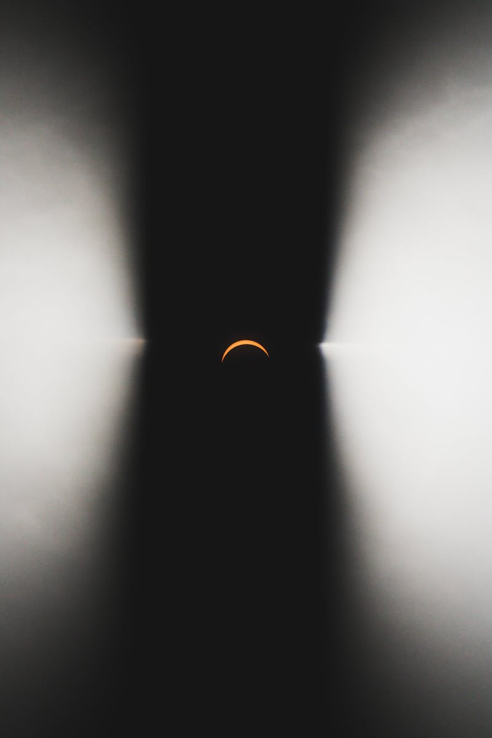
Eclipse
Understanding Solar and Lunar Eclipses
Photo by Pexels

Slide 2
01
Introduction to Eclipses
Table of Contents
02
Solar Eclipse Types
03
Lunar Eclipse Types
04
Solar Eclipse Phenomena
05
Lunar Eclipse Phenomena
06
Observing Solar Eclipses
07
Observing Lunar Eclipses
08
Historical Eclipses
09
Eclipses in Science
10
Future Eclipses

Slide 3

1
Introduction to Eclipses
What are Eclipses?
Occurs when the Moon comes between the Earth and the Sun, blocking sunlight from reaching the Earth.
Happens when the Earth comes between the Sun and the Moon, casting a shadow on the Moon.
Eclipses have fascinated humans for centuries and are significant astronomical events.
Eclipses are categorized into solar and lunar types, each with unique characteristics.

Slide 4
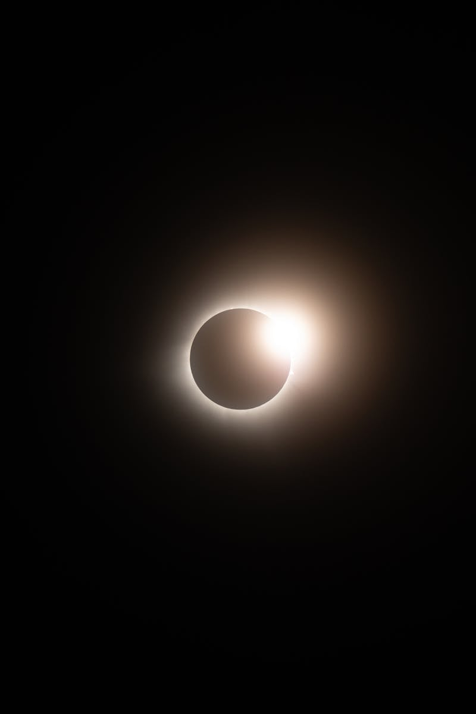
2
Solar Eclipse Types
Different Types of Solar Eclipses
The Moon completely covers the Sun, leading to temporary darkness.
The Moon covers only a part of the Sun, partially blocking sunlight.
The Moon is smaller in size, creating a ring-like appearance around the Sun.
A rare type that shifts between total and annular eclipses.

Slide 5
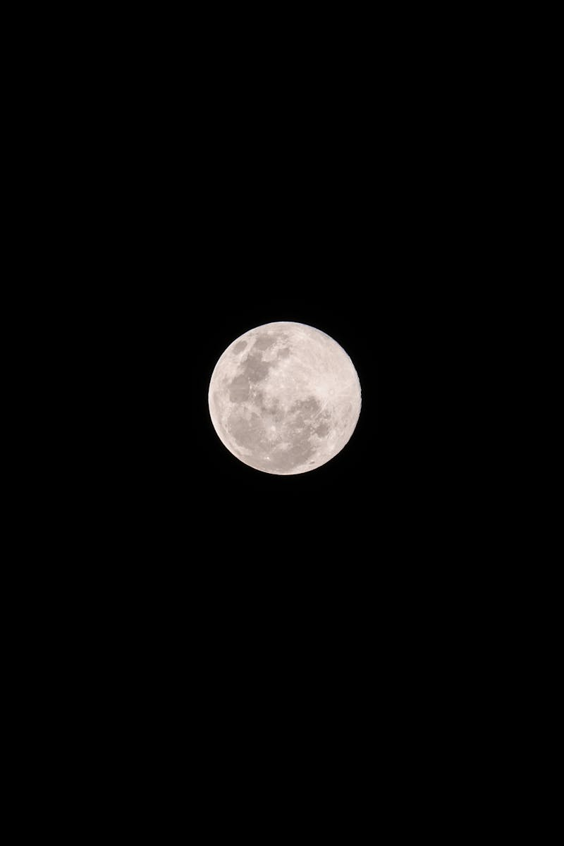
3
Lunar Eclipse Types
Different Types of Lunar Eclipses
The Moon is entirely in the Earth's shadow, appearing reddish.
Only a portion of the Moon enters the Earth's shadow.
The Moon passes through the Earth's penumbral shadow, causing subtle shading.
During a total lunar eclipse, the Moon appears red, known as a Blood Moon.

Slide 6
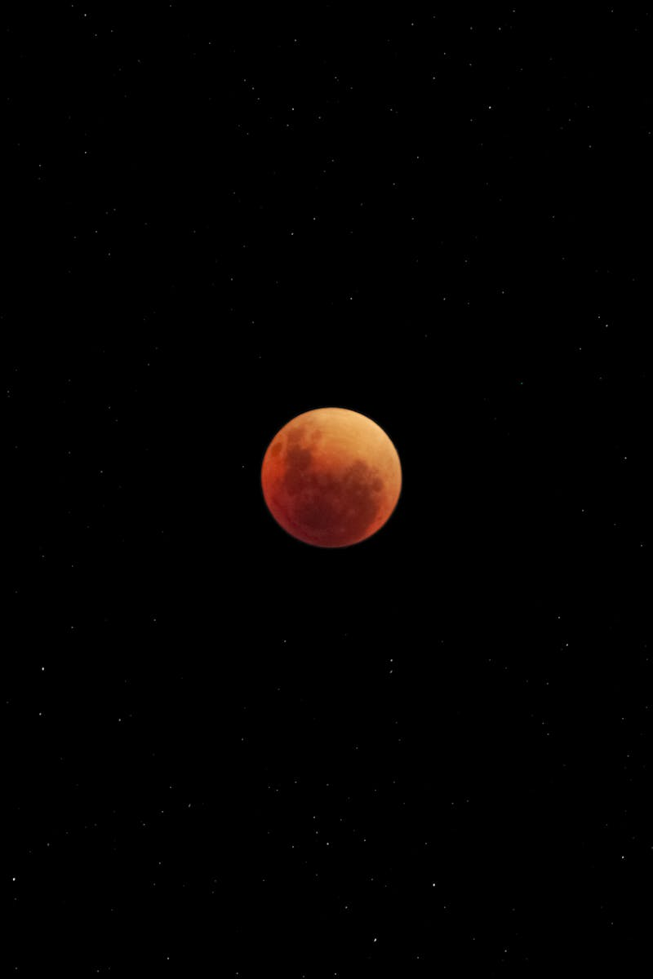
4
Solar Eclipse Phenomena
Unique Aspects of Solar Eclipses
Small spots of light seen around the Moon's edge during a solar eclipse.
A bright spot of light resembling a diamond ring, visible during a total solar eclipse.
The Sun's corona becomes visible during a total solar eclipse.
Wavy lines of alternating light and dark, seen on the ground before and after totality.

Slide 7
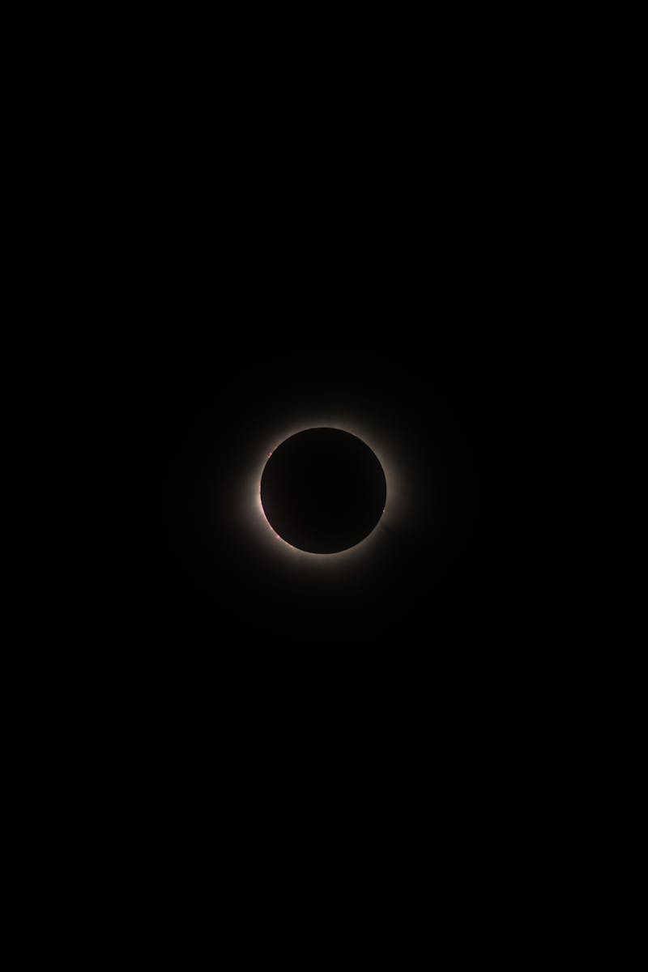
5
Lunar Eclipse Phenomena
Unique Aspects of Lunar Eclipses
The Earth's shadow causes the Moon to darken during a lunar eclipse.
The Moon changes color, often appearing red, during a total lunar eclipse.
Lunar eclipses can be seen from anywhere on the night side of the Earth.
Lunar eclipses have held cultural significance in various societies throughout history.

Slide 8
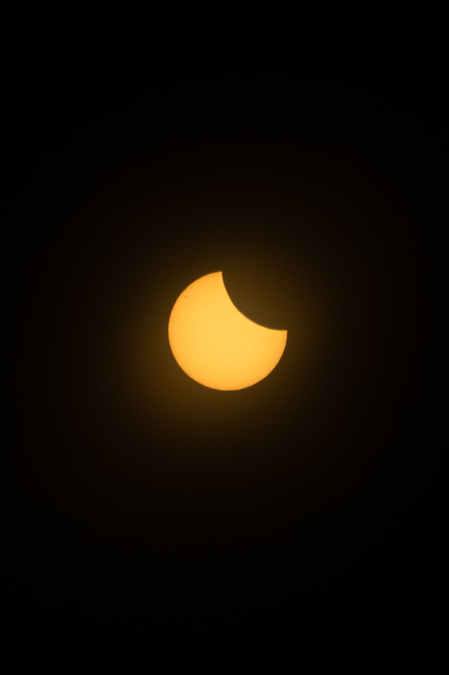
6
Observing Solar Eclipses
How to Safely View Solar Eclipses
Special glasses are necessary to safely view solar eclipses.
A simple device to project the Sun's image during an eclipse.
A telescope equipped with a solar filter allows safe viewing.
Never look directly at the Sun without proper eye protection.

Slide 9
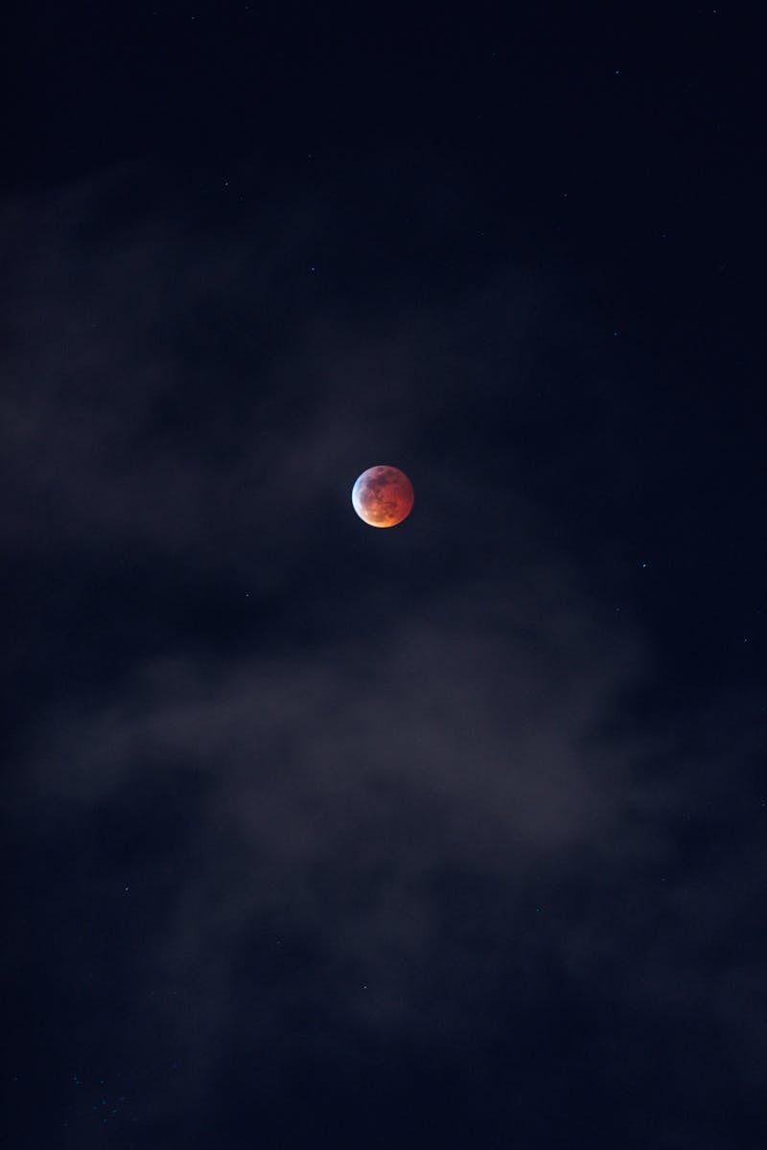
7
Observing Lunar Eclipses
How to View Lunar Eclipses
Lunar eclipses can be safely viewed with the naked eye.
Binoculars enhance the viewing experience of a lunar eclipse.
Tips for capturing stunning images of lunar eclipses.
Clear skies and minimal light pollution provide the best viewing.

Slide 10

8
Historical Eclipses
Notable Eclipses in History
Proved Einstein's theory of general relativity.
One of the most viewed eclipses of the 20th century.
A total solar eclipse visible across the United States.
Many cultures have myths and legends about lunar eclipses.

Slide 11
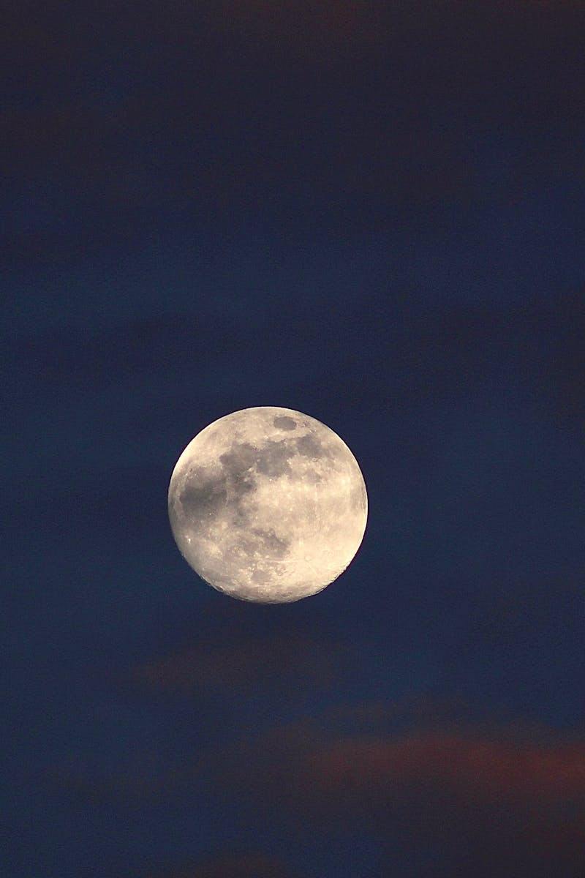
9
Eclipses in Science
Scientific Importance of Eclipses
Solar eclipses allow scientists to study the Sun's outer atmosphere.
Lunar eclipses provide opportunities to study the Moon's surface.
Eclipses help in understanding gravitational effects and celestial mechanics.
Eclipses have led to significant discoveries in astronomy.

Slide 12

10
Future Eclipses
Upcoming Eclipses to Watch
Details about the next total solar eclipse and its path.
Information on the next total lunar eclipse and visibility.
Tips for planning and experiencing future eclipses.
Eclipse events and gatherings around the world.

