Slide 1

Economic History of India
Post-Independence Era
Photo by Pexels

Slide 2
01
Post-War Recovery
Table of Contents
02
Interlinking Production

Slide 3
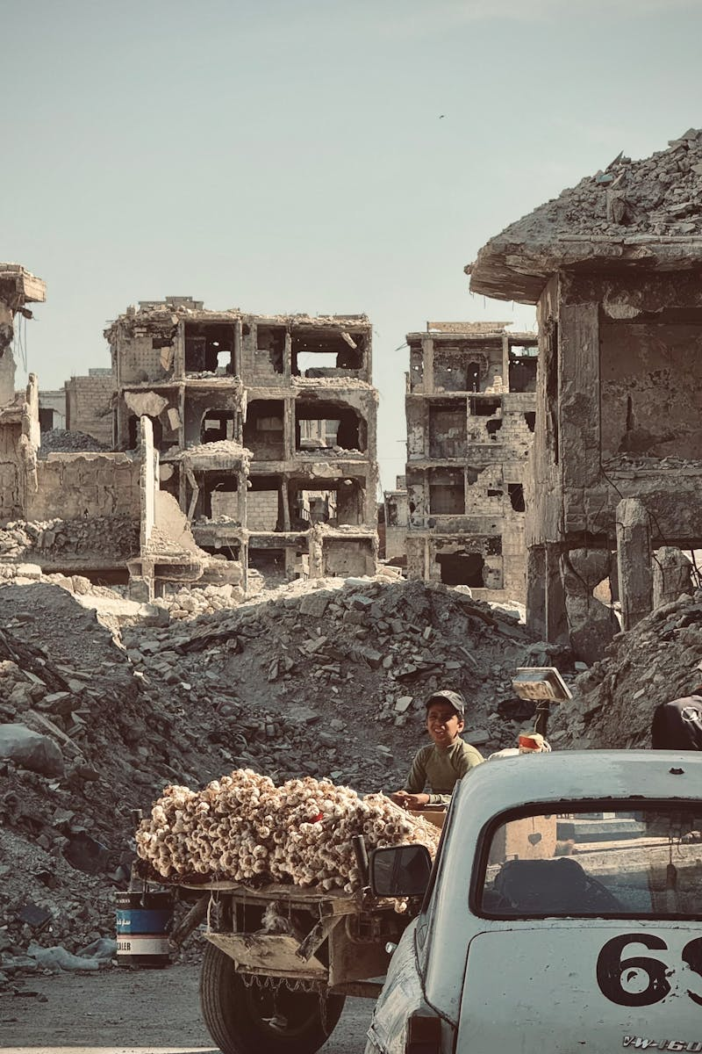
1
Post-War Recovery
Rebuilding Economies After Conflict
Focus on rebuilding economies devastated by war.
Implementation of policies designed to aid economic recovery.
Emphasis on policies that foster trade expansion.
India's gradual path towards economic stabilization.

Slide 4
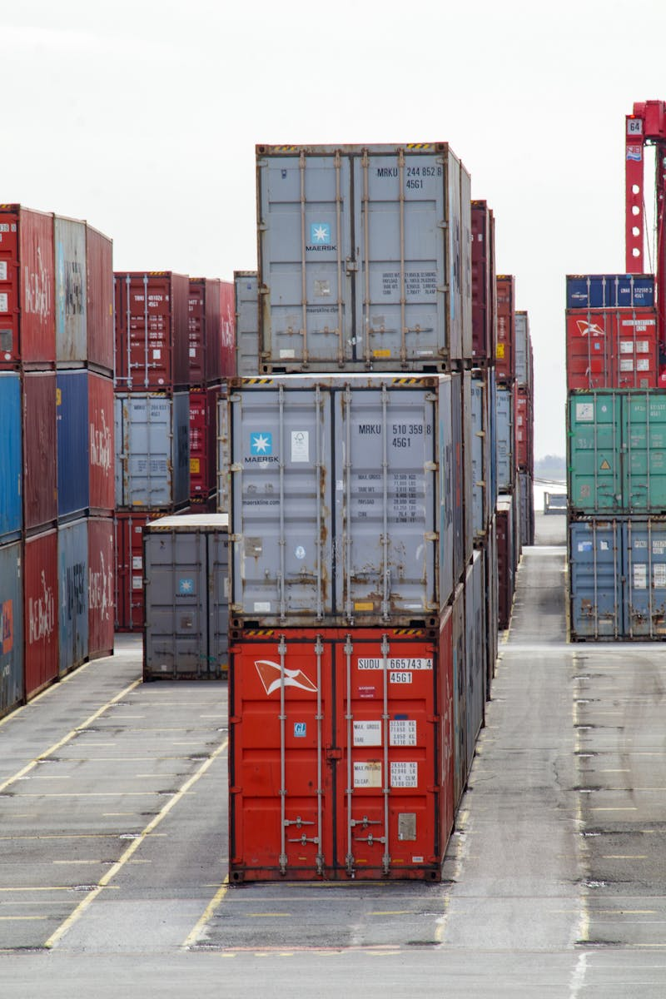
2
Interlinking Production
Global Supply Chains and Trade
The crucial role of global supply chains in modern economies.
The importance of intricate trade networks worldwide.
Understanding India's position in the global production landscape.
India's integration within global production and supply chains.

