Slide 1



Economic System and Its Types
Babu Banarasi Das University
July 2025

Slide 2

Table of Contents
1
BABU BANARASI DAS UNIVERSITY
5
Socialist Economy
2
What is an Economic System?
6
Mixed Economy
3
Types of Economic Systems
7
Quiz Time!
4
Capitalist Economy
8
Conclusion

Slide 3

BABU BANARASI DAS UNIVERSITY
Photo by Pexels
01

Slide 4

What is an Economic System?
An economic system is how a society organizes the production, distribution, and consumption of goods and services. It's the set of rules, practices, and institutions that govern economic activity.
Key features include how resources are owned (private or public), how decisions are made (centralized or decentralized), and what motivates economic activity (profit or social welfare). Example: A feature of a market economy is private property rights.
Economic systems determine what gets produced, how it's produced, and who gets it. A well-functioning system can lead to prosperity and stability. Example: A system that encourages innovation can lead to economic growth.
The system determines how resources are allocated. For instance, does the government decide, or does the market through supply and demand? Example: Government deciding to provide healthcare to all.
Photo by Pexels
02

Slide 5
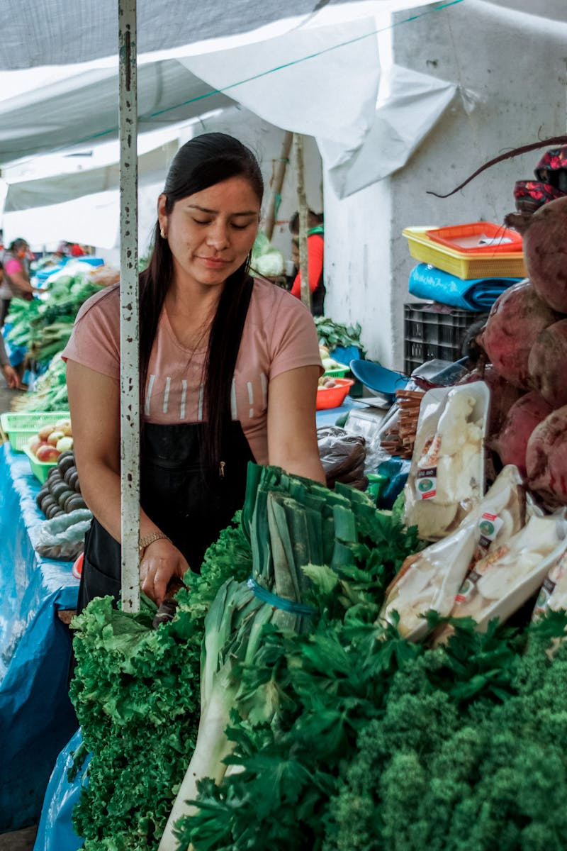
Types of Economic Systems
Emphasizes private ownership and free markets. Decisions are decentralized.
Emphasizes public ownership and central planning. Decisions are centralized.
Combines elements of both capitalism and socialism. Most modern economies are mixed.
Draw a flowchart visually representing the relationship between capitalist, socialist, and mixed economies, highlighting key features and characteristics of each.
Photo by Pexels
03

Slide 6

Capitalist Economy
An economic system where the means of production are privately owned and operated for profit. Prices and production are determined by supply and demand.
Private property, free markets, competition, and profit motive. Example: The United States, where businesses are largely privately owned.
Efficiency, innovation, and consumer choice. Example: Increased competition leads to lower prices and better products.
Inequality, market failures, and potential for exploitation. Example: A large gap between the rich and poor.
Photo by Pexels
04

Slide 7

Socialist Economy
An economic system where the means of production are owned and controlled by the state or the community as a whole. Resources are allocated based on need rather than profit.
Public ownership, central planning, income redistribution, and social welfare. Example: Cuba, where the government controls many industries.
Greater equality, reduced poverty, and provision of essential services. Example: Universal healthcare and education.
Inefficiency, lack of innovation, and limited consumer choice. Example: Potential for shortages and lack of responsiveness to consumer demands.
Photo by Pexels
05

Slide 8

Mixed Economy
An economic system that combines elements of both capitalism and socialism. It features private and public ownership, and government intervention in the economy.
Private and public sectors, government regulation, and social safety nets. Example: Most Western European countries, where there are strong welfare states.
Balance between efficiency and equity, social welfare, and economic stability. Example: Reduced inequality compared to pure capitalism.
Compromises, potential for bureaucracy, and difficulty in balancing competing interests. Example: High taxes and regulations can stifle economic growth.
Photo by Pexels
06

Slide 9

Quiz Time!
Photo by Pexels
07

Slide 10

Conclusion
We've explored the different types of economic systems: capitalist, socialist, and mixed. Each has its own advantages and disadvantages.
Understanding these systems helps us to analyze and evaluate economic policies and their impact on society.
Most countries operate under a mixed economy, adapting to the challenges of our current era.
Keep considering what economic systems and policies will best suit society and the world!
Photo by Pexels
08

