Slide 1

Electric Power Industry Understanding Power Plants and Their Planning
Photo by Pexels

Slide 2
01
Electric Power Industry Overview
Table of Contents
02
Thermal Power Plants
03
Nuclear Power Plants
04
Renewable Power Plants
05
Power Plant Planning

Slide 3
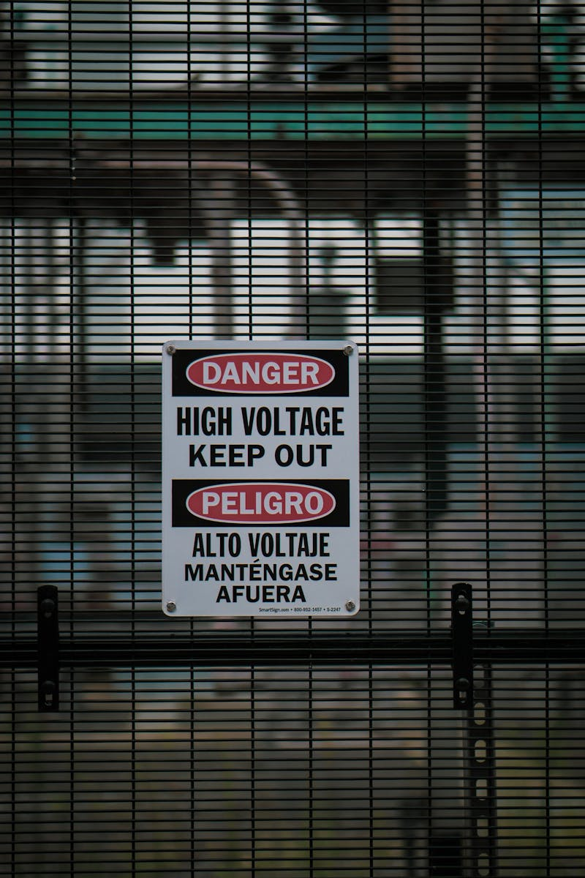
1
Electric Power Industry Overview
The Foundation of Modern Civilization
Electric power industry transforms various energy sources into electricity that powers our homes, businesses, and industries. Modern electric power systems consist of generation, transmission, distribution, and consumption components working together seamlessly. The industry utilizes diverse energy sources including fossil fuels, nuclear, hydro, wind, solar, and biomass to produce electrical energy. Electric power industry forms the backbone of economic development, enabling technological advancement and improving quality of life worldwide.

Slide 4
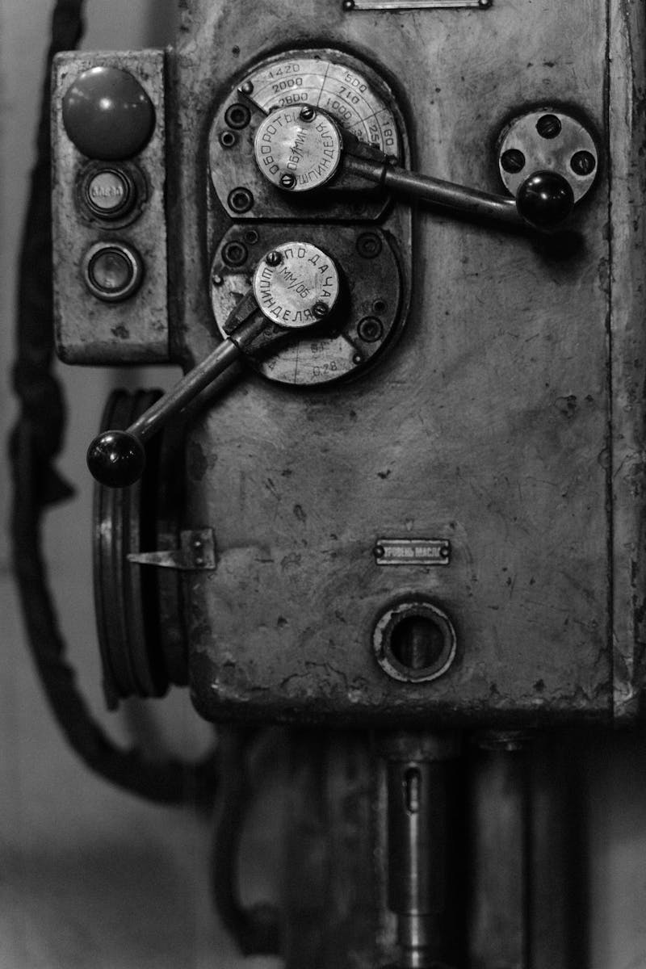
2
Thermal Power Plants
Conventional Energy Generation
Coal power plants burn coal to produce steam that drives turbines, generating electricity through electromagnetic induction principles. Gas-fired power plants use natural gas combustion to create high-pressure steam or directly drive gas turbines for efficient electricity production. Oil power plants utilize petroleum derivatives as fuel, offering flexibility in operation but facing environmental and economic challenges. Advanced thermal plants combine gas and steam cycles to achieve higher efficiency rates, reducing fuel consumption and emissions.

Slide 5
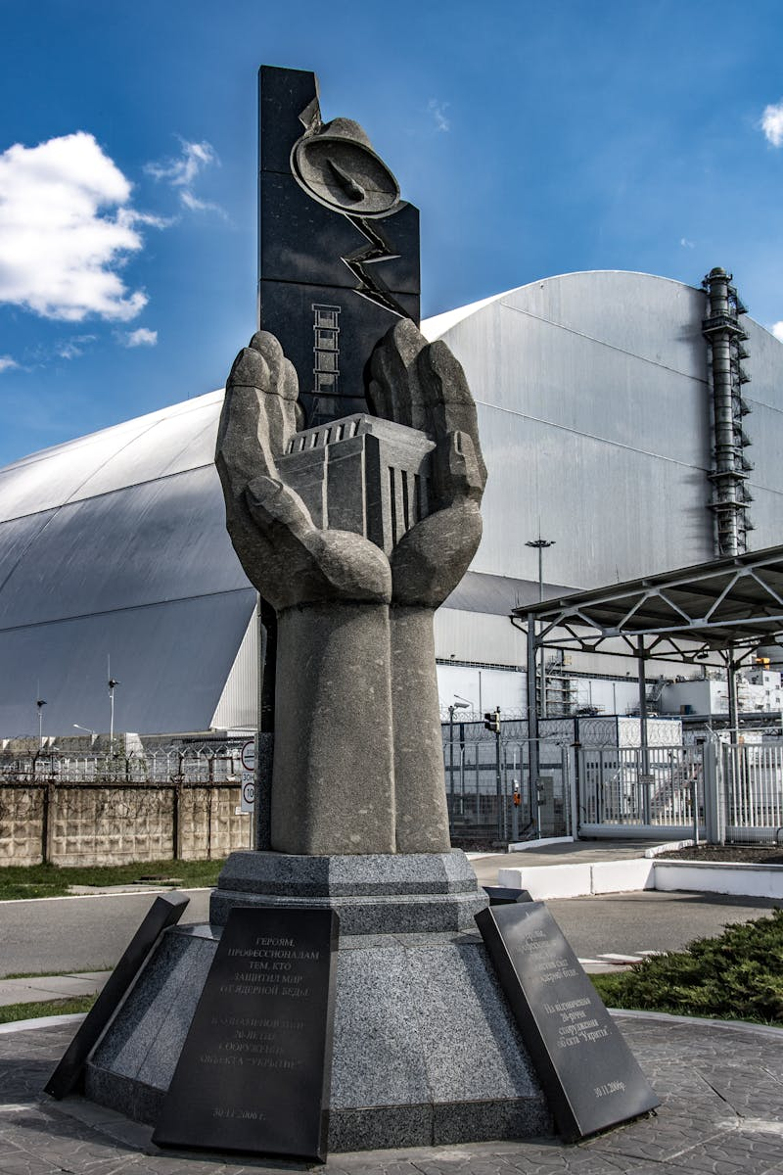
3
Nuclear Power Plants
Atomic Energy Generation
Nuclear plants split uranium atoms in controlled chain reactions, releasing enormous amounts of heat to produce steam for electricity generation. Different reactor designs including pressurized water reactors, boiling water reactors, and advanced modular reactors offer various safety and efficiency profiles. Nuclear fuel undergoes mining, enrichment, fabrication, use in reactor, and disposal or recycling processes in the complete fuel cycle. Multiple redundant safety systems including cooling, containment, and emergency shutdown features ensure safe nuclear power operation.

Slide 6
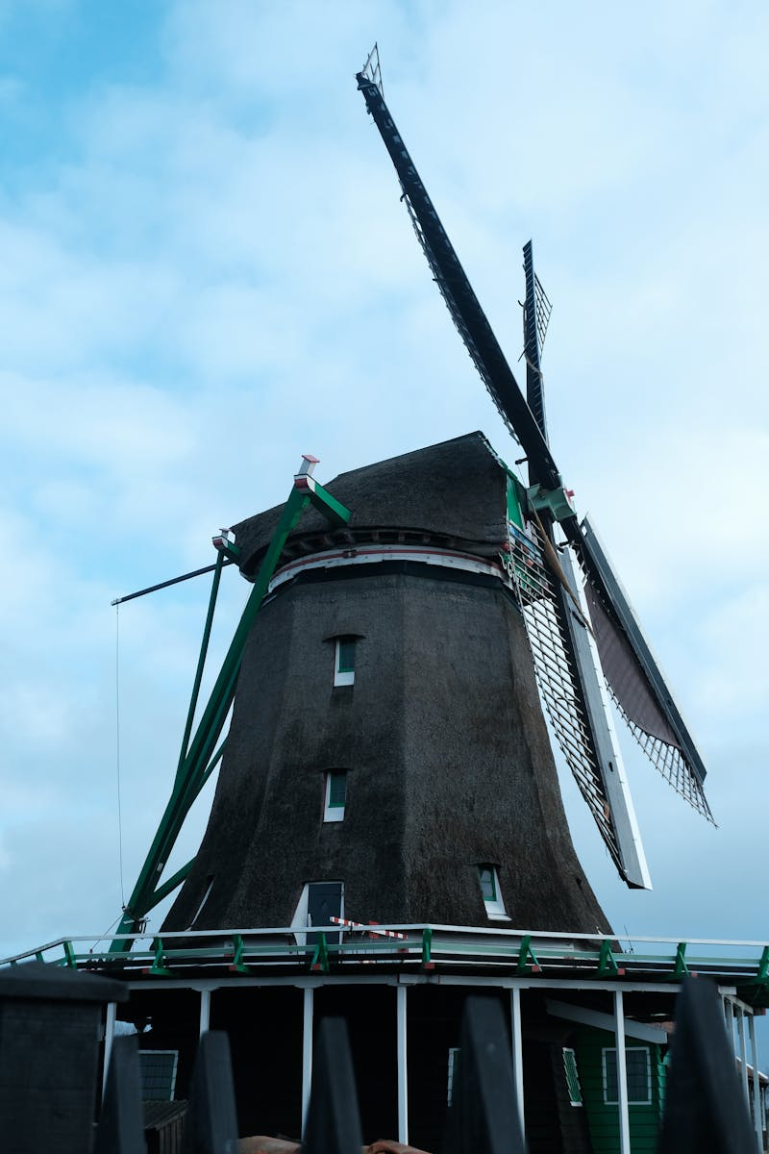
4
Renewable Power Plants
Clean Energy Solutions
Hydro plants convert the kinetic energy of flowing water into electricity using turbines and generators, providing reliable renewable energy. Wind farms capture wind energy through turbine blades, converting mechanical rotation into electrical power through electromagnetic induction. Solar plants convert sunlight directly into electricity using photovoltaic cells or indirectly through concentrated solar power systems. Biomass power plants convert organic materials into energy through combustion, gasification, or anaerobic digestion processes.

Slide 7

5
Power Plant Planning
Strategic Development Approach
Power plant planning involves careful evaluation of geographical, environmental, and social factors to determine optimal plant locations. Planning processes include thorough analysis of available technologies, comparing efficiency, costs, and environmental impacts for each option. Comprehensive environmental assessments evaluate potential effects on air, water, soil, and wildlife to ensure sustainable development. Power plant planning considers integration with existing grid infrastructure, transmission lines, and distribution networks for efficient energy delivery.

