Slide 1
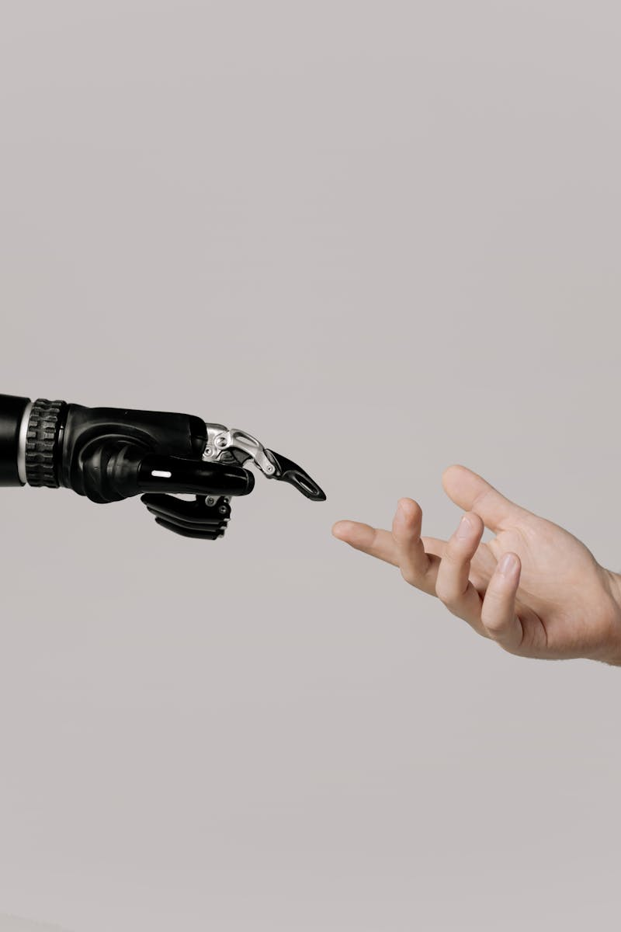
Emerging Trends in AI, Hardware, and Modeling – 2025 From PyTorch and Intel GPUs to Novel Diffusion Techniques and AI Benchmarks
Photo by Pexels

Slide 2
01
PyTorch 2.7 + Intel GPUs
Table of Contents
02
NATTEN by SHI-Labs
03
Memory in Time-Dependent PDEs
04
InverseBench Framework
05
Level1Techs Dual RTX 5090 Build
06
L4DC 2025 Registration Open
07
Alibaba Qwen3 Models
08
Interpreting Transformer Attention
09
Abliteration: Uncensoring LLMs
10
Xiaomi MiMo-7B Model
11
Entropic Time Schedulers
12
Transformers vs. State Space Models

Slide 3
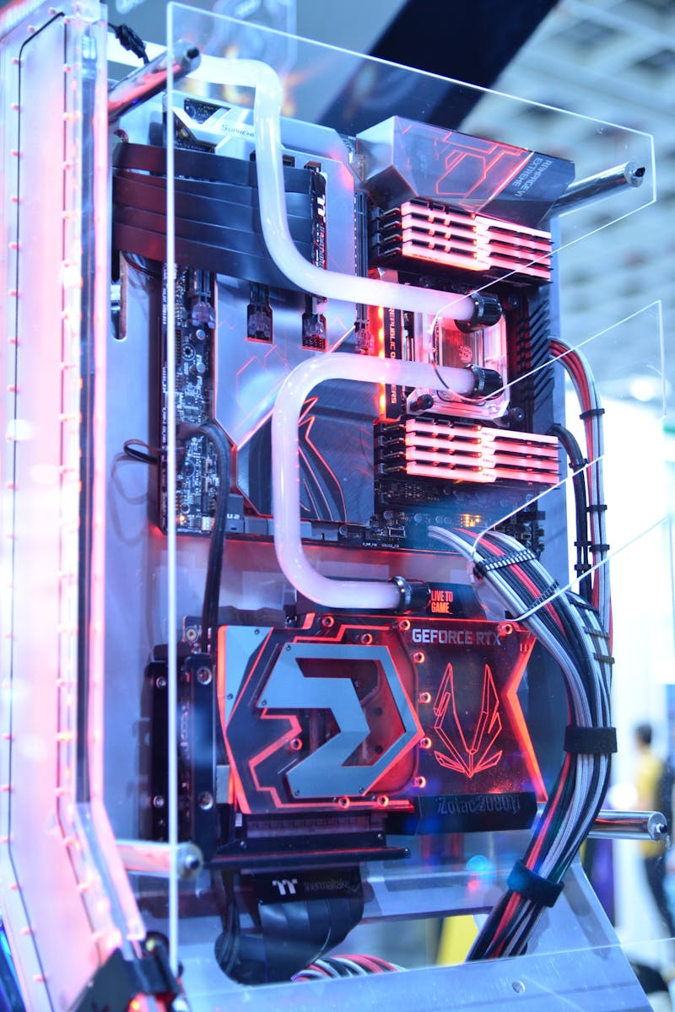
1
PyTorch 2.7 + Intel GPUs
Speed and platform enhancements with Intel hardware
PyTorch 2.7 improves support for Intel GPUs on Windows and Linux. Integration of SDPA boosts inference speeds up to 3x. Notable hardware: Intel Arc B580 Graphics, Intel Core Ultra 7.
Photo by Pexels

Slide 4
2
NATTEN by SHI-Labs
Neighborhood Attention Extension in PyTorch
NATTEN implements localized attention mechanisms. Supports both local and dilated attention types. Enhances performance in vision-related models.
Photo by Pexels

Slide 5
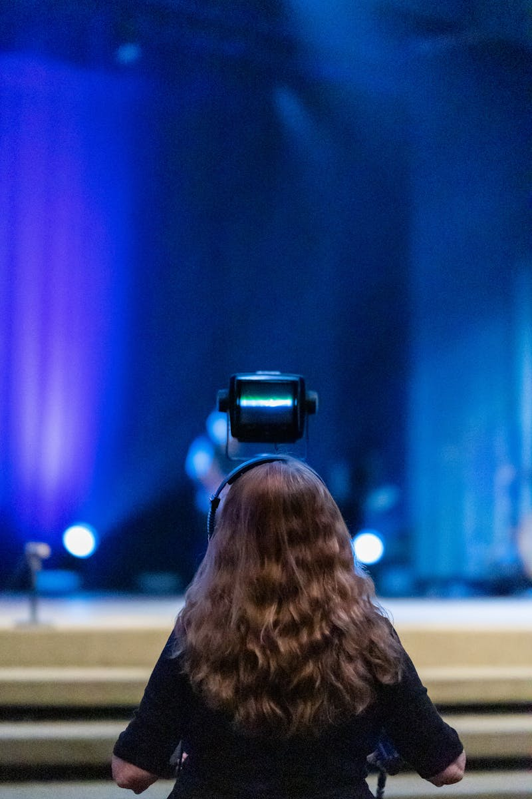
3
Memory in Time-Dependent PDEs
Advantages of Memory Neural Operators (MemNO)
MemNO blends state space models and Fourier Neural Operators. Significant improvements over Markovian models. Performs well with low-resolution or noisy data.
Photo by Pexels

Slide 6
4
InverseBench Framework
Benchmarking Diffusion for Inverse Problems
InverseBench evaluates diffusion models across 14 tasks. Focus areas: tomography, medical imaging, fluid dynamics. Highlights strengths/weaknesses of existing approaches.
Photo by Pexels

Slide 7
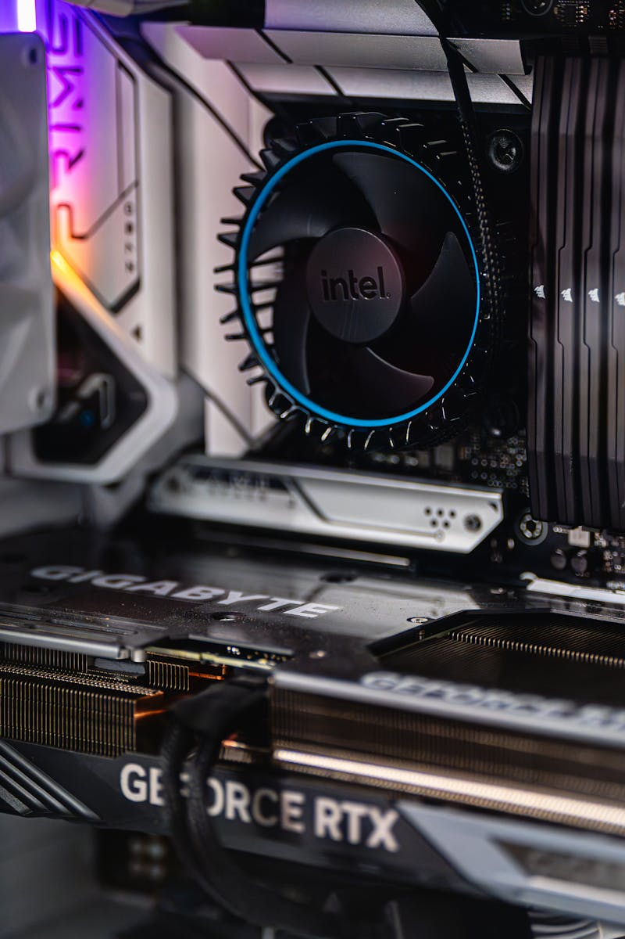
5
Level1Techs Dual RTX 5090 Build
Extreme PC Setup for AI and Content Creation
Showcases custom Silverstone build with dual RTX 5090 GPUs. Optimized for high-demand workloads. Ideal for creators and AI researchers alike.
Photo by Pexels

Slide 8
6
L4DC 2025 Registration Open
Learning for Dynamics and Control Conference
Scheduled for June 5-6, 2025; tutorials on June 4. Early bird deadline: May 2, 2025. NSF-funded student travel grants available.
Photo by Pexels

Slide 9
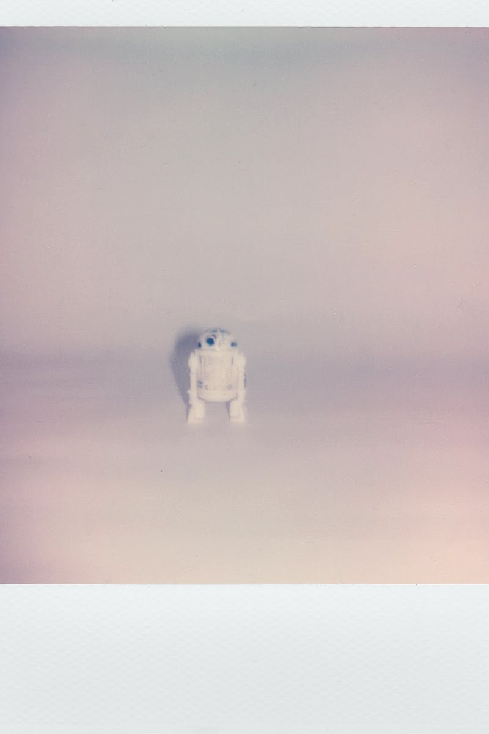
7
Alibaba Qwen3 Models
New State-of-the-Art Hybrid AI Models
Open-weight models with MoE and dense types. Range from 0.6B to 235B parameters. Claimed parity or better performance than Google/OpenAI models.
Photo by Pexels

Slide 10
8
Interpreting Transformer Attention
Anthropic’s Insights on Transformer Mechanisms
Analyzes attention superposition and cross-layer reps. QK diagonalization proposed to improve interpretability. Improves our understanding of how models reason.
Photo by Pexels

Slide 11
9
Abliteration: Uncensoring LLMs
Technique to Remove Refusal Mechanisms
Targets specific refusal-behavior vectors in LLMs. Does not require retraining. Raises ethical and safety implications.
Photo by Pexels

Slide 12
10
Xiaomi MiMo-7B Model
Compact Reasoning Model with Big Potential
7B parameters trained from scratch. Outperforms larger models in math/code tasks. Uses dense RL strategies.
Photo by Pexels

Slide 13
11
Entropic Time Schedulers
Entropy-Based Sampling for Diffusion Models
Uses entropy rather than uniform time steps. Ensures each step contributes meaningfully. May enhance diffusion output quality.
Photo by Pexels

Slide 14
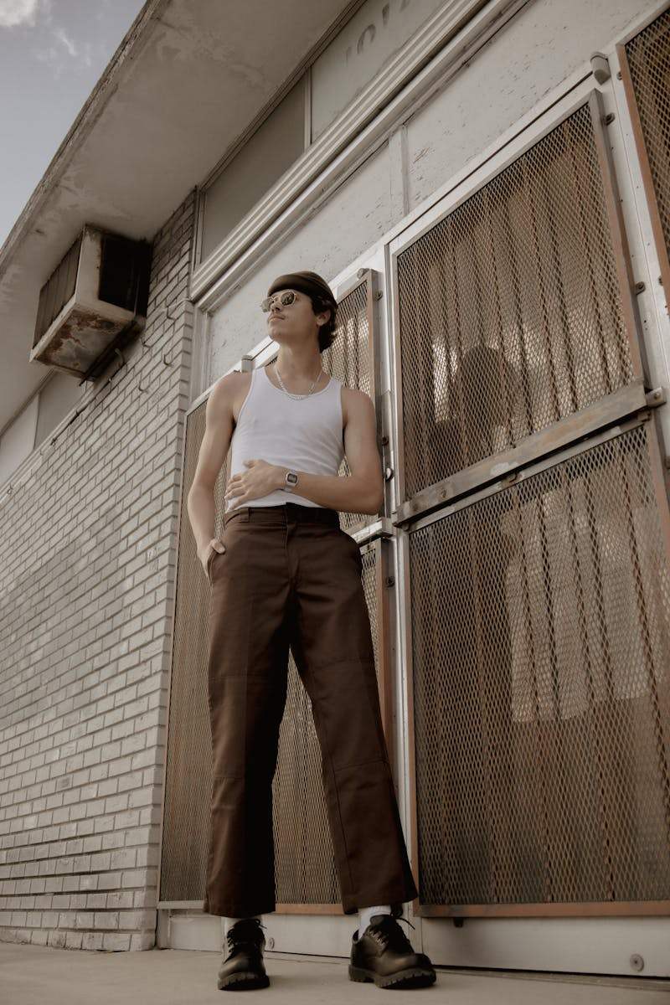
12
Transformers vs. State Space Models
Architecture Comparison by Albert Gu
SSMs excel in sequence modeling. Transformers outperform in algorithmic tasks. Suggests hybrid architectures could be optimal.
Photo by Pexels

