Slide 1

Empowering Education: Technology's Transformative Role
Unlocking potential through innovative digital tools and strategies.
Photo by Pexels

Slide 2
01
Welcome to the Digital Classroom!
Table of Contents
02
Unlocking Potential: The Benefits
03
Toolbox Essentials: Platforms & Apps
04
Strategic Integration: Best Practices
05
Navigating the Hurdles: Challenges
06
In Action: Real-World Success
07
Teacher's Toolkit: Key Strategies
08
EdTech Horizon: The Future
09
Key Takeaways
10
Thank You

Slide 3
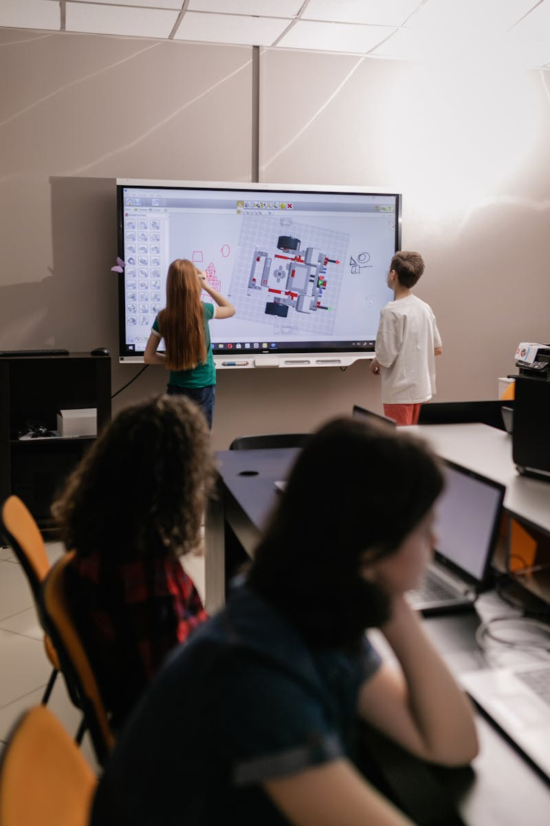
1
Welcome to the Digital Classroom!
Exploring the integration of technology in modern education.
Technology is reshaping how we teach and learn, creating new opportunities for engagement and growth in modern education.
Technology drives engagement, broadens accessibility, and boosts efficiency, creating a more dynamic and effective learning environment.
We'll delve into the benefits, tools, strategies, and challenges of integrating technology in education to unlock student potential.
An overview will be provided to understand how technology can facilitate personalized learning experiences.

Slide 4

2
Unlocking Potential: The Benefits
Harnessing technology to elevate the learning experience.
Technology captivates students, sparking curiosity and motivation by giving them an entertaining educational environment.
Adapting to individual needs, technology enables customized learning paths, and educational programs ensuring every student thrives.
Technology fosters teamwork and communication, connecting students to share ideas, collaborate on projects and learn from each other.
Technology grants instant access to a wealth of online resources, enriching learning with diverse perspectives and up-to-date information.

Slide 5

3
Toolbox Essentials: Platforms & Apps
Navigating the digital landscape with essential educational tools.
LMS platforms like Google Classroom and Canvas streamline learning management, facilitating assignment distribution, feedback, and communication.
Tools like Zoom and Microsoft Teams bridge distances, enabling seamless online collaboration, group projects, and virtual class discussions.
Platforms like Kahoot!, Quizlet, and Nearpod transform learning into engaging games and interactive experiences.
Apps such as Duolingo, Khan Academy, and Scratch offer targeted skill development in languages, math, coding and more.

Slide 6

4
Strategic Integration: Best Practices
Implementing technology effectively for maximum impact.
Ensure technology aligns with learning objectives, complementing curriculum goals, and enhancing educational outcomes.
Begin with manageable tech implementations, scaling gradually, gathering insights, and optimizing strategies for wider adoption.
Provide comprehensive training and ongoing support, enabling teachers to confidently integrate technology, and maximizing its benefits.
Cultivate responsible online behavior, emphasizing digital citizenship, and ethical technology use, and promoting safe digital practices.

Slide 7

5
Navigating the Hurdles: Challenges
Addressing the challenges and considerations of technology integration.
Address digital divide challenges by ensuring equitable access to technology and internet connectivity for all students, promoting inclusivity.
Minimize distractions and prevent over-reliance by teaching mindful technology use, encouraging balanced learning habits, and promoting focus.
Invest in ongoing professional development to equip teachers with the latest tech skills and strategies, empowering them to innovate.
Prioritize data privacy and cybersecurity by implementing robust security measures, safeguarding student data, and complying with privacy regulations.

Slide 8

6
In Action: Real-World Success
Inspiring examples of technology transforming education.
Explore how flipped classrooms leverage technology for pre-class learning and in-class application, boosting student engagement and comprehension.
Discover how coding and robotics programs use technology to enhance STEM education, fostering problem-solving, and critical-thinking skills.
Explore the transformative potential of AR/VR in creating immersive, hands-on learning experiences, bringing abstract concepts to life in class.
Innovative tech integrations have produced better understanding and academic excellence in students.

Slide 9

7
Teacher's Toolkit: Key Strategies
Empowering teachers to become tech-savvy innovators.
Keep abreast of emerging tech trends, exploring new tools and strategies to enhance teaching practices, and promoting continuous improvement.
Foster a culture of innovation, encouraging experimentation with technology, embracing creativity, and empowering students to take ownership.
Utilize analytics to monitor student progress, identifying learning gaps, and tailoring instruction to meet individual needs, to enhance learning.
Collaborate with peers, share best practices, and exchange insights to foster a supportive community, and enhance collective expertise.

Slide 10

8
EdTech Horizon: The Future
Looking ahead at the evolving landscape of educational technology.
Explore the potential of AI in personalizing learning, automating tasks, and providing intelligent tutoring systems to enhance educational outcomes.
Embrace gamification strategies to boost engagement, motivation, and knowledge retention through game-based learning experiences, to increase student knowledge.
Personalized and adaptive paths will soon be designed to cater to individual student abilities and needs, providing a richer and more engaging environment.
Virtual and hybrid models will enhance the students learning by having the access to education anywhere and anytime with ease.

Slide 11

9
Key Takeaways
Recap and call to action.
Technology enhances engagement, personalizes learning, and supports collaboration. Use tools strategically to meet learning goals.
As educators, our role is evolving. We must embrace technology to enhance teaching practices and engage students effectively, by being up to date.
We all should embrace and explore the transformative potential of technology in your teaching to unlock new possibilities for student success.
We need to be up to date with new technologies and use them for teaching for greater academic success.

Slide 12

10
Thank You
Grateful for your participation!
A big thank you for your active participation and insightful contributions to this presentation.
We encourage you to continue exploring and integrating technology to enrich your teaching practices.
Feel free to connect with me if you have any further questions or want to discuss further.
Wishing you all the best in your journey of integrating technology in education!

