Slide 1


Empowering Teams: Unleashing Potential Through Autonomy
Discover the advantages of fostering independent decision-making and problem-solving within your team.

Slide 2


Table of Contents
1
Igniting Innovation: The Power of Trust
2
Accelerating Growth: Learning Through Action
3
Boosting Efficiency: Streamlining Processes
4
Elevating Engagement: Fostering a Positive Culture
5
Cultivating Accountability: Taking Responsibility
6
Mitigating Risks: Safeguarding Autonomy

Slide 3
7
Building Trust: The Foundation of Autonomy
8
Investing in Training: Preparing for Success
9
Continuous Improvement: Iterating and Refining
10
Thank You

Slide 4

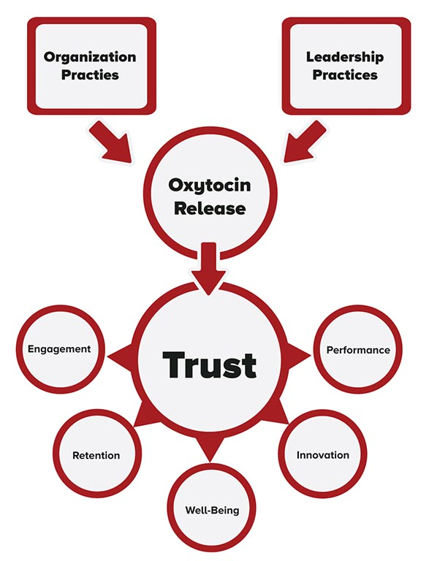
Igniting Innovation: The Power of Trust
Independent problem-solving fuels creative thinking. Team members explore novel approaches, leading to innovative solutions and fresh perspectives.
When teams make decisions, they develop a sense of ownership. It fosters dedication to implement solutions effectively and achieve success.
Autonomy encourages team members to take initiative. They proactively identify challenges and develop solutions without constant supervision.
A supportive environment for independent problem-solving promotes experimentation. Teams are empowered to try new things and learn from their experiences.
Photo by Google

Slide 5
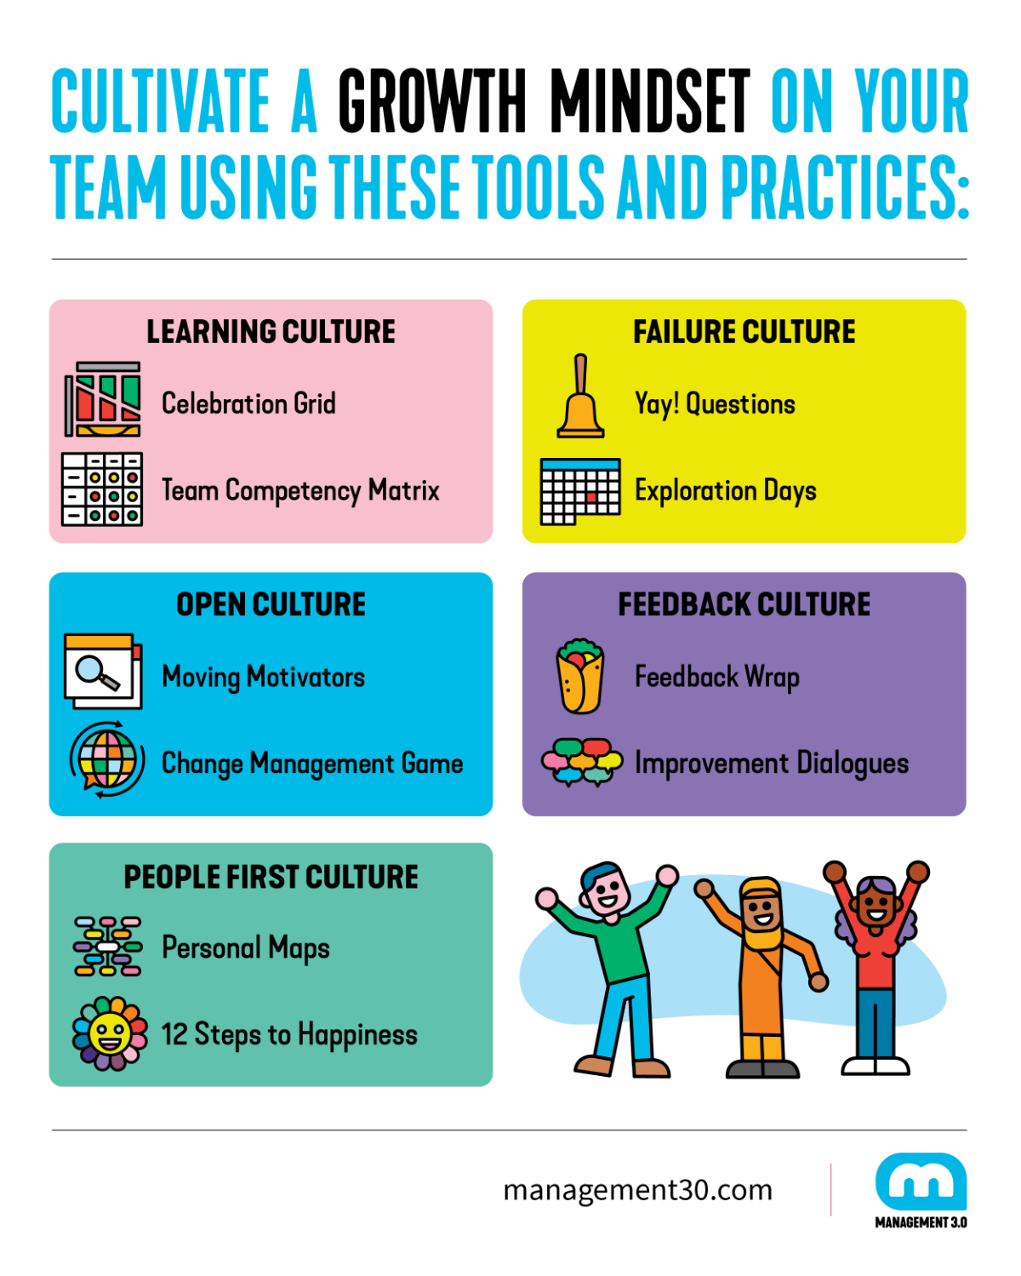
Accelerating Growth: Learning Through Action
Tackling challenges independently hones problem-solving skills. Team members learn to analyze situations, evaluate options, and make informed decisions.
Successful problem-solving builds confidence within the team. They gain belief in their abilities, empowering them to take on future challenges.
When teams share their problem-solving experiences, they contribute to collective knowledge. This promotes a culture of continuous learning and improvement.
Independent decision-making develops adaptability. Teams learn to respond effectively to changing circumstances, making them resilient and resourceful.
Photo by Google

Slide 6
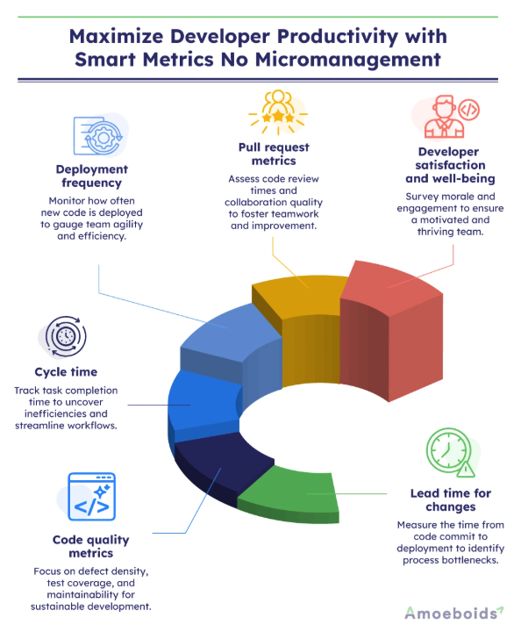
Boosting Efficiency: Streamlining Processes
Independent teams bypass layers of approval, leading to quicker decisions. This reduces delays and accelerates project timelines.
Empowered teams can respond promptly to customer needs and market changes. This enhances customer satisfaction and strengthens competitive advantage.
Distributing decision-making authority eliminates bottlenecks. This frees up management time, allowing them to focus on strategic priorities.
Teams can allocate resources more effectively when they have decision-making authority. This ensures that resources are used where they are most needed.
Photo by Google

Slide 7
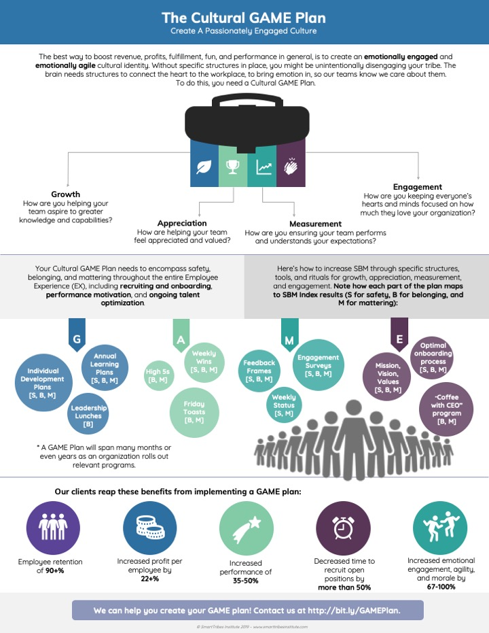
Elevating Engagement: Fostering a Positive Culture
Empowered teams are more motivated. They feel valued and respected, inspiring them to excel in their roles and go the extra mile.
Independent decision-making increases job satisfaction. Team members find fulfillment in their work when they have the autonomy to make a difference.
When teams collaborate to solve problems, it strengthens bonds. They develop a sense of camaraderie, improving communication and teamwork.
Organizations that empower their teams attract top talent. High-performing individuals seek opportunities where they can make a meaningful impact.
Photo by Google

Slide 8
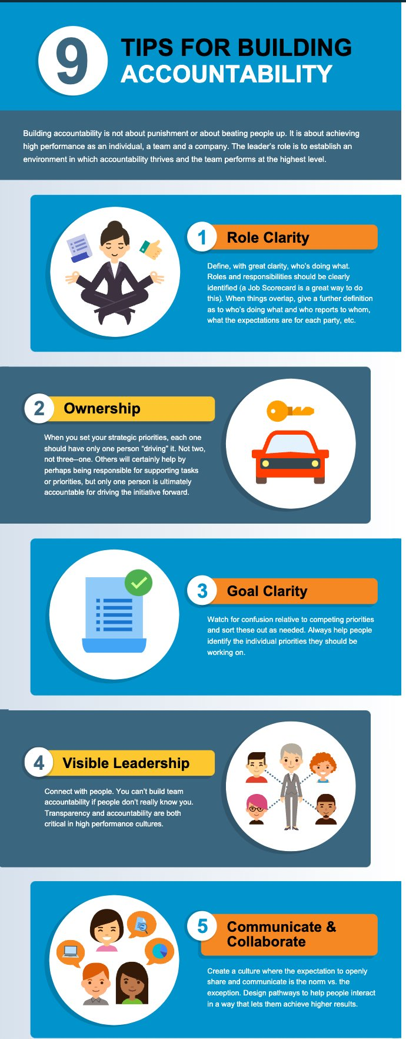
Cultivating Accountability: Taking Responsibility
Establish clear expectations and guidelines for independent decision-making. This ensures that teams understand their responsibilities and limitations.
Promote transparent communication within teams. They share information openly, ensuring that everyone is informed and aligned.
Provide regular feedback to teams on their decision-making performance. This helps them to learn from their mistakes and improve their decision-making skills.
Recognize and celebrate the successes of empowered teams. This reinforces positive behavior and encourages them to continue taking ownership.
Photo by Google

Slide 9
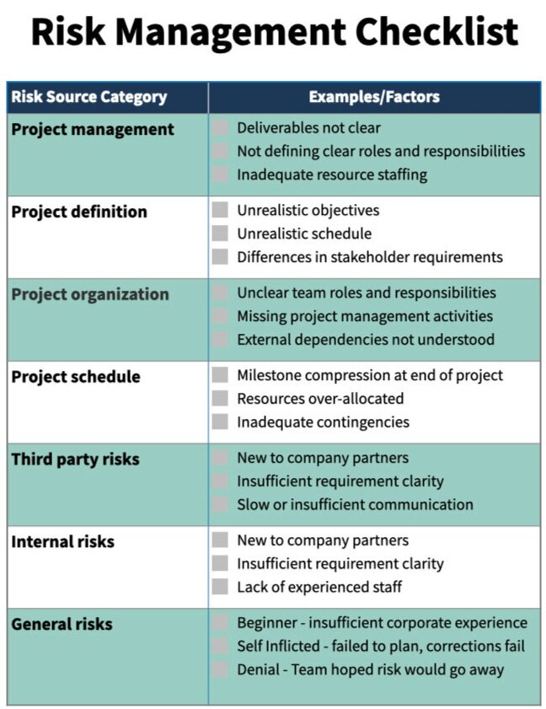
Mitigating Risks: Safeguarding Autonomy
Define the boundaries within which teams can make decisions. This prevents them from exceeding their authority and making decisions that are harmful to the organization.
Offer support and guidance to empowered teams. Mentorship ensures that they have the resources and knowledge they need to make informed decisions.
Monitor the performance of empowered teams. It helps in identifying potential problems and taking corrective action promptly.
Foster a culture of learning from mistakes. It encourages teams to view mistakes as opportunities for growth and improvement.
Photo by Google

Slide 10

Building Trust: The Foundation of Autonomy
Demonstrate trust in your team members by empowering them to take ownership. Leading by example fosters a culture of trust throughout the organization.
Communicate openly and honestly with your team members. Transparency builds trust and fosters strong relationships.
Delegate authority and empower teams to take ownership of their work. This shows that you trust their abilities and judgment.
Offer support and guidance to your team members. Mentorship demonstrates that you care about their success and are invested in their development.
Photo by Google

Slide 11
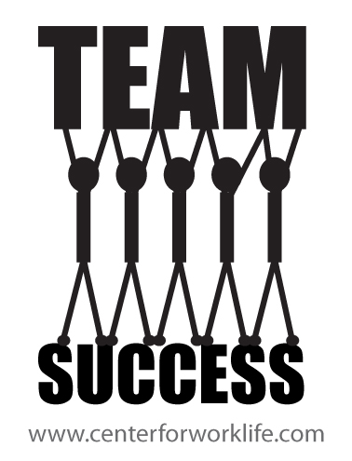
Investing in Training: Preparing for Success
Provide training to enhance team members' skills. This empowers them to make informed decisions and solve problems effectively.
Teach teams decision-making frameworks. These frameworks help in analyzing situations, evaluate options, and make sound judgments.
Train teams in conflict resolution techniques. This allows them to address disagreements constructively and reach mutually beneficial solutions.
Introduce teams to various problem-solving methodologies. These methodologies provide a structured approach to tackle challenges and find innovative solutions.
Photo by Google

Slide 12
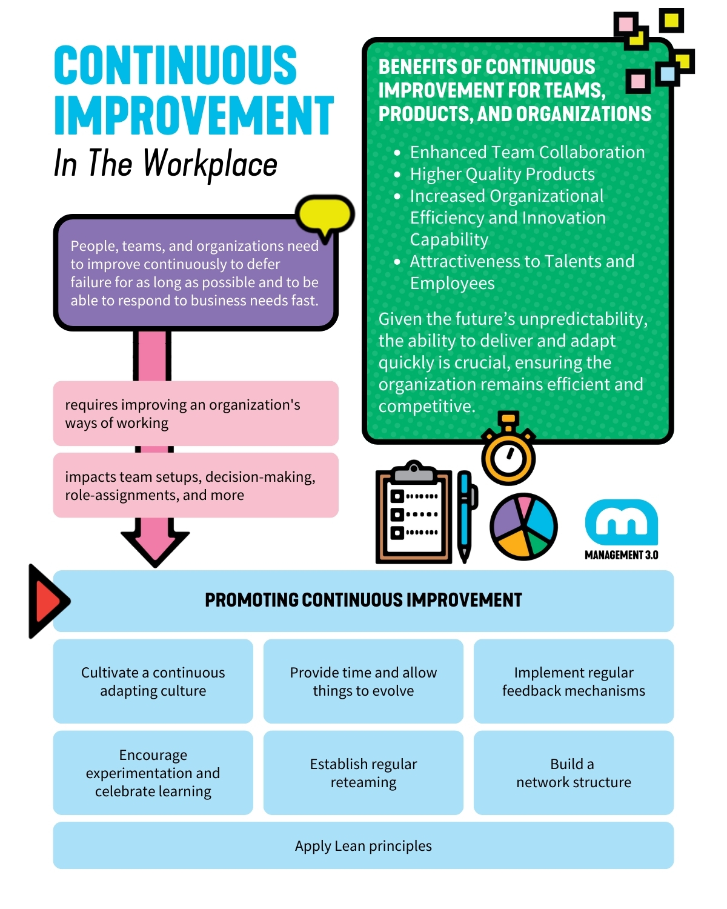
Continuous Improvement: Iterating and Refining
Conduct regular reviews of team performance. This helps to identify areas for improvement and track progress over time.
Establish feedback loops to gather insights from team members and stakeholders. This ensures that decision-making processes are aligned with organizational needs.
Empower teams to optimize their decision-making processes. This allows them to adapt to changing circumstances and improve efficiency.
Encourage teams to share their learnings and best practices. This promotes a culture of continuous improvement and accelerates organizational growth.
Photo by Google

Slide 13

Thank You
Thank you for your time and attention. We hope this presentation has provided valuable insights into the benefits of empowering teams.
We encourage you to implement these strategies within your organization to unlock the full potential of your teams and drive innovation.
Consider exploring additional resources and research on team empowerment to deepen your understanding of this important topic.
We wish you the best in your efforts to create empowered and high-performing teams. Your success is our success.
Photo by Google

