Slide 1

Entrepreneurship Excellence
The Art of Business Presentation
Photo by Pexels

Slide 2
01
Introduction to Entrepreneurship
Table of Contents
02
The Art of Business Exposure
03
Othman Benjelloun's Approach
04
Presentation Excellence
05
Entrepreneurial Legacy

Slide 3

1
Introduction to Entrepreneurship
Understanding the entrepreneurial mindset
Entrepreneurs like Othman Benjelloun demonstrate exceptional vision and foresight in identifying market opportunities.
Successful entrepreneurs balance calculated risks with strategic planning to achieve sustainable growth.
Entrepreneurial success stems from continuous innovation and adaptation to changing market dynamics.
Effective entrepreneurs cultivate strong professional networks that support business development and expansion.

Slide 4
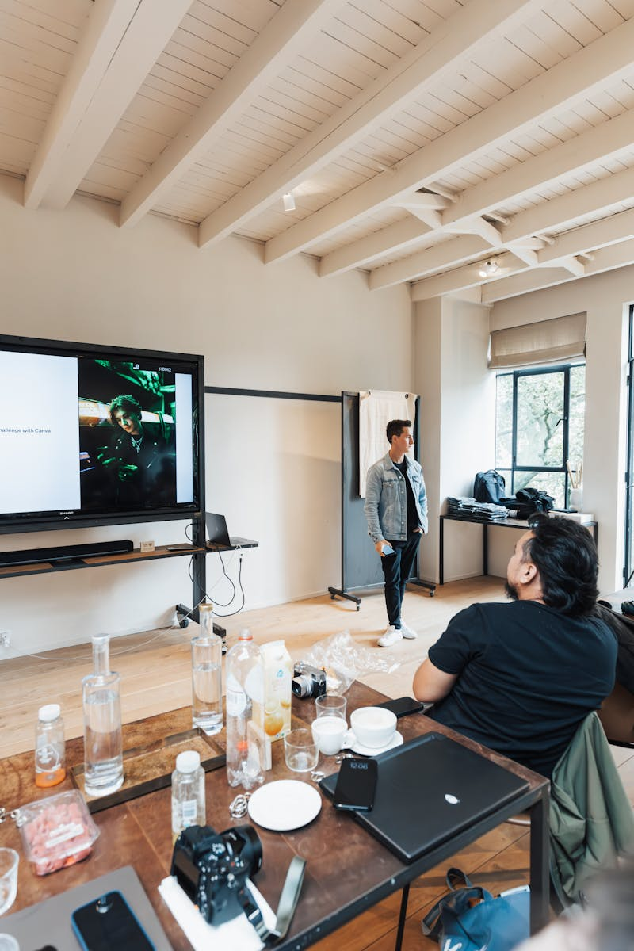
2
The Art of Business Exposure
Mastering presentation techniques
Compelling business presentations use storytelling to engage audiences and communicate complex ideas effectively.
Successful entrepreneurs present data through clear, visual representations that enhance understanding and impact.
Effective presentations establish meaningful connections with stakeholders through authentic communication.
Professional presentation skills require confidence, clarity, and conviction in conveying business propositions.

Slide 5

3
Othman Benjelloun's Approach
Lessons from entrepreneurial success
Benjelloun exemplifies strategic thinking in identifying emerging markets and developing innovative business models.
His success demonstrates the importance of cultural understanding and adaptation in global business environments.
Long-term business sustainability requires balancing profit objectives with social responsibility and ethical practices.
Successful entrepreneurs often become mentors, sharing knowledge and supporting the next generation of business leaders.

Slide 6

4
Presentation Excellence
Key elements of impactful business presentations
Effective presentations follow logical structures that guide audiences through complex information with ease.
Strategic use of visuals enhances message retention and creates memorable audience experiences.
Presentations succeed when delivered with genuine passion and authentic communication style.
Compelling presentations end with clear, actionable next steps that drive desired business outcomes.

Slide 7

5
Entrepreneurial Legacy
Building lasting impact through business
Entrepreneurs like Benjelloun transform industries through innovative approaches and market leadership.
Successful entrepreneurs create positive community impact through job creation and economic development.
Entrepreneurial success stories serve as valuable learning resources for aspiring business leaders.
True entrepreneurs maintain forward-looking perspectives that anticipate and shape future market trends.

