Slide 1

Evolution: A Journey Through Time
Discovering Our Past and Present
Photo by Pexels

Slide 2
01
The Essence of Evolution
Table of Contents
02
Key Mechanisms of Evolution
03
Pioneers of Evolutionary Science
04
Genetics and Evolution
05
Conclusion: A Continuous Journey

Slide 3
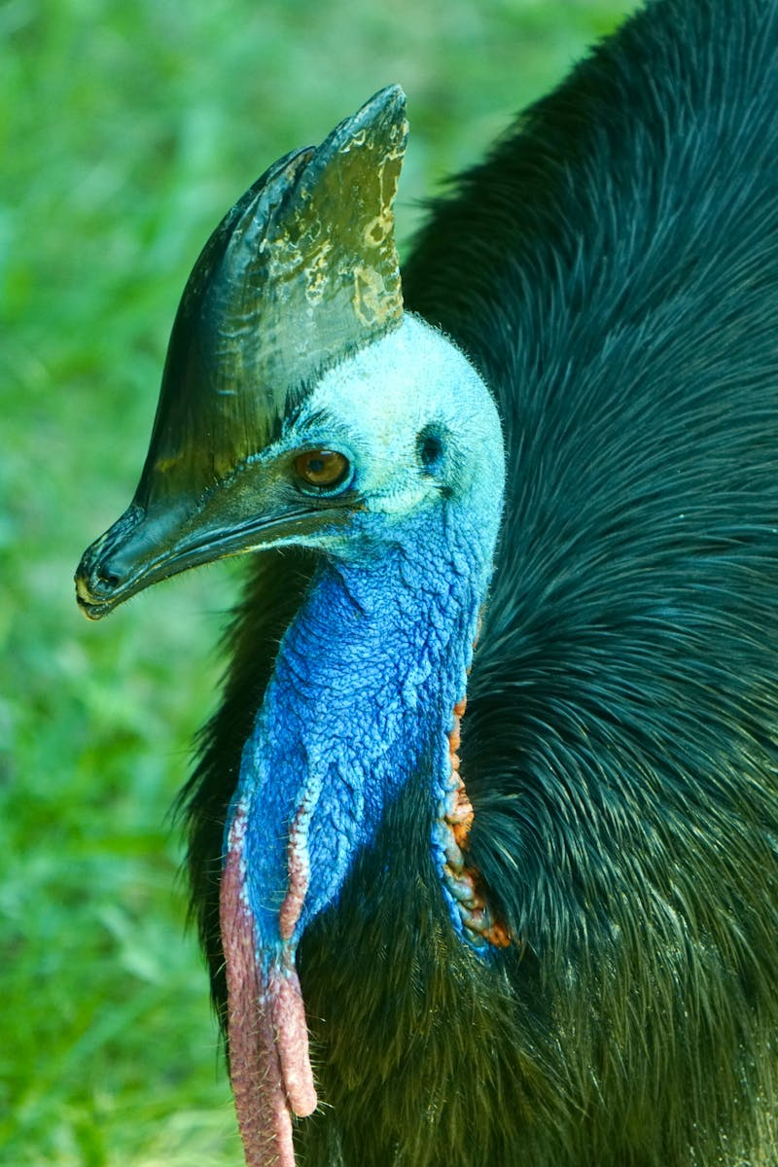
1
The Essence of Evolution
Understanding Change
Evolution is a continuous journey that tells us how life has transformed over billions of years.
Each species is a product of countless adaptations, driven by natural selection and environmental challenges.
The journey reflects innovation, resilience, and the fight for survival through complex processes.
From single-celled organisms to complex mammals, evolution shapes biodiversity in awe-inspiring ways.
Photo by Pexels

Slide 4

2
Key Mechanisms of Evolution
Driving Forces
Natural selection is the process through which organisms better adapted to their environment tend to survive and reproduce.
Genetic drift introduces random changes, influencing populations in unpredictable ways.
Gene flow enables the exchange of genetic material, enhancing variation within species.
These mechanisms collectively drive speciation, creating the incredible diversity of life on Earth.
Photo by Pexels

Slide 5

3
Pioneers of Evolutionary Science
Inspiring Figures
Charles Darwin's theory of natural selection revolutionized our understanding of life's complexity.
Gregor Mendel laid the groundwork for genetics, illuminating heredity and variation.
Together, these pioneers established foundational principles still influential today.
Their remarkable contributions inspire ongoing exploration in evolutionary biology.
Photo by Pexels

Slide 6

4
Genetics and Evolution
The DNA Connection
Genetics provides insights into how traits are passed down through generations, impacting evolution.
DNA sequencing allows scientists to trace lineage and understand evolutionary relationships.
The study of genomes fuels discoveries about ancient species and their adaptations.
Genetics intertwines with evolution, unraveling the mysteries of life's intricate tapestry.
Photo by Pexels

Slide 7

5
Conclusion: A Continuous Journey
Thank You!
The story of evolution is not complete; it's an ongoing narrative filled with discoveries.
As we learn more about our past, we gain insights that can shape our future.
Embracing evolution as a journey inspires curiosity and a deeper appreciation for life's diversity.
Thank you for exploring this captivating topic with us!
Photo by Pexels

