Slide 1
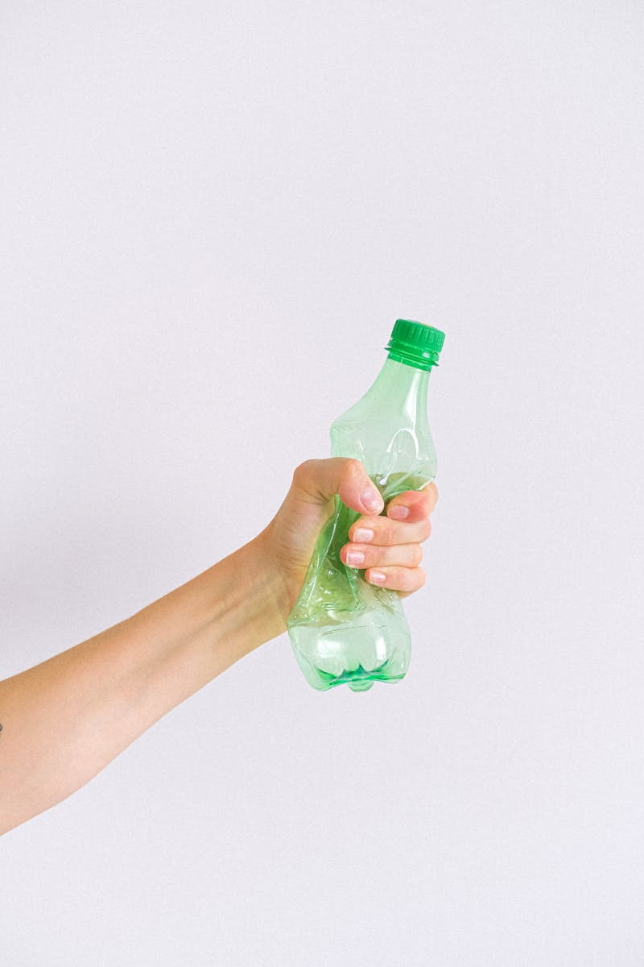
Expanding Bekia’s Horizons
Sustainable Innovation & Eco-Entertainment
Photo by Pexels

Slide 2
01
EXPANDING BEKIA'S HORIZONS
Table of Contents
02
BEKIA UPCYCLED | CONCEPT
03
BEKIA UPCYCLED | IMPACT
04
BEKIA UPCYCLED | OBJECTIVES
05
BEKIA UPCYCLED | AUDIENCE
06
SECTION BREAK
07
BEKIA WRECK LAB | FEATURES
08
BEKIA WRECK LAB | OBJECTIVES
09
BEKIA STRATEGY | MARKETING
10
BEKIA MEDIA | CHANNELS
11
BEKIA ASSETS | SOCIAL MEDIA
12
BEKIA ASSETS | OUTDOOR

Slide 3
13
BEKIA ASSETS | RADIO
Table of Contents
14
BEKIA ASSETS | STORYBOARD
15
BEKIA ASSETS | VIDEO
16
BEKIA TECH | APP
17
BEKIA APP | SCREENSHOTS
18
BEKIA LOYALTY | BONUS
19
CONCLUSION

Slide 4
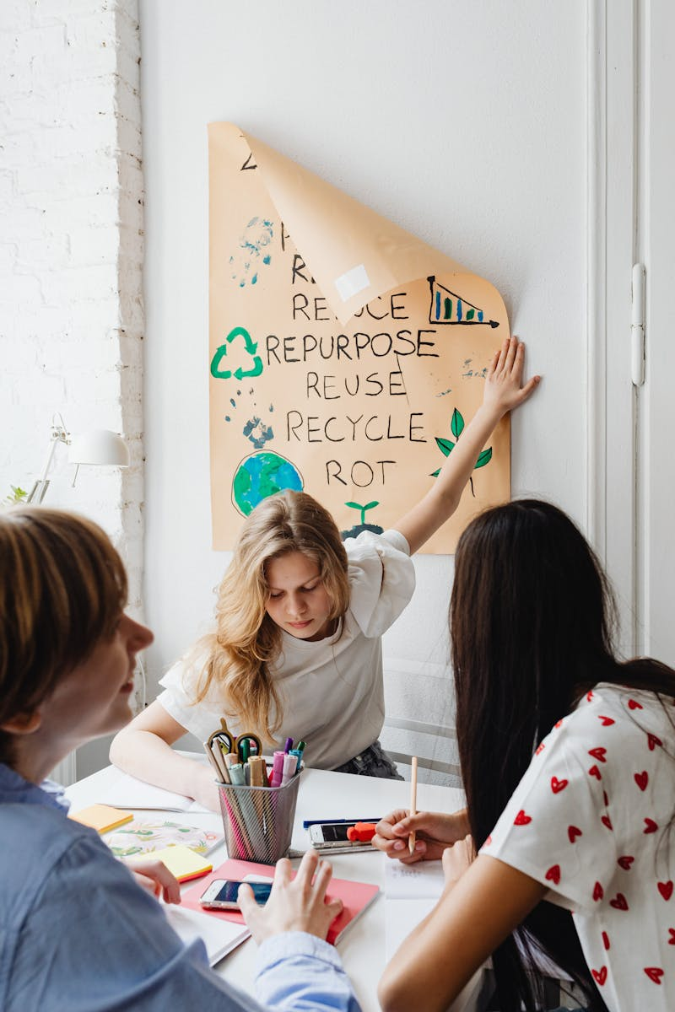
1
EXPANDING BEKIA'S HORIZONS
SUSTAINABLE INNOVATION & ECO-ENTERTAINMENT
Team:
Rahma Gaafar (202200443)
Rahma Atef (202300011)
Maritia Samer (202200293)
Youssef Almohamedy (202201268)
Sara Elfiki (202200313)
Noor Alsakkaf (202001450)
Photo by Pexels

Slide 5

2
BEKIA UPCYCLED | CONCEPT
Empowering Women Through Waste
Turning difficult-to-recycle materials (like textile scraps and packaging) into fashionable goods such as tote bags and accessories.
Mechanism: Bekia provides raw materials and the platform; local artisans provide the craftsmanship — completing a circular economy loop.
Photo by Pexels

Slide 6
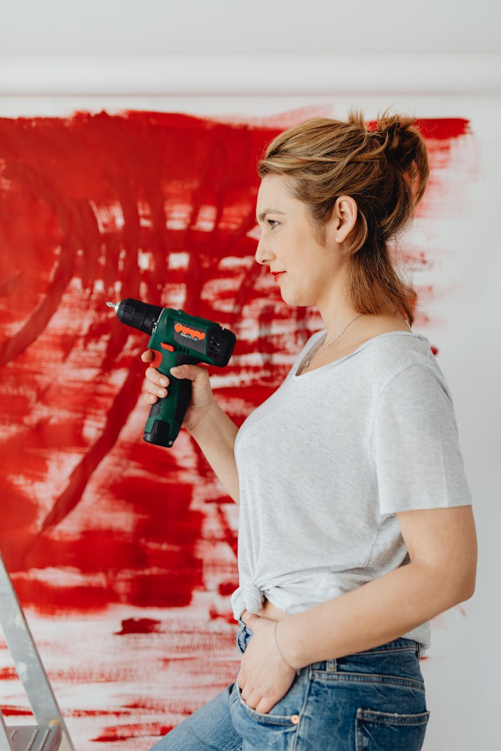
3
BEKIA UPCYCLED | IMPACT
Dual Impact Strategy
Economic: Providing flexible work-from-home income for local women, fostering financial independence.
Heritage: Reviving traditional crafts like sewing and weaving using recycled materials.
Role Shift: Transforming women from passive waste consumers into active value creators.
Photo by Pexels

Slide 7

4
BEKIA UPCYCLED | OBJECTIVES
Performance Targets
300k EGP Revenue (6 months, 40% margin)
10 Tons Diverted Waste (9 months)
50 Artisans Trained (6 months)
4.5/5 Customer Satisfaction
Photo by Pexels

Slide 8

5
BEKIA UPCYCLED | AUDIENCE
Who We Serve
The Producers: Homemakers seeking flexible income, skilled in traditional crafts.
The Buyers: Urban Gen Z & Millennials who value ethical consumption and storytelling.
Slogan: TURN WASTE INTO WORTH
Photo by Pexels

Slide 9

6
SECTION BREAK
BEKIA WRECK LAB — Unleash Your Stress Responsibly
بيكيا طلع طاقتك صح
Photo by Pexels

Slide 10
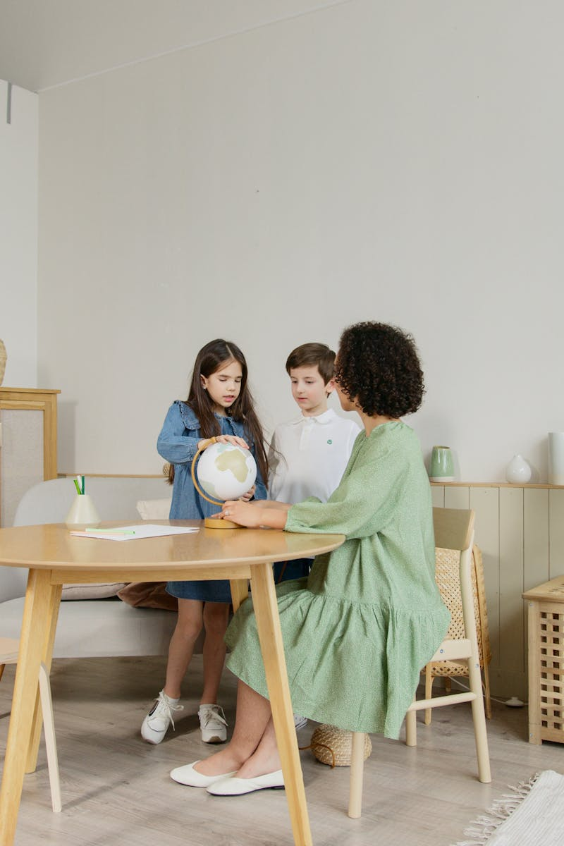
7
BEKIA WRECK LAB | FEATURES
Why Wreck Lab?
Guilt-Free: 100% of debris recycled immediately.
Rewards: Earn Bekia points redeemable for cash or groceries.
Safe & Private: Secure environment with safety gear and clean-energy aesthetic.
Tiered Booking: Customizable sessions like 'Finals Fury'.
Photo by Pexels

Slide 11
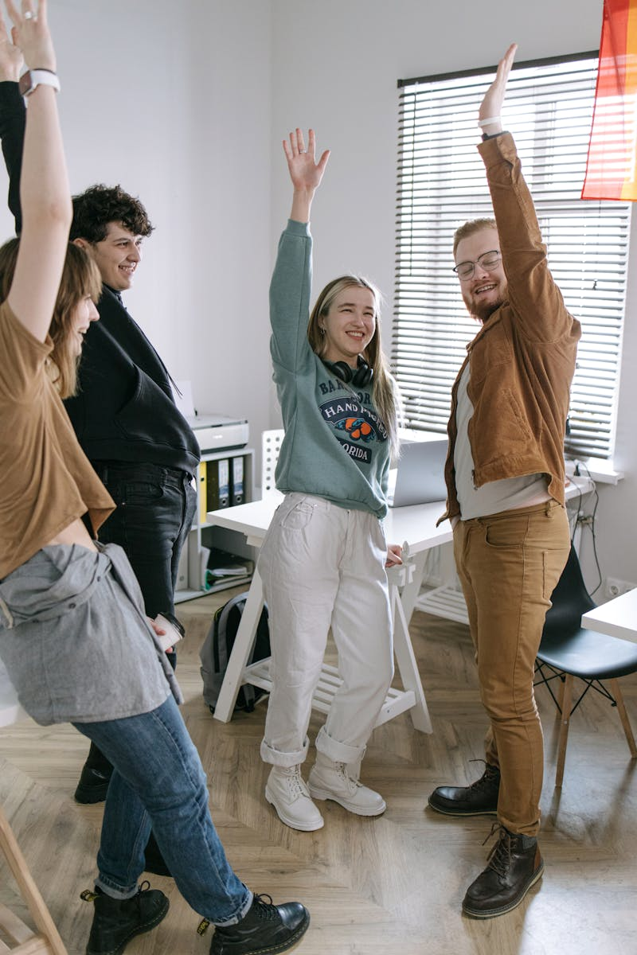
8
BEKIA WRECK LAB | OBJECTIVES
Strategic Goals
Engage Gen Z & Millennials — shifting Bekia’s brand to a bold lifestyle identity.
150k EGP Revenue in 3 months.
1.5 Tons of E-Waste Diverted.
50 Participants during Launch Phase.
Photo by Pexels

Slide 12

9
BEKIA STRATEGY | MARKETING
Humor & Storytelling
Tone: Playful, lighthearted, energetic — making smashing electronics shareable.
Slogan: Bekia... Unleash your potential right | بيكيا طلع طاقتك صح
Story Example: 'The Day Tarek Snapped' — a student finds relief by smashing e-waste and recycling responsibly.
Quote: “Stress: Deleted. Waste: Recycled.”
Photo by Pexels

Slide 13

10
BEKIA MEDIA | CHANNELS
Reaching the Audience
Radio: Nogoum FM & 9090 (Rush hour)
Social Media: TikTok & Instagram Reels (viral clips)
Influencers: Comedy & Lifestyle creators (Ali Hustler, Sara Abu-elkhair)
Offline: Billboards, Mall & University booths.
Photo by Pexels

Slide 14
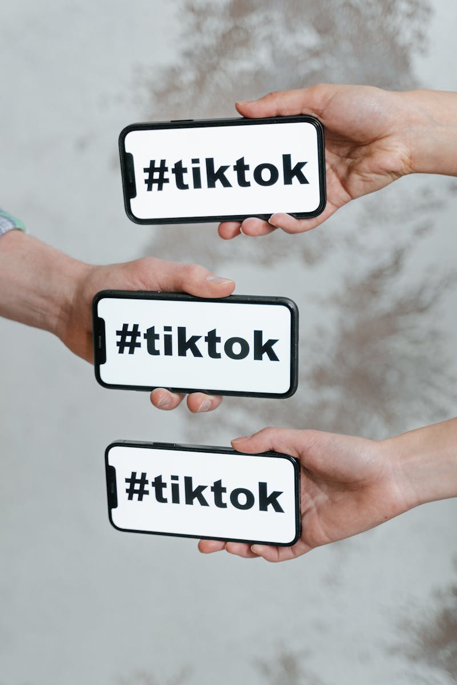
11
BEKIA ASSETS | SOCIAL MEDIA
Social Strategy Overview
Instagram: Reels (smashing sessions, BTS, testimonials), Stories (polls, Q&A).
TikTok: Fast-paced viral clips with trending sounds.
Facebook: Videos, user-generated content, themed promotions.
Frequency: 3–4 posts/week | Timing: Peak engagement hours.
Tone: Lighthearted, authentic, and stress-relieving.
Example caption: 'Deadlines hit hard? Smash responsibly at Bekia Wreck Lab.'
Photo by Pexels

Slide 15

12
BEKIA ASSETS | OUTDOOR
Billboards & Booth Activations
Digital Screens: The Waterway, Garden 8, Galleria 40, Arkan Plaza.
Highway Billboards: 6th of October Bridge, Ring Road (CFC).
University Booths: AUC, BUE, GUC, Ain Shams, Cairo Univ (10AM–3PM).
Mall Booths: Mall of Egypt, CFC, Mall of Arabia (4PM–10PM).
Focus: Eye-catching visuals + QR code to book instantly.
Photo by Pexels

Slide 16

13
BEKIA ASSETS | RADIO
Nogoum FM / 9090 Ad Script
📞 [SFX: Annoying ringtone]
🎙️ (Lina, shouting): يوووه! أحمد تاني؟ أنا جبت آخري من الزن ده!
🎶 [Upbeat music cuts the ringtone]
(Dina): ماترديش.. افتحي بيكيا واحجزي Rage Room فوراً!
🎧 [Click + Laugh]
(Lina): حجزت ودفعت أونلاين.. هقوله ييجي نتفاهم هناك!
🎵 (Outro): بيكيا.. طلع طاقتك صح!
Photo by Pexels

Slide 17
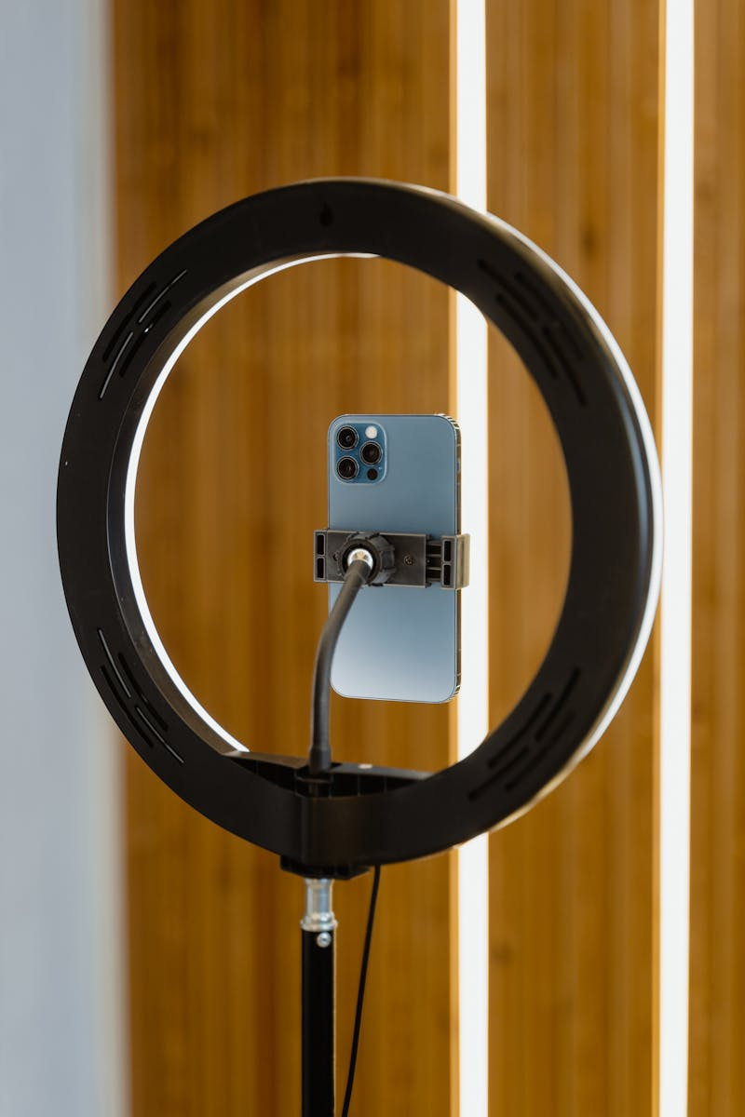
14
BEKIA ASSETS | STORYBOARD
‘The Day Tarek Snapped’ (In a Good Way)
Scene 1: Tarek stressed in finals week.
Scene 2: Scrolls TikTok – sees Bekia Wreck Lab video.
Scene 3: Books session on the app.
Scene 4: Smashes e-waste in protective gear.
Scene 5: Team recycles debris. He smiles, relieved.
Tagline: “Stress: Deleted. Waste: Recycled.” | بيكيا طلع طاقتك صح
Photo by Pexels

Slide 18

15
BEKIA ASSETS | VIDEO
Campaign Commercial Concept
Concept: Fast-cut montage of real emotions — stress to relief.
Scenes: Deadlines, traffic, arguments — cut to smashing sessions.
Tone: Energetic, cinematic, and humorous.
CTA: 'Book now. Smash safe. Recycle right.'
End Frame: Bekia logo + Slogan in English & Arabic.
Photo by Pexels

Slide 19
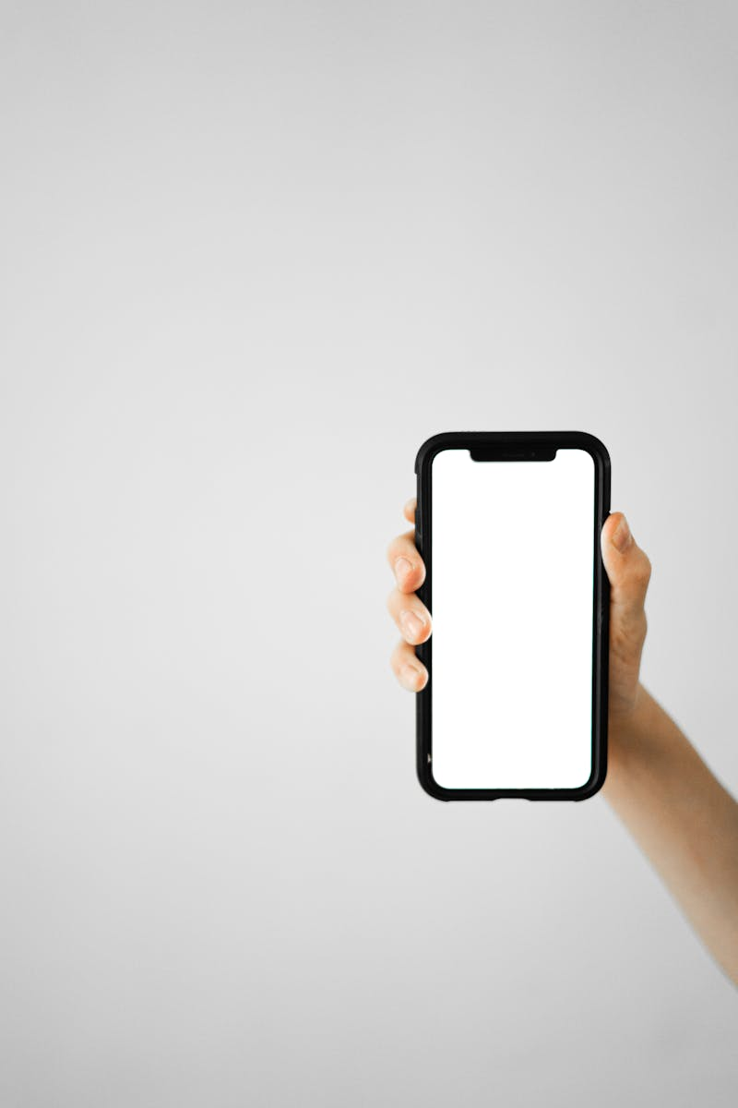
16
BEKIA TECH | APP
Seamless Digital Experience
Fast Booking: Browse packages & book instantly.
Payment: InstaPay, Vodafone Cash.
Gamification: Track mood & unlock achievements.
Photo by Pexels

Slide 20
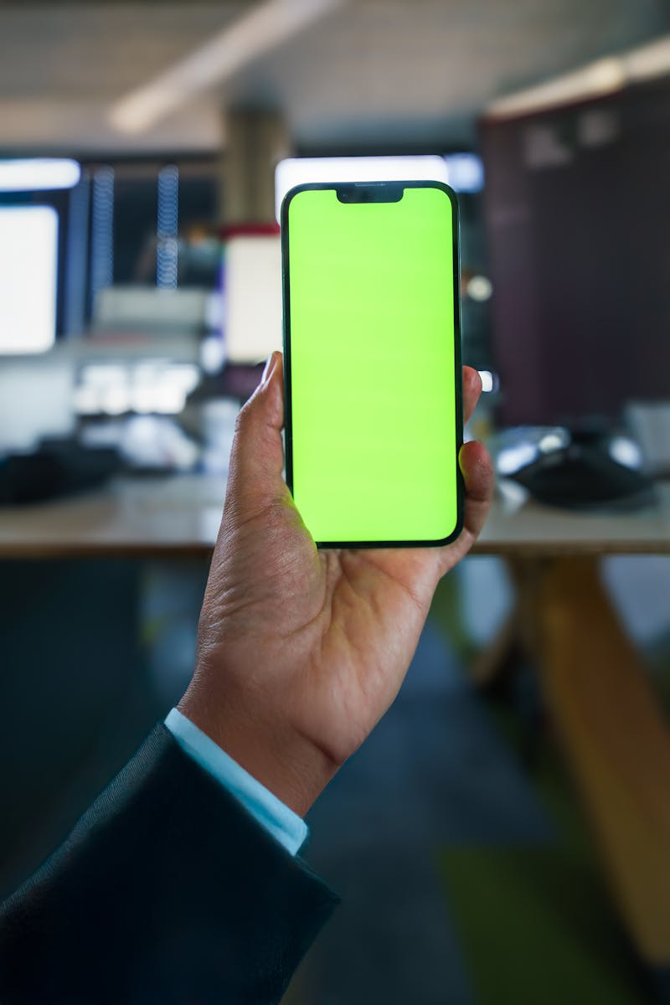
17
BEKIA APP | SCREENSHOTS
UI/UX Showcase
Placeholder for App Interface visuals — highlight clean energy aesthetic and intuitive design.
Photo by Pexels

Slide 21

18
BEKIA LOYALTY | BONUS
Elite Membership — Active Recycler Status
Benefits:
• 2x Reward Points
• Priority Pickup Service
• Exclusive Partner Discounts
Photo by Pexels

Slide 22

19
CONCLUSION
Bekia... More Than Just Recycling
بيكيا.. أكتر من إعادة التدوير
Join us in transforming waste into value.
Thank You!
Photo by Pexels

