Slide 1
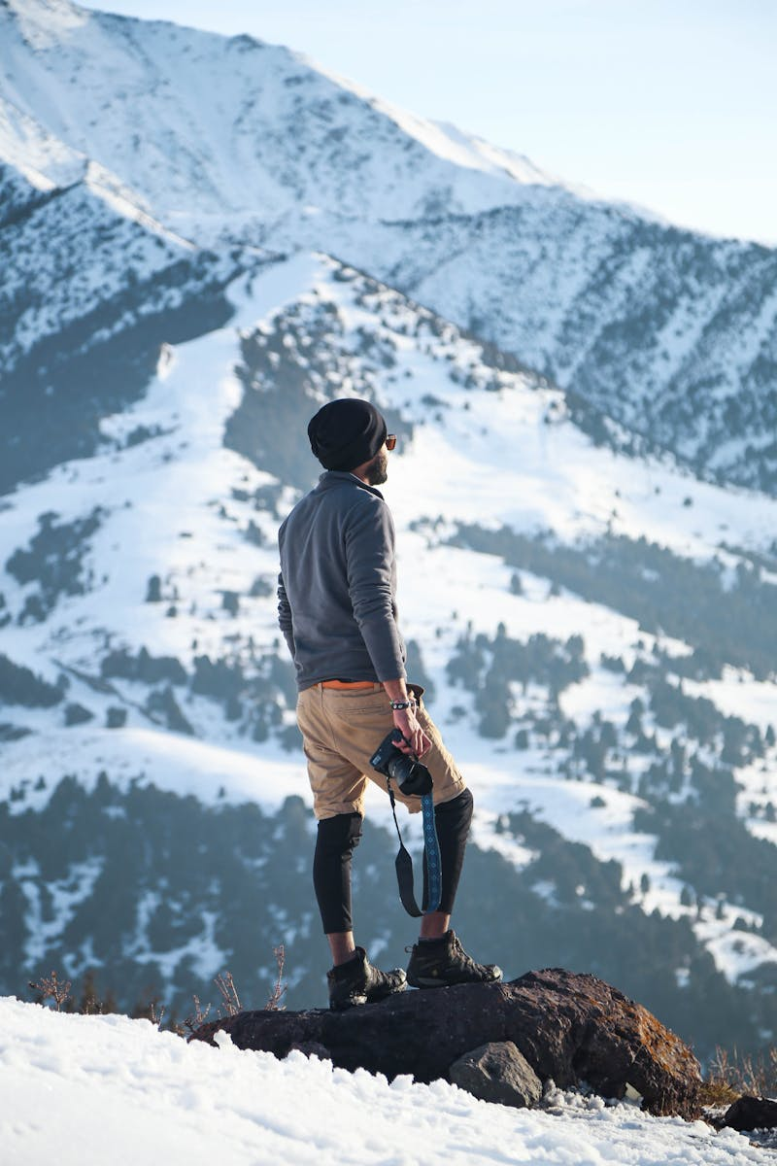
Exploring the Unknown A Journey into New Frontiers
Photo by Pexels

Slide 2
01
The Call to Adventure
Table of Contents
02
Navigating New Territories
03
The Power of Curiosity
04
Building Resilience
05
The Journey Continues

Slide 3

1
The Call to Adventure
Embracing the Unknown
Embarking on a journey begins with a single step into the unknown, filled with excitement and anticipation. Every adventure comes with its own set of challenges that test our resolve and determination. Through challenges, we learn and grow, gaining new insights and perspectives. The journey offers rewards, both tangible and intangible, enriching our lives in unexpected ways.

Slide 4

2
Navigating New Territories
Charting the Course
Creating a roadmap helps in navigating through uncharted territories with confidence. Identifying and overcoming obstacles is crucial for a successful journey. Being adaptable allows us to adjust to changing circumstances and environments. Acknowledging achievements along the way keeps the spirit high and motivates further exploration.

Slide 5

3
The Power of Curiosity
Fuel for Exploration
Curiosity drives us to ask questions and seek answers beyond the obvious. The pursuit of knowledge opens doors to new possibilities and discoveries. Thinking outside the box leads to innovative solutions and breakthroughs. Our curiosity can inspire others to embark on their own journeys of exploration.

Slide 6

4
Building Resilience
Strength in Adversity
Failure is a stepping stone to success, teaching us valuable lessons along the way. Staying persistent in the face of adversity builds resilience and character. Setbacks provide opportunities to learn and improve, strengthening our resolve. Success is sweeter when achieved through perseverance and hard work.

Slide 7
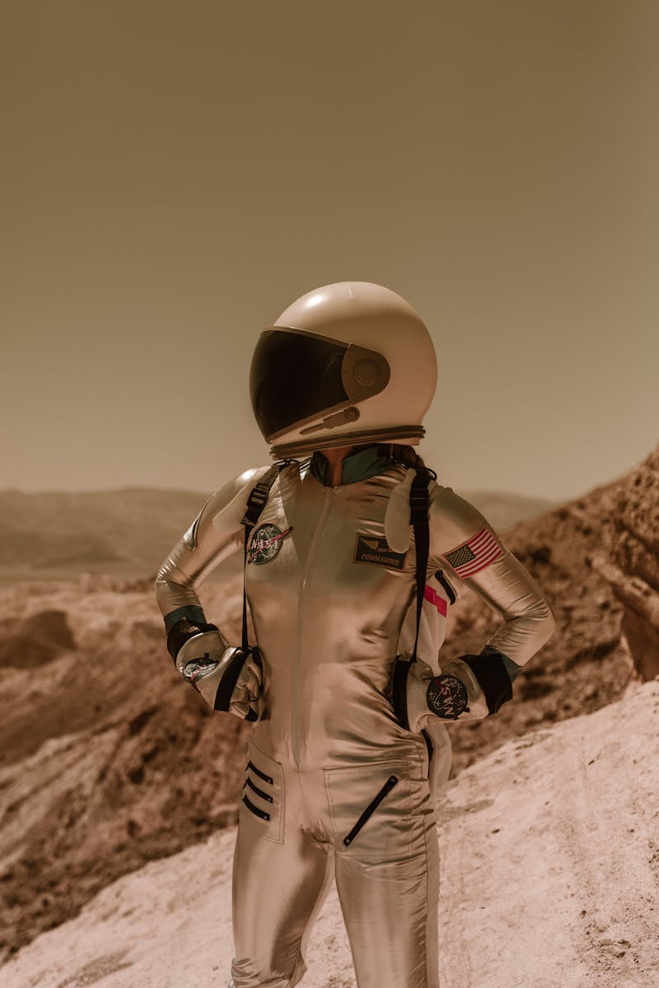
5
The Journey Continues
Endless Possibilities
Every journey opens up new horizons, inviting us to explore further. Learning is a lifelong journey that never truly ends. Sharing our experiences enriches others and builds a community of explorers. The future holds endless possibilities for those willing to explore.

