Slide 1


Farzi Degree? Ab Nahi! CollegeTips to the Rescue!
Exposing College Scams and Empowering Students
Photo by Google

Slide 2




Table of Contents
01
The Farzi Reality
02
CollegeTips' Slap!
03
Join the Fight!
04
Reaching the Masses
05
Thank You

Slide 3


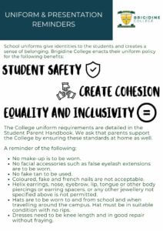
The Farzi Reality
Students are lured by deceptive claims, such as guaranteed 100% placement and free laptops, only to find themselves trapped in education scam.
Many fake colleges use false placement assurances as bait, deceiving students and their families for monetary gain and damage careers.
Hidden fees, inflated costs, and unexpected charges contribute to financial exploitation, making quality education inaccessible and injustice.
This problem represents a concerning trend, impacting students across Tier 2/3 cities and metros, and warrants immediate attention.
Photo by Google

Slide 4

CollegeTips' Slap!
CollegeTips is committed to exposing and combating farzi colleges, providing students with the resources and knowledge to make informed decisions.
We aim to uncover the truth by gathering and sharing experiences of students who have fallen victim to these scams, to spread awareness.
Through awareness campaigns, CollegeTips empowers students to recognize red flags and avoid traps associated with fake universities.
Our main goal is to prevent future students from falling prey to deceptive practices, with resources for proper college selection.
Photo by Google

Slide 5

Join the Fight!
If you've been a victim of a farzi college, DM us your story. Your experience can help others avoid similar scams and hold institutions accountable.
Engage with our content by commenting 'Farzi' if you or someone you know has been scammed. This helps spread awareness on social media platforms.
Share our posts and use hashtags like #FightAgainstFarzi, #CollegeTips, and #EducationScam to amplify our message and reach a wider audience.
Share valuable insights from CollegeTips through WhatsApp groups and comment sections of related advertisement to boost reach.
Photo by Google

Slide 6
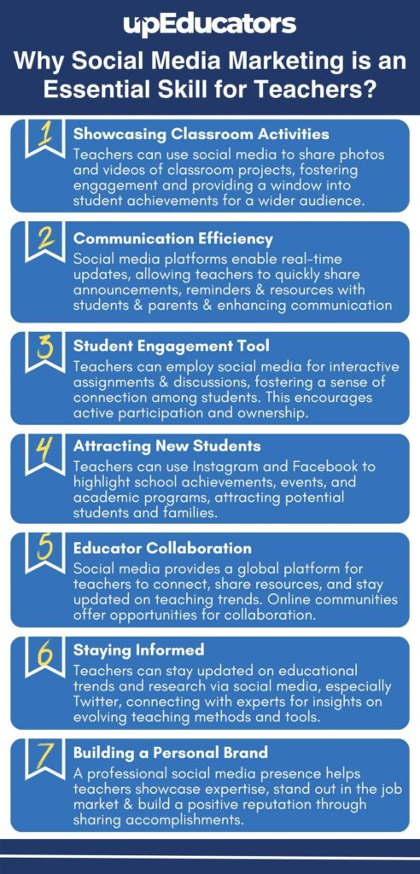
Reaching the Masses
Our primary focus is on students aged 16–25 years, particularly in Tier 2/3 cities and metropolitan areas, to promote informed decision.
We will utilize paid advertising with a budget of ₹1-2k, collaborate with meme pages, and conduct story polls to increase engagement and reach.
We anticipate achieving 50k–200k Reel views and 5k+ shares through a combination of organic and paid strategies and maximize impact.
Use meme to convey social message and reach maximum students. It helps in grabbing attention and deliver the message effectively.
Photo by Google

Slide 7

Thank You
Thank you for joining CollegeTips in the fight against farzi colleges. Your support and participation are invaluable in protecting students.
Continue to be aware of potential scams and share your knowledge with others. Together, we can create a more transparent education system.
Sharing your experiences help in uncovering scams and spreading awareness so more students can stay safe from these traps.
Remember, CollegeTips is here to support you in your educational journey. Don't hesitate to reach out with any questions or concerns.
Photo by Google

